Slide 1
A Systematic Study of Leveraging Subword Information for Learning Word Representations
Abhishrut Vaidya
2021SIY7558

Slide 2
Introduction😄
What does Subword Information mean? 🤔
It is the information obtained about the word by splitting it into its corresponding sub-parts
What is Word Representation, then?😅
To perform any analysis(probabilistic or causal) on the language, it has to be represented in some ‘operationalizable’ format
The well know form used throughout the industry is Vector Format
What is there to study about all this?😑
The different ways the particular language is converted into the vector format could affect the way we understand that language
Okay, that sounds awesome! 😍 Let’s go!

Slide 3
Motivation🫡
The use of subword-level information has become ubiquitous in modern-day word representation learning
Its importance can be seen in languages having rich morphology, which creates a large number of rare words
Although there is steadily increasing interest in the subword-level word representation, the systematic study of comparison between different tasks is still missing
The study done by Yi Zhu compares the thorough results for the English, German, Finnish, Turkish, and Hebrew language
But not much work is done for the Indo-Aryan languages
Hence, we propose a similar study for one of the Indian regional languages, specifically Marathi😎

Slide 4
Related Work🫣
Yi Zhu et al. have done a brief study on the Subword-level word representation for the English Language
Bofang Li et al. proposed a hybrid training scheme in which a pure subword-level model is trained jointly with a conventional word-level embedding model based on lookup-tables
Piotr Bojanowski et al. proposed a new way of vector representation. Word as a bag of character n-gram. It is better known as the Word2Vec model
Aditya Joshi et al. presented learnings of subword-LSTM architecture for sentiment analysis and empirical analysis on Hindi-English code mixed social media dataset

Slide 5
Resources💎
We have used the code made publicly available by Yi Zhu: https://github.com/cambridgeltl/sw_study
For Marathi data, we have used the Samanantar Marathi dataset(v0.3) from Ai4Bharat: https://ai4bharat.iitm.ac.in/samanantar
Dataset specs:
3,627,480 sentences
218,633 unique words
For Word Comparison Task, we used Marathi data from: https://github.com/syedsarfarazakhtar/Word-Similarity-Datasets-for-Indian-Languages
For the subword segmentation of the words we have used:
Morfessor: https://github.com/aalto-speech/morfessor
BPE: https://github.com/bheinzerling/bpemb
CHIPMUNK: http://cistern.cis.lmu.de/chipmunk/

Slide 6
Methodology⚙️
Our proposed study has two crucial components
Segmentation of words
Subword composition functions
For the segmentation, well-known techniques used are:
Character N-gram
Byte pair encoding
Morfessor
CHIPMUNK
For the composition, the attention-based feed-forward network is trained and used

Slide 7
Methodology⚙️
General Framework
w = f_{Θ}(δ(w),W_{s},W_{p})
f_{Θ}(): Composition function
δ(): Segmentation deterministic function
W_{s}: Subword embedding matrix
W_{p}: Position embedding matrix
For the composition, the attention-based feed-forward network is trained and used
H_{w} = tanh(W_{h1}R^{T}_{w})
A_{w} = softmax(W_{h2}H_{w})
H_{w}: Hidden representation
A_{w}: Weight vector for rows of R_{w}

Slide 8
Methodology⚙️
The first step was to get the data for the Marathi study
We obtained the Samanantar Marathi dataset from Ai4Bharat
Data is in the format of:
ids: id
src: source language sentence
tgt: target language sentence
data_source: source of data
The dataset has ~3.6M sentences collected from multiple sources(wiki, new-websites, etc) and pre-cleaned
We extract all the src(which is in Marathi) and combine them all together as a Marathi text corpus
Reason to pick this dataset?
It is already cleaned and has been used for various benchmarks for Machine Translation models
It has be published by Ai4Bharat which is an IITM + Microsoft initiative for Indian NLU
idx | src | tgt | data_source

Slide 9
Methodology⚙️
We extracted Marathi ‘src’ sentences from the Samanantar Marathi dataset and created the Marathi dataset
We run the given code for the charn(character n-gram) model
It generates the list of unique words and dictionary of their frequency from the dataset
It trains the model for the same
We install pretrained Marathi bpemb and generate Byte-pair encoding for each word
Same for Morfessor, we pass in the word list with the default configuration, and the Morfessor encoding is generated
For CHIPMUNK, the model can generate embeddings but requires supervised embedding data. Once the supervised data is fed in model can be trained, and encoding is generated

Slide 10
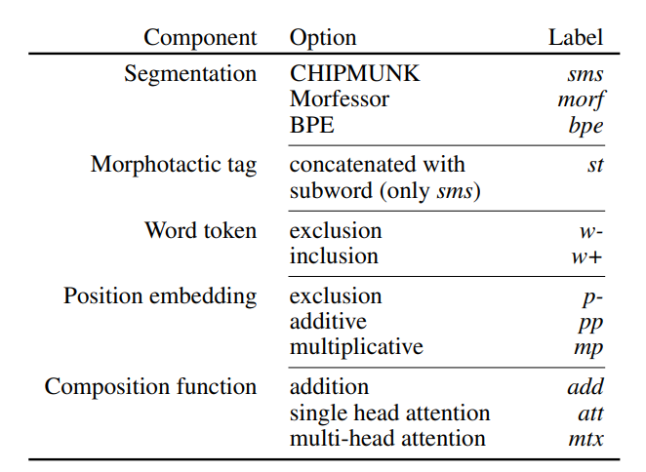
Methodology⚙️
Once the different kinds of encodings are generated, we are ready to train the Neural Model and generate the embeddings to evaluate the results
As the code is set up from Segmentation to Composition based on the configuration selected, we can have around 48 different configurations
Due to the time-constrained we have chosen only 12 configurations (excluding the Position embeddings and Morphotactic tags)
We get:
bpe(.add/.att/.mtxatt)
charn(.add/.att/.mtxatt)
morf(.add/.att/.mtxatt)
sms(.add/.att/.mtxatt)

Slide 11
Evaluation🔬
To compare the performance of our trained models we have compared them with the two industry-used pre-trained embeddings models:
FastText
SGNS (Word2Vec)
The embeddings for each word in the Marathi_WC dataset are calculated for each model, and the cosine-similarity is calculated between vectors of two words
The Similarity score is scaled to the range of 0 to 10
For each model cosine score, the Spearman’s rank correlation score is calculated between human scores and model scores

Slide 12
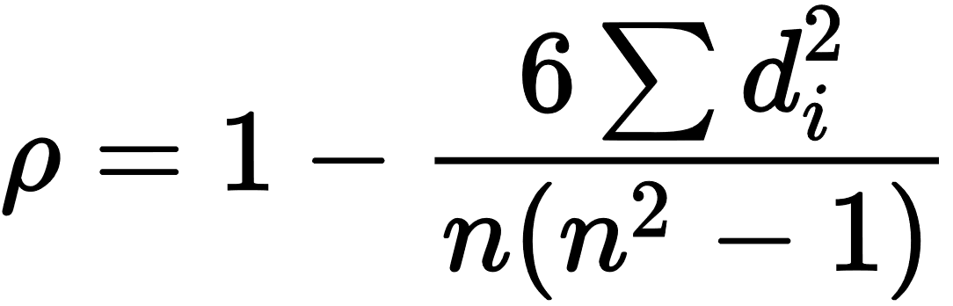
Evaluation🔬
To compare the performance of our trained models we have compared them with the two industry-used pre-trained embeddings models:
FastText
SGNS (Word2Vec)
The embeddings for each word in the Marathi_WC dataset are calculated for each model, and the cosine-similarity is calculated between vectors of two words
The Similarity score is scaled to the range of 0 to 10
For each model cosine score, the Spearman’s rank correlation score is calculated between human scores and model scores
ρ: Spearman's rank correlation coefficient
di: Difference between the two ranks of each observation
n: Number of observations
It is used measure the strength and direction of association between two ranked variables

Slide 13
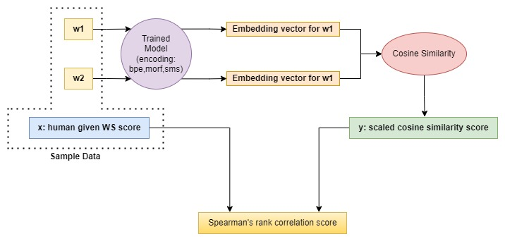
Evaluation Workflow🌊

Slide 14
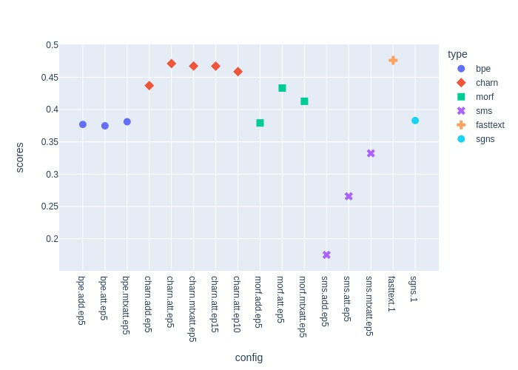
Results📈

Slide 15
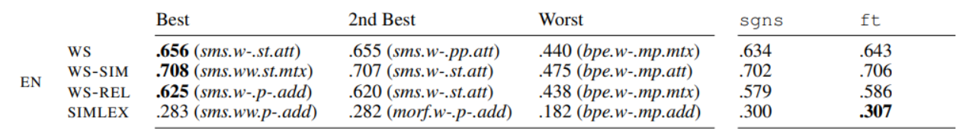
Discussion🫂
Comparing our results with the existing study for the English Language
Their best results are above the sgns and but slightly less than ft
task | state | config | sgns | ft
WS | Best | (0.471)charn.att.ep5 | 0.382 | 0.476
 | 2nd best | (0.467)charn.mtxatt.ep5
 | Worst | (0.374)bpe.att.ep5

Slide 16
Future Work🔮
For the CHIPMUNK(sms) model, we did not have supervised annotated encoding for Marathi, so we could not reproduce comparative results. Would like to annotate those and repeat the experiment
Here, we have only compared the results of models on only one task given time-constrained, but we would like to perform analysis on:
Dependency Parsing
Fine-Grained Entity Typing
Would like to pre-process data with different methods and see the new experimental results
Extend this experimental analysis to other Indo-Aryan languages like Sanskrit, Urdu, Punjabi, Gujarati, Konkani, etc.

Slide 17
Tech-Stack💻
Python v3.0.13
Anaconda v4.14.0
CPU
Intel(R) Xeon(R) Silver 4208 CPU @ 2.10GHz
32 cores
GPU
Nvidia A100 80G
Cuda 11.7
Model train timings(with iterations 5 and batch_size of 10000):
Add: ~1 hrs
Att: ~3 hrs
MtxAtt: ~4.5hrs

Slide 18
thank you धन्यवाद ありがとうございました ಧನ್ಯವಾದಗಳು આભાર நன்றி ਤੁਹਾਡਾ ਧੰਨਵਾਦ ధన్యవాదాలు gracias ধন্যবাদ توهان جي مهرباني
🙏

