Slide 1
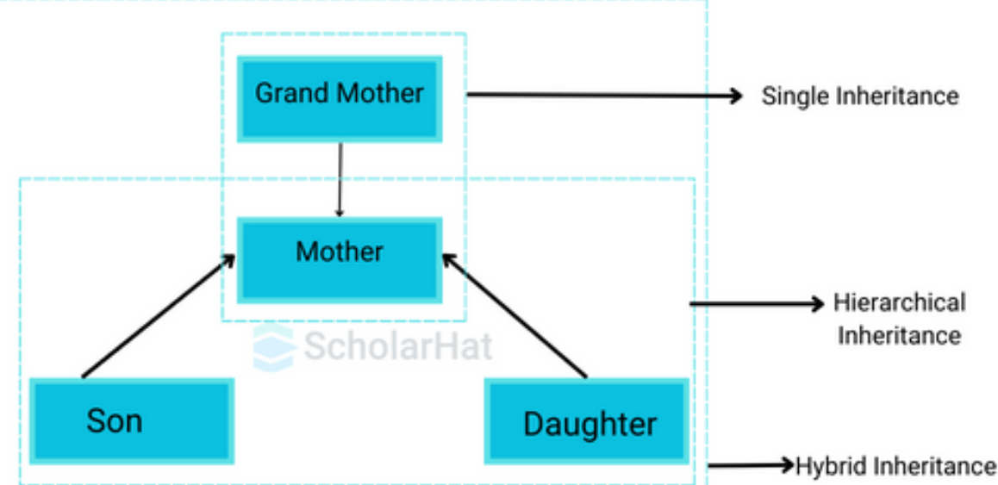
What is Inheritance?
Inheritance allows a new class (child/subclass) to acquire properties and methods of an existing class (parent/superclass).
Promotes:
Code Reusability
Extensibility
Hierarchical classification
Polymorphism
class Parent:
pass
class Child(Parent):
pass

Slide 2
Basic Inheritance
class Person:
def __init__(self, name):
self.name = name
def greet(self):
print("Hello, I am", self.name)
class Student(Person):
pass
s = Student("Ram")
s.greet()
Hello, I am Ram

Slide 3
Customizing an Existing Class
Method Overriding
class Person:
def greet(self):
print("Hello from Person")
class Student(Person):
def greet(self):
print("Hello from Student")
s = Student()
s.greet()
We inherit and then:
Add new methods
Override existing methods
Extend behavior
Hello from Student
Child method overrides parent method.

Slide 4
Using super() to Extend Behavior
class Person:
def greet(self):
print("Hello from Person")
class Student(Person):
def greet(self):
super().greet()
print("Hello from Student")
s = Student()
s.greet()
Hello from Person
Hello from Student
This is customization without losing original behavior.

Slide 5
What is a Superclass?
A Superclass (Parent Class) is a class whose properties and methods are inherited by another class.
Child class = Subclass Parent class = Superclass
class Animal: # Superclass
def speak(self):
print("Animal speaks")
class Dog(Animal): # Subclass
pass
d = Dog()
d.speak()
Animal speaks
✔ Dog inherited speak()
✔ Animal is the superclass

Slide 6
What is a Superclass?
super() is used to:
Call methods of the superclass
Access parent class constructor
Extend functionality instead of replacing it
super() in Method Overriding
class Animal:
def speak(self):
print("Animal sound")
class Dog(Animal):
def speak(self):
print("Bark")
d = Dog()
d.speak()
Bark

Slide 7
What is a Superclass?
With super()
super() in Method Overriding
class Animal:
def speak(self):
print("Animal sound")
class Dog(Animal):
def speak(self):
print("Bark")
d = Dog()
d.speak()
class Animal:
def speak(self):
print("Animal sound")
class Dog(Animal):
def speak(self):
super().speak()
print("Bark")
d = Dog()
d.speak()
Bark
Animal sound
Bark
✔ Parent behavior preserved ✔ Child behavior added
This is called method extension.

Slide 8
super() in Constructors (__init__)
If parent has constructor, child must call it.
class Person:
def __init__(self, name):
self.name = name
print("Person constructor")
class Student(Person):
def __init__(self, name, roll):
super().__init__(name)
self.roll = roll
print("Student constructor")
s = Student("Ram", 101)
✔ Parent constructor runs first
✔ Child constructor runs next
Person constructor
Student constructor

Slide 9
What Happens If You Don't Use super()?
class Student(Person):
def __init__(self, name, roll):
self.roll = roll
super() in Multiple Inheritance
class A:
def show(self):
print("A")
class B(A):
def show(self):
super().show()
print("B")
class C(B):
def show(self):
super().show()
print("C")
obj = C()
obj.show()
s = Student("Ram", 101)
print(s.name)
ERROR → name not defined
A
B
C

Slide 10
Real-World Example
class BankAccount:
def __init__(self, balance):
self.balance = balance
def withdraw(self, amount):
self.balance -= amount
print("Withdrawn:", amount)
class SavingsAccount(BankAccount):
def withdraw(self, amount):
if amount > self.balance:
print("Insufficient balance")
else:
super().withdraw(amount)

Slide 11
Types of Inheritance in Python
1. Single Inheritance
One parent → One child
2.Multiple Inheritance
One child → Multiple parents
3. Multilevel Inheritance
Grandparent → Parent → Child
4. Hierarchical Inheritance
One parent → Many children
class A:
pass
class B:
pass
class C(A, B):
pass

Slide 12
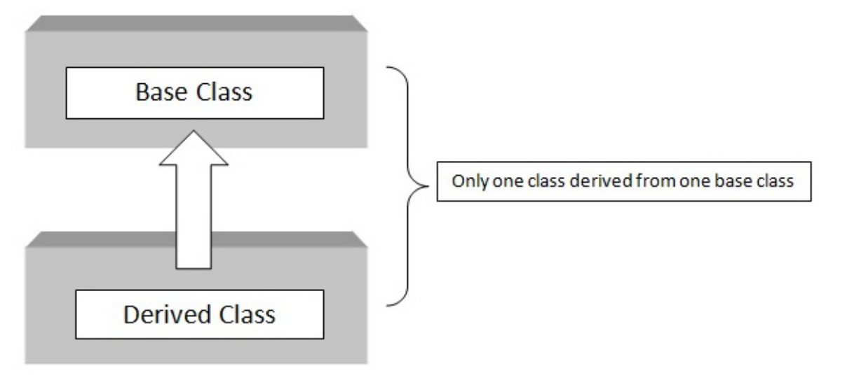
Types of Inheritance in Python
Single Inheritance
class Person:
def __init__(self, name):
self.name = name
def show(self):
print("Name:", self.name)
class Student(Person):
def study(self):
print(self.name, "is studying")
s = Student("Ram")
s.show()
s.study()
Name: Ram
Ram is studying
✔ Child gets all parent methods
✔ No duplication
✔ IS-A relationship (Student IS-A Person)

Slide 13
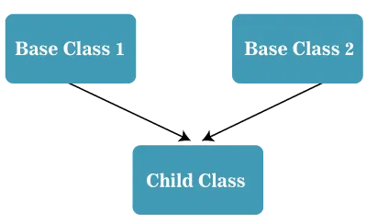
Types of Inheritance in Python
Example:
class Father:
def skills(self):
print("Gardening skills")
class Mother:
def talents(self):
print("Painting talent")
class Child(Father, Mother):
def hobbies(self):
print("Reading books")
c = Child()
c.skills() # from Father
c.talents() # from Mother
c.hobbies() # own method
Multiple Inheritance
class Parent1:
pass
class Parent2:
pass
class Child(Parent1, Parent2):
pass
Gardening skills
Painting talent
Reading books

Slide 14
Types of Inheritance in Python
class Teacher:
def teach(self):
print("Teaching students")
class Researcher:
def research(self):
print("Doing research work")
class Professor(Teacher, Researcher):
def guide(self):
print("Guiding PhD students")
p = Professor()
p.teach()
p.research()
p.guide()
Teaching students
Doing research work
Guiding PhD students

Slide 15
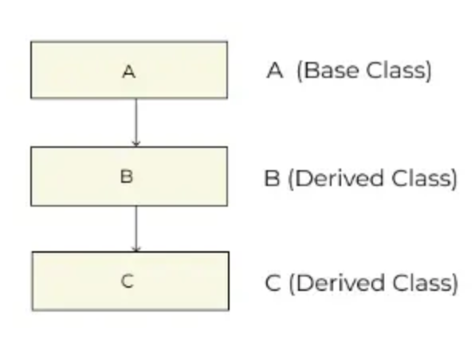
Types of Inheritance in Python
class Person:
def __init__(self, name):
self.name = name
def show_name(self):
print("Name:", self.name)
class Employee(Person):
def __init__(self, name, emp_id):
super().__init__(name)
self.emp_id = emp_id
def show_emp(self):
print("Employee ID:", self.emp_id)
class Manager(Employee):
def __init__(self, name, emp_id, department):
super().__init__(name, emp_id)
self.department = department
def show_dept(self):
print("Department:", self.department)
m = Manager("Ram", 101, "IT")
m.show_name()
m.show_emp()
m.show_dept()
Multilevel Inheritance
Name: Ram
Employee ID: 101
Department: IT
class A:
pass
class B(A):
pass
class C(B):
pass

Slide 16
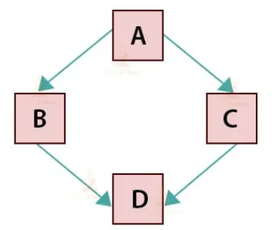
Types of Inheritance in Python
class A:
def show(self):
print("Class A")
class B(A):
def show(self):
super().show()
print("Class B")
class C(A):
def show(self):
super().show()
print("Class C")
class D(B, C):
def show(self):
super().show()
print("Class D")
obj = D()
obj.show()
Hybrid Inheritance
Class A
Class C
Class B
Class D
Hierarchical (A → B, A → C)
Multiple (D inherits B and C)
Multilevel (A → B → D)

Slide 17
Types of Inheritance in Python
class Person:
def details(self):
print("Basic personal details")
class Employee(Person):
def work(self):
print("Employee work")
class Student(Person):
def study(self):
print("Student studies")
class TeachingAssistant(Employee, Student):
def role(self):
print("Teaching Assistant role")
ta = TeachingAssistant()
ta.details()
ta.work()
ta.study()
ta.role()
Hybrid Inheritance
Basic personal details
Employee work
Student studies
Teaching Assistant role
Hierarchical (A → B, A → C)
Multiple (D inherits B and C)
Multilevel (A → B → D)

Slide 18
MCQ 1
class A:
def __init__(self):
print("A")
class B(A):
def __init__(self):
print("B")
super().__init__()
class C(B):
def __init__(self):
super().__init__()
print("C")
obj = C()
What is the output?
A) A B C B) B A C C) B C A D) A C B
Notes:
Answer: B
C() → calls super() → goes to B
B.__init__() prints B
Then super() inside B → calls A
A.__init__() prints A
Back to C → prints C

Slide 19
MCQ 2
class A:
def __init__(self):
print("A constructor")
class B(A):
def __init__(self):
print("B constructor")
obj = B()
What is the output?
A) A constructor B) B constructor C) A constructor B constructor D) Error
Notes:
Answer: B

Slide 20
MCQ 3
class A:
def show(self):
print("A")
class B(A):
def show(self):
super().show()
print("B")
obj = B()
obj.show()
Output?
A) A B) B C) A B D) B A
Notes:
Answer: C
Execution:
super().show() → prints A
then prints B

Slide 21
Assignment 1 - SUBMIT BY 16-03-2026
1. Implement Bubble Sort and Merge Sort. Conduct experimental analysis on random and nearly sorted datasets. Evaluate their performance based on execution time, stability, and theoretical complexity. [BT 5] [CO1]
2. Implement Recursive Fibonacci and Iterative Fibonacci. Measure the number of function calls and execution time for increasing input sizes. Analyze why the recursive version exhibits exponential growth and suggest improvements. [BT 4] [CO1]
3. Implement insertion and deletion operations at different positions in an array. Analyze the time complexity of each operation and justify the limitations of arrays for dynamic data handling. [BT 4] [CO2]
4. Implement a Singly Linked List with insertion (beginning & end), deletion, and search operations. Compare its performance with array implementation and evaluate which structure is more efficient under different scenarios. [BT 5] [CO2]
5. Design an abstract class StackADT and implement two concrete subclasses: ArrayStack and LinkedStack. Experimentally evaluate their performance for large datasets and justify which implementation is more suitable for real-world applications. [BT 5] [CO3]
6.Design an abstract class StackADT and implement two concrete subclasses: ArrayStack and LinkedStack. Experimentally evaluate their performance for large datasets and justify which implementation is more suitable for real-world applications.[BT 5] [CO3]
Notes:
Answer: C
Execution:
super().show() → prints A
then prints B

Slide 22
What is an Abstract Class?
In Python, an abstract class:
Cannot be instantiated directly
May contain:
Abstract methods (must be implemented in child classes)
Concrete methods (already implemented and shared)
Ensures code reusability + enforcement of structure
Python provides abstract class support using the abc (Abstract Base Class) module.
Notes:
Answer: C
Execution:
super().show() → prints A
then prints B

Slide 23
Basic Syntax:
from abc import ABC, abstractmethod
class ClassName(ABC):
@abstractmethod
def method_name(self):
pass
Problem Without Abstract Class (Redundant Code)
Example: Payment System
Suppose we have multiple payment types:
CreditCardPayment
DebitCardPayment
UPIPayment
Notes:
Answer: C
Execution:
super().show() → prints A
then prints B

Slide 24
Without Abstract Class
class CreditCardPayment:
def validate(self):
print("Validating payment...")
def pay(self, amount):
print("Processing credit card payment:", amount)
class DebitCardPayment:
def validate(self):
print("Validating payment...")
def pay(self, amount):
print("Processing debit card payment:", amount)
validate() method is repeated
No guarantee every class implements pay()
Hard to maintain in large systems.
If we change logic later then we must change in many places
Notes:
Answer: C
Execution:
super().show() → prints A
then prints B

Slide 25
Solution
from abc import ABC, abstractmethod
class Payment(ABC):
def validate(self):
print("Validating payment...")
@abstractmethod
def pay(self, amount):
Pass
Child Classes:
class CreditCardPayment(Payment):
def pay(self, amount):
print("Processing credit card payment:", amount)
class DebitCardPayment(Payment):
def pay(self, amount):
print("Processing debit card payment:", amount)
Forces implementation
Easier maintenance
events misuse
payment1 = CreditCardPayment()
payment1.validate()
payment1.pay(5000)
payment2 = DebitCardPayment()
payment2.validate()
payment2.pay(2000)
Notes:
Answer: C
Execution:
super().show() → prints A
then prints B

Slide 26
Stack ADT (Abstract Data Type)
A stack is a linear collection of items where insertion and removal happen only at one end called the "top."
It follows the Last-In-First-Out (LIFO) principle, meaning the last item pushed is the first one popped.
Imagine a stack of plates: you add (push) plates on top and remove (pop) plates from the top only.
The main operations are:
push(x): Add element x to the top
pop(): Remove the top element
peek()/top(): View the top element without removing it
isEmpty(): Check if stack is empty
Notes:
Answer: C
Execution:
super().show() → prints A
then prints B

Slide 27
Stack Visual Representation Example:
Imagine the stack initially empty:
Stack: [ ]
Push elements 5, 10, 15:
Stack: [15 (top), 10, 5]
Pop one element removes 15:
Stack: [10 (top), 5]
Peek shows 10 without pop.
Applications of Stacks
Expression evaluation and syntax parsing
Browser history navigation (back button)
Notes:
Answer: C
Execution:
super().show() → prints A
then prints B

Slide 28
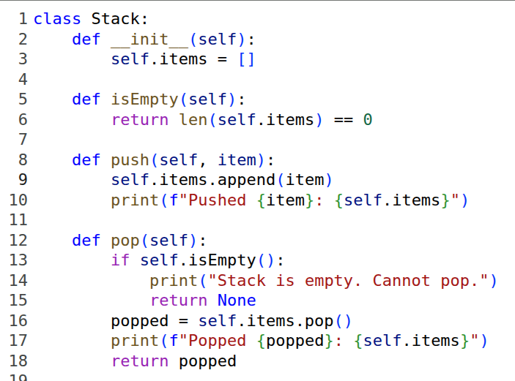
Notes:
Answer: C
Execution:
super().show() → prints A
then prints B

Slide 29
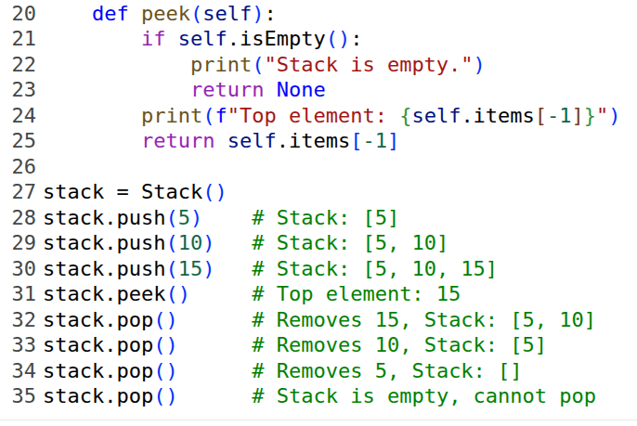
Notes:
Answer: C
Execution:
super().show() → prints A
then prints B

Slide 30
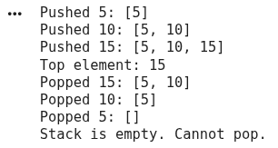
Notes:
Answer: C
Execution:
super().show() → prints A
then prints B

Slide 31
What is a Queue?
A Queue is a linear data structure that follows the FIFO (First In, First Out) principle.
First In , First Out
The element inserted first is removed first.
Think of it like a line of people waiting for a ticket:
The person who comes first gets the ticket first.
Key Terms
Front – The position of the first element in the queue (to be removed).
Rear – The position of the last element in the queue (most recently added).
Notes:
Answer: C
Execution:
super().show() → prints A
then prints B

Slide 32
Queue ADT
A queue allows insertion at the rear and removal from the front, enforcing FIFO order across all accesses and updates.
Typical queue states track front, rear, and size, with overflow/underflow considerations in fixed-capacity arrays and circular buffers.
Operation | Description
enqueue(x) | Insert element x at the rear.
dequeue() | Remove and return element from the front.
peek() / front() | Return element at front without removing.
isEmpty() | Check if the queue is empty.
isFull() | Check if the queue is full (for fixed-size queues).
Notes:
Answer: C
Execution:
super().show() → prints A
then prints B

Slide 33
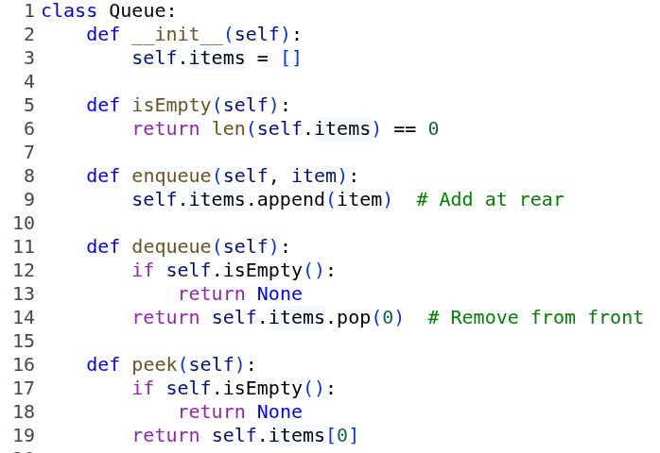
Notes:
Answer: C
Execution:
super().show() → prints A
then prints B

Slide 34
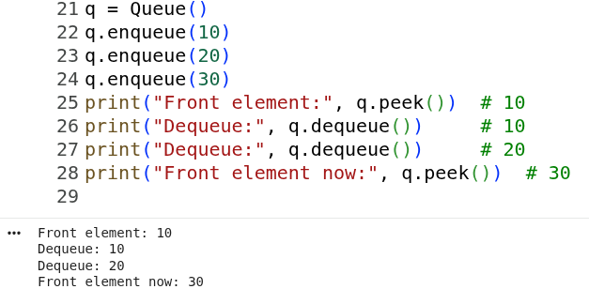
Notes:
Answer: C
Execution:
super().show() → prints A
then prints B

Slide 35
Applications
Graph algorithms: breadth-first search (BFS) explores neighbors level-wise using a queue.
Order processing and service systems: fair handling of requests by arrival time
Notes:
Answer: C
Execution:
super().show() → prints A
then prints B

