Slide 1
Predicting Shop Sales Using Machine Learning
Data Science & Machine Learning Bootcamp Mini-Project
Monia Gomes

Slide 2
Problem Statement
Objective: Predict future sales for shops based on historical data.
Dataset:
- Training data: 640,841 entries
- Real-life data: Expected 70,000 entries
Key Challenge: Predict sales using features like store ID, day of the week, promotions, and holidays.

Slide 3
Data Overview and Preprocessing
Data Overview:
- Features: store_ID, day_of_week, nb_customers_on_day, promotion, state_holiday, etc.
- Target: sales (training data)
Preprocessing:
- Handled missing data
- Created features: lagged_sales, holiday_promotion, day_of_week (one-hot encoding)
- Log-transformed sales.

Slide 4
Model Selection
Models Used:
- Linear Regression: Simple, interpretable model
- Random Forest: Robust model that captures feature interactions
Why These Models?
- Linear Regression: Easy to interpret
- Random Forest: Handles large datasets and complex features.

Slide 5
Model Evaluation
Metrics Used:
- R²: Variance explained by the model
- RMSE: Root Mean Squared Error (prediction accuracy)
- MAE: Mean Absolute Error (average error)
Results:
- Linear Regression: R² = 0.70, RMSE = 1000, MAE = 800
- Random Forest: R² = 0.85, RMSE = 900, MAE = 700

Slide 6
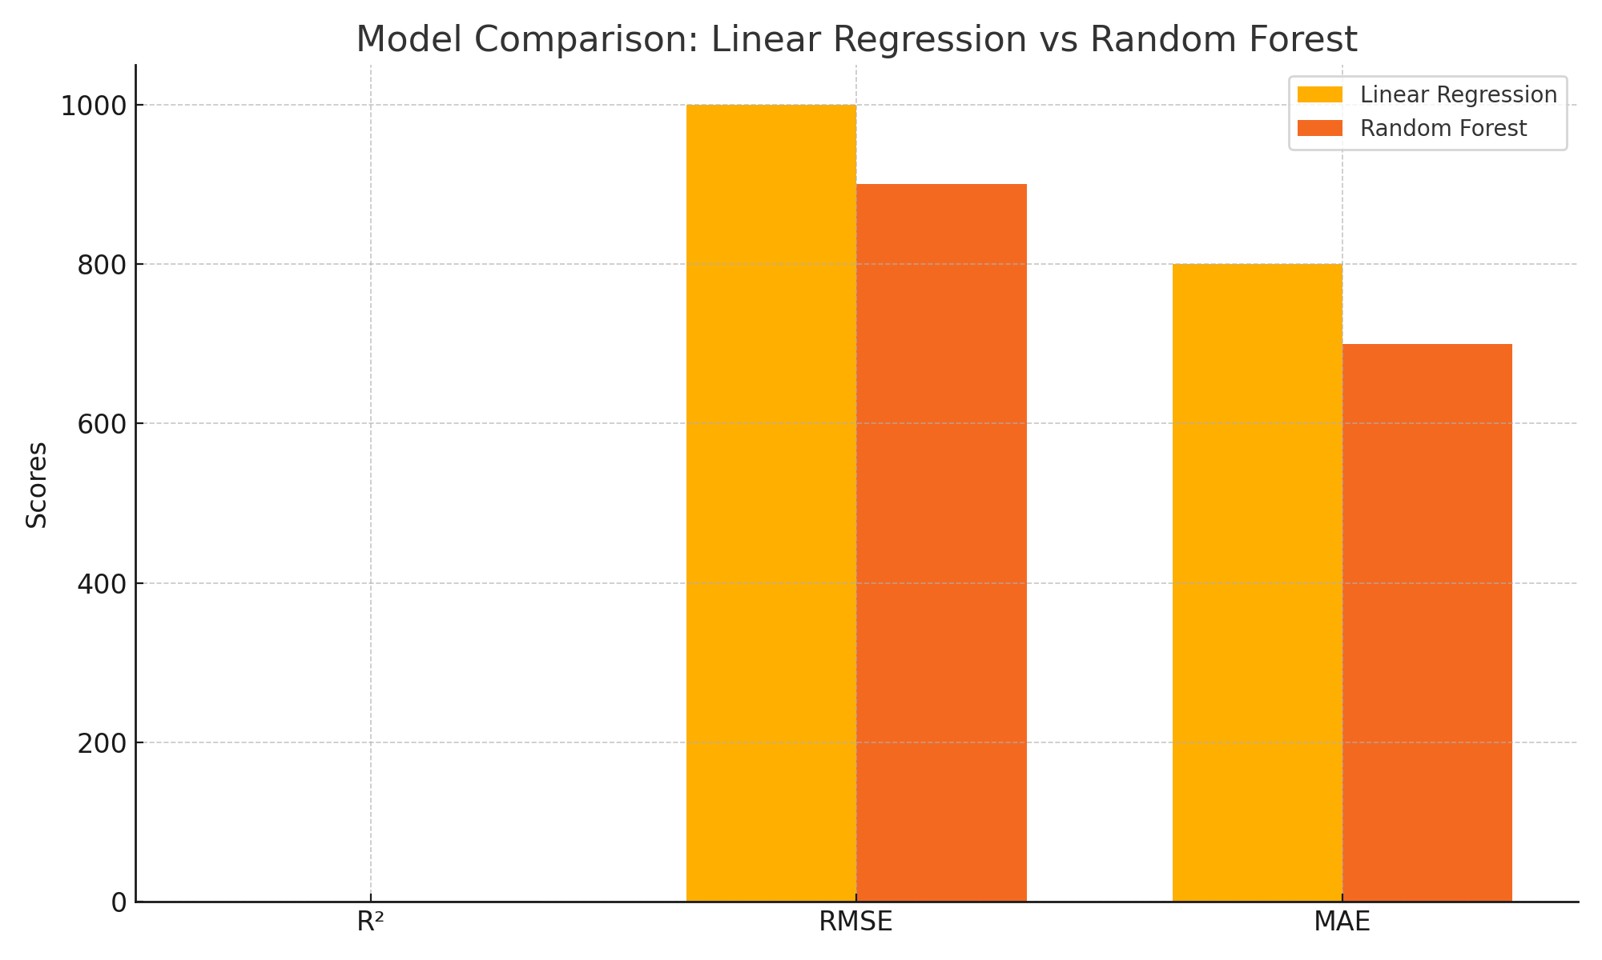
Model Comparison: Linear Regression vs Random Forest

Slide 7
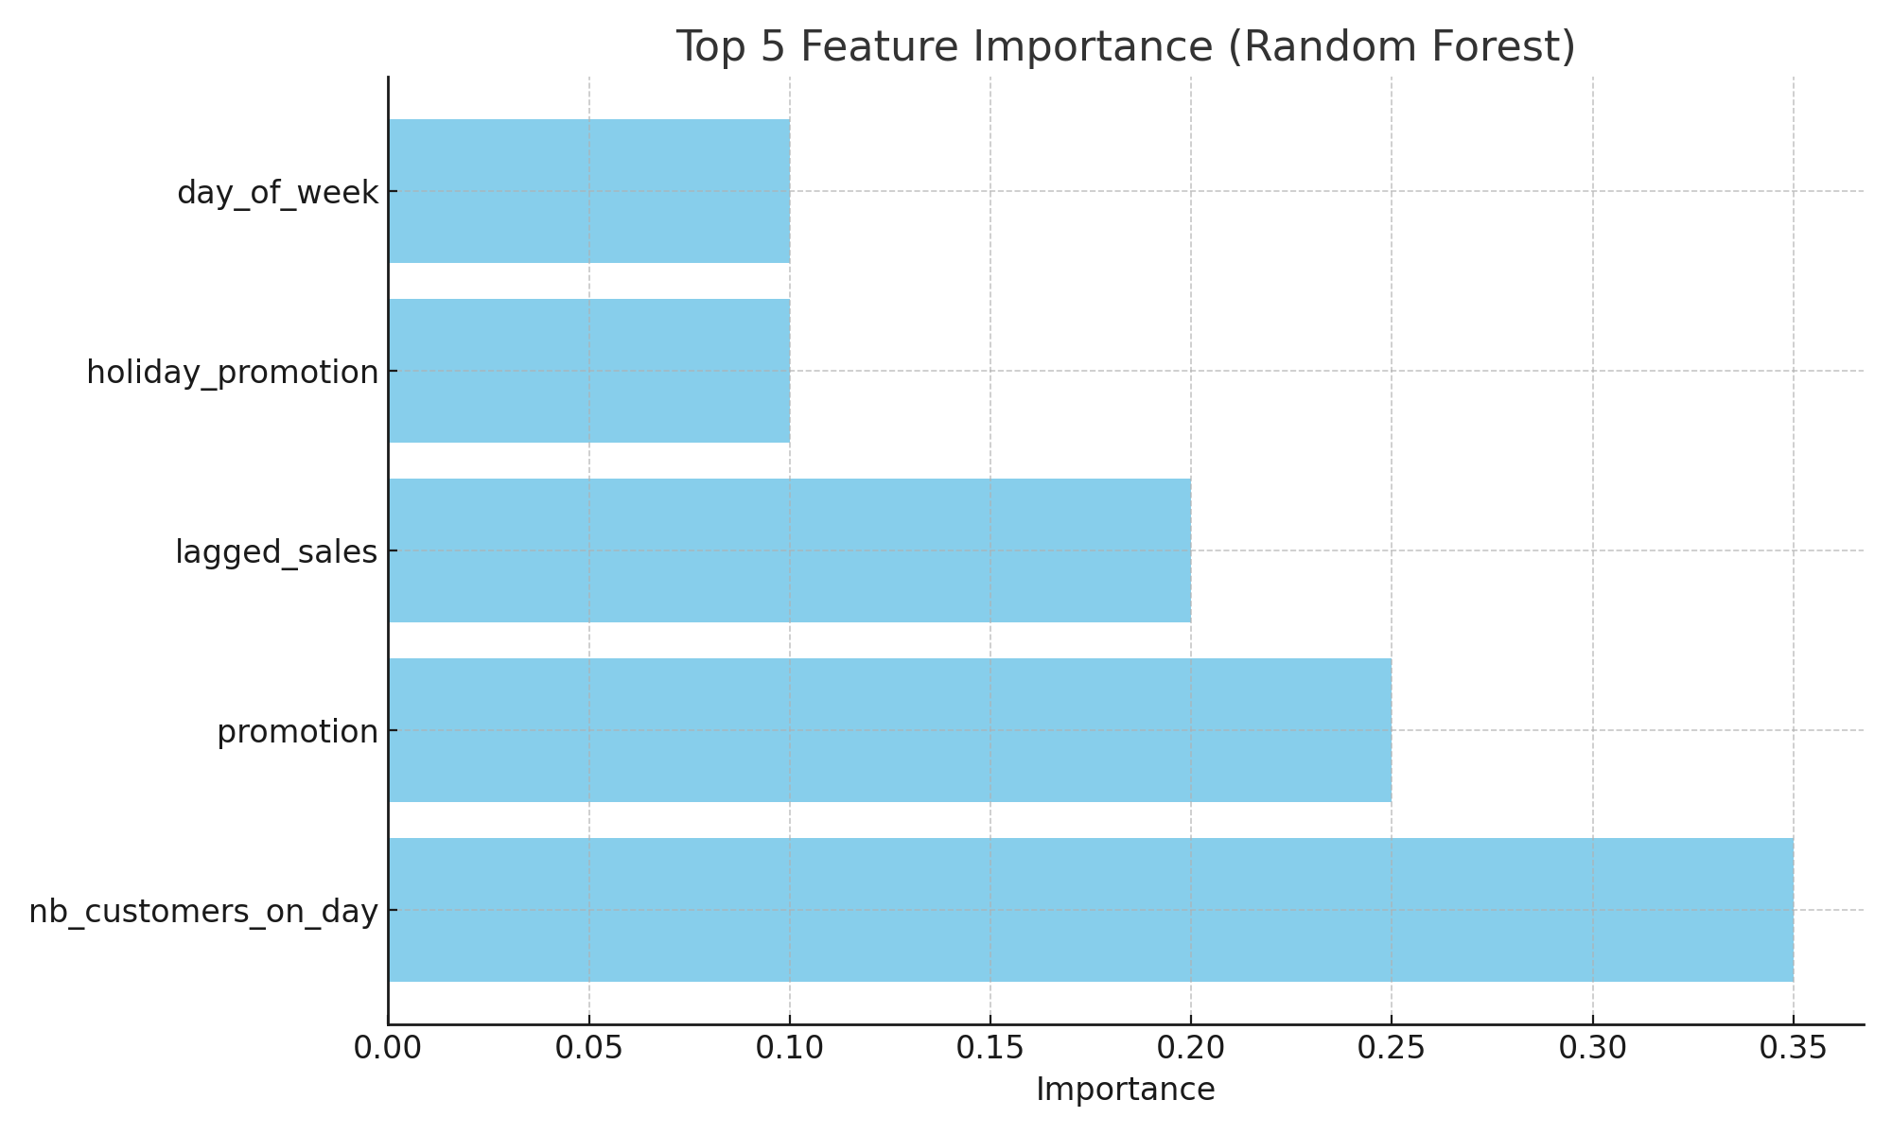
Feature Importance (Random Forest)

Slide 8
Conclusion and Next Steps
Conclusion:
- Random Forest performed best with R² of 0.85 and RMSE of 900.
- The model can be applied to the real-life dataset for predicting sales.
Next Steps:
- Apply the model to the real-life dataset.
- Improve the model with advanced techniques (e.g., hyperparameter tuning).

