Slide 1
Employee Data Analysis using Excel
STUDENT NAME: BABY PRIYANKA J
REGISTER NO: 2213031036250
DEPARTMENT: BCOM (GENERAL)
COLLEGE DR AMBEDKAR GOVT ARTS COLLEGE

Slide 2
PROJECT TITLE
Employee Performance Analysis using Excel

Slide 3


AGENDA
Problem Statement
Project Overview
End Users
Our Solution and Proposition
Dataset Description
Modelling Approach
Results and Discussion
Conclusion
3/21/2024 Annual Review

Slide 4

PROBLEM STATEMENT
Companies analyze employee performance for many reasons , including
1: Feedback
2: Goal setting
3: Career development
4: Company growth
5: reflecation

Slide 5

PROJECT OVERVIEW
.
Employee data analysis as a project which I have done is able to show members in company in gender wise and there grade in a graph view

Slide 6

WHO ARE THE END USERS?
1:Employee
2:Employer
3:software company
4:Industries . etc

Slide 7

OUR SOLUTION AND ITS VALUE PROPOSITION
1:Conditional formatting- missing
2:Filter-remove
3:Formula-performance
4:Pivot-summary
5:Graph-data visualization

Slide 8
Dataset Description
1:Employee=-Kaggle
2:26-features
3:9-features
4:Emp id- Num
5:Name-text
6:Emp type
7:Performance level
8:Gender-Male,Female
9 Employee rating -Num

Slide 9

THE "WOW" IN OUR SOLUTION
.Performance level =IFS(Z8>=5,”VERY HIGH”,Z8>=4,”HIGH”
Z8>=3,”MED”,TRUE,”LOW”)
3/21/2024 Annual Review
9

Slide 10
MODELLING
Data collection
Edunet dashboard
Kaggle
Feature collection
1) Fillter
Data cleaning
Identified missing value
Performance level
1)Through grads
10

Slide 11
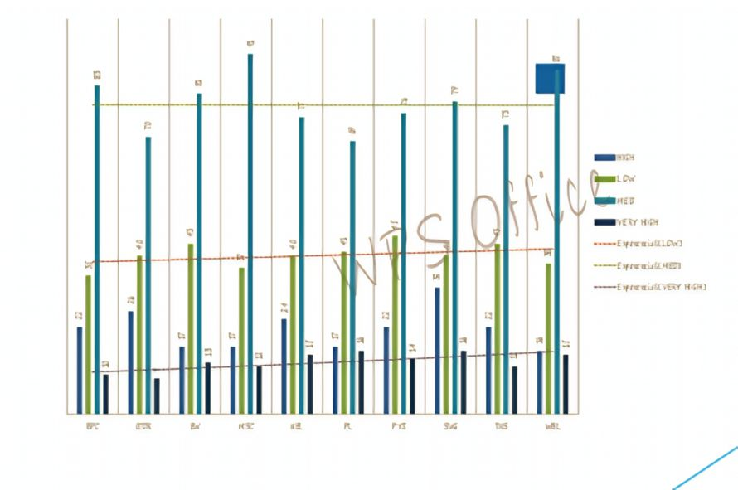
RESULTS
11

Slide 12
conclusion
The conclusion over all PL ,PYZ , and SVG are well performed
Than others

