Slide 1
Sky alignment

Slide 2
What I have done
Find an algorithm to calculate the celestial coordinate.
Choose hygdata_v3 as database and import it into mysql database.
Image processing(image binarization) and find the 4 brightest stars. Get the radius and area of every 4 star.
Calculate the apparent magnitude and select these star with calculated mag in database.
Choose horizontal coordinate as celestial coordinate and use Ra and Dec of the star to calculate the altitude and azimuth via astropy.

Slide 3
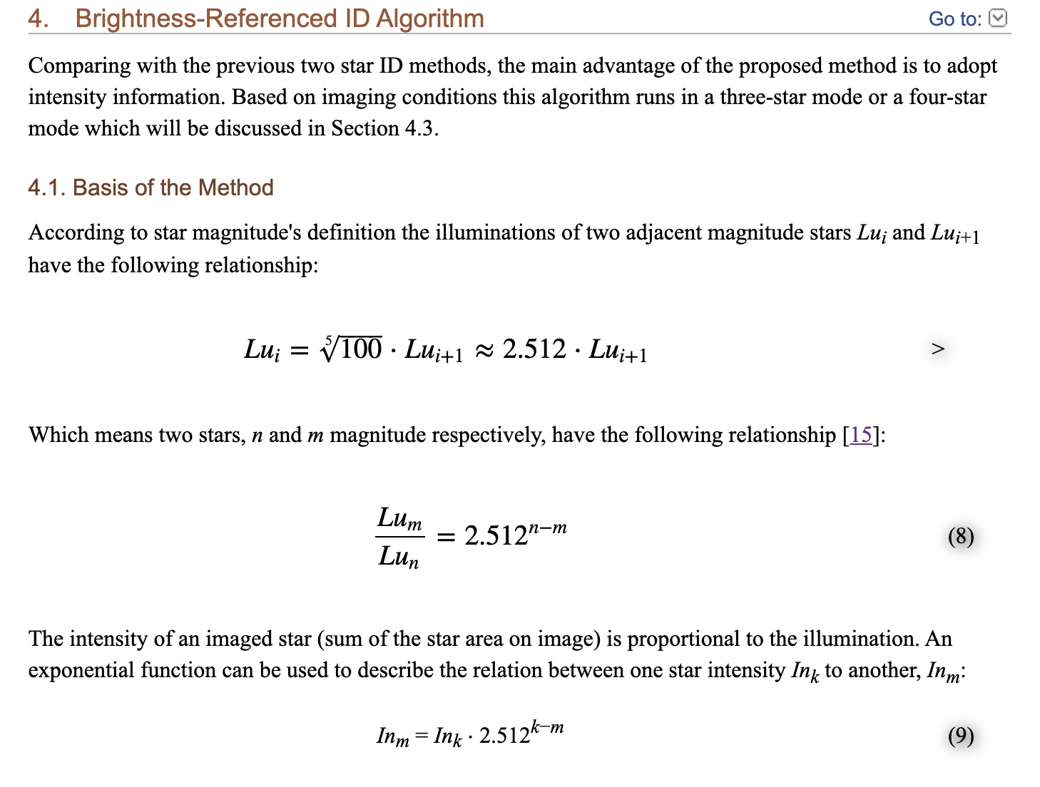
Algorithm
Reference to A Brightness-Referenced Star Identification Algorithm for APS Star Trackers
Peng Zhang,¹ Qile Zhao,^{1,*} Jingnan Liu,¹ and Ning Liu²

Slide 4
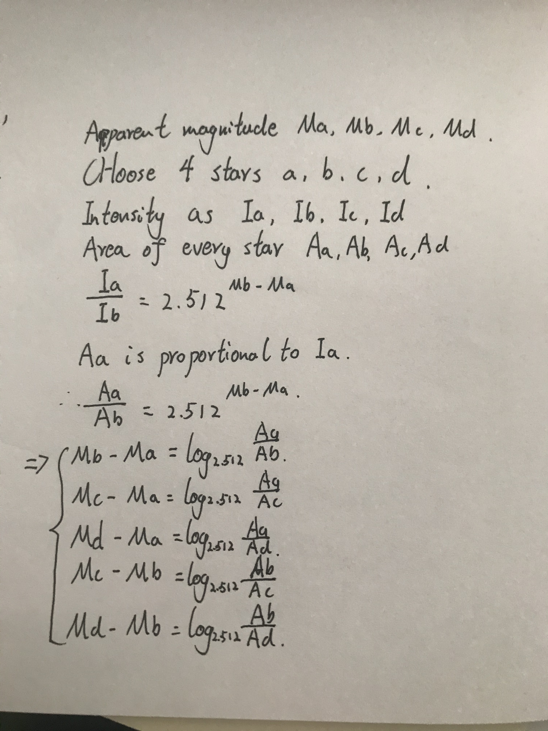
Brief formula
Calculate the relationship between the brightest stars in an image.
Select these stars in the database. Find the corresponding RA (right ascension) and Dec (declination) of every star.

Slide 5
What have not done
Just find an algorithm but did not find the real celestial coordinate of the picture. The problem is when I select the 4 stars’ apparent magnitude from the database, there are several groups that have the same relationship. Find a filter that select the most relevant stars in the database in the future would solve this problem.

