Slide 1

Density Functional Theory Study of CO₂ Capture with Transition
Metal Oxides and Hydroxides
Zhang, B., Duan, Y., Johnson, K. Journal of Chemical Physics (2012) 136(6):064516
Bruno A. Calfa
06-640: Literature Review Project
September 24th, 2012

Slide 2
Motivation and Objectives
CO₂ is one of the primary greenhouse gases
Capture and sequestration to mitigate its effect on global climate change
Three classes of CO₂ capture technologies:
Pre-combustion: Removal of CO₂ from the fossil fuel prior to combustion
Post-combustion: CO₂ capture from the flue gas after combustion of the fossil fuel (traditionally scrubbing with liquid monoethanolamine (MEA))
Oxy-fuel: Combustion of fossil fuel with pure oxygen rather than air (avoids NO_{x} and concentrates CO₂)
Objectives:
Investigate the efficiency of solid sorbents to capture CO₂
Compute phase diagrams of reactions between sorbents and CO₂
Assess the accuracy of five different DFT generalized gradient functionals for the prediction of the reaction thermodynamics of various transition metal oxides and hydroxides
Screen these materials for suitability in pre-combustion and post-combustion CO₂ capture

Slide 3
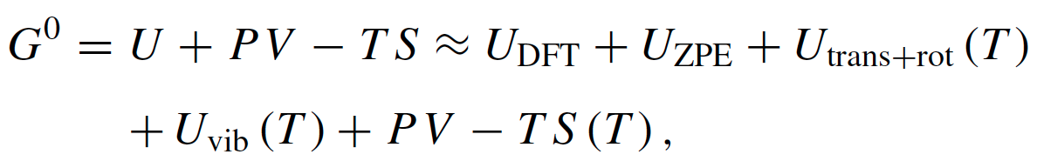
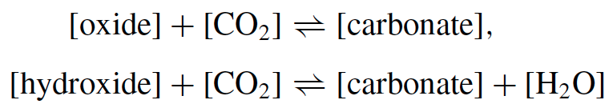
Methodology: DFT and Thermochemistry
Computational packages and exchange-correlation functionals
VASP (PW91 and PBEsol)
GPAW (PBE, TPSS, and revTPSS)
Functionals were used to calculate the ground state energies of all the solid phase and gas phase compounds
Thermochemistry of CO₂ capture reactions
Statistical mechanical ideal gas expressions
Reactions

Slide 4
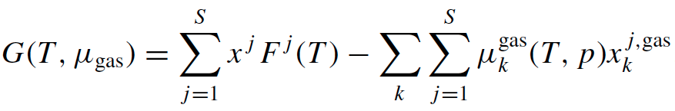
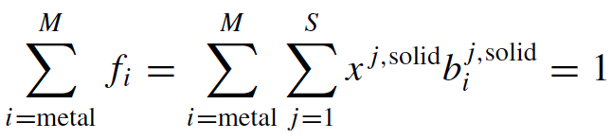
Methodology: Phase Diagrams
Minimization of the grand-canonical Gibbs free energy of a system where all possible solid phases are in contact with a gas-phase reservoir having specified partial pressures of CO₂ and H₂O
subject to (mass conservation constraints):
Choose small intervals of temperature and pressure and obtain x^{j} mole fractions of solids in phase j

Slide 5
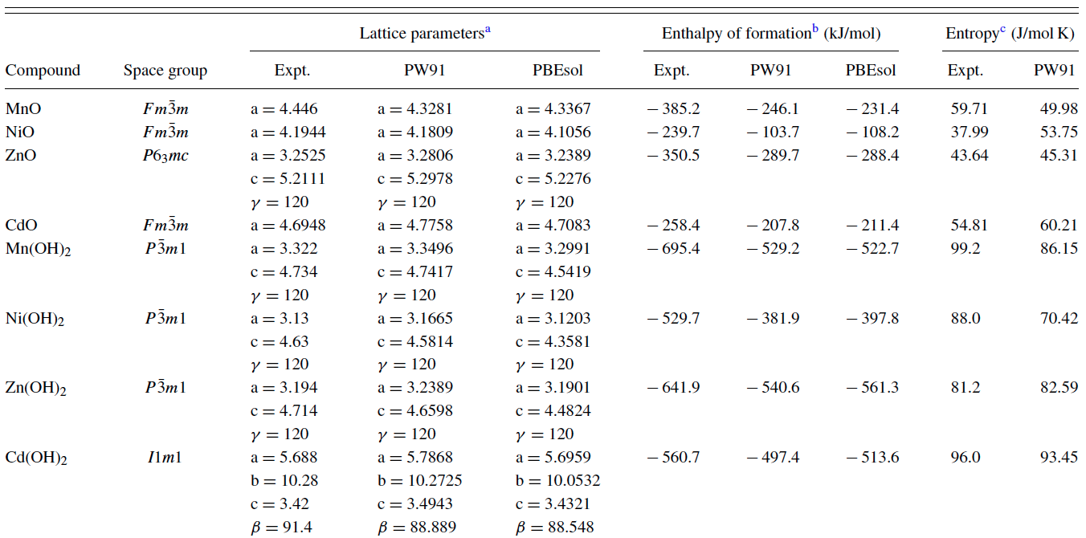
Some Results: DFT Calculations
Lattice parameters, better agreement with experimental values when using
PBEsol for compounds containing Zn and Cd except Zn(OH)₂
PW91 for compounds containing Mn and Ni
Entropies calculated from frozen-phonon approach
Discrepancies are within 10 J/(mol K) except for NiO and Ni(OH)₂

Slide 6
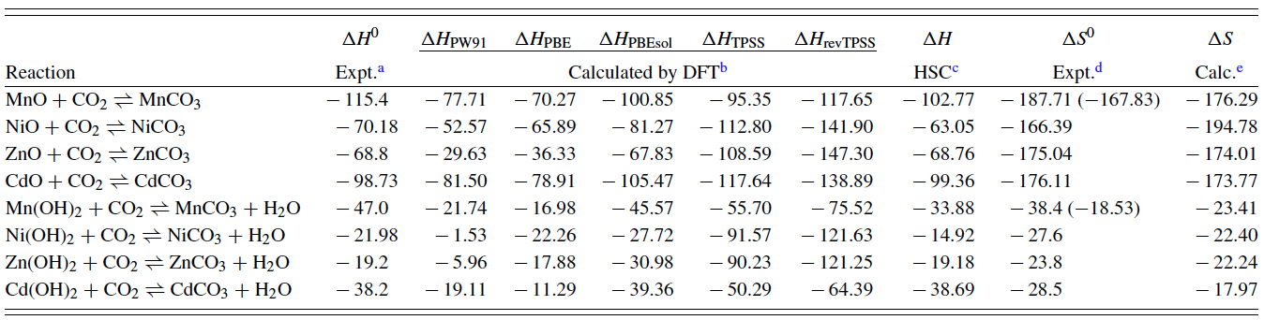
Some Results: Thermo Properties for CO₂ Capture
HSC CHEMISTRY is a chemical reaction and equilibrium software package that can be used to calculate reaction equilibrium based on correlation of experimental data
Relatively large differences between the calculated enthalpies of reaction at 298.15 K from all DFT methods and the experimentally measured values
PBEsol functional performs much better on average
Reaction entropies lie in between the HSC values (in the parenthesis) and the experimental data for the Mn-containing reactions

Slide 7
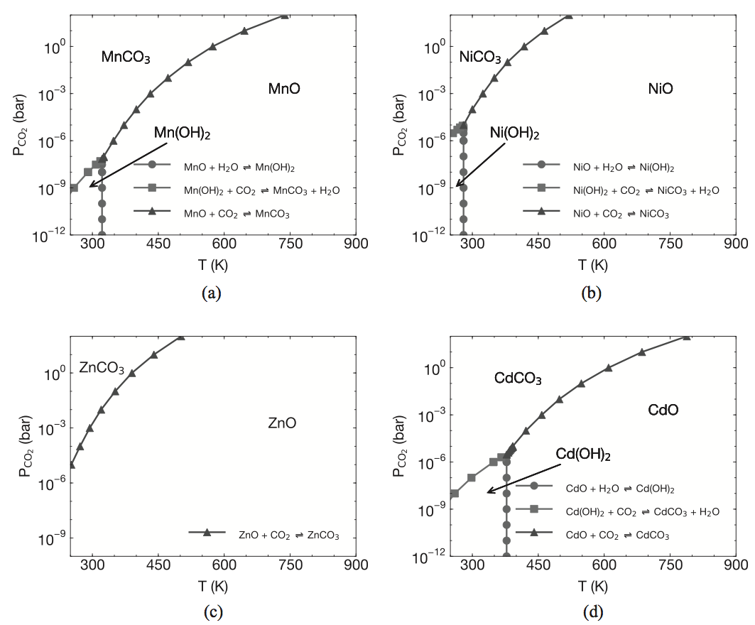
Some Results: Phase Diagrams Computed from DFT
Pre-combustion
Post-combustion
Pre-combustion (20 – 25 bar, 523 – 723 K): Only MnO and CdO
Post-combustion (0.1 – 0.2 , 300 – 350 K): all oxides
Hydroxides decompose at relatively low temperatures and partial pressures of CO2 and are not suitable for CO₂ capture

Slide 8
Conclusions
Choice of exchange-correlation functionals directly affect the accuracy of DFT calculations
LDA usually underestimates lattice constants for solids, whereas GGA usually overestimates them
Lattice constants play an important role in determining a number of properties
“Higher-level” functionals (TPSS and revTPSS) performed better than GGA at predicting the enthalpy of formation of carbonates and oxides
Reaction enthalpies computed with these meta-GGA functionals are not as accurate as data computed from the PBEsol functional
May be due to the use of pseudopotentials that are not tuned for meta-GGA functionals
Screening of metals for CO₂ capture
All the oxides may be useful for post-combustion CO₂ capture
Only MnO and CdO are possibilities for pre-combustion capture
None of the hydroxides are suitable for CO₂ capture (decompose)

Slide 9
Backup Slides

Slide 10
Computational Details: Packages
VASP package
Core-electron interactions: Projector Augmented-Wave (PAW) potentials
Exchange-Correlation functionals: PW91 (CG method) and PBEsol (quasi-Newton method)
Cut-off energy: 520 eV
k-point meshes: Monkhorst-Pack method with a spacing of around 0.027 Å⁻¹ between k-points along the axes of the reciprocal unit cells
Stopping criterion for energy: < 0.01 meV
GPAW code
Exchange-Correlation functionals: PBE, TPSS, and revTPSS (meta-GGA)
Energy convergence criterion: 10⁻⁶ eV/atom using a grid spacing of 0.15 Å
k-point meshes: same as above

Slide 11
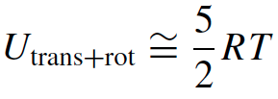
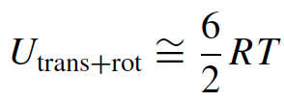
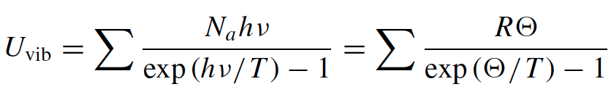
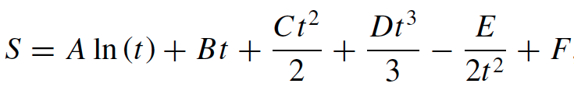




Thermochemistry Calculations
Terms in Gibbs free energy
Linear molecules
Nonlinear molecules
, with t = T/1000
where
where

