Slide 1

EOSfit
A Python Module to Fit First-Principles E vs. V
to Equations of State and Perform Statistical Analyses
Bruno A. Calfa
06-640: Final Project
December 10th, 2012

Slide 2
Motivation and Objectives
There are many Equations of State (EOS) models available in the literature to predict first-principles calculated energy as function of volume
Simply estimating the models’ fitting parameters is not enough to guarantee a level of confidence of their true values
Confidence Intervals (CIs) indicate the reliability of an estimate
95% confidence intervals mean that “we are 95% confident that the true value of the parameter is in our confidence interval”
Some EOS models contain fitting parameters (a, b, c, d, …) that have no physical meaning (V₀, E₀, B₀, B₀’, …)
Estimate physical parameters and their CIs by propagating the uncertainty or error associated with fitting parameters via simulation
Objectives
Implement capabilities discussed above
Allow plotting a single EOS model and multiple models in the same figure
Attempt to be (aesthetically) compatible with ASE’s EquationOfState class

Slide 3
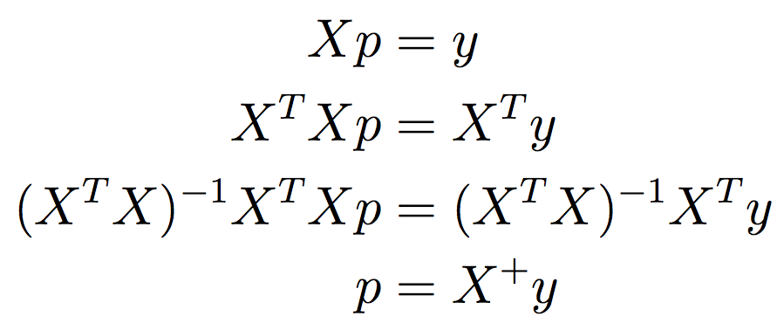
Methodology: Regression and CIs
Fitting data to linear models can be done exactly in a least-squares sense by calculating the pseudo-inverse of the regressor matrix
Linear model: y = Xp, where X is the regressor matrix and p is the vector of parameters
No need to provide initial guesses for fitting function
CIs are computed by estimating the covariance matrix , extracting its main diagonal elements (variances), and using the inverse of the Student’s t Cumulative Distribution Function (CDF) to obtain standard deviations
Therefore, each fitting parameter has the form:
Requires: NumPy’s linalg.solve
Nonlinear models: covariance matrix is already estimated by SciPy’s curvefit. Standard deviations are readily calculated

Slide 4
Examples: Comparing EOS Models (I)
from eosfit import EOS, EOSmodel
import numpy as np
V = np.array([8., 8.5, 9., 9.6, 10.2, 10.9, 11.6, 12.2, 13., 13.8, 14.5]) # [Ang^3]
E = np.array([-4.65, -5.05, -5.3, -5.48, -5.57, -5.59, -5.575, -5.5, -5.4, -5.3, -5.18]) # [eV/atom]
eos1 = EOS(V, E, ID='mBM4', model=EOSmodel.mBM4)
V0_mBM4, E0_mBM4, B0_mBM4 = eos1.fit() # No need for initial guess (linear model)
ci_mBM4 = eos1.get_phys_ci()
print '''mBM4
===
V0 = {0} Ang^3
E0 = {1} eV/atom
B0 = {2} GPa
phys ci = {3}
'''.format(V0_mBM4, E0_mBM4, B0_mBM4*160.217, ci_mBM4)
eos2 = EOS(V, E, ID='VI4', model=EOSmodel.VI4)
p0 = [V0_mBM4, E0_mBM4, B0_mBM4, eos1.get_B0p()] # Initial guesses from fitting linear model
V0_VI4, E0_VI4, B0_VI4 = eos2.fit(p0) # Provide custom initial guesses
ci_VI4 = eos2.get_ci()
print '''VI4
===
V0 = {0} Ang^3
E0 = {1} eV/atom
B0 = {2} GPa
ci = {3}
'''.format(V0_VI4, E0_VI4, B0_VI4*160.217, ci_VI4)
# Plot multiple EOS objects
EOS.plotm([eos1, eos2], filename='eosfit_example_mBM4_VI4.png')

Slide 5
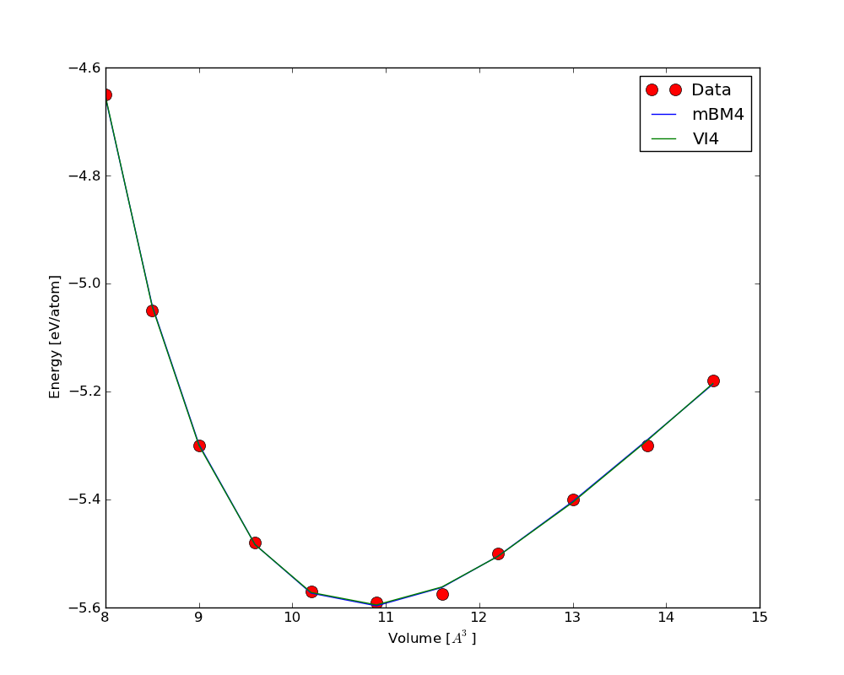
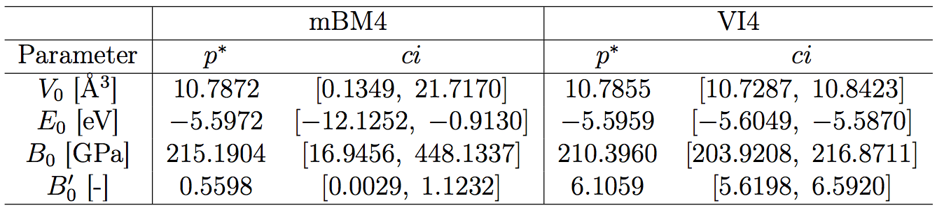
Examples: Comparing EOS Models (II)
Tighter CIs for VI4
More uncertainty in fitting parameters of mBM4 propagated to physical parameters: B₀ and B₀’ differ significantly between models

Slide 6
Conclusions and Extensions
Rigorous statistical treatment to parameter estimation is important to characterize the goodness of model fitting
Large confidence intervals for fitting parameters propagate to physical parameters affecting their estimated values and confidence intervals
Possible extensions:
Implementation of other EOS models
Calculation of higher-order pressure derivatives of the bulk modulus for 4-parameter models
Calculation of additional physical parameters from the E(V) expressions of each EOS model

Slide 7
Backup Slides

Slide 8
References
EOS Models
S-L. Shang, Y. Wang, D. Kim, and Z-K Liu. First-principles Thermodynamics from Phonon and Debye Model: Application to Ni and Ni3Al. Computational Materials Science, 47(4):1040–1048, 2010.
Calculation of Confidence Intervals
D. M. Bates and D. G. Watts. Nonlinear Regression Analysis and Its Applications. John Wiley & Sons, 1988.

Slide 9

Methodology: Estimating Physical Parameters and their CIs via Simulation
For models that the fitting parameters do not directly represent physical quantities, we can propagate the uncertainty associated with the fitting parameters to the physical parameters through simulation
Sample 10,000 points for each fitting parameter from Gaussian random generator with same average and standard deviation
Obtain analytical expressions for V₀ by solving dE/dV = 0 for V
Calculate V₀ for all sample points making sure the valid root is used
Calculate other physical parameters (E₀, B₀, B₀’, …) from samples and V₀ values
Obtain average values and, given a percentile, extract corresponding values at both ends of distribution to get lower and upper bounds on CIs
Physical parameters are then expressed as:

Slide 10
Examples: Fitting Data to an EOS (I)
from eosfit import EOS, EOSmodel
import numpy as np
V = np.array([8., 8.5, 9., 9.6, 10.2, 10.9, 11.6, 12.2, 13., 13.8, 14.5]) # [Ang^3]
E = np.array([-4.65, -5.05, -5.3, -5.48, -5.57, -5.59, -5.575, -5.5, -5.4, -5.3, -5.18]) # [eV/atom]
eos1 = EOS(V, E, ID='MU4')
p0 = [12., -3., 1., 5.] # Order [V0, E0, B0, B0']
V0_MU4, E0_MU4, B0_MU4 = eos1.fit(p0) # Initial guess required (nonlinear model)
ci_MU4 = eos1.get_ci()
E_MU4 = eos1.eval()
R2_MU4 = eos1.get_rsquared()
eos1.plot(filename='eosfit_example_MU4.png')
print '''MU4
===
V0 = {0} Ang^3
E0 = {1} eV/atom
B0 = {2} GPa
ci = {3}
E = {4} eV/atom
R^2 = {5}
'''.format(V0_MU4, E0_MU4, B0_MU4*160.217, ci_MU4, E_MU4, R2_MU4)

Slide 11
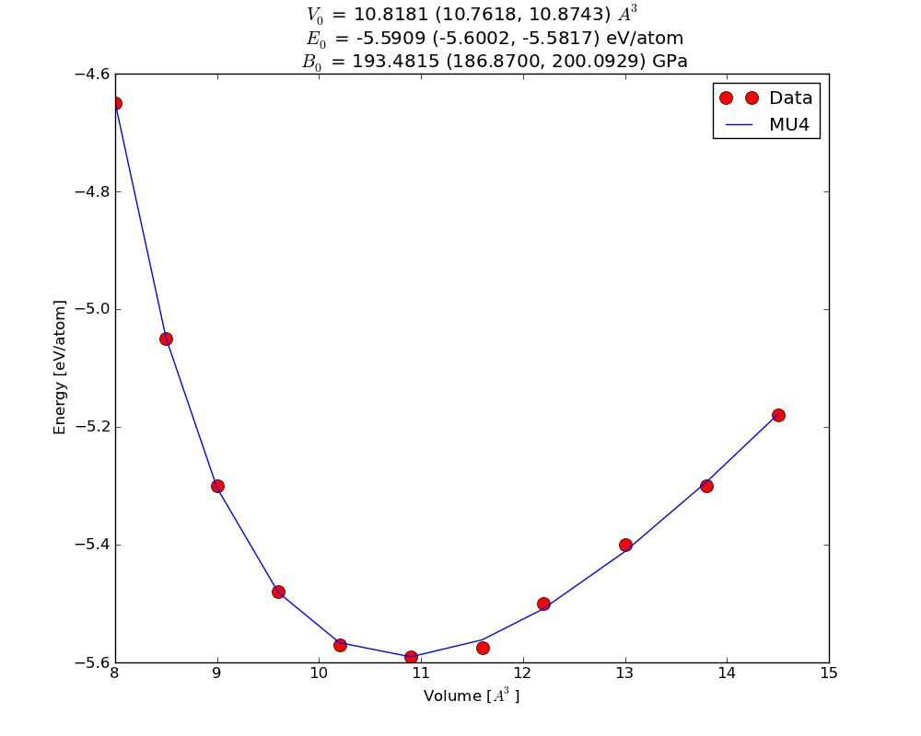
Examples: Fitting Data to an EOS (II)

Slide 12
Examples: Plotting Distribution of Physical Parameters (I)
from eosfit import EOS, EOSmodel
import numpy as np
V = np.array([8., 8.5, 9., 9.6, 10.2, 10.9, 11.6, 12.2, 13., 13.8, 14.5]) # [Ang^3]
E = np.array([-4.65, -5.05, -5.3, -5.48, -5.57, -5.59, -5.575, -5.5, -5.4, -5.3, -5.18]) # [eV/atom]
eos = EOS(V, E, ID='BM4', model=EOSmodel.BM4)
V0_BM4, E0_BM4, B0_BM4 = eos.fit() # No need for initial guess (linear model)
ci_BM4 = eos.get_phys_ci() # Done via simulation
print '''BM4
===
V0 = {0} Ang^3
E0 = {1} eV/atom
B0 = {2} GPa
phys ci = {3}
'''.format(V0_BM4, E0_BM4, B0_BM4*160.217, ci_BM4)
# Plot distributions
eos.plot_hist_V0('eosfit_example_BM4_V0_dist.png')
eos.plot_hist_E0('eosfit_example_BM4_E0_dist.png')
eos.plot_hist_B0('eosfit_example_BM4_B0_dist.png')
eos.plot_hist_B0p('eosfit_example_BM4_B0p_dist.png')

Slide 13
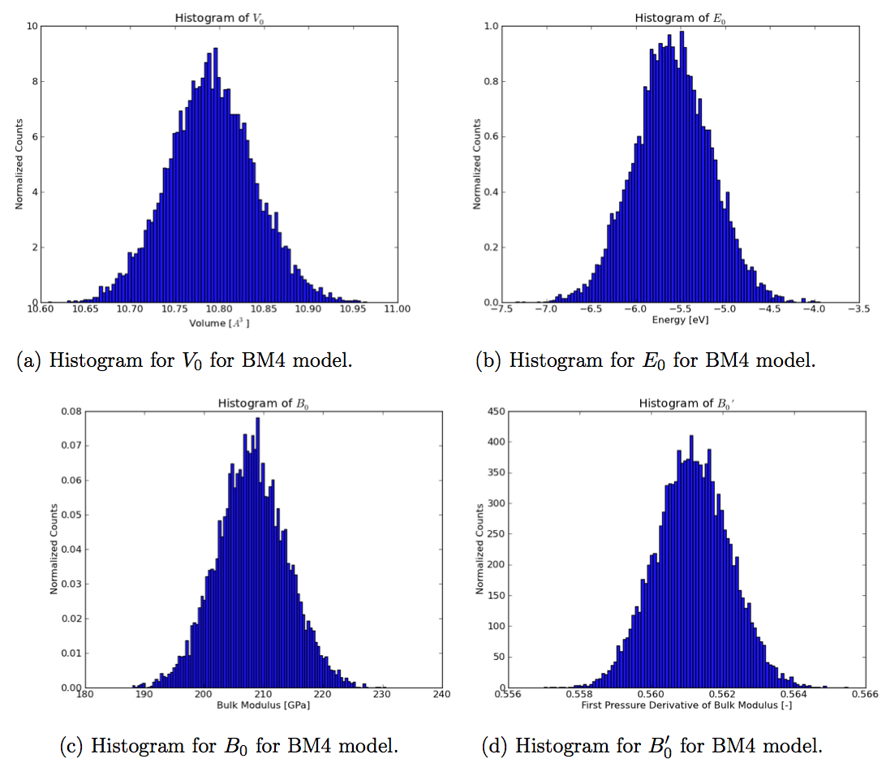
Examples: Plotting Distribution of Physical Parameters (II)

Slide 14
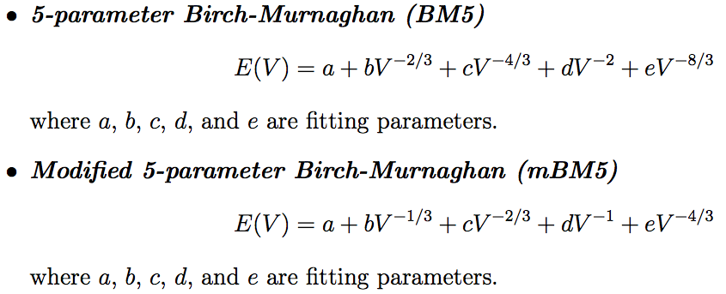
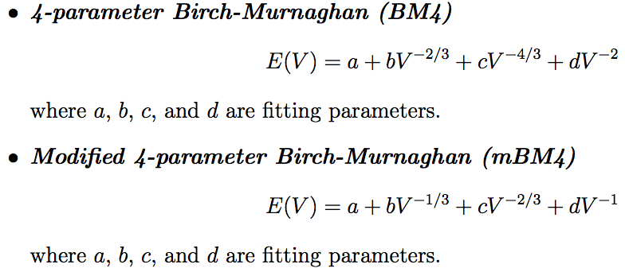
EOS Models (I)

Slide 15
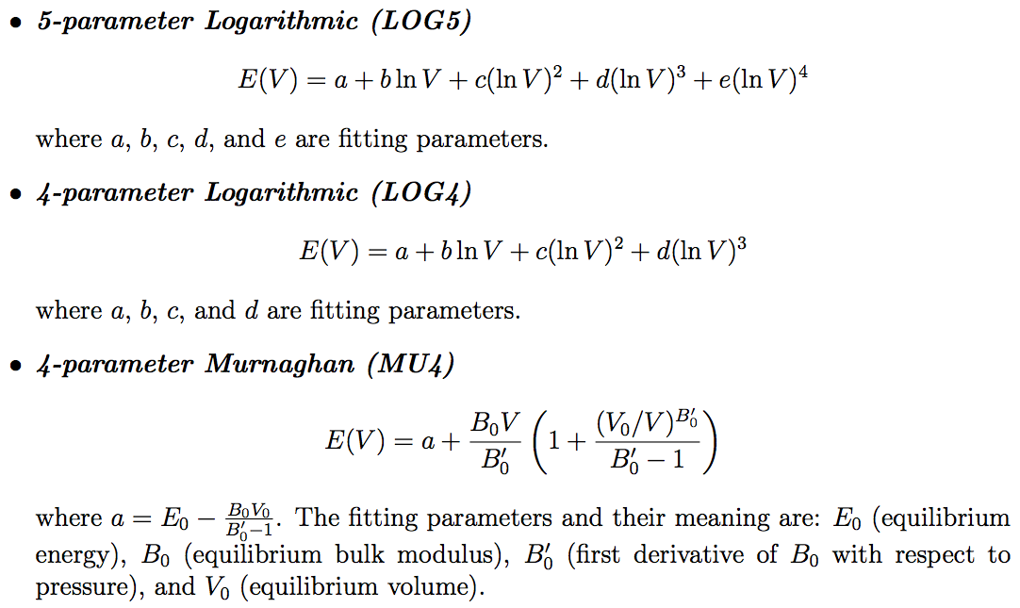
EOS Models (II)

Slide 16
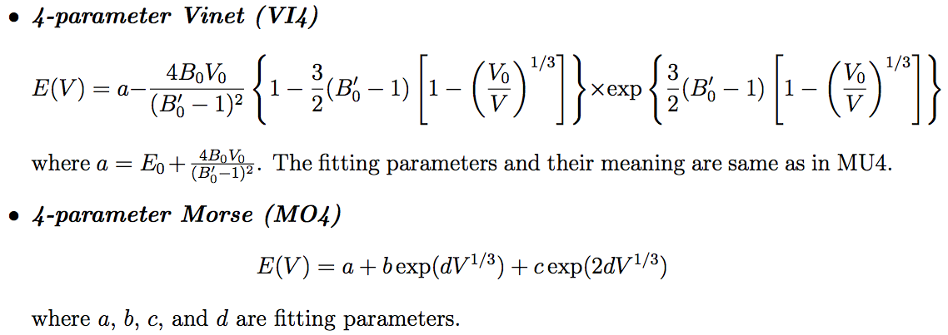
EOS Models (III)

Slide 17
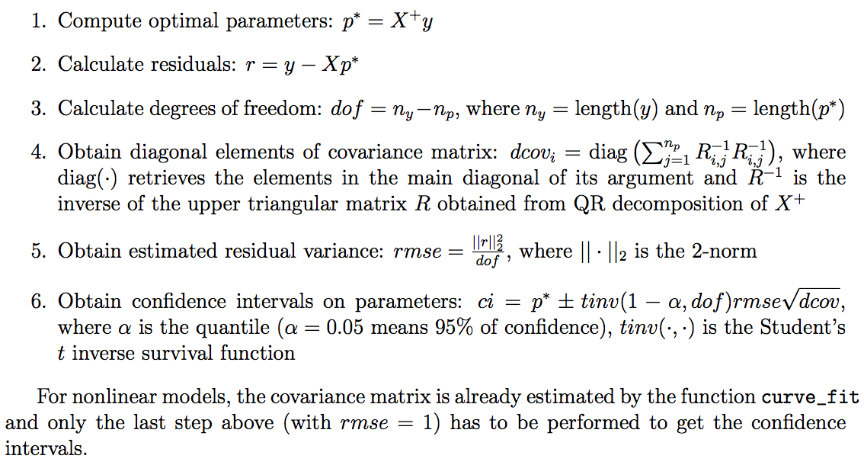
Steps to Obtain CIs for Fitting Parameters

Slide 18
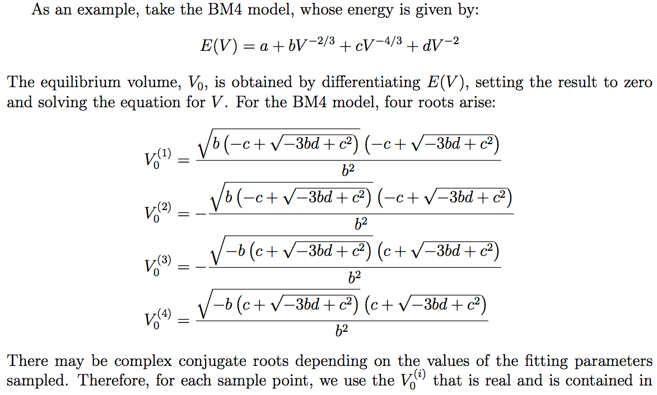
Confidence Intervals of Physical Parameters via Simulation (I)

Slide 19
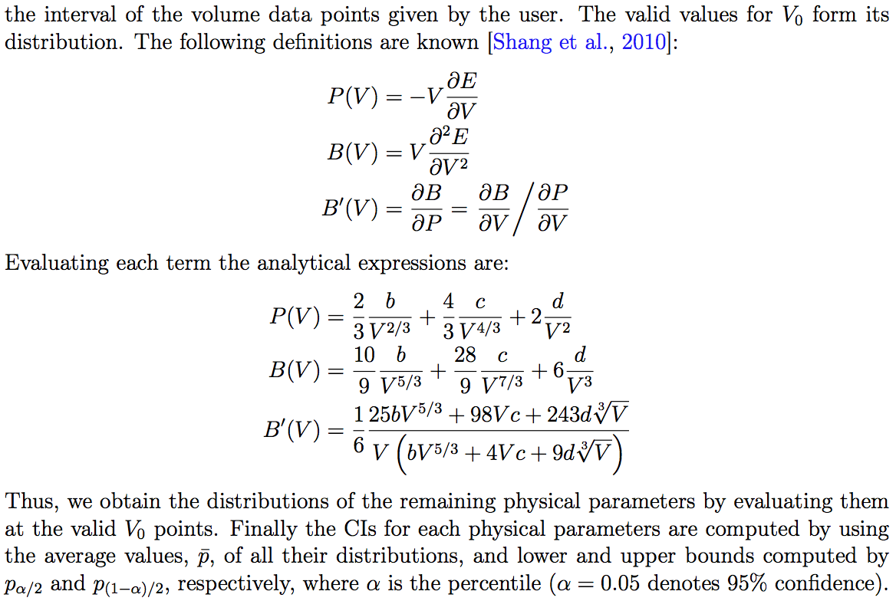
Confidence Intervals of Physical Parameters via Simulation (II)

Slide 20
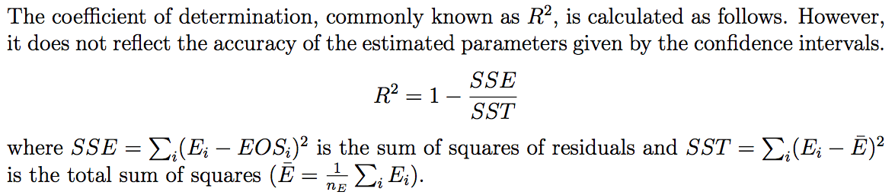
Coefficient of Determination (R²)

