Slide 1

Campus traffic and e-Learning during COVID-19 pandemic
Thomas Favale, Francesca Soro, Martino Trevisan, Idilio Drago, Marco Mellia

Slide 2
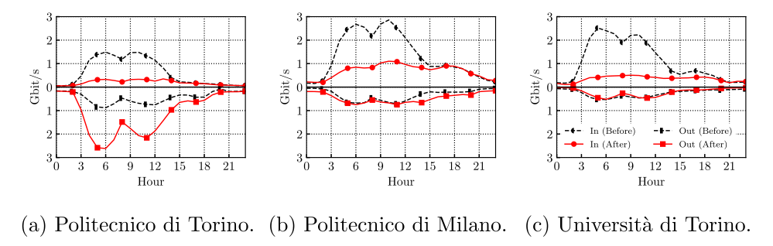
The traffic from 3 large Italian universities
Universities are closed during the lockdown:
-> Incoming traffic drops
Outgoing Incoming
Outgoing Incoming
PoliTO is peculiar: has an in-house remote teaching infrastructure
-> The outgoing traffic explodes

Slide 3
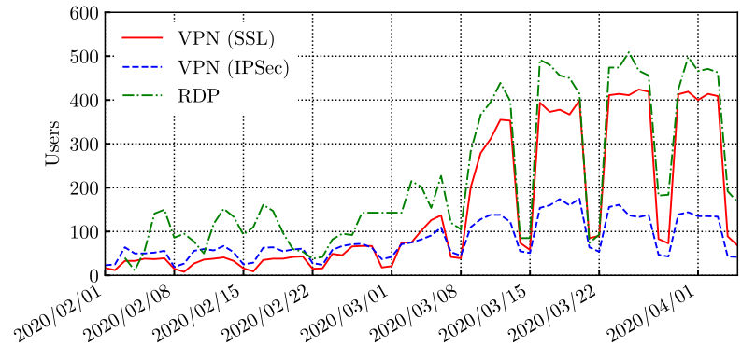
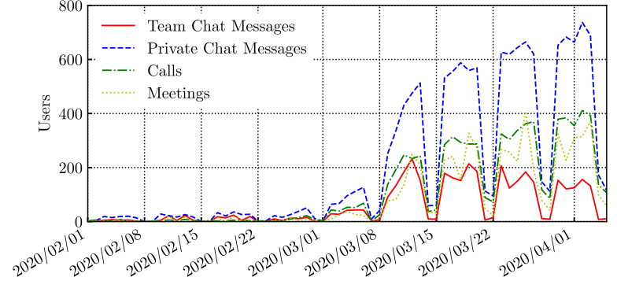
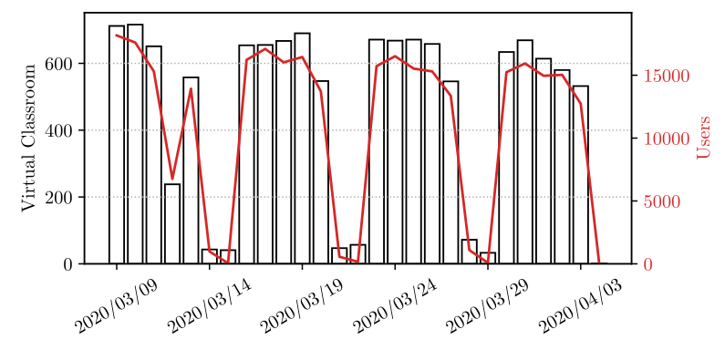
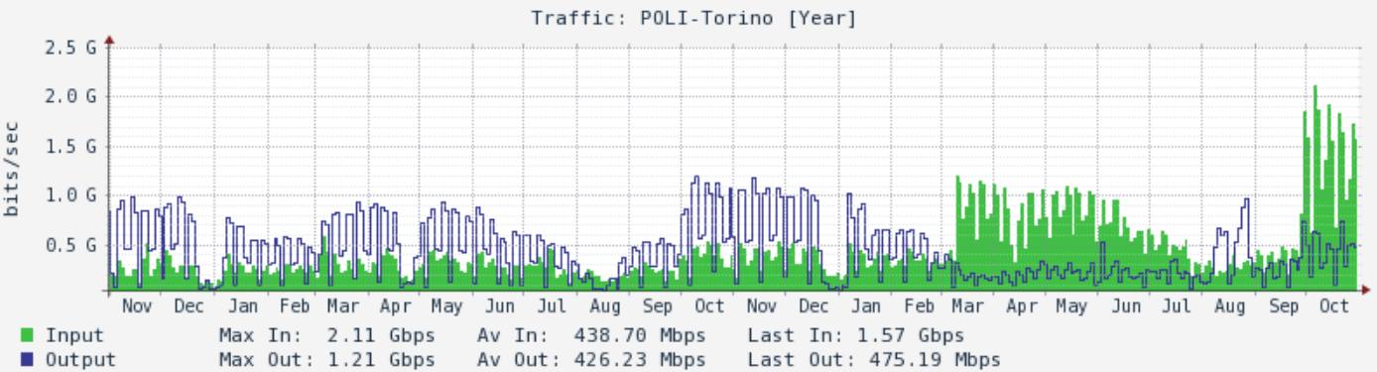
How traffic changed at PoliTO
Remote access (VPN, remote desktop) exploded
Employees and students started using (heavily) Microsoft Teams (cloud-based)
PoliTO launched an in-house platform for remote learning, based on BBB (open-source)
-> 15 k studets and 700 lectures daily
-> Large impact on the Campus' traffic
-> Uplink traffic explodes!
The pattern changes are persistent
Ongoing semester
Pre-Covid Lock Down
Downlink > Uplink Down < Up
Uplink
Downlink

Slide 4
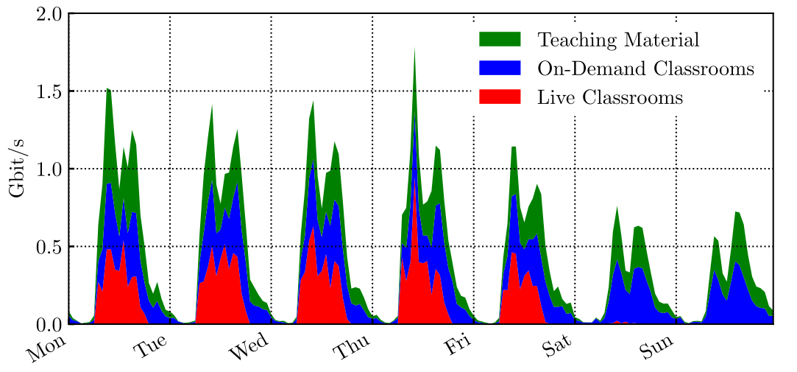
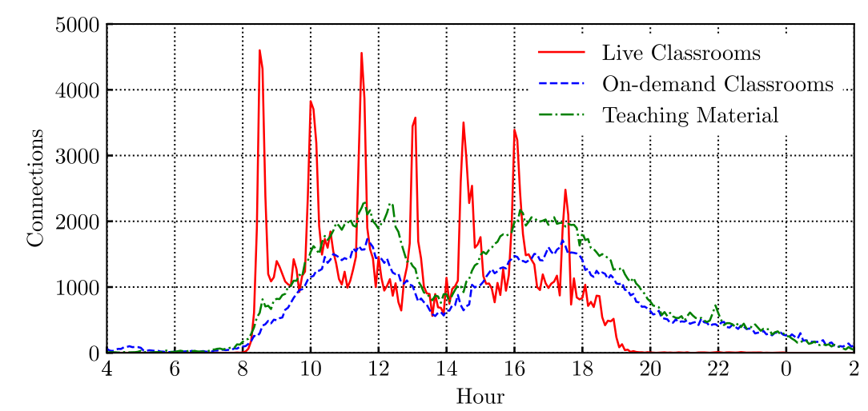
Remote Teaching: We observe new traffic patterns
The live virtual classrooms are scheduled only on weekdays
-> Up 0.5 Gbit/s from 8:30 to 19:00
-> RTP (UDP) traffic – clients are based on WebRTC
Students download on-demand classrooms and teaching material all the week long
-> Peaks of 1.5 Gbit/s during the weekend
-> HTTPS (TCP) traffic
Lectures are scheduled to start every 90 minutes
-> Massive new TCP/UDP flows are born coordinately
-> Clear peaks at the beginning of lectures

Slide 5
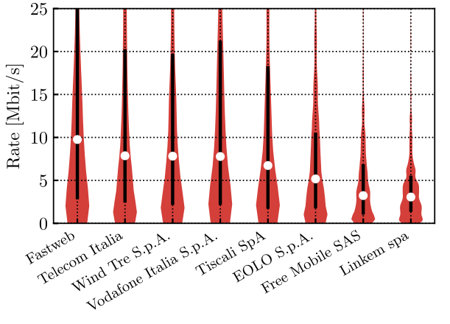
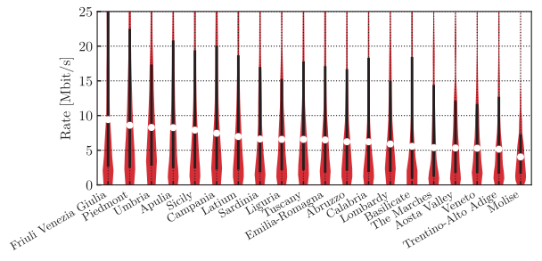
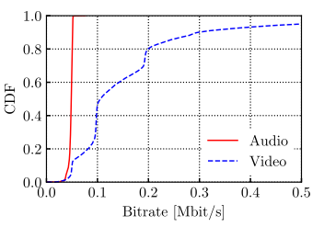
How is the students' network performance
Bitrate for on-demand teaching material (over HTTPS)
Some differences across operators
-> FTTH-based operators are faster :)
-> Mobile and low cost operators are slower :(
Less differences across Italian regions
-> Median bitrate in 5-10 Mbit/s
Live Virtual Classrooms (over RTP UDP)
We did not observe any severe network issue during the lockdown, neither students reported impairments
-> The required bitrate is not very high (less than 0.5 MBit/s)

