Slide 1
Measuring congestion on interconnection links
David Clark, MIT, presenter
Young Hyun, Ricky Mok, Roderick Fanou, Amogh Dhamdhere (now at AWS), kc claffy CAIDA (UCSD)
Matthew Luckie (Wiakato University NZ) ,

Slide 2
Background
Links that interconnect different ISPs require bilateral business negotiation.
When negotiation does not go well (e.g., ISPs vs. Netflix), serious congestion can result.
Since 2016, CAIDA and MIT have been measuring congestion on many interconnection links.
We measure RTT to near and far side of link every 5 minutes and look for periods of increased latency.
We focus on recurring diurnal events, where we can infer congestion with the most confidence.
We can use this data to look for changes since the onset of the pandemic.

Slide 3
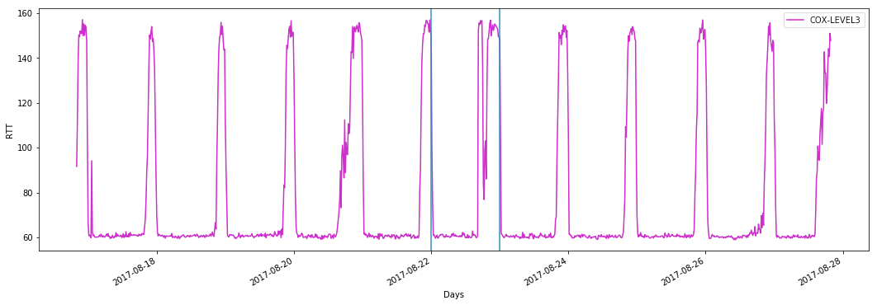
An example of recurring diurnal congestion
Congestion on link from Level3 to Cox.
Near side data omitted for clarity. We check near side as well to detect if congestion is internal to network hosting the vantage point.

Slide 4
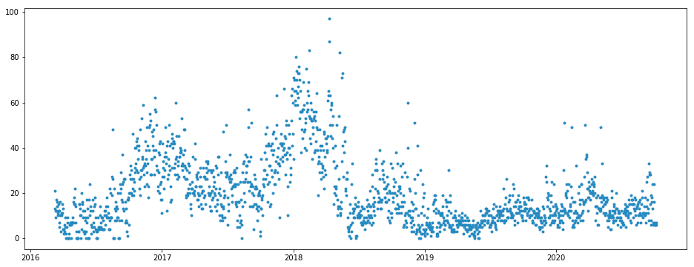
Getting an overview.
For every day, for every link our probes found, we count the number of links that have more than 30 minutes congestion.
Data from Comcast to its peers, transit providers, and major content providers (not customers).
Total number of links in data set: about 475 (the number fluctuates).

Slide 5
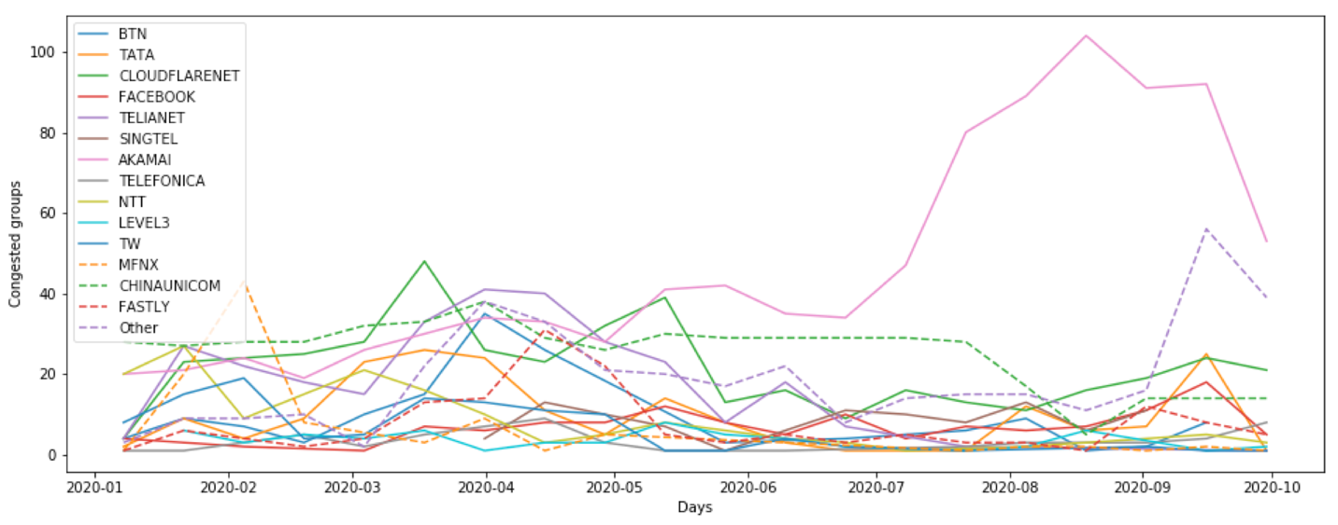
Where does congestion occur?
Links from Comcast to peers, transit providers and content providers.
We divide data into two-week bins, and for each interconnected party, count the number of congested link-days. (In other words, 14 on the vertical axis means that on average the interconnected party had one congested link per day.) We do not normalize here by the number of links. Some parties may have 2 or 3 links; Akamai has well over 50.

Slide 6
Discussion
It appears that in spring of 2020, congestion did appear on various links. It then vanishes. This observation is consistent with the reports from operators that they have moved quickly, together with their interconnected parties, to add capacity to alleviate congestion.
The congestion due to Akamai is perhaps surprising, but in fact represents a small percentage of their total points of interconnection. There may be technical reasons that prevent those links being upgraded, or perhaps they are used for a class of service where congestion does not degrade QoE.
Note: this plot includes all links congested for more then 30 minutes. Whether congestion persisted for 45 minutes or 8 hours does not change what is reported here. The Akamai links were in general not congested for long periods.

Slide 7
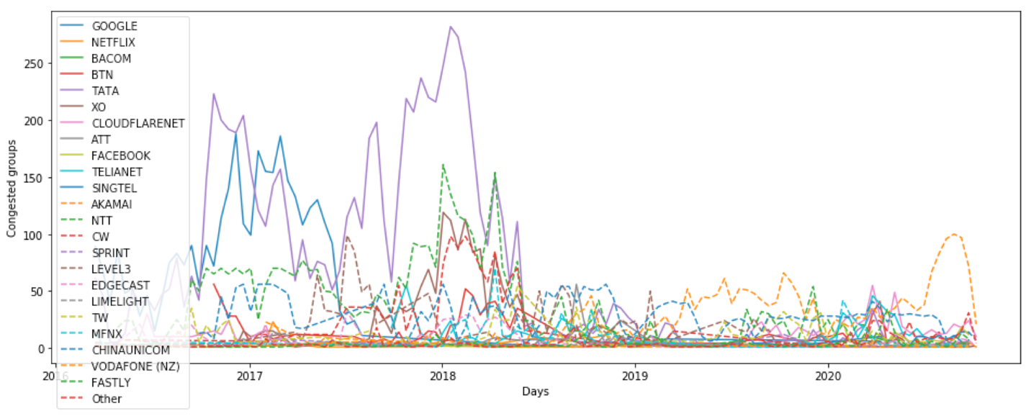
Sources of congestion change over time
Contributions to congestion over the full period of data collection. The primary contributors during the early episodes were Google (Youtube) and Tata, a transit provider being used at the time as an indirect path by content providers. NTT, another transit provider, also shows elevated congestion.

Slide 8
Other US ISPs
Data from other major U.S. ISPs is similar in appearance. Plots are in the paper.

