Slide 1
The Lockdown Effect: Implications of the COVID-19 Pandemic on Internet Traffic
A measurement perspective on ISPs, IXPs, edu network
Notes:
Internetwork = interconnection of independent networks

Slide 2
Lots of data, lots of data crunchers

Slide 3
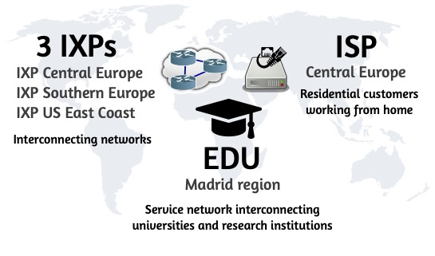
Vantage Points

Slide 4
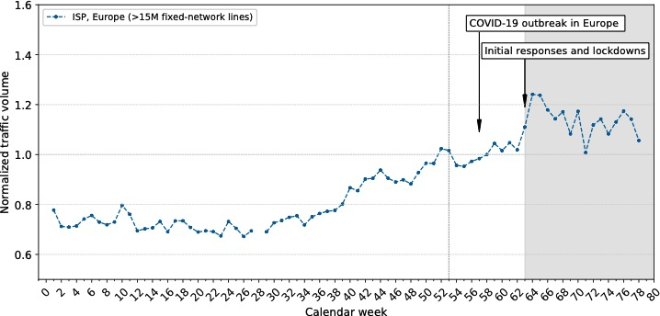
Traffic changes: January 2019 to June 2020
Once the lockdown started the ISP saw an increase in traffic which normally spans over multiple months.

Slide 5
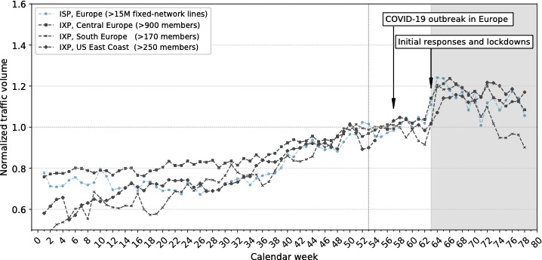
Traffic changes: January 2019 to June 2020
Similar behaviour for the IXPs;
for the IXP CE and IXP US the traffic levels stayed elevated.

Slide 6
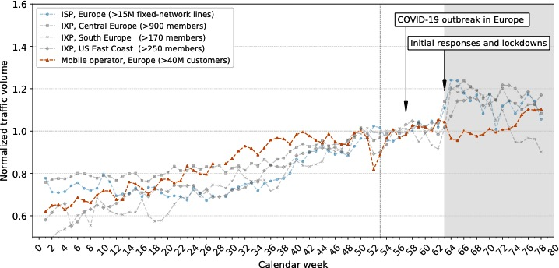
Traffic changes: January 2019 to June 2020
Once the lockdown started mobile traffic decreased measurably and increased ^{as relaxations} ^{started in mid April.}

Slide 7
People change → traffic changes
Changes in people’s lives lead to new traffic patterns
Difference between workday and weekend vanishes
Traffic shift: Applications for remote work, education, VPN, and video conferencing see significant increase in traffic
Educational network: Absence of users can lead to decrease in traffic
Many of the relevant applications are not served by hypergiants
→ only focusing on hypergiants may not suffice
We find, that the human behavior change caused by the COVID-19 pandemic are directly reflected in changes to Internet traffic patterns.

Slide 8
People change → traffic changes
Traffic increase of 15-30% within a few days (Networks usually provision for ≈30% increase per year)
Impact on peak traffic is limited, but valleys get filled
The CE IXP reports capacity increases of 1,500 Gbps
Networks did react quickly to the additional need for capacity
Networks can accommodate sudden changes in demand if they’re planned with spare capacity and quick reaction times.

