Slide 2
Comp491 Project Progress
KUPEP
Umut Günçer, Taluhan Öneş, Batuhan Acar, Yiğit Çırak
Progress meeting 2
19.03.2021

Slide 3
Previous Progress Meeting
Document current system disadvantages and the new system’s requirements.
Search for the appropriate technology (internet enabling and disabling)

Slide 4
Current Progress Meeting
Main goal of this week
Develop a user-friendly interface both for the exam taker and the examiner.
Search for the appropriate technology (internet enabling and disabling)
Description of work
T3.1 (w2) Examine the user interface for similar applications
T3.2 (w2) Design user interface for the examiner
T3.3 (w2) Design user interface for the exam taker
T3.4 (w2) Finalize UI Design document
T2.1 (w2) Search for the appropriate technology (internet enabling and disabling)

Slide 5
Deliverable information
User Interface Design
Technology Search document

Slide 6
Details of this week’s work
Examine the user interface for similar applications
We will examine the user interface for similar applications that are available.
Design user interface for the examiner
We will design a UI for the examiner part of the software considering the ups and downs of the design aspects in the similar applications.
Design user interface for the exam taker
We will design a UI for the exam taker part of the software taking into account the ups and downs of the design aspects in the similar applications
Finalize UI Design document
The design for the exam taker and the examiner will be merged and finalized into one final document
Search for the appropriate technology (internet enabling and disabling)
We will research for how to disable and enable the internet connection during the exam. This knowledge will be used in the software development phase

Slide 7
Details of this week’s work
Search for the appropriate technology (internet enabling and disabling)
We decided to customize a Java written proxy server so that the server would take commands from our examiner program by socket programming and will control the internet traffic accordingly.

Slide 8
Details of this week’s work
Search for the appropriate technology (internet enabling and disabling)
Current Situtation: All the computer connect to internet via the university servers
Internet
Provider
Examiner
Exam taker 1
Exam taker 2
Exam taker N
…

Slide 9
Details of this week’s work
Search for the appropriate technology (internet enabling and disabling)
Our Solution:We will first develop a Proxy server written in Java and configure all the exam taker computers to use this Proxy for their internet connection. The examiner will still reach the internet provider directly
Internet
Provider
Examiner
Proxy Server
Exam taker 1
Exam taker 2
Exam taker N
…

Slide 10
Details of this week’s work
Search for the appropriate technology (internet enabling and disabling)
Our Solution: Then we will develop the examiner program so that it communicates with the Proxy server and enables/disables the internet
Examiner
Internet
Provider
The examiner will control the Proxy,
through his examiner program
Proxy Server
Exam taker 1
Exam taker 2
Exam taker N
…

Slide 11
Details of this week’s work
Search for the appropriate technology (internet enabling and disabling)
The examiner program will also communicate with the exam taker clients to send exam content and exam settings. The exam taker program also communicates with the examiner to submit data and other communication needs such as help button and messaging
Examiner
Internet
Provider
The examiner will control the Proxy,
through his examiner program
The examiner and exam taker communicate.
All settings and exam communications are done this way except for internet enabling/disabling.
Proxy Server
Exam taker 1
Exam taker 2
Exam taker N
…
To achieve this architecture we will need a server to host our Proxy progam, since our Proxy program has to provide the internet connection 24/7

Slide 12
SIMILAR APPLICATION
Since most of the exam softwares are online based, which includes exam questions and answers to be loaded into the system, we were not able to find more than one freely available offline exam software to examine and compare the user interface.
The only one similar software we have found was the SimExams software and It has also released its online version because the offline based software of SimExams is not very useful.

Slide 13
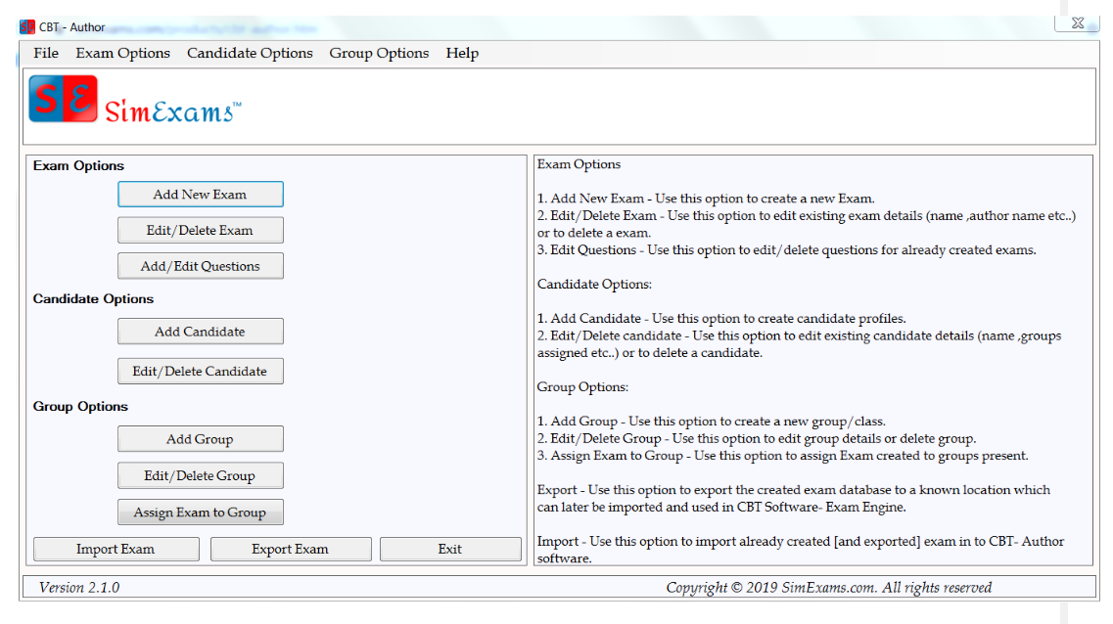
SimsExams - Examiner

Slide 14
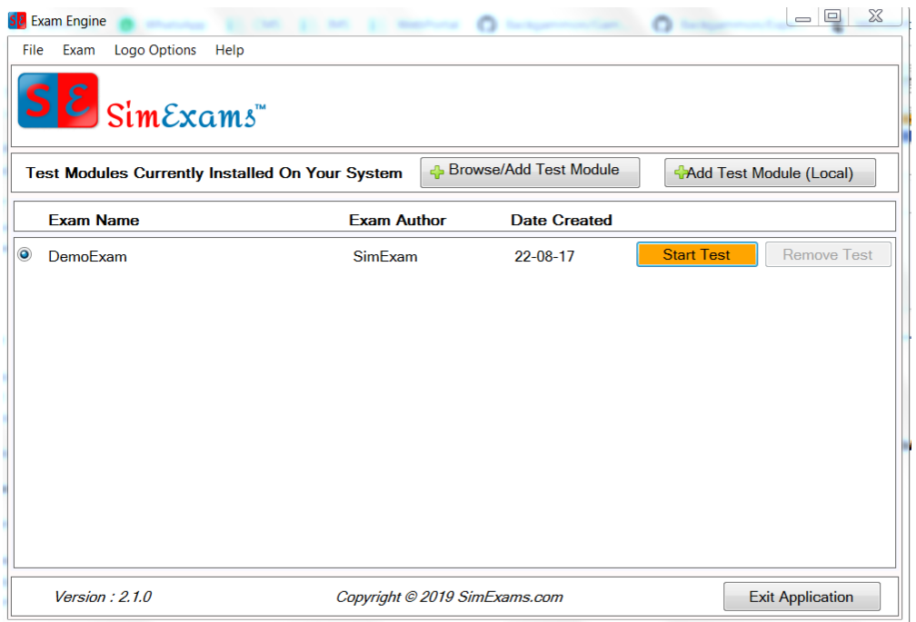
SimsExams – Exam taker

Slide 15
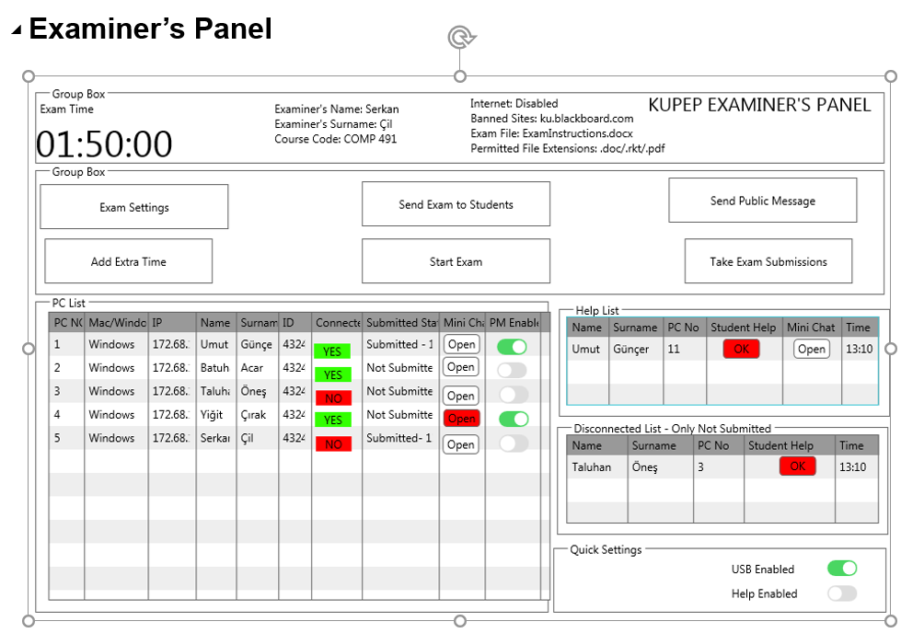
Details of Delivarable Information

Slide 16
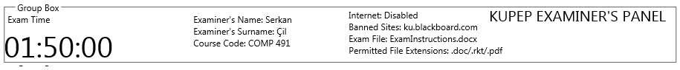
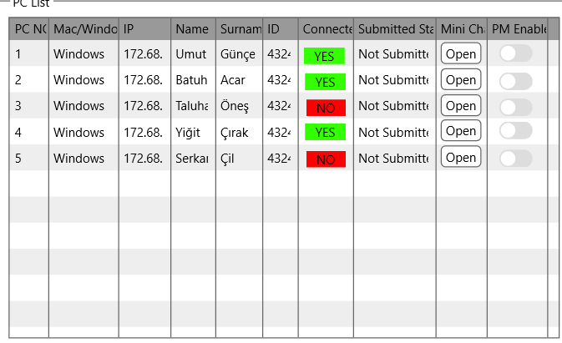
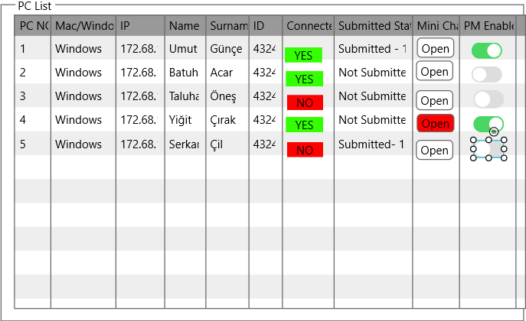
Details of Delivarable Information
PC List
Examiner will see who is connected or not. He can let exam takers to use private message by enabling “PM Enabled” or examiner can directly message to someone by opening “Mini Chat”. If a student submits his work, it will be seen like “ Submitted-13:45”, examiner will see at which time the student has submitted. He will also see the model of computer, ip addresses, name ,surname and id.

Slide 17
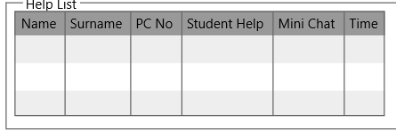
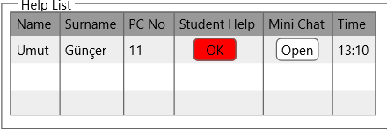
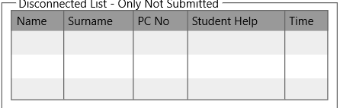
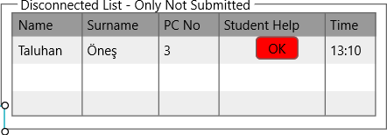
Details of Delivarable Information
Help List
When exam-taker wants help, examiner will see the student in the “Help List” and will see the time the student demanded for help and the PC number.
Disconnected List
This list will be active after the exam starts. If a student has not submitted a work and appears to be disconnected during the exam, it will be seen like this. Again, a button “ok” in red will appear and examiner will press it. Because all the actions will be logged, and examiner must help student for changing the computer in the lab and it can be watched by the logs.

Slide 18
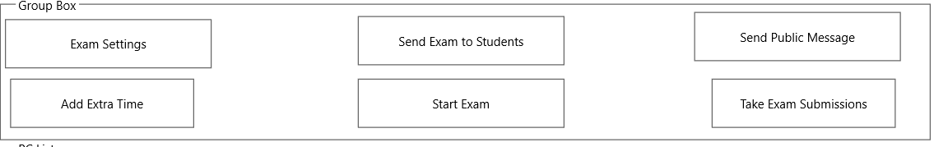

Details of Delivarable Information
Examiner will use these 6 buttons and quick settings. He will adjust the exam content, send exam to students, make announcements, add extra time , start the exam and take exam submissions. When examiner presse “Send Exam to Students” and “Start Exam”, he will be asked for “are you sure you want to Send Exam to Students” and “are you sure you want to Start Exam”. When examiner presses “Take Exam Submissions”, he will be able to reach each folder of exam-takers. He will also change the “usb enabled” and “help-enabled” during the exam.

Slide 19
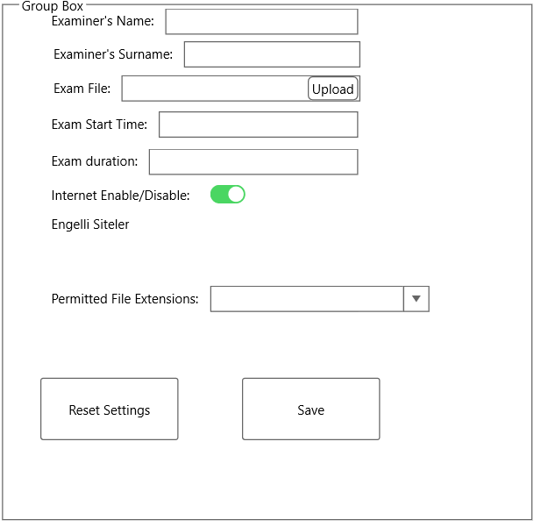
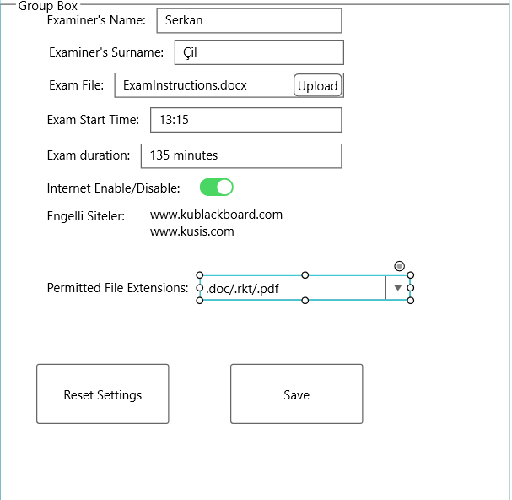
Details of Delivarable Information
Exam Settings
Examiner will write his name and surname. He will upload the exam from this section. He will adjust the exam time and duration. He will control the internet enable/disable, write the banned sites manually and permitted file extensions. When he presses save, he will be asked for “are you sure you want to save”.
He can also reset the settings to do quick changes.

Slide 20
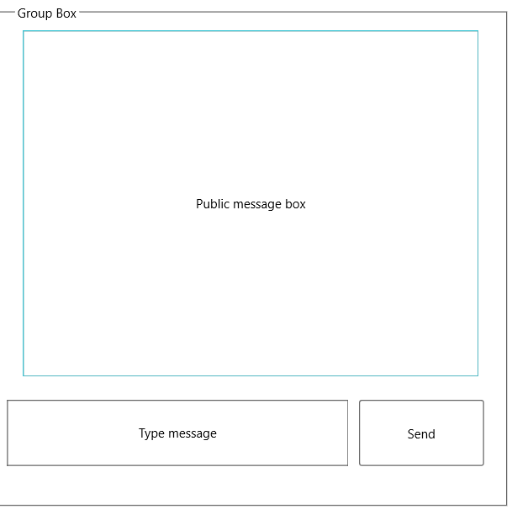
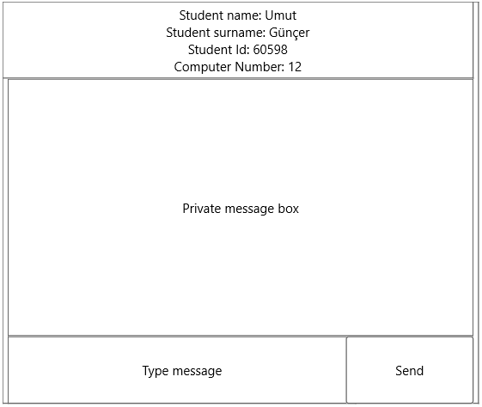
Details of Delivarable Information
Public Message and Private Message
Examiner can make announcements from public message box and he can directly text to a student bt seeing the name, surname, id and computer number. All the messages will be seen in the private message box. Public and Private messages will not be deleted.

Slide 21
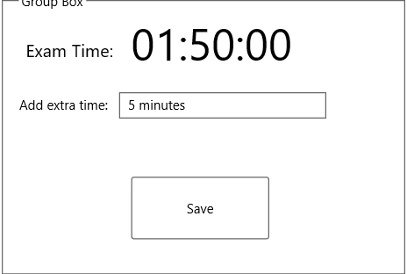
Details of Delivarable Information
Add extra time
Examiner can add extra time during the exam. When examiner presses “Save” button, he will be asked “are you sure you want to save”.

Slide 22
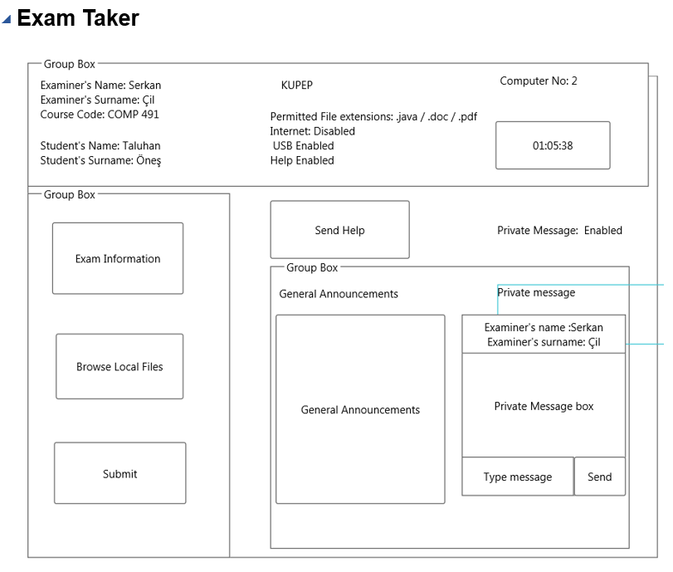
Details of Delivarable Information

Slide 23
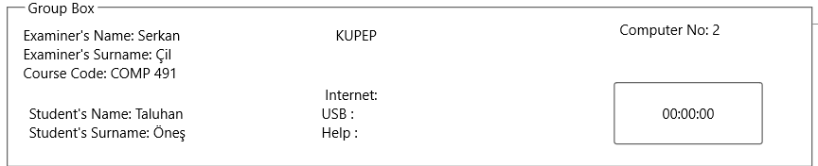
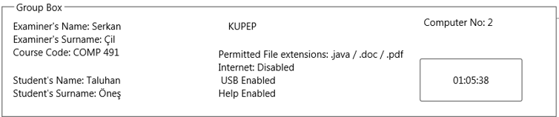
Details of Delivarable Information
After Examiner starts the exam, exam-takers will see internet, usb, help,timer and permitted file extensions. Before and during the exam, exam-takers will be able to see their examiner’s nam, their name and their computer numbers.

Slide 24
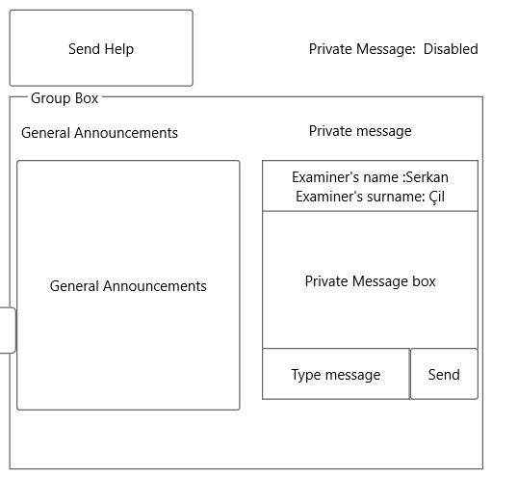
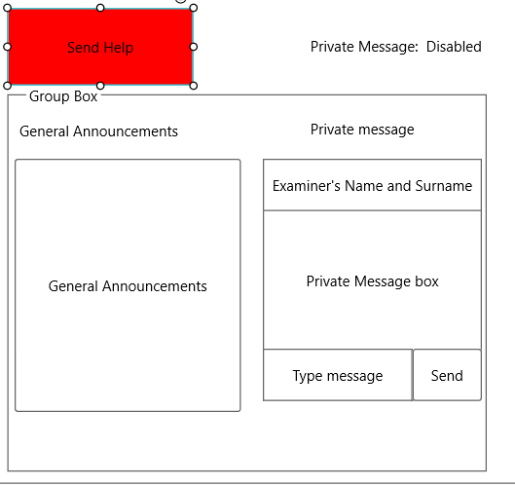
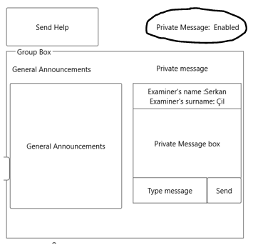
Details of Delivarable Information
Exam taker can demand for help during the exam by pressing "Send Help". When he presses, button will be in red which means student has already asked for help and will wait for examiner's response. Examiner's will see this help in the Help list. When examiner presses "ok" in help list. "Send Help" will return to its default color. Then, examiner may let student to use private message or go next to the student during the exam. Exam-takers will see the general announcements and with the permission of examiner, they can send private message to the teacher.

Slide 25
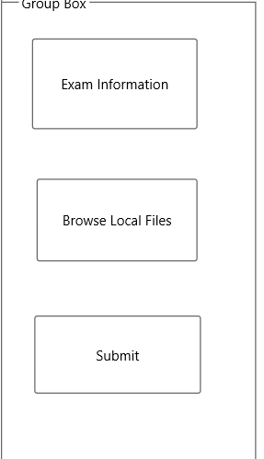
Details of Delivarable Information
Students will reach the “Exam Information”, the examiner uploaded from “Exam Settings” and when they finish their work, they can choose the file from“Browse Local Files”. After they choose the file, they can submit their work by pressing “Submit” button. “Submit” button will ask for “are you sure you want to submit” to check students whether they have chosen the right files

Slide 26
Next Progress Meeting
Next week’s Description of work
T4.1 (w4) Development of the examiner
The examiner side of the project will be developed first, since this is will be the main program that the clients will connect to. The client and the server (examiner) will communicate through the Java network programming. Our program will use a MYSQL database to store the logs. Admins can log in the database and see the logs.
T4.2 (w5) Development of the exam taker
The exam taker’s client program will be developed.
T4.3 (w6) Finalize the programming
Make final developments both for the examiner and the exam takers side. Make sure all the functions have been covered and developed.

Slide 27
References
[1] How to Block Websites on Computer Windows 10?, Retrieved March 10, 2021, from
https://www.iseepassword.com/block-websites-on-windows-10-computer.html
[2] World-Wide Web Proxies, Ari Luotonen, April 1994, Retrieved March 11, 2021, from
https://courses.cs.vt.edu/~cs4244/spring.09/documents/Proxies.pdf

Slide 28
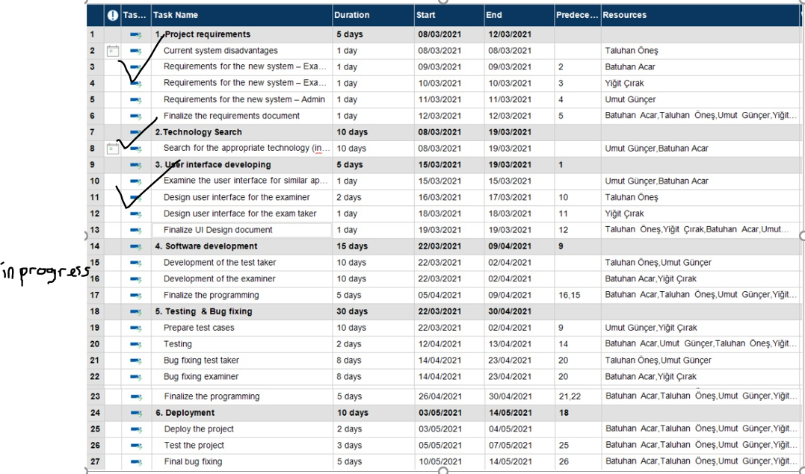
Gantt Chart

Slide 29
