Slide 2
Comp491 Project Progress
KUPEP
Umut Günçer, Taluhan Öneş, Batuhan Acar, Yiğit Çırak
Progress meeting 1
11.03.2021

Slide 3
Previous Progress Meeting
This is the first meeting so there is no previous works yet. We have updated our proposal.
There are not any faced problems yet.

Slide 4
Current Progress Meeting
Main goal of this week
Provide a well-documented requirements document that is subject to minor changes only.
Document current system disadvantages and the new system’s requirements.
Search for the appropriate technology (internet enabling and disabling)
Description of work
T1.1 (w1) Document Current system disadvantages
T1.2 (w1) Requirements for the new system – Examiner
T1.3 (w1) Requirements for the new system – Exam Taker
T1.4 (w1) Requirements for the new system – Admin
T1.5 (w1) Finalize the requirements document
T2.1(w2)Search for the appropriate technology (internet enabling and disabling)

Slide 5
Deliverable information
Functional Requirements document (delivered this week)

Slide 6
Details of this week’s work
Document Current system disadvantages
We will prepare a report that will document the disadvantages of the current system
Requirements for the new system – Examiner
The requirements for the examiner part of the program will be documented. Examiner will be able to manage the exam.
Requirements for the new system – Exam Taker
The requirements for the exam taker part of the program will be documented.
Requirements for the new system – Admin
The requirements for the admin part of the program will be documented. Admin will be able to retrieve program logs.
Finalize the requirements document
All the documents that are produced in the first 4 tasks of this section will be merged into a single functional requirements document.

Slide 7
Details of Delivarable Information
Functional Requirements document
- Current System Disadvantages
We have analysed both from examiners’ perspective and the exam takers’ perspective and defined the current system disadvantages.
- New System – Examiner
We have defined the necessary novelties that our program should have for providing a better ,faster and convenient exam platform for examiners.
- New System – Exam taker
We have defined the necessary changes that exam-takers will no more have problems during the exam and after the exam.
- New System – Admin
We have defined Admin’s duties and authorities which will change the exam platform to a safer, controllable platform.
Technology Search document
burayazıcaz

Slide 8
Details of this week’s work
Search for the appropriate technology (internet enabling and disabling)
We will research for how to disable and enable the internet connection during the exam. This knowledge will be used in the software development phase
Work in progress:
Internet can be blocked by these approaches [1]:
1. Block Websites from Router's Web Interface (Not suitable for our case)
2. Block Websites by Editing Hosts File (Possible but not sufficient )
3. Block Websites using URL Blocker (Not suitable for our case)
Host file solution is good for blocking sites name by name, this is good but we still need a solution that will disable all the internet at once. So we made more research and concluded to use a Proxy server.

Slide 9
Details of this week’s work
Search for the appropriate technology (internet enabling and disabling)
What is a Proxy Server?
In computer networking, a proxy server is a server application or appliance that acts as an intermediary for requests from clients seeking resources from servers that provide those resources.[2]
But we need a Proxy Server that our application can communicate with. So we have decided to implement on in Java. There are already some Java Proxy codes on the internet, we will enhance them with the functionality to communicate with the examiner program.

Slide 10
Details of this week’s work
Search for the appropriate technology (internet enabling and disabling)
Current Situtation: All the computer connect to internet via the university servers
Internet
Provider
Examiner
Exam taker 1
Exam taker 2
Exam taker N
…

Slide 11
Details of this week’s work
Search for the appropriate technology (internet enabling and disabling)
Our Solution:We will first develop a Proxy server written in Java and configure all the exam taker computers to use this Proxy for their internet connection. The examiner will still reach the internet provider directly
Internet
Provider
Examiner
Proxy Server
Exam taker 1
Exam taker 2
Exam taker N
…

Slide 12
Details of this week’s work
Search for the appropriate technology (internet enabling and disabling)
Our Solution: Then we will develop the examiner program so that it communicates with the Proxy server and enables/disables the internet
Examiner
Internet
Provider
The examiner will control the Proxy,
through his examiner program
Proxy Server
Exam taker 1
Exam taker 2
Exam taker N
…

Slide 13
Details of this week’s work
Search for the appropriate technology (internet enabling and disabling)
The examiner program will also communicate with the exam taker clients to send exam content and exam settings. The exam taker program also communicates with the examiner to submit data and other communication needs such as help button and messaging
Examiner
Internet
Provider
The examiner will control the Proxy,
through his examiner program
The examiner and exam taker communicate.
All settings and exam communications are done this way except for internet enabling/disabling.
Proxy Server
Exam taker 1
Exam taker 2
Exam taker N
…
To achieve this architecture we will need a server to host our Proxy progam, since our Proxy program has to provide the internet connection 24/7

Slide 14
Next Progress Meeting
Next week’s Description of work
Examine the user interface for similar applications
We will examine the user interface for similar applications that are available.
Design user interface for the examiner
We will design a UI for the examiner part of the software considering the ups and downs of the design aspects in the similar applications.
Design user interface for the exam taker
We will design a UI for the exam taker part of the software taking into account the ups and downs of the design aspects in the similar applications.
Finalize UI Design document
The design for the exam taker and the examiner will be merged and finalized into one final document
Finalize Technology Search document

Slide 15
References
[1] How to Block Websites on Computer Windows 10?, Retrieved March 10, 2021, from
https://www.iseepassword.com/block-websites-on-windows-10-computer.html
[2] World-Wide Web Proxies, Ari Luotonen, April 1994, Retrieved March 11, 2021, from
https://courses.cs.vt.edu/~cs4244/spring.09/documents/Proxies.pdf

Slide 16
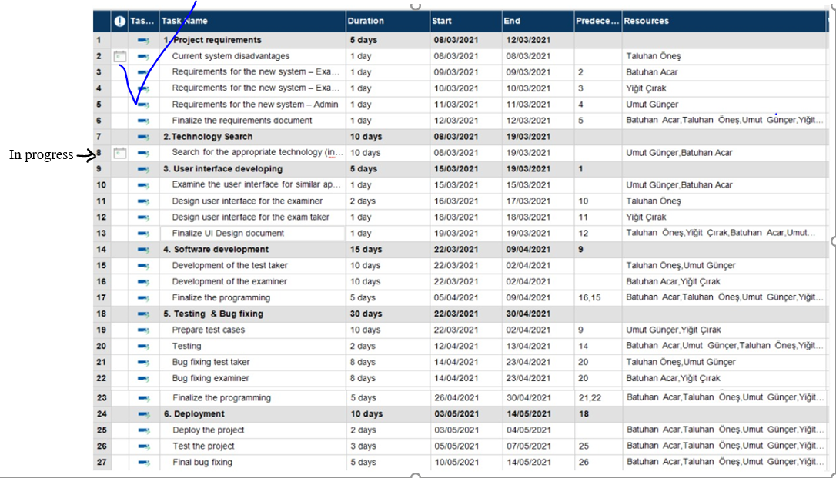
Gantt Chart

Slide 17
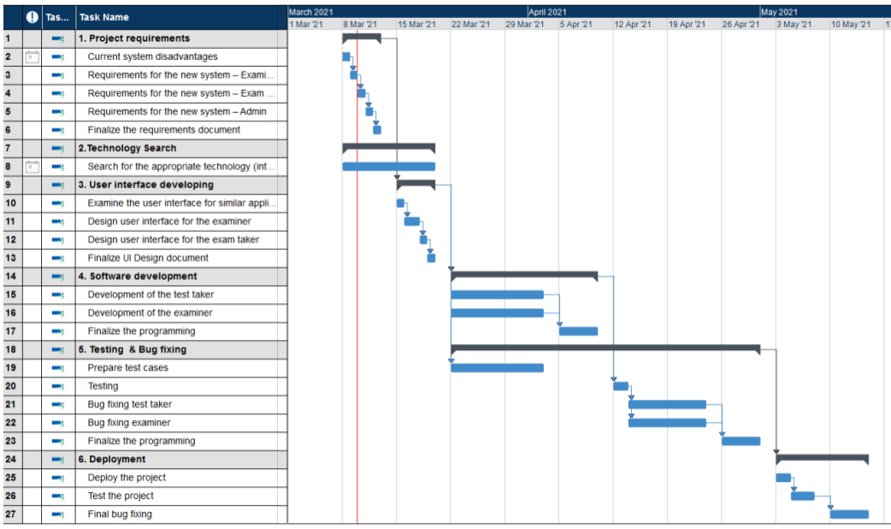
Gantt Chart

