Slide 1
Neural oscillations: Insights from computational modeling
John Huguenard

Slide 2
Neuronal oscillations: functions
Sleep
Generate activity that is independent of sensory input
May play roles in memory consolidation or reprioritization.
Spindles, delta, sharp-wave ripple complexes
Awake behavior
Exploration – theta
Sensory binding & attention – gamma
Sensory discrimination – olfaction
Pathology
Epilepsy
Parkinson’s disease

Slide 3
Non-linearities and oscillations

Slide 4
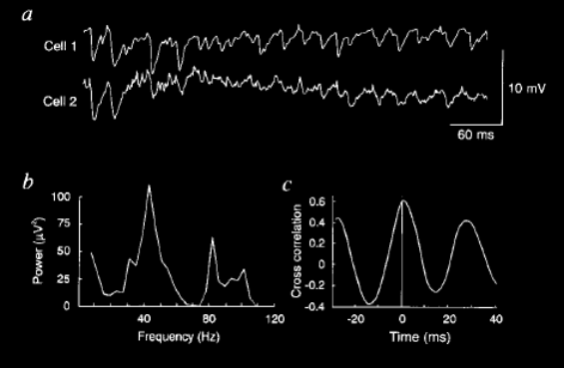
Gamma oscillations develop in cortical networks in absence of excitatory connectivity
Glutamate application, synaptic excitation blocked
Whittington et al, 1995
Notes:
Glutamate application, in presence of ionotropic iGluR blockers. Two CA1 neurons depolarized to make IPSPs larger. Other experiments show this to be mGluR dependent.

Slide 5
Ring inhibitory networks
Wang and Buzsaki, 1996

Slide 6
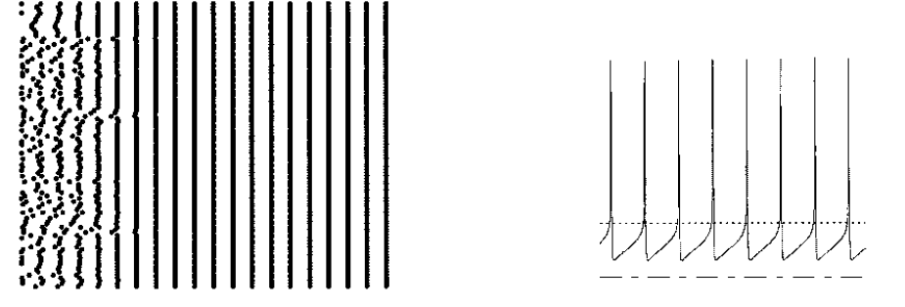
Uniform network, random initial conditions: perfect synchrony
Wang and Buzsaki, 1996

Slide 7
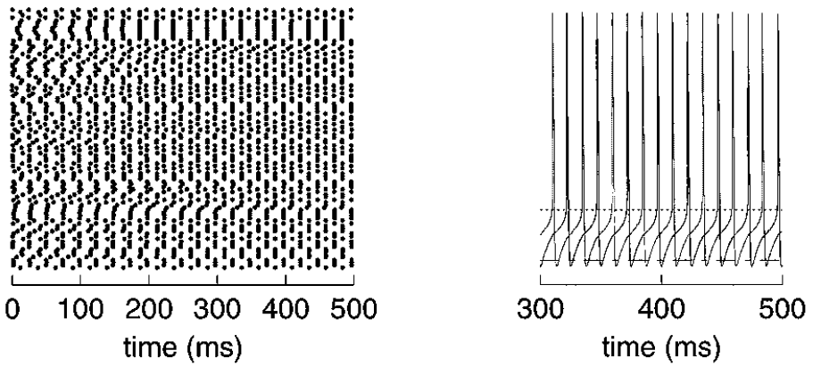
Uniform network, random initial conditions, deep AHP: antiphase synchrony
Wang and Buzsaki, 1996

Slide 8
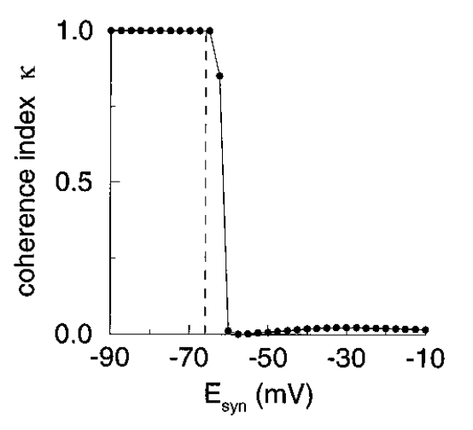
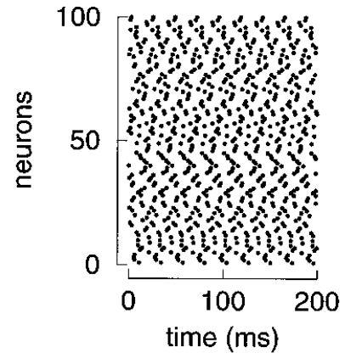
Synchrony as a function of E-syn
E-syn = 0 : ≈ excitatory
Wang and Buzsaki, 1996

Slide 9
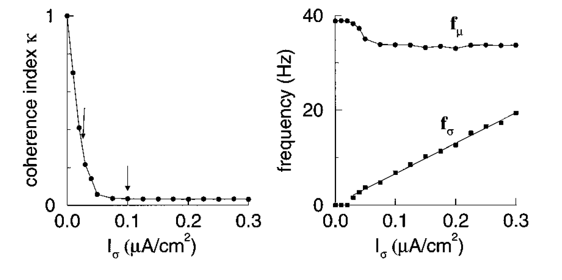
Heterogeneous network: Gamma is common output, while coherence is not
Wang and Buzsaki, 1996

Slide 10
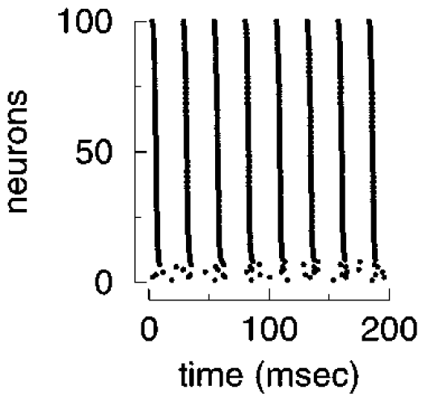
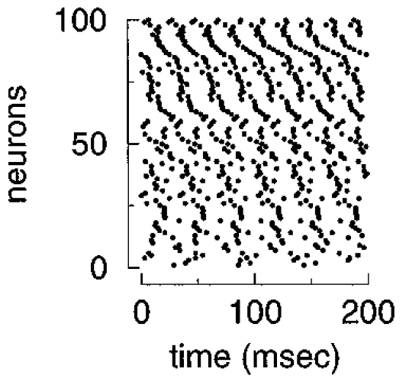
Heterogeneous network: Gamma is common output, while coherence is not
Wang and Buzsaki, 1996

Slide 11
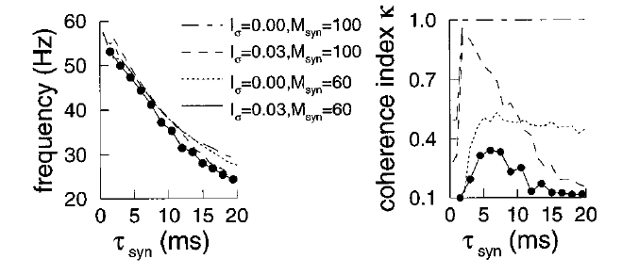
Dependence on synaptic properties: Time constant of decay governs network frequency, and indirectly, coherence
Wang and Buzsaki, 1996

Slide 12
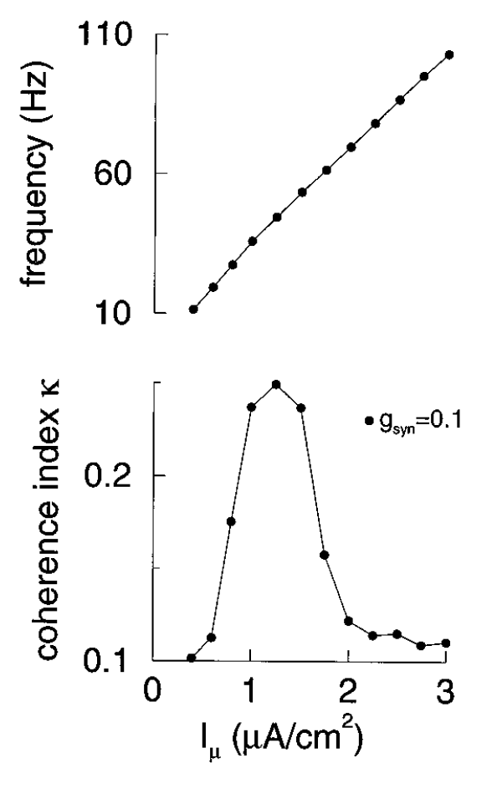
Coherence only in gamma frequencies
Wang and Buzsaki, 1996

Slide 13
Neurons as active computational devices

Slide 14
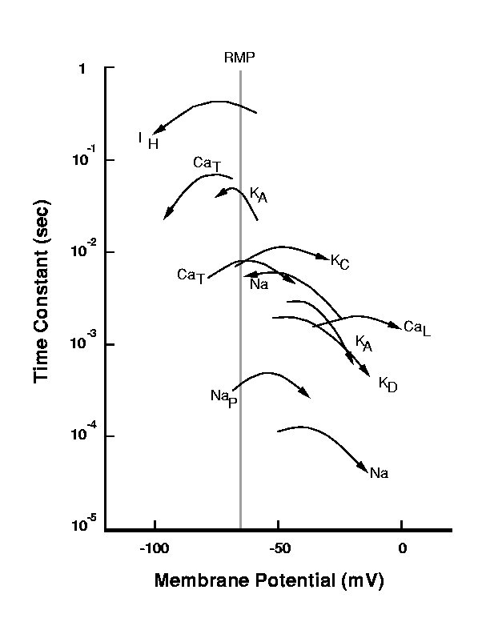
Dynamics of peri-threshold voltage gated ion channels
Courtesy W Lytton

Slide 15
Bistable membranes

Slide 16
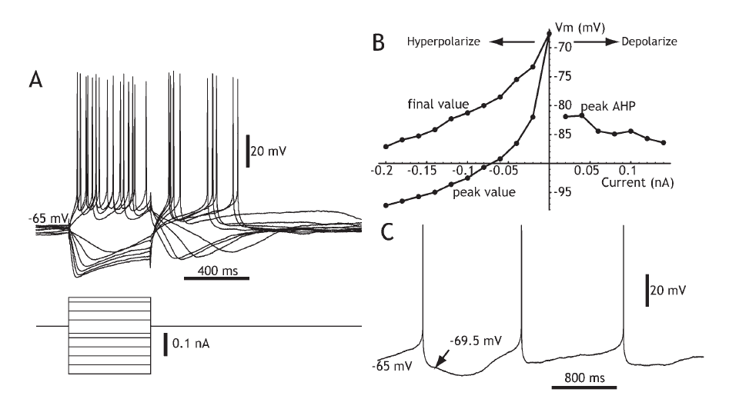
Membrane bistability from non-linearity of ion channel gating
Wilson, 2005

Slide 17
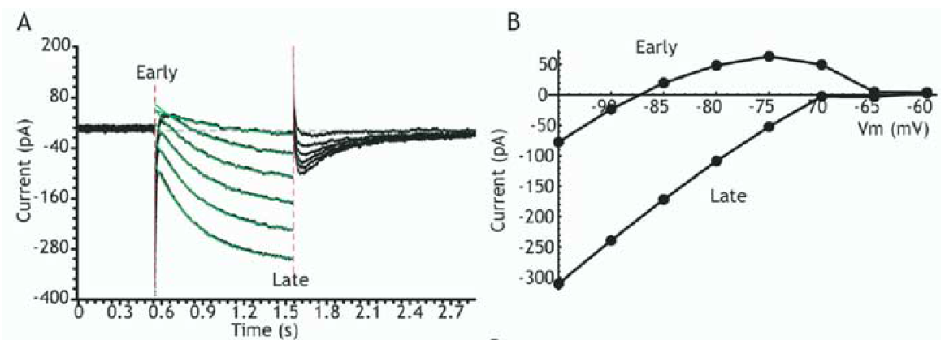
Membrane bistability from non-linearity of ion channel gating
Wilson, 2005

Slide 18
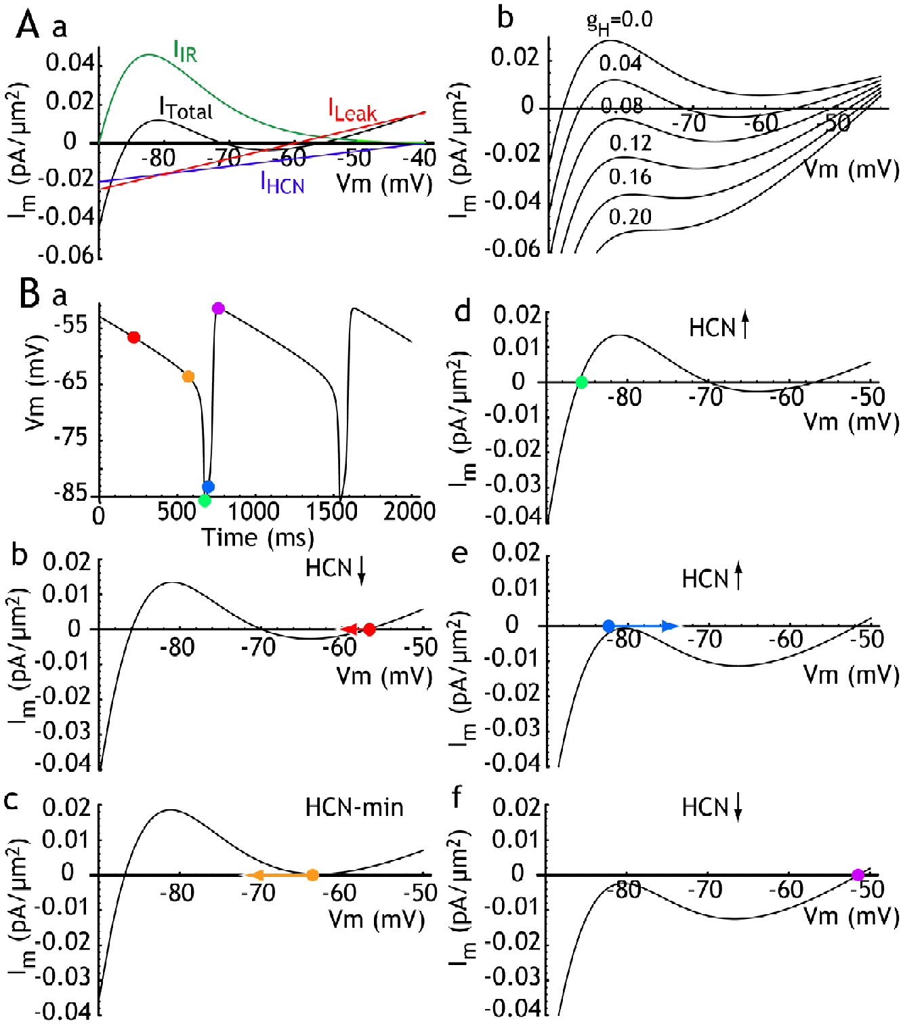
Membrane bistability from non-linearity of ion channel gating
Wilson, 2005

Slide 19
Thalamic oscillators, cells and circuits

Slide 20
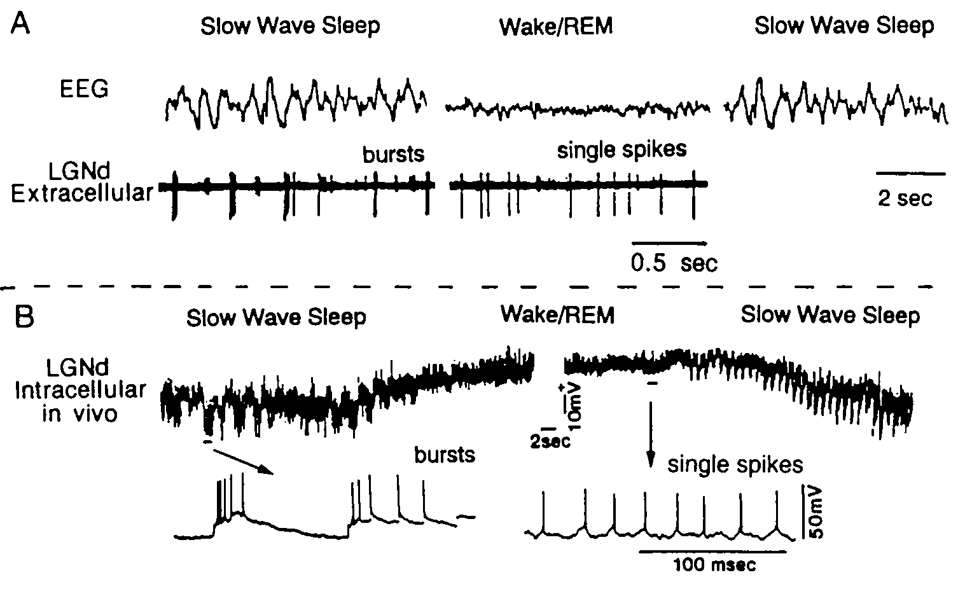
Relay neuron have state dependent firing modes
McCarley, Benoit & Barrionuevo, J. Neurophysiol, 50:798, 1983. Hirsch, Fourment & Marc, Brain Res. 259:308, 1983

Slide 21
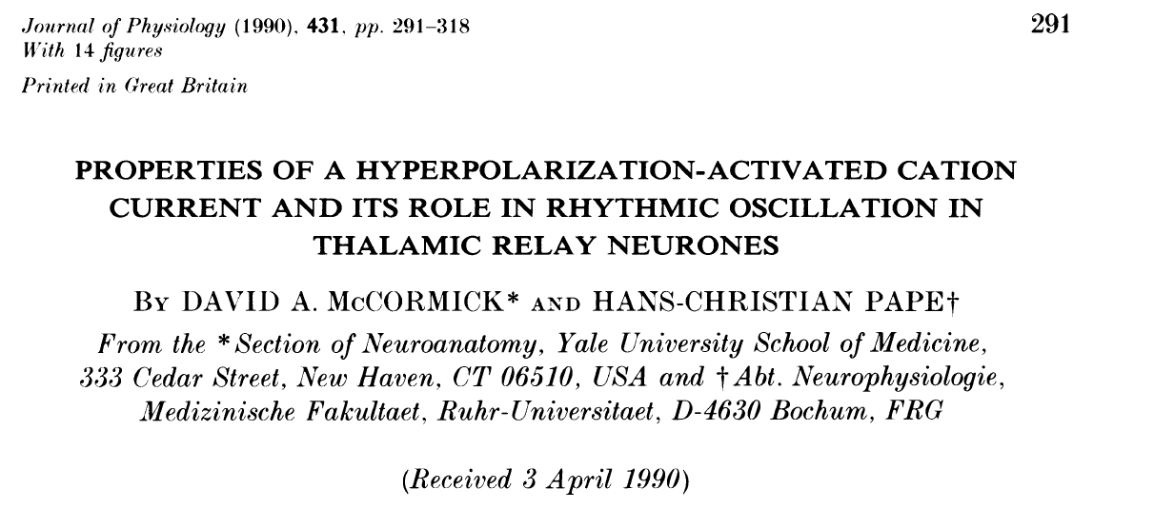
I-h, and its rhythogenic properties

Slide 22
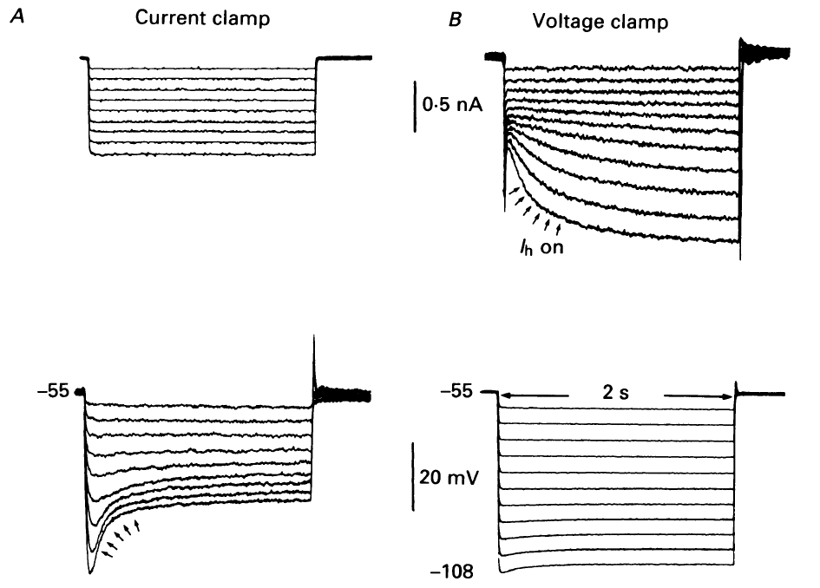
I-h, a hyperpolarization activated current with interesting dynamics
McCormick and Pape, 1990a

Slide 23
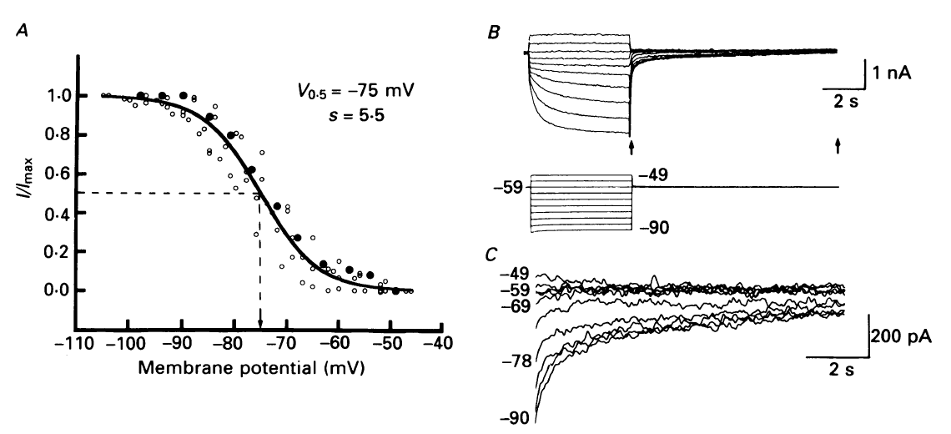
Properties of I-h, steady state activation
McCormick and Pape, 1990a

Slide 24
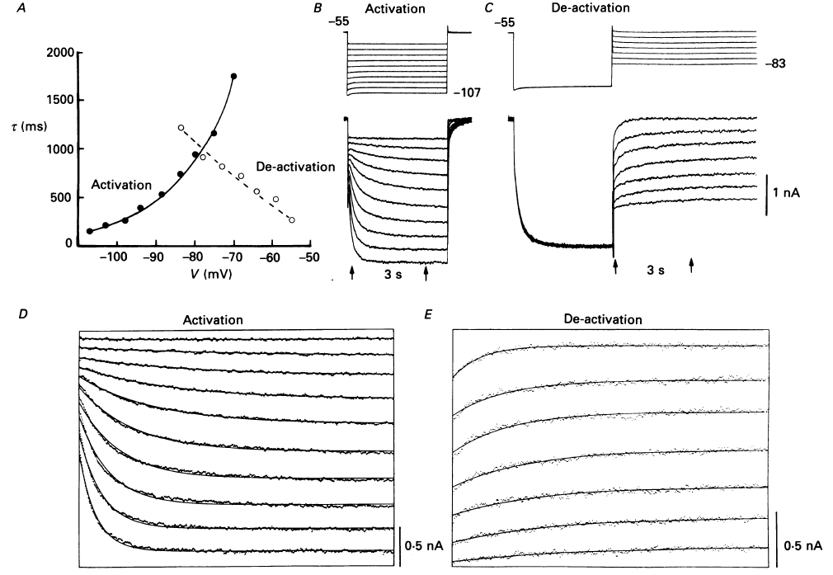
Properties of I-h, activation/deactivation rates
McCormick and Pape, 1990a

Slide 25
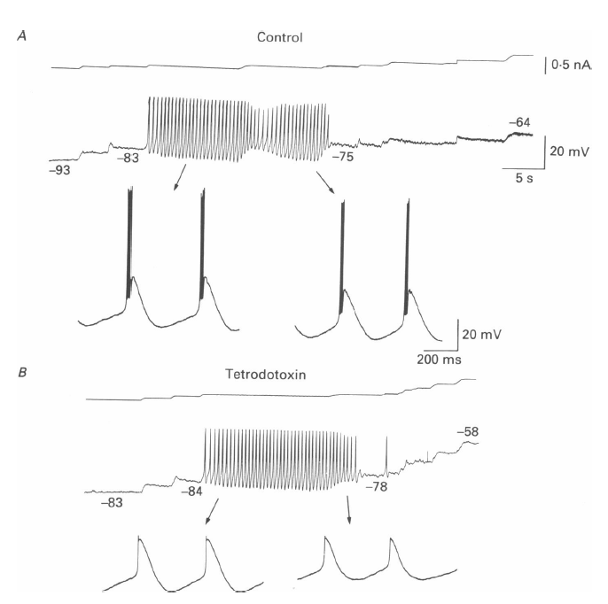
Thalamic relay neurons are intrinsic oscillators: dependence on sub-threshold conductances
McCormick and Pape, 1990a

Slide 26
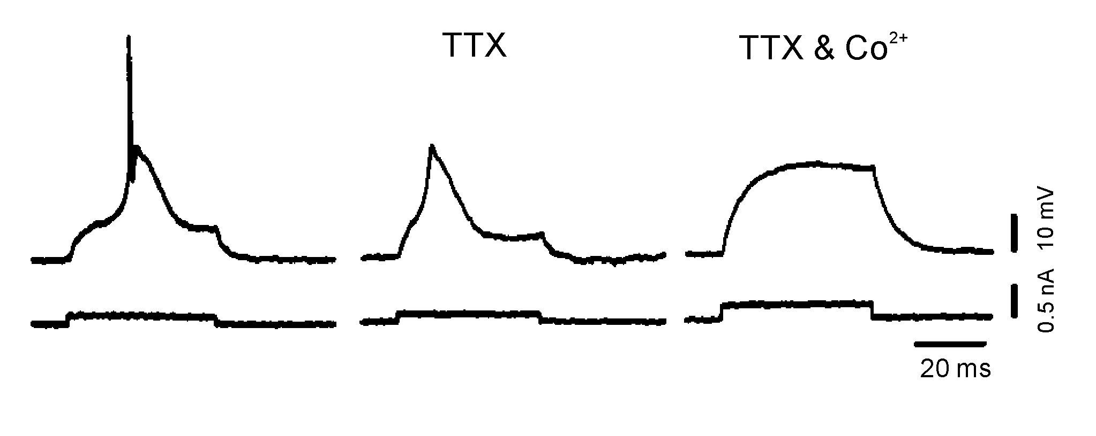
Basis of the burst: the low threshold spike (LTS)
Llinás and Jahnsen, Nature 297:406, 1982

Slide 27
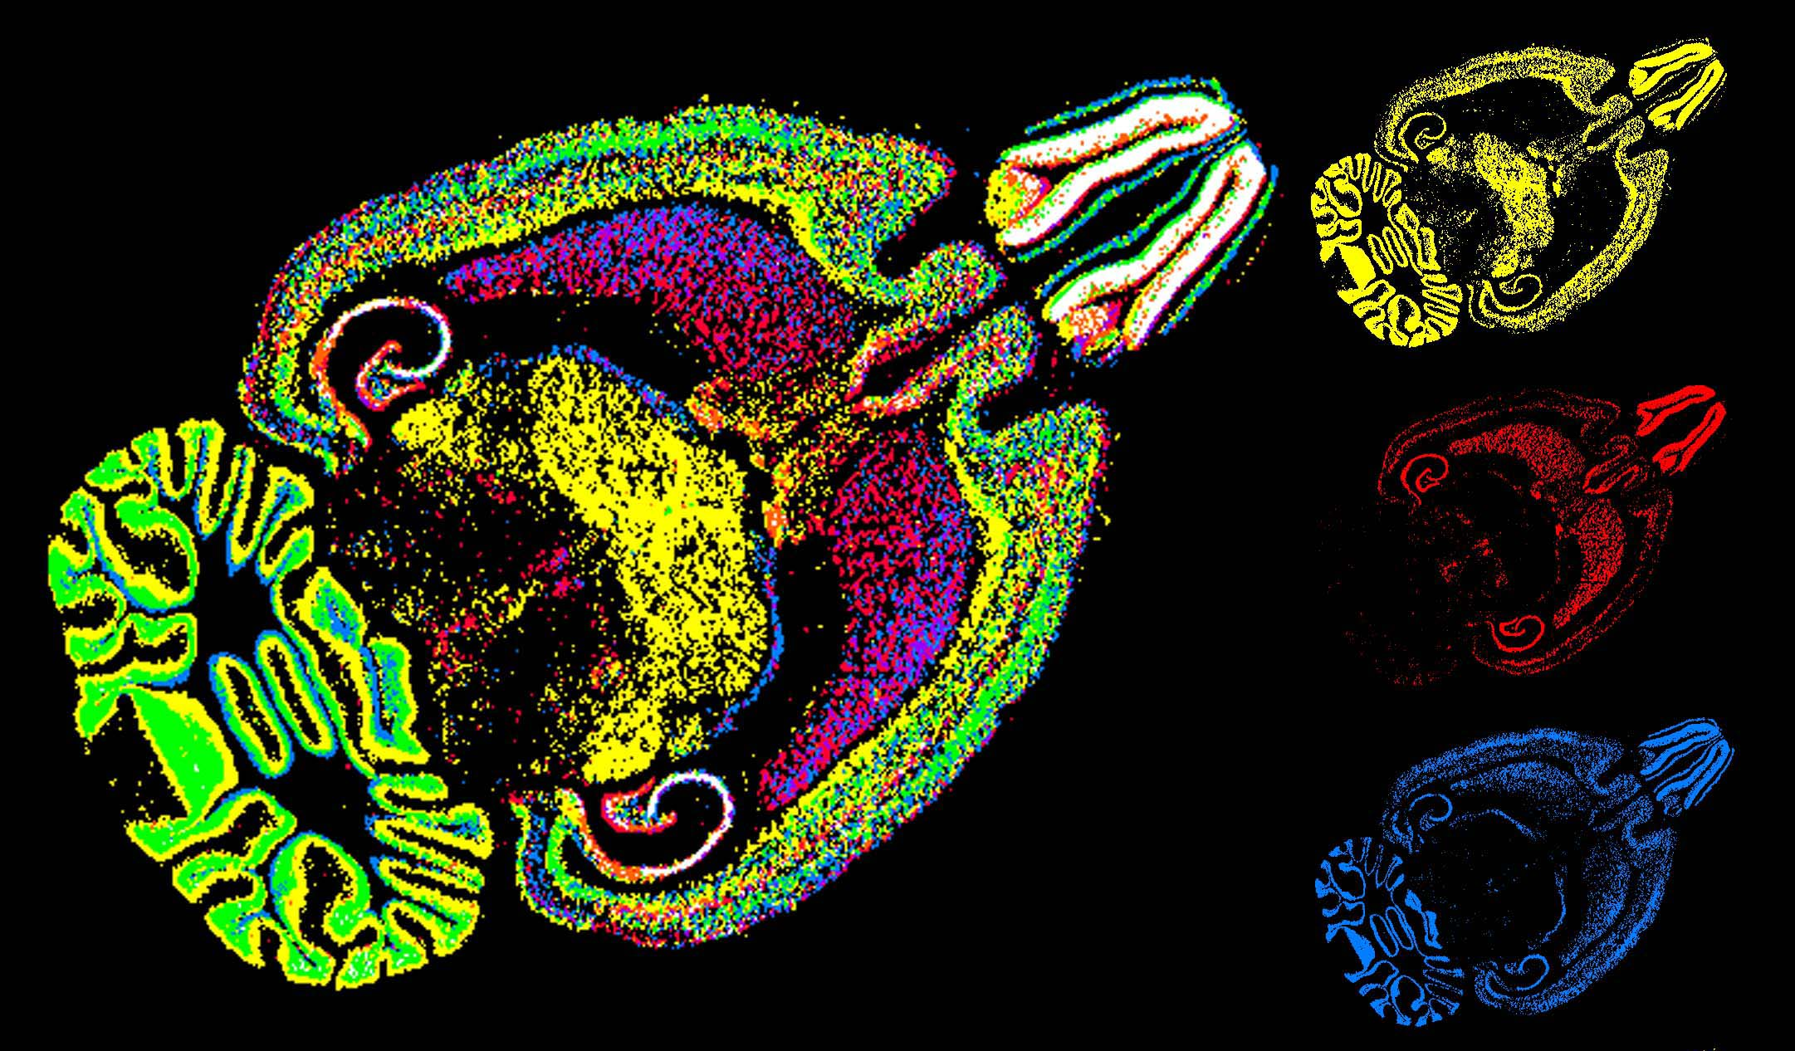
T type calcium channel genes in thalamus
Notes:
A1g in dt, ai,h in nrt , leads to differences in bursts
A1g yellow, a1h red, a1i blue

Slide 28
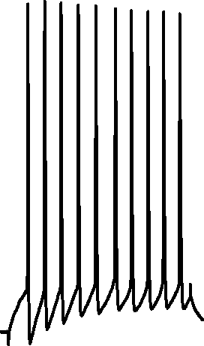
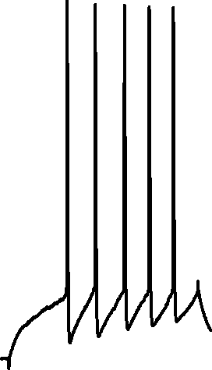
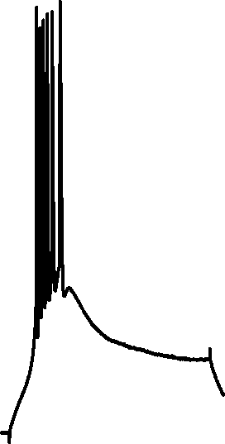

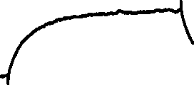
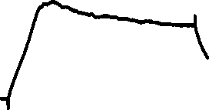
Paradoxical excitability in thalamic relay neurons
Huguenard and Prince, J Neurosci 1992
Notes:
-55 through –75 mV

Slide 29
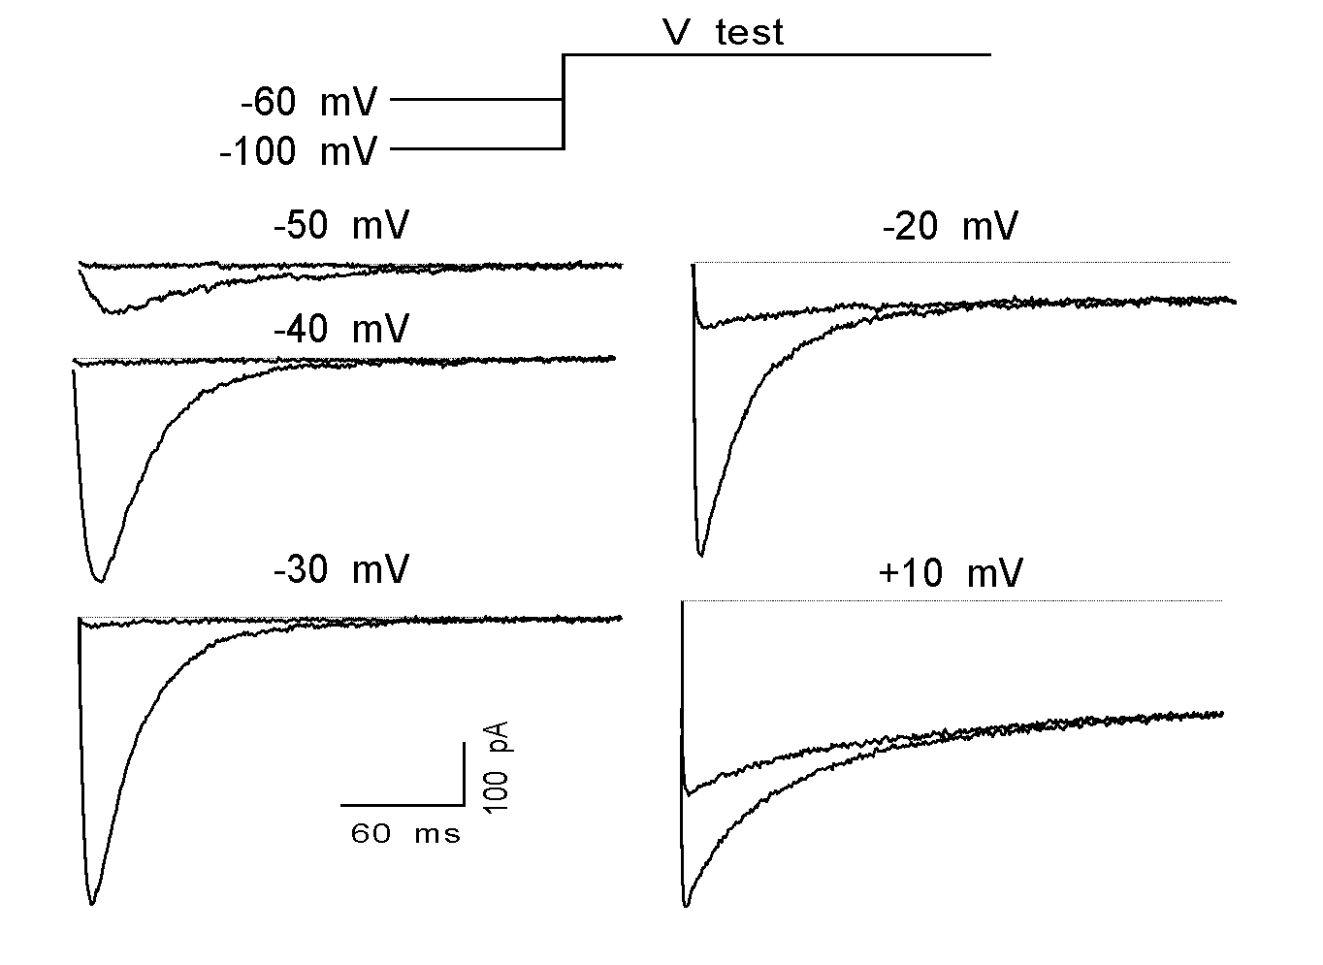
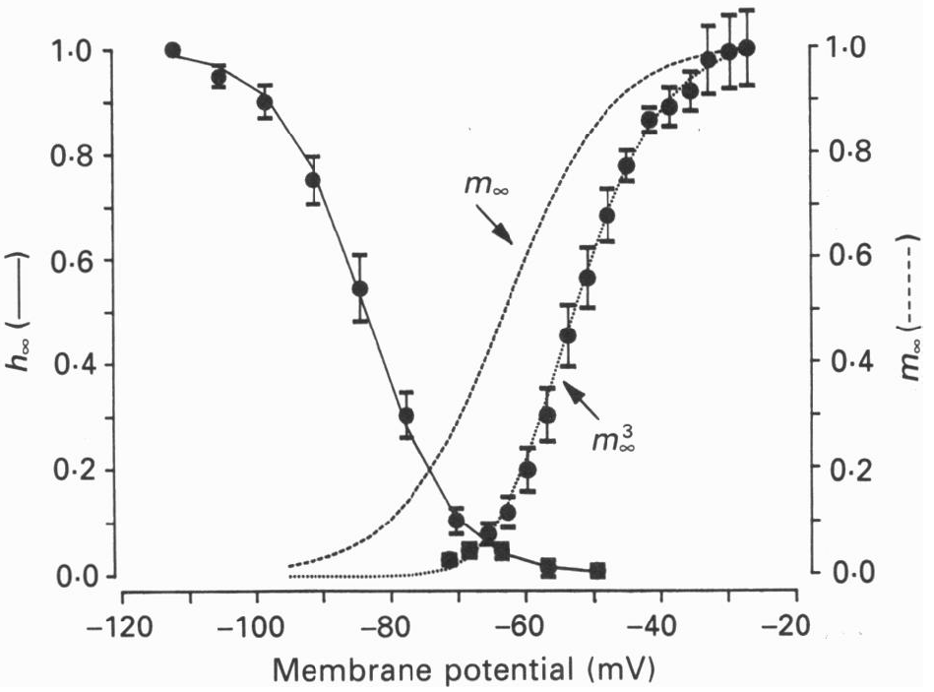
Isolation of I_{T} based on voltage clamp protocols: Hodgkin-Huxley-esque approach
Huguenard and Prince, J Neurosci 1992,
Coulter, *Huguenard and Prince, J. Physiol 1989

Slide 30
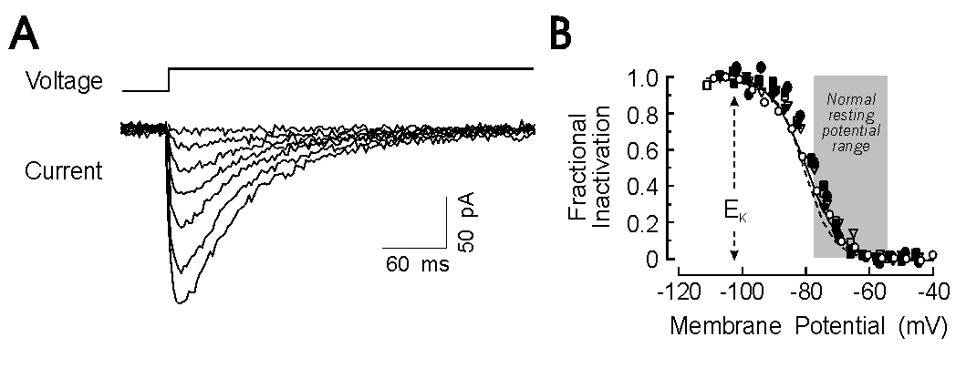
I-t is significantly inactivated at rest

Slide 31
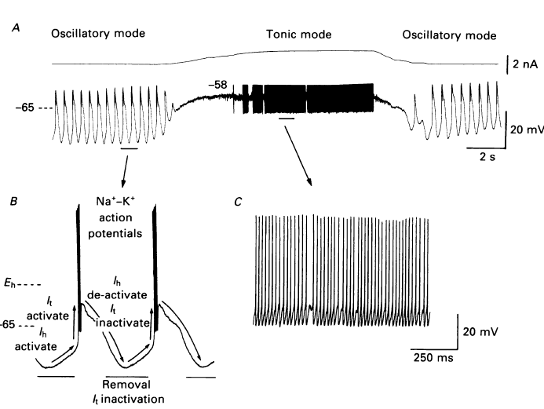
I-h is partner with I-t in intrinsic oscillations
McCormick and Pape, 1990a

Slide 32
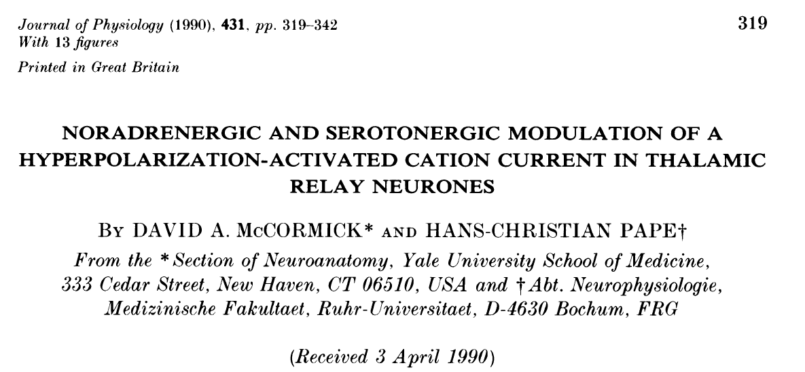
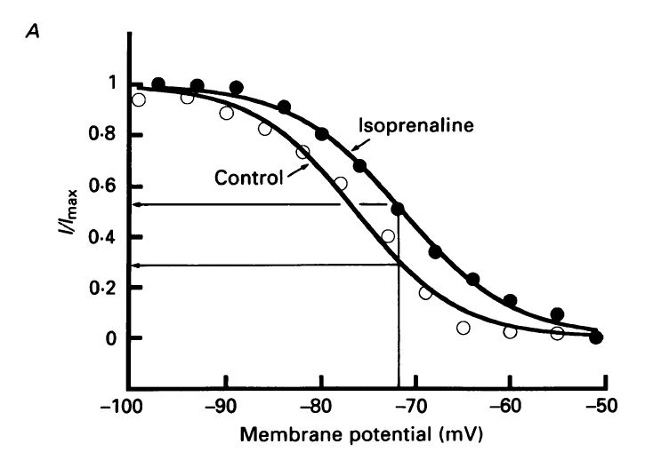
I-h is modulable

Slide 33
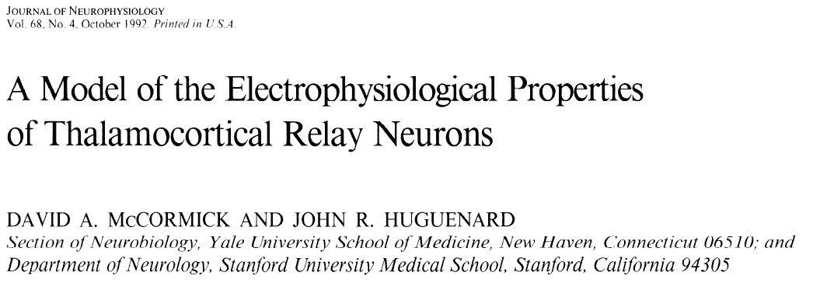
There are models available for cells with complex properties

Slide 34
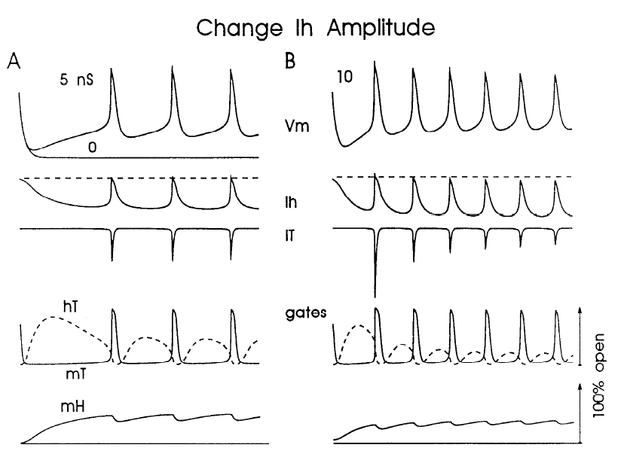
Can systematically vary different parameters to determine, e.g. sensitivity and necessity
McCormick and Huguenard, 1992

Slide 35
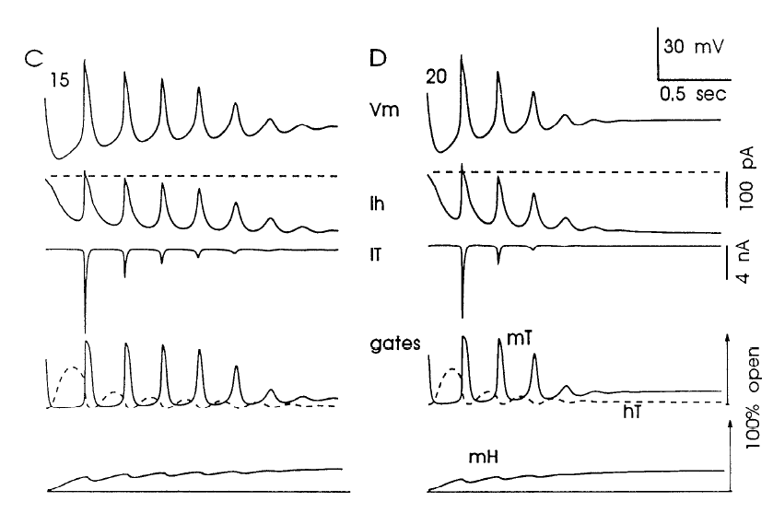
Too much of a good thing?
McCormick and Huguenard, 1992

Slide 36
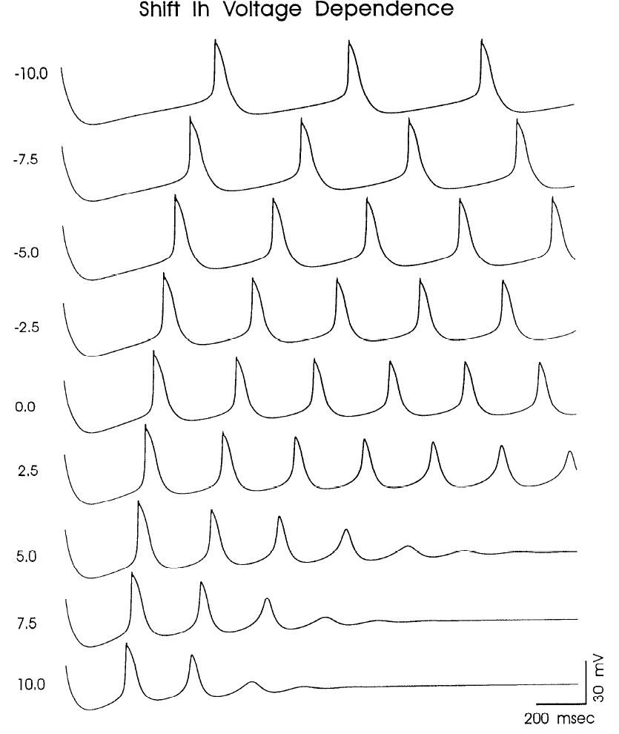
Modulation of I-h modifies network strength and structure
McCormick and Huguenard, 1992

Slide 37
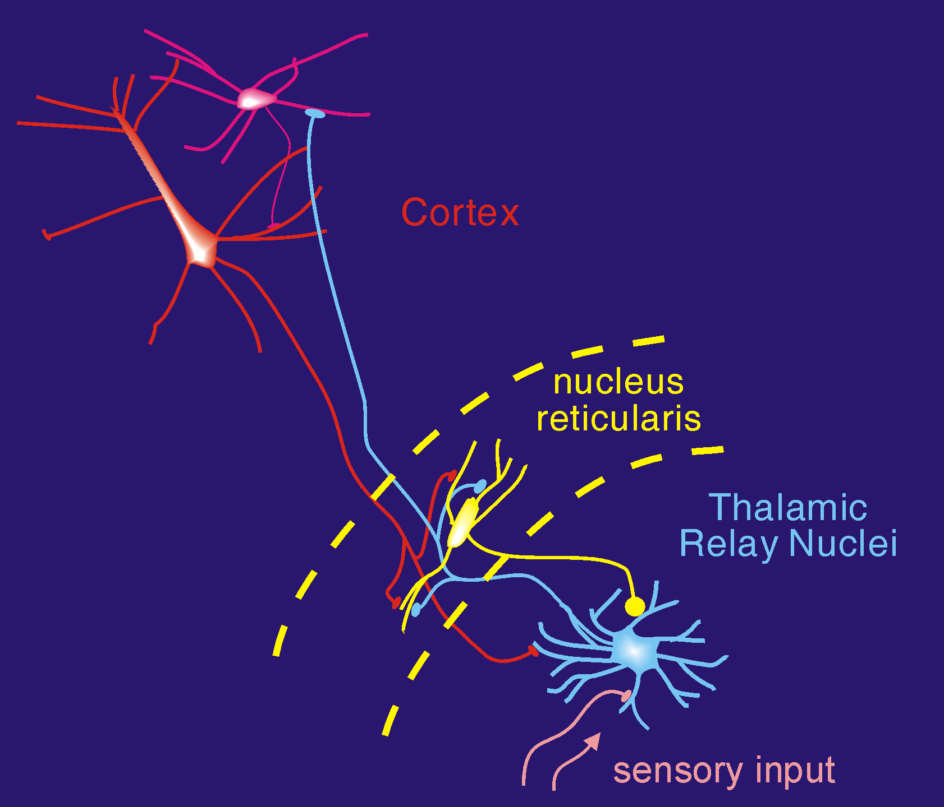
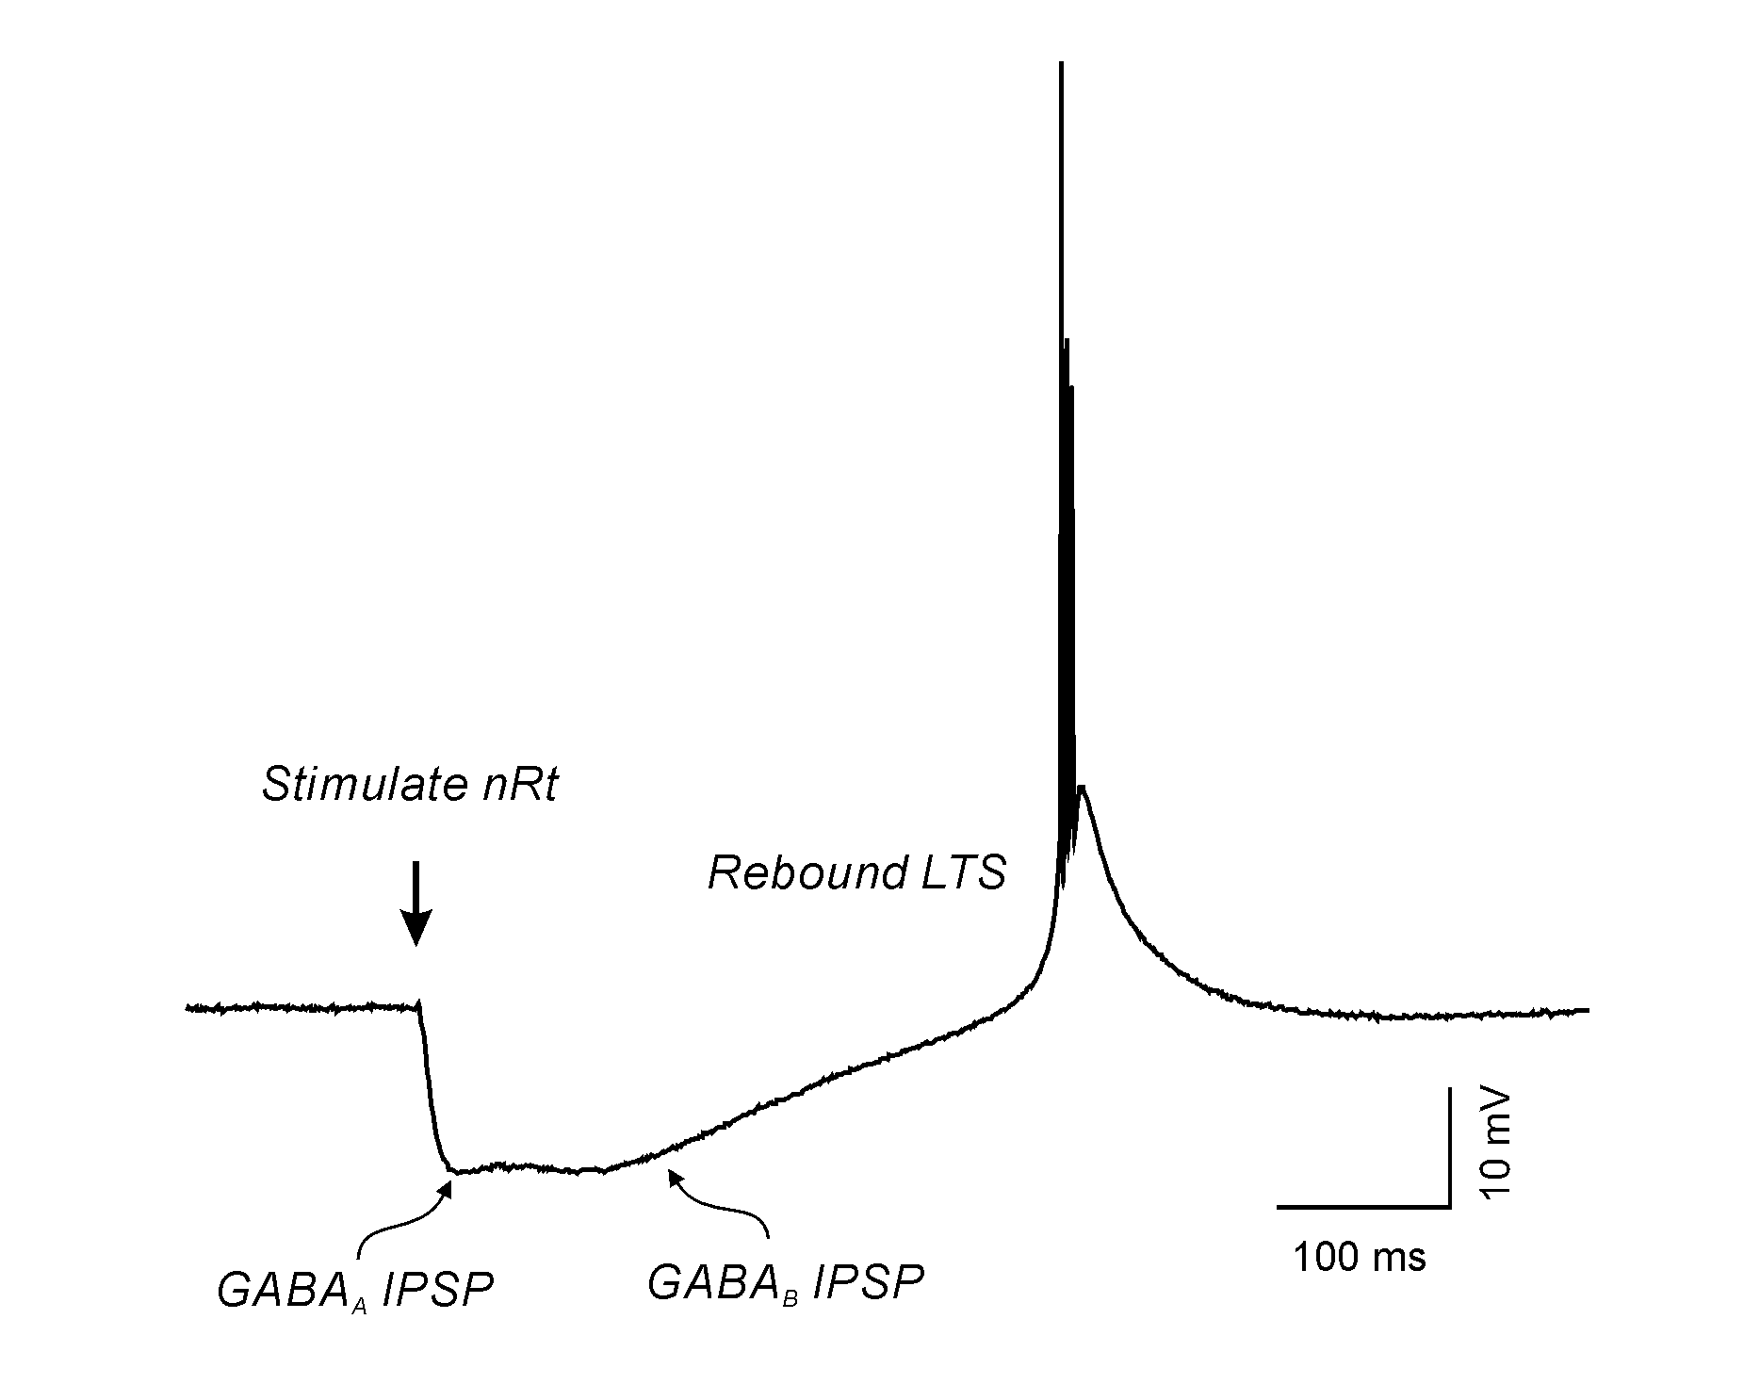
Post inhibitory rebound in thalamus and sleep rhythms
When active, thalamocortical cells receive recurrent (feedback) inhibition from neurons of the thalamic reticular nucleus (TRN). The inhibitory feedback in turn, leads to post-inhibitory rebound low threshold spike, re-excitation of TRN, and recurrent network oscillations, such as those occurring during spindle-stage sleep.

Slide 38
Summary, oscillations
Oscillations can be generated in neural networks
through synaptic interactions, usually inhibitory
Through the intrinsic voltage dependent properties of neural elements

Slide 39
Summary, oscillations
Recurrency promoted by membrane bistability
Between depolarized and hyperpolarized states
The latter is associated with activity
the former is generally associated with quiescence
Bistability is a result of non-linearities in the V/I relationship of neurons

Slide 40
Summary, oscillations
Non-linearities in neural membranes
N-shaped I/V curves
Different from passive cells with largely linear I/V curves
N-shaped I/V curves with more than one positive crossing of current axis will have more than one stable point
Interactions with synapses (e.g. inhibition) or voltage gated ion channels (H-channels) result in reentrant transitions between stable states, and ultimately, oscillations

