Slide 1
NEPR208 Synapses, plasticity and learning
Synaptic depression and adaptation
Synaptic facilitation and working memory
Spike time dependent plasticity and long term memory
Heterosynaptic long term depression and network stability
Anti-hebbian plasticity and decorrelation

Slide 2


The visual system adapts to the mean luminance

Slide 3

The visual system adapts to the mean luminance

Slide 4
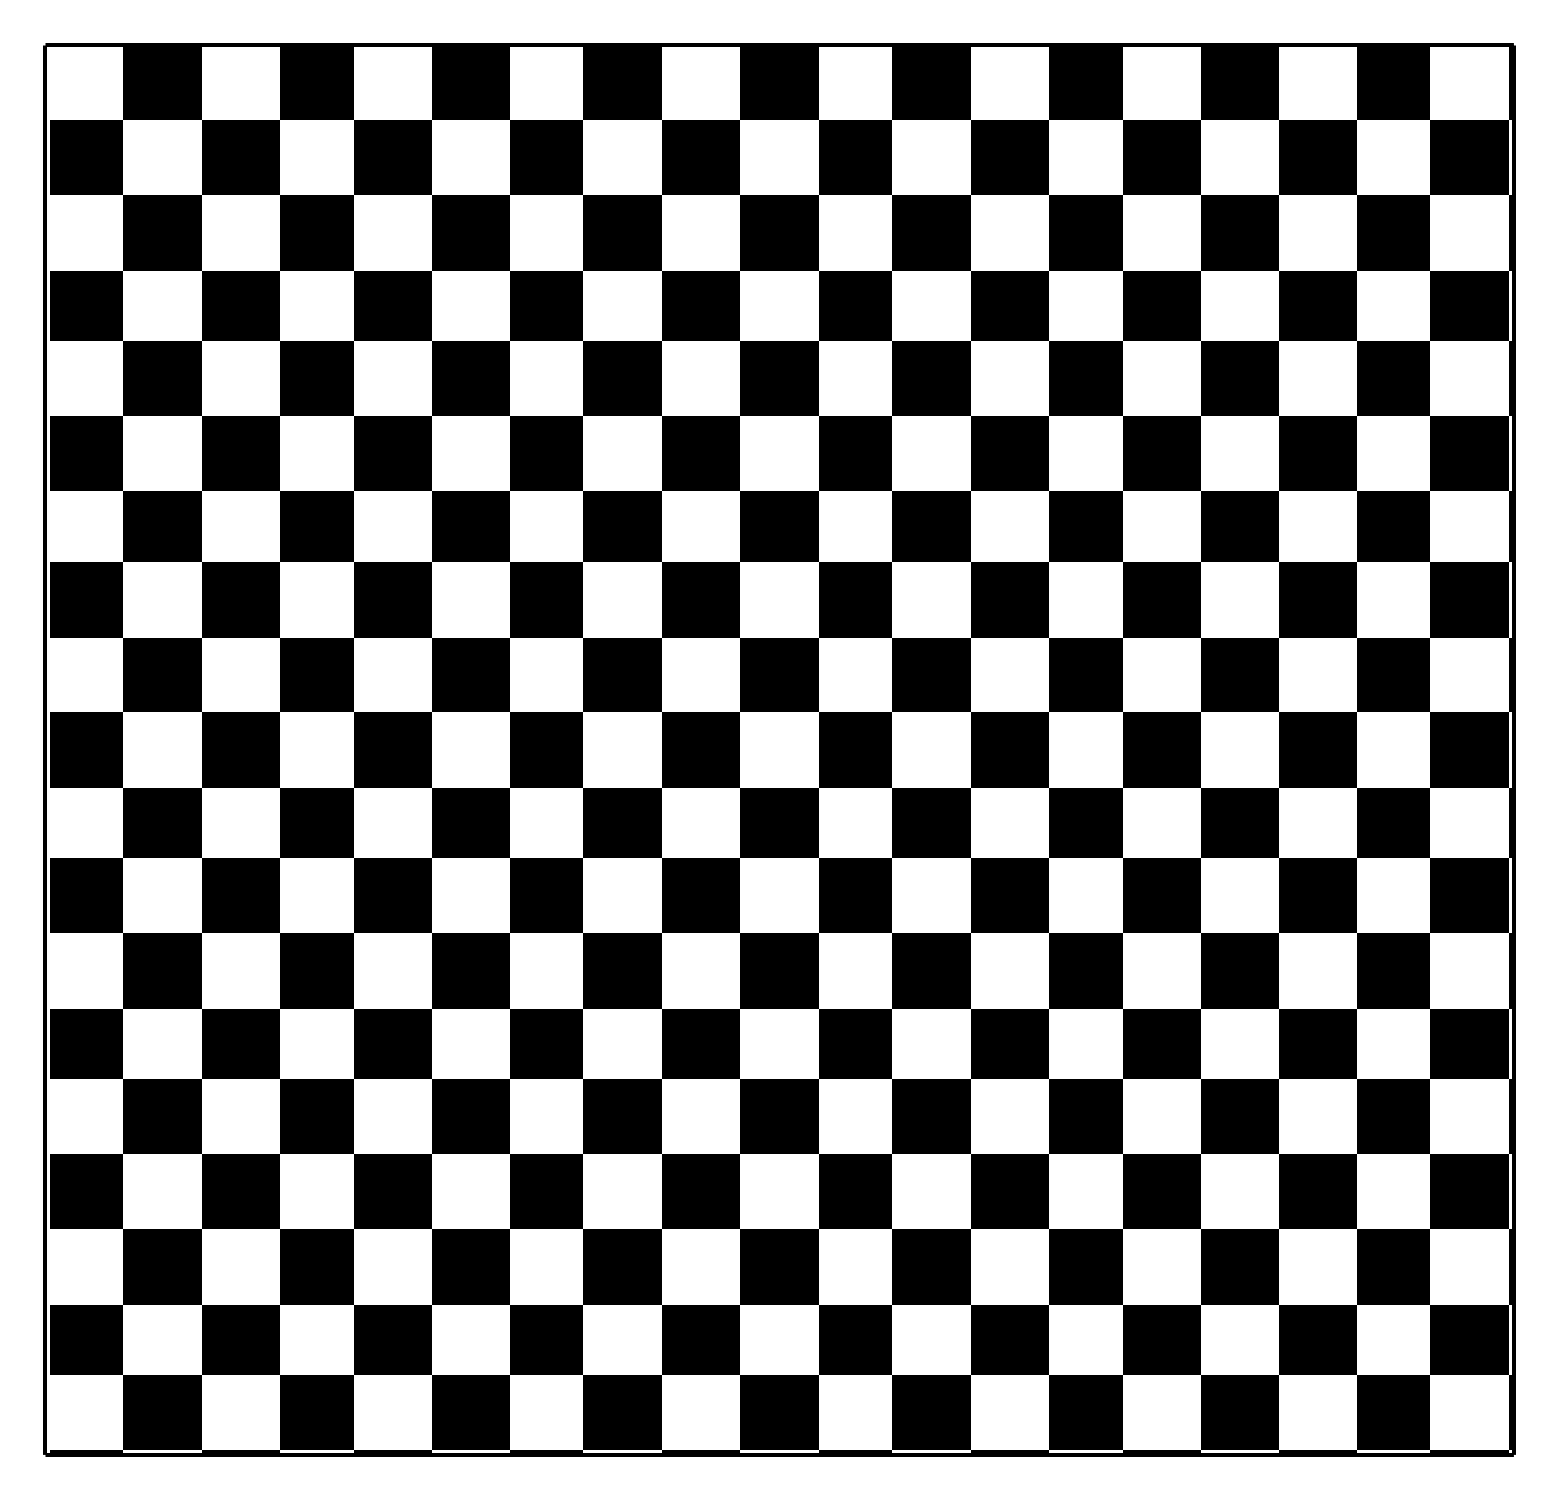

The visual system adapts to contrast

Slide 5
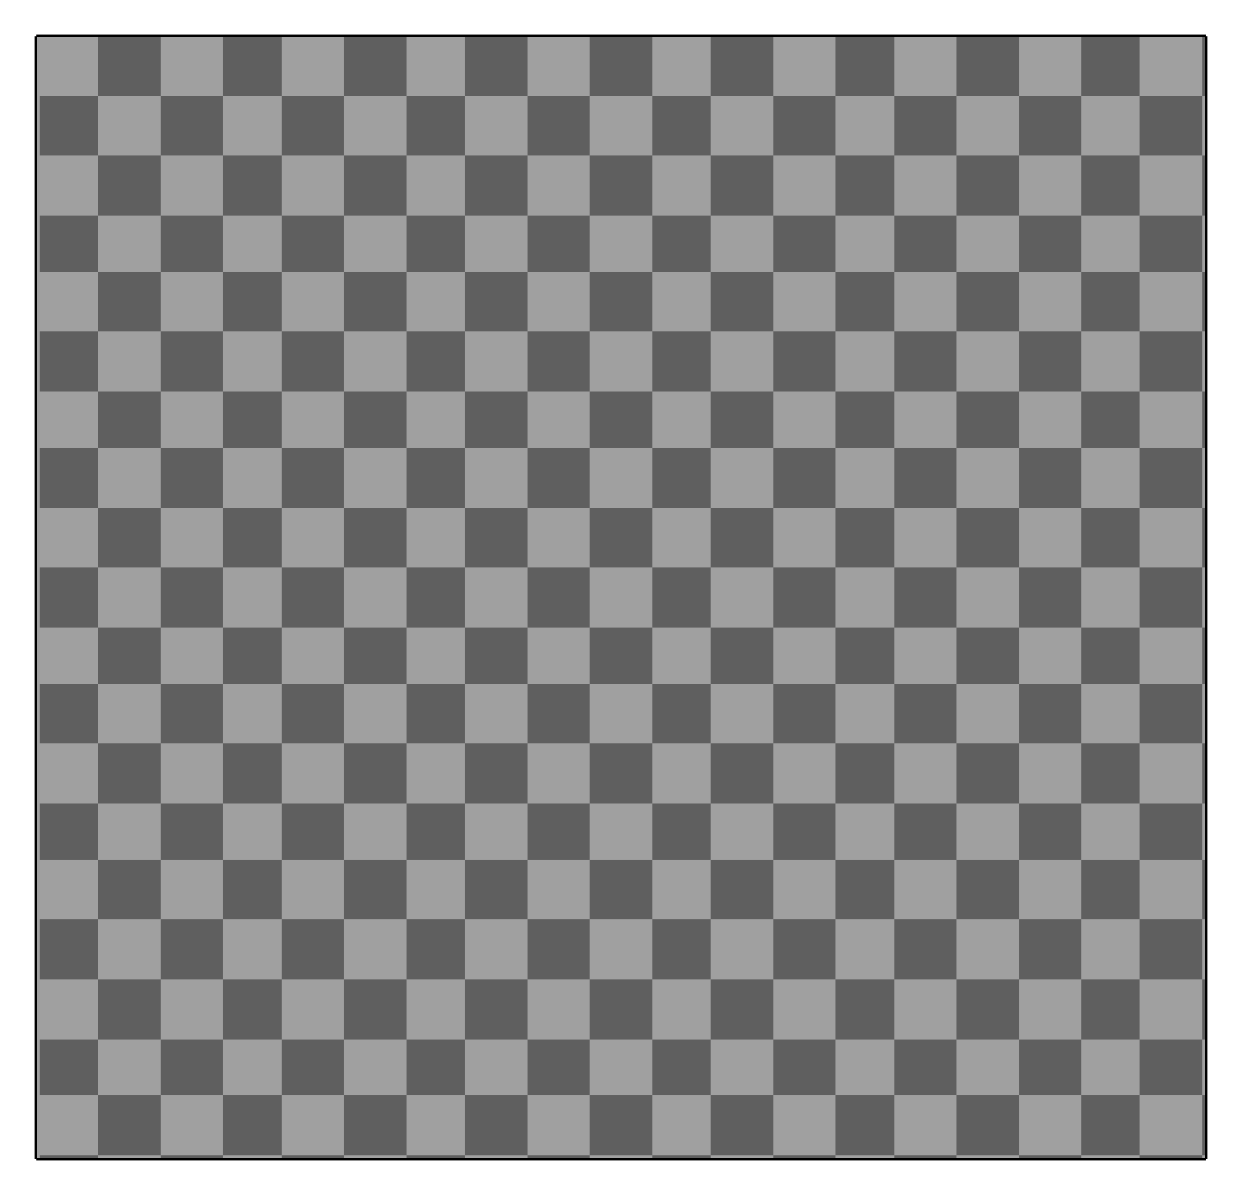
The visual system adapts to contrast

Slide 6
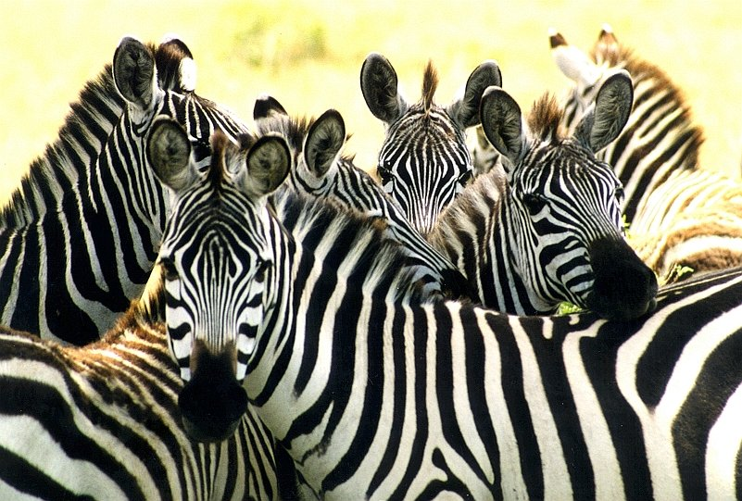

Functional importance of adaptation
Luminance adaptation
Contrast adaptation
Blakemore & Campbell, 1969
Shapley & Victor, 1979
Smirnakis et al., 1997

Slide 7
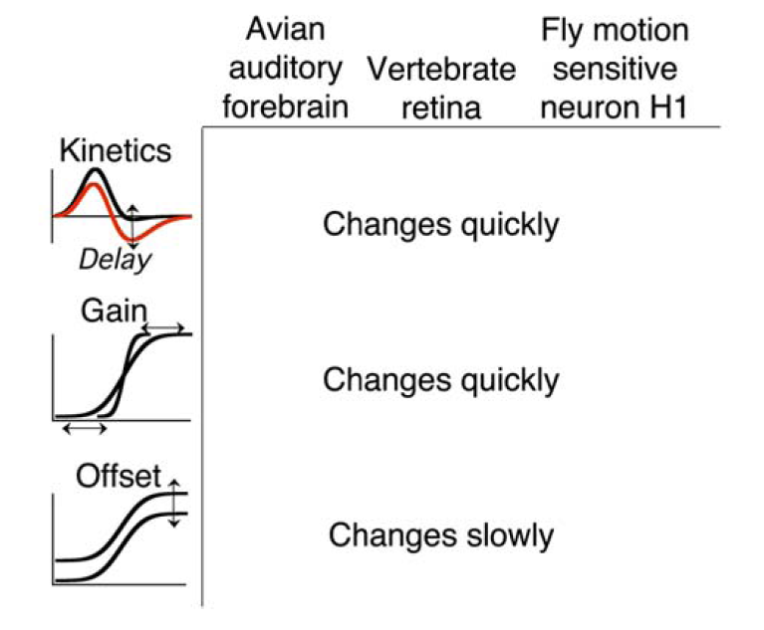
Common properties of contrast adaptation
Change quickly
Changes quickly
Amplitude
Changes slowly
Nagel & Doupe, 2006
Fairhall et al., 2001

Slide 8
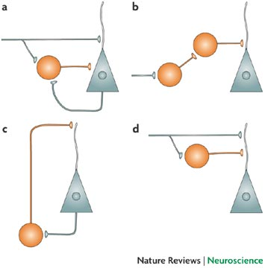
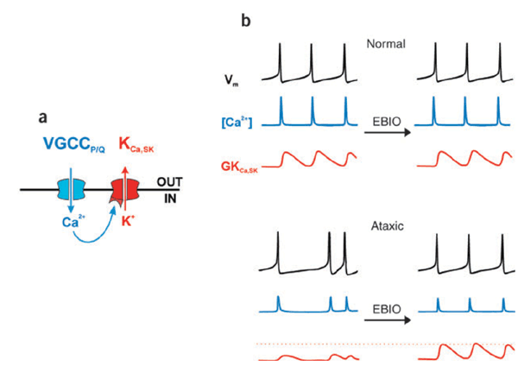
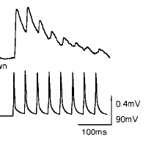
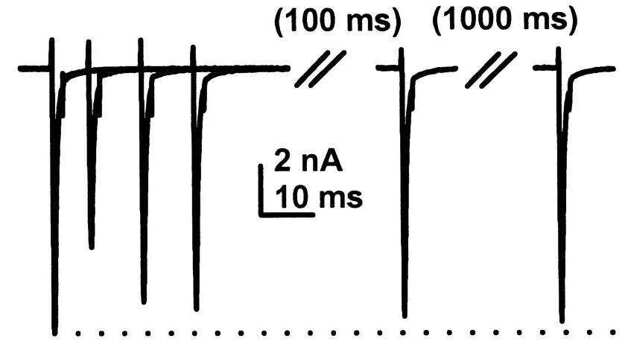
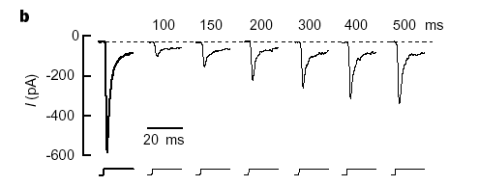
Change in sensitivity by modulation
Feedforward inhibition
Feedback inhibition
Spike dependent conductances
Change in sensitivity by depletion
Ion channel inactivation
Short-term synaptic plasticity
synaptic depression
Receptor desensitization
Post
Pre

Slide 9
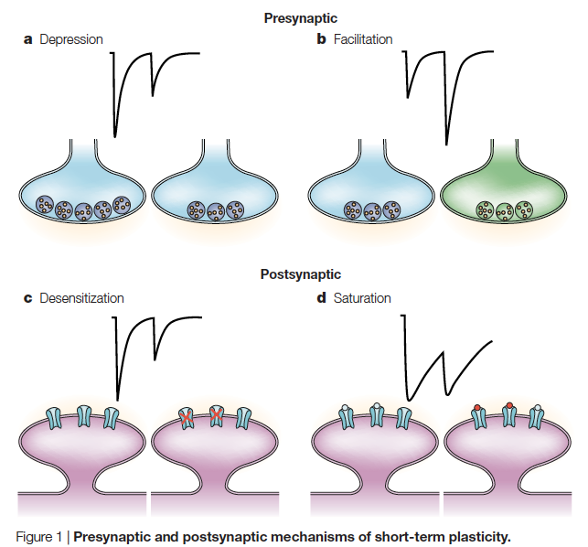
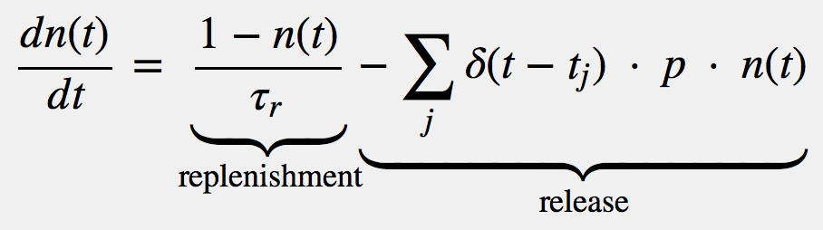
Short-term synaptic plasticity – synaptic depression
Post
Pre
Depletion of available vesicles as a mechanism for depression
n: Number of vesicle
p: Probability of vesicle release
Release = n x p
Hennig, 2013. Theoretical models of synaptic short term plasticity
Chance FS, Nelson SB, Abbott LF. (1998)
Ozuysal & Baccus (2012)

Slide 10
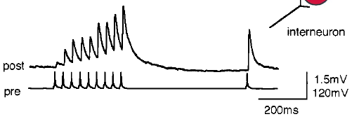
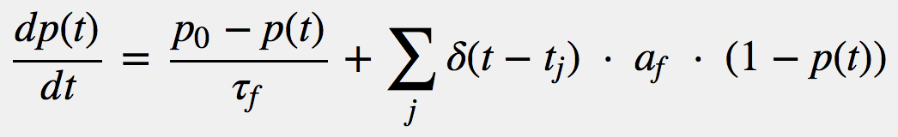
Short-term synaptic plasticity – synaptic facilitation
Residual calcium as a mechanism for increased release

Slide 11
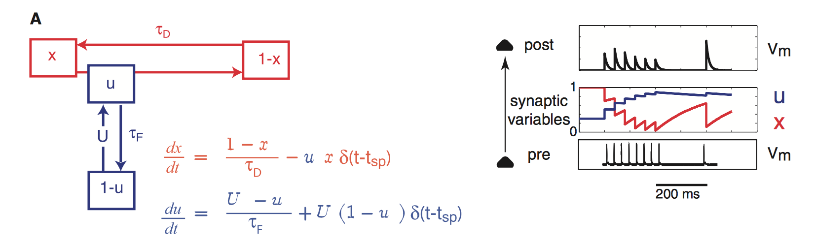
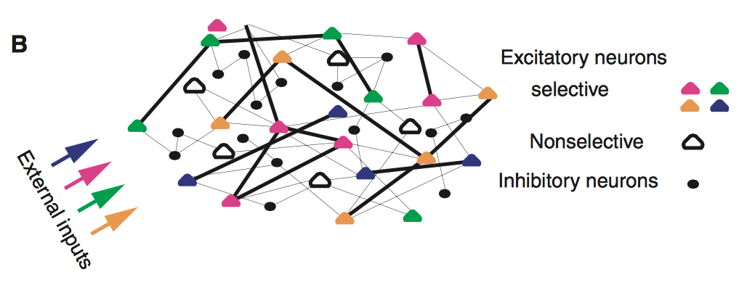
Proposal for synaptic facilitation in short-term memory
x : ~ N (vesicles)
U : ~ p (release probability
Release & Replenishment
Facilitation
Synaptic theory of working memory
Mongillo, Barak & Tsodyks, 2008

Slide 12
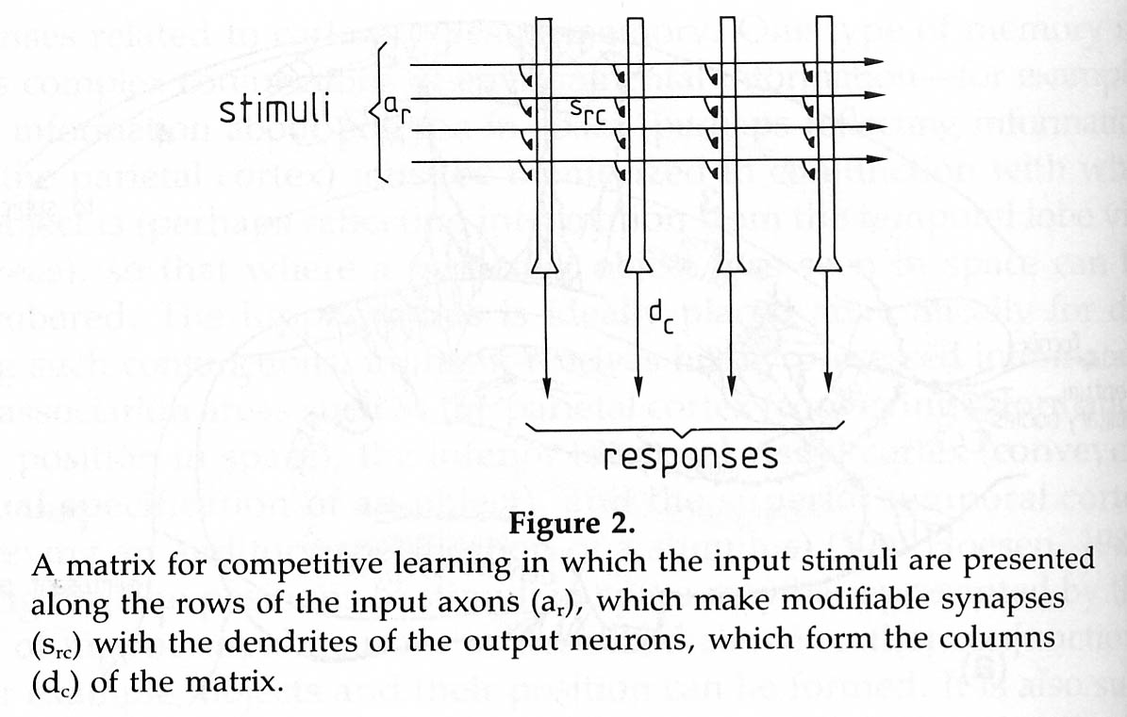
Synaptic transmission as a matrix multiplication
X
W
Input X, column vector
Output Y, column vector
Matrix of synapses W
n
m
m
1
n
Y
1
W
X
Y
m
=
m
n
n
1
1

Slide 13
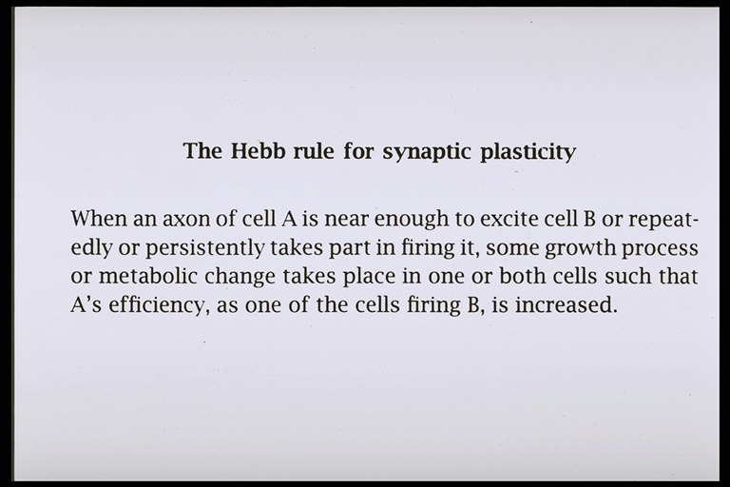
A
B
Hebbian plasticity
A excites B: Coincidence leads to greater release

Slide 14
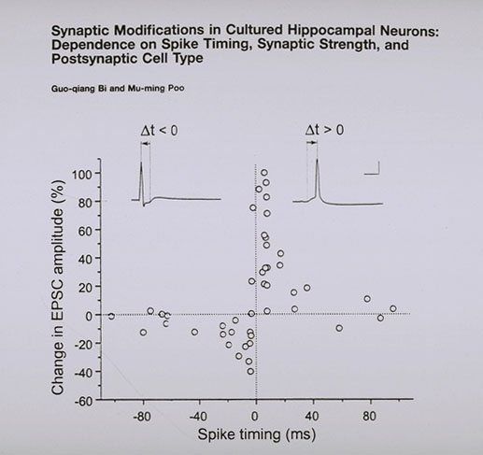
Hebbian spike timing plasticity (STDP)
hippocampal neurons
Pre before Post
Bi & Poo (1998)
Simplified:

Slide 15
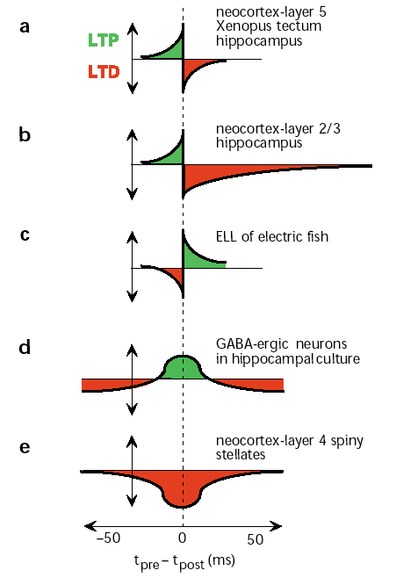
Different varieties of
Spike-timing dependent plasticity
Abbott L. and Nelson S.
Synaptic plasticity: taming the beast (2000)

Slide 16
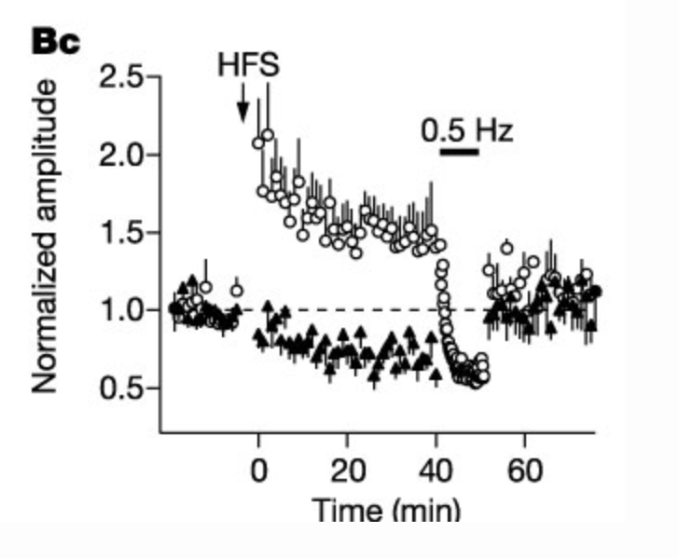
How can Hebbian networks be stable?
Heterosynaptic Long Term Depression
Royer & Pare, 2003
Decrease each w_{ij} by
Another stability rule, Oja’s rule

Slide 17
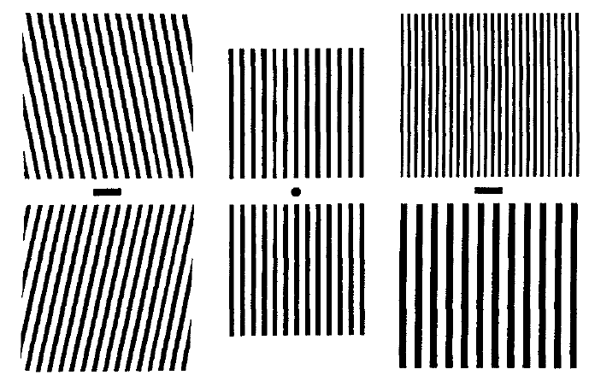
Predictive coding: removing predictable signals from the brain
various aftereffects including tilt and motion
Barlow HB, The knowledge used in vision and where it comes from (1997)
Hosoya et al., Dynamic predictive coding in the retina (2005)

Slide 18
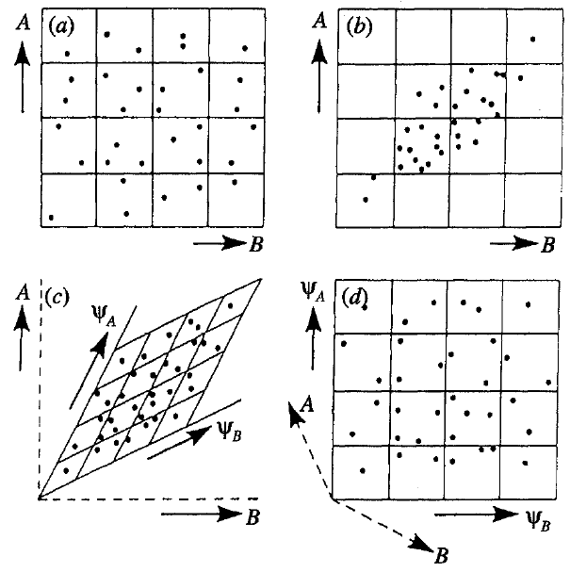
“Decorrelation” – increasing the difference between inputs
Two uncorrelated inputs
Two correlated inputs
A new representation
Decorrelated in the new representation
Barlow HB, The knowledge used in vision and where it comes from (1997)

Slide 19
A
B
W
Hebbian plasticity
A excites B: Coincidence leads to greater release
A inhibits B: Coincidence leads to less release
“Anti-Hebbian” plasticity
A excites B: Coincidence leads to less release
A inhibits B: Coincidence leads to greater release

