Slide 1
Title
Text

Slide 2
Exercise 2: LSQ & Newton’s Method
MAD
bacdavid@student.ethz.ch

Slide 3
Outline
Information
Goals
Theory/ Recap
Exercises

Slide 4
Information

Slide 5
General
Lecture material & problem sets available here
Tutorial material available here

Slide 6
Goals

Slide 7
Goals of Today
Know about SVD
Understand the meaning of the condition number
Know how to compute pseudo-inverse
Know how to use Newton’s Method

Slide 8
Theory / Recap

Slide 9
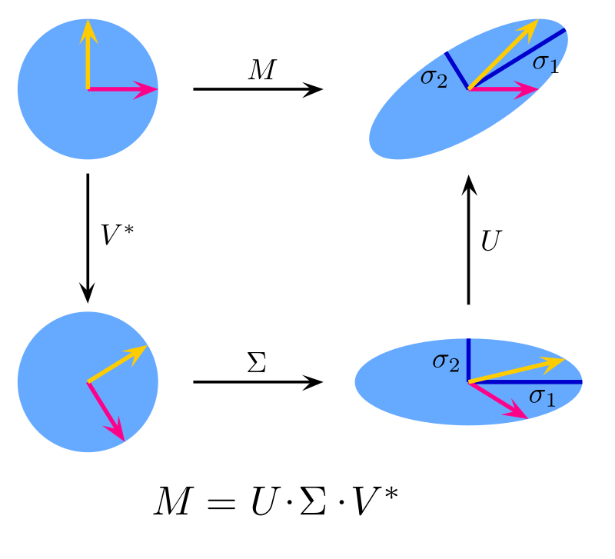
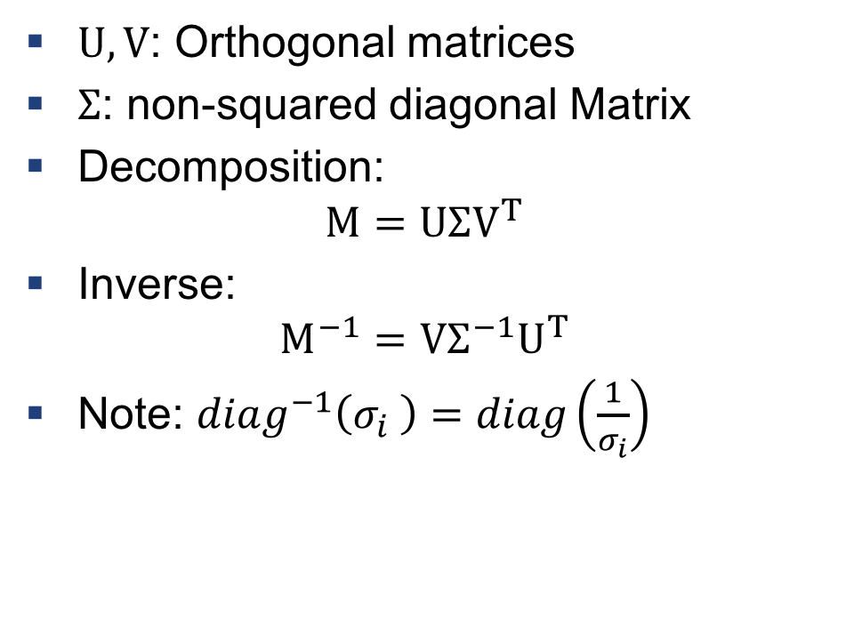
SVD
$U, V$: Orthogonal matrices
$Σ$: non-squared diagonal Matrix
Decomposition:
$$M=UΣV^{T}$$
Inverse:
$$M^{−1}=VΣ^{−1}U^{T}$$
Note: $diag^{−1}\left(σ_{i} \right)=diag\left(\frac{1}{σ_{i}}\right)$

Slide 10
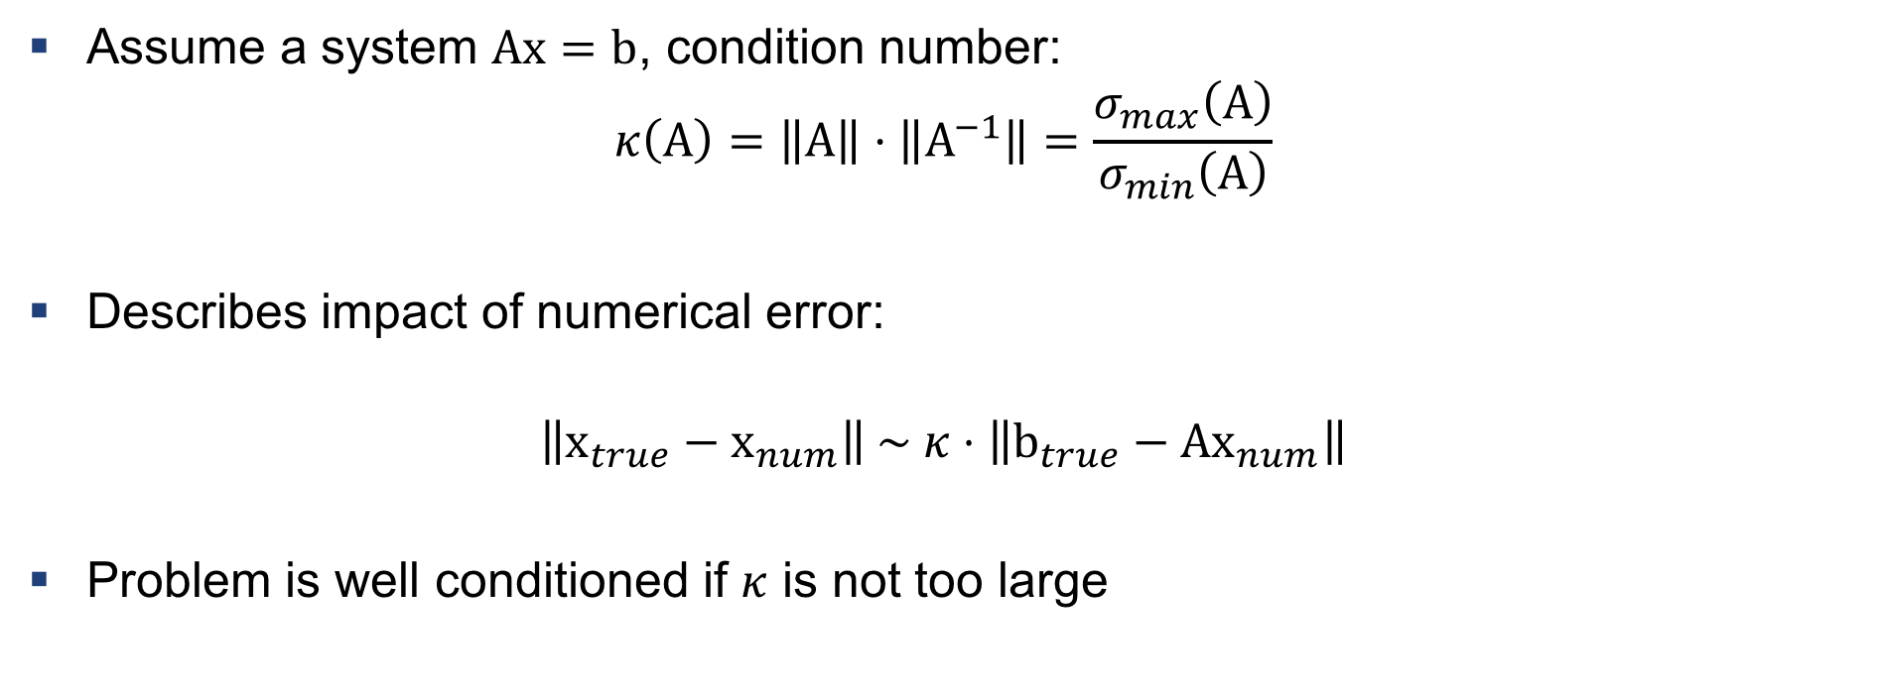
Conditional Number
Assume a system $Ax=b$, condition number:
$$κ\left(A\right)=\left\|A\right\|⋅\left\|A^{−1}\right\|=\frac{σ_{max}\left(A\right)}{σ_{min}\left(A\right)}$$
Describes impact of numerical error:
$$\left\|x_{true}−x_{num}\right\| \sim κ⋅\left\|b_{true}−{Ax}_{num}\right\|$$
Problem is well conditioned if $κ$ is not too large

Slide 11

Example 1: Compute Conditional Number
x-data: $𝒳=\left\{\left[1, 0, 0\right], \left[0, 2, 0\right], \left[0, 0, \frac{1}{2}\right]\right\}$
Assume LSQ problem
Compute the conditional number
Is the problem well conditioned?

Slide 12
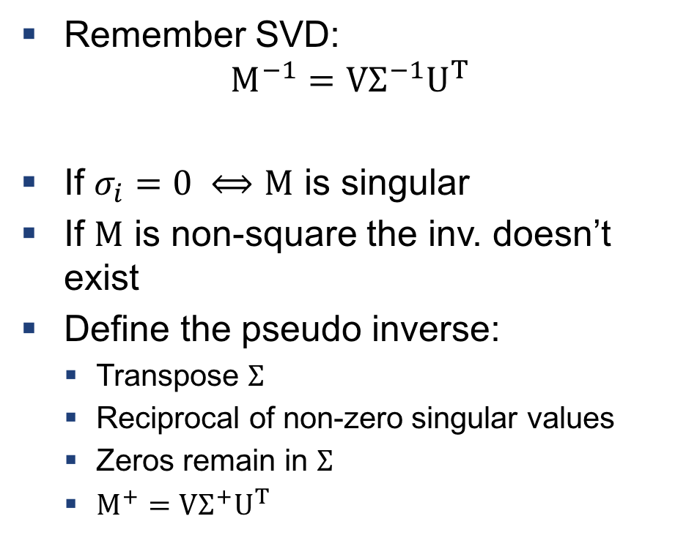

Pseudo Inverse
Remember SVD:
$$M^{−1}=VΣ^{−1}U^{T}$$
If $σ_{i}=0 ⟺M$ is singular
If $M$ is non-square the inv. doesn’t exist
Define the pseudo inverse:
Transpose $Σ$
Reciprocal of non-zero singular values
Zeros remain in $Σ$
$M^{+}=VΣ^{+}U^{T}$
$$Σ^{+}=\left[\begin{matrix}\frac{1}{σ_{1}} & & & & & \\ & ⋱ & & & & \\ & & \frac{1}{σ_{r}} & & & \\ & & & 0 & & \\ & & & & ⋱ & \\ & & & & & 0 \\ & & & & & \end{matrix}\right]$$

Slide 13
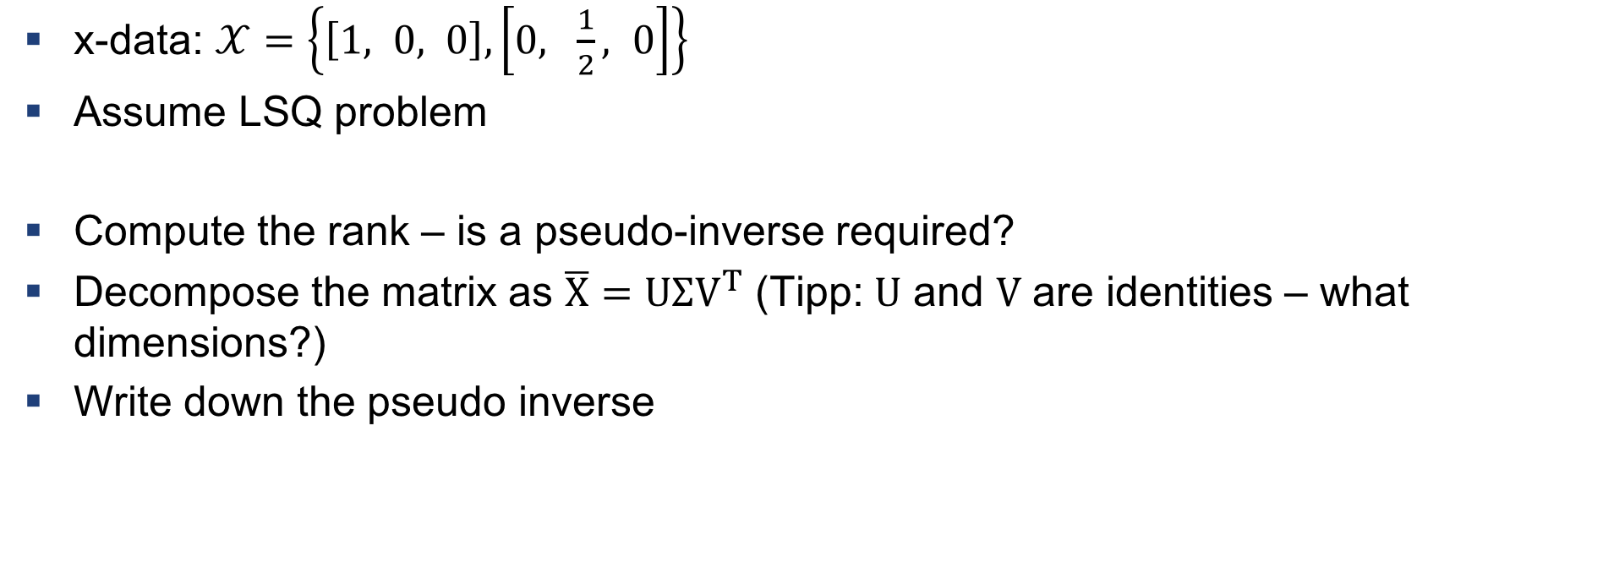
Example 2: Compute the pseudo-inverse
x-data: $𝒳=\left\{\left[1, 0, 0\right], \left[0, \frac{1}{2}, 0\right]\right\}$
Assume LSQ problem
Compute the rank – is a pseudo-inverse required?
Decompose the matrix as $\overline{X}=UΣV^{T}$ (Tipp: $U$ and $V$ are identities – what dimensions?)
Write down the pseudo inverse

Slide 14
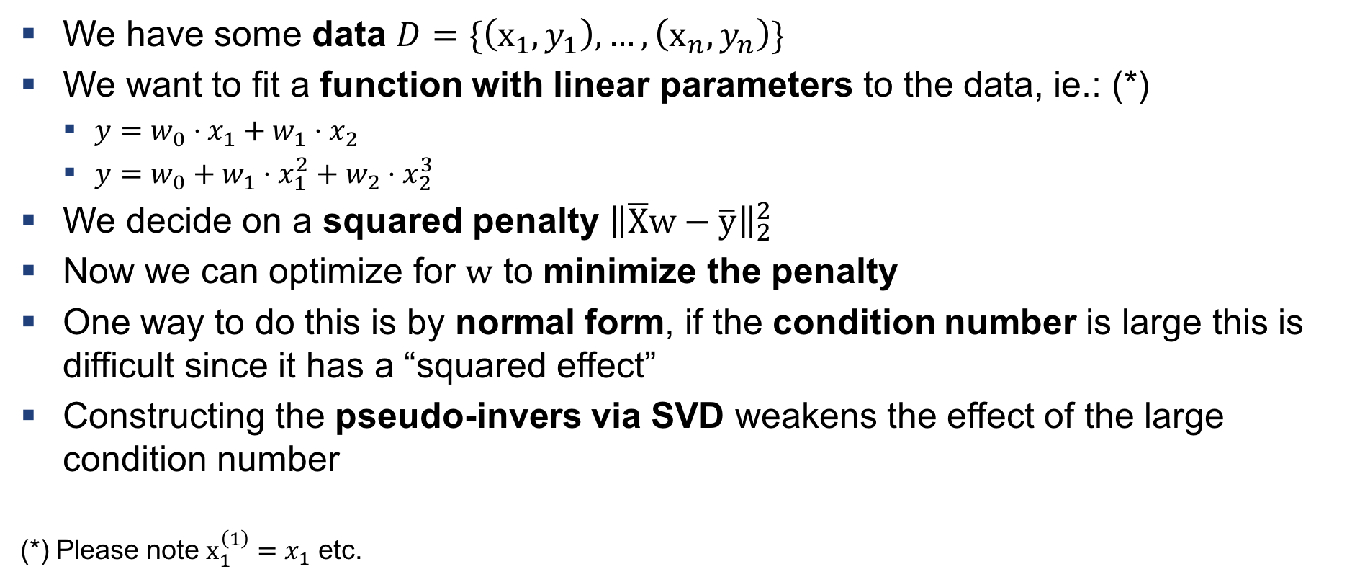
Intervention: What have we done so far?
We have some data $D=\{\left(x_{1}, y_{1}\right), …,\left(x_{n}, y_{n}\right)\}$
We want to fit a function with linear parameters to the data, ie.: (*)
$y=w_{0}⋅x_{1}+w_{1}⋅x_{2}$
$y=w_{0}+w_{1}⋅x_{1}^{2}+w_{2}⋅x_{2}^{3}$
We decide on a squared penalty ${\left\|\overline{X}w−\overline{y}\right\|}_{2}^{2}$
Now we can optimize for $w$ to minimize the penalty
One way to do this is by normal form, if the condition number is large this is difficult since it has a “squared effect”
Constructing the pseudo-invers via SVD weakens the effect of the large condition number
(*) Please note $x_{1}^{\left(1\right)}=x_{1}$ etc.

Slide 15
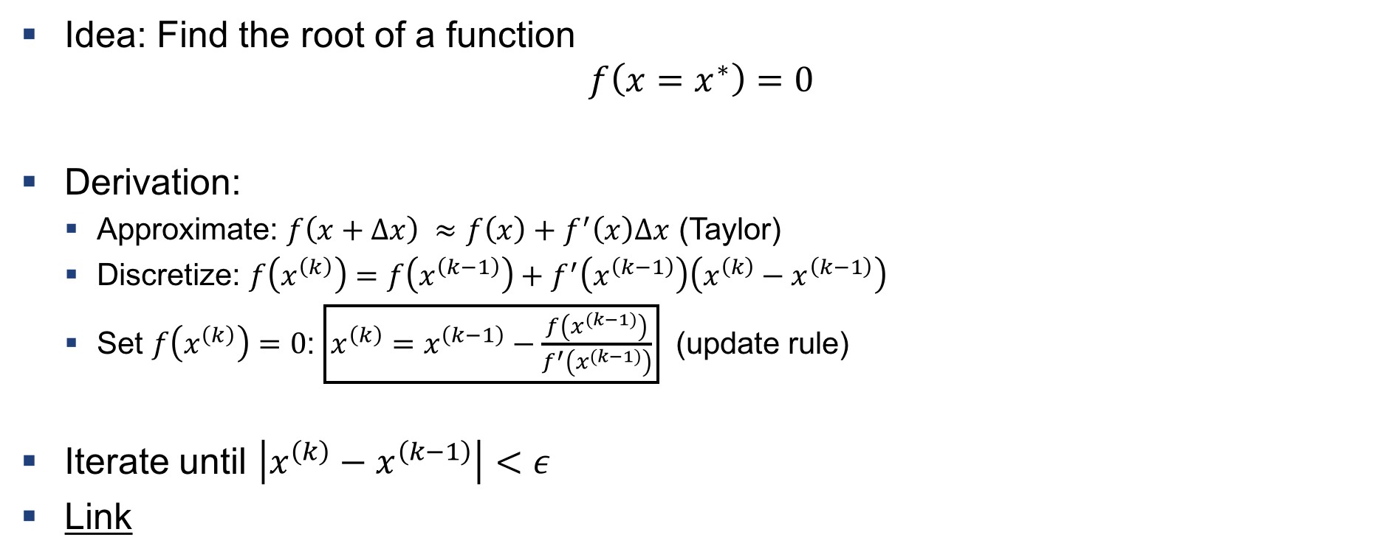
Now something different: Newton’s Method
Idea: Find the root of a function
$$f\left({x=x}^{∗}\right)=0$$
Derivation:
Approximate: $f\left(x+Δx\right) ≈f\left(x\right)+f^{′}\left(x\right)Δx$ (Taylor)
Discretize: $f\left(x^{\left(k\right)}\right)=f\left(x^{\left(k−1\right)}\right)+f^{′}\left(x^{\left(k−1\right)}\right)\left(x^{\left(k\right)}−x^{\left(k−1\right)}\right)$
Set $f\left(x^{\left(k\right)}\right)=0$: $\boxed{x^{\left(k\right)}=x^{\left(k−1\right)}−\frac{f\left(x^{\left(k−1\right)}\right)}{f^{′}\left(x^{\left(k−1\right)}\right)}}$ (update rule)
Iterate until $\left|x^{\left(k\right)}−x^{\left(k−1\right)}\right|<ε$
Link

Slide 16

Example 3: Using Newton’s method
Cube of volume 10 m³ - What‘s the side length?
Write down the function you are trying to find a root of
Make an initial guess
Iterate once using newton’s method
Use $x^{0}=0$ as an initial guess – what happens? Why?

Slide 17
Exercises

Slide 18
Q1
Compute the condition number and find out what insights it reveals about a numerical problem
Compute the pseudo inverse using SVD

Slide 19
Q2
Pseudo-code of a recursive task
Use newton’s method to compute the sqrt. (similar to example 3)
Implement newton’s method

Slide 20

Questions?

