Slide 1
Title
Text

Slide 2
Exercise 3: Newton’s Method for Systems
MAD
bacdavid@student.ethz.ch

Slide 3
Outline
Information
Goals
Theory/ Recap
Exercises

Slide 4
Information

Slide 5
General
Lecture material & problem sets available here
Tutorial material available here

Slide 6
Goals

Slide 7
Goals of Today
Understand Newton’s method (again)
Understand issues related to Newton’s Method
Understand how to generalize the method to a system of equations

Slide 8
Theory / Recap

Slide 9

Root of a function
$f\left(x^{∗}\right)=0$, $x^{∗}$ is a root of $f$
Intermediate Value Theorem:
$f$ is continuous
$sign f\left(a\right)≠sign f\left(b\right)$
Then $x^{∗}∈\left[a,b\right]$
https://en.wikipedia.org/wiki/Zero_of_a_function#/media/File:X-intercepts.svg

Slide 10
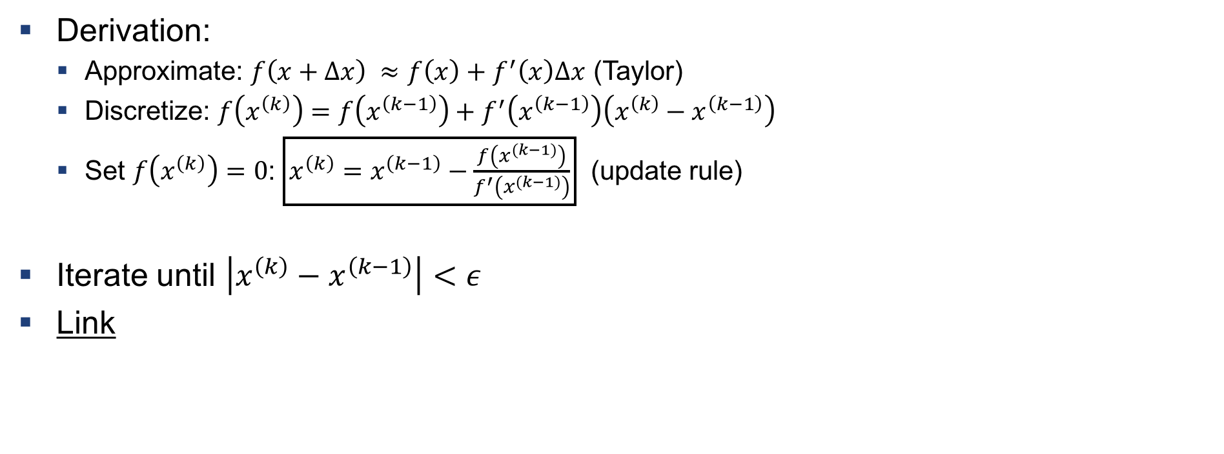
Newton’s Method
Derivation:
Approximate: $f\left(x+Δx\right) ≈f\left(x\right)+f^{′}\left(x\right)Δx$ (Taylor)
Discretize: $f\left(x^{\left(k\right)}\right)=f\left(x^{\left(k−1\right)}\right)+f^{′}\left(x^{\left(k−1\right)}\right)\left(x^{\left(k\right)}−x^{\left(k−1\right)}\right)$
Set $f\left(x^{\left(k\right)}\right)=0$: $\boxed{x^{\left(k\right)}=x^{\left(k−1\right)}−\frac{f\left(x^{\left(k−1\right)}\right)}{f^{′}\left(x^{\left(k−1\right)}\right)}}$ (update rule)
Iterate until $\left|x^{\left(k\right)}−x^{\left(k−1\right)}\right|<ε$
Link

Slide 11
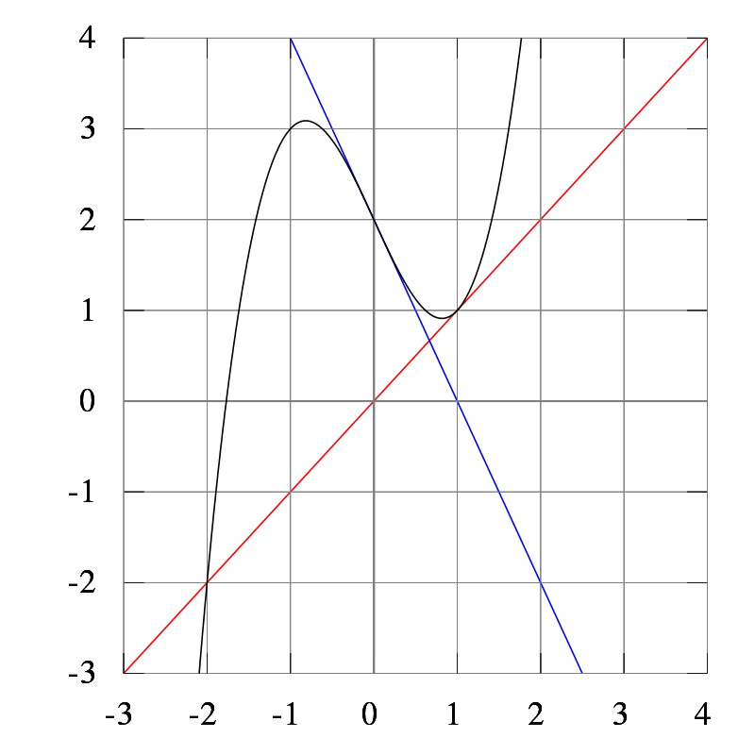
Issues
Oscillation
Stationary point
https://en.wikipedia.org/wiki/Newton%27s_method#/media/File:NewtonsMethodConvergenceFailure.svg

Slide 12

Newton’s Method for Systems
$x^{∗}={\left[x_{1}^{∗}, …, x_{N}^{∗}\right]}^{T}$, $F\left(x^{∗}\right)={\left[f_{1}\left(x_{1}^{∗}\right), …, f_{N}\left(x_{N}^{∗}\right)\right]}^{T}=0$
Update rule: $x^{\left(k\right)}=x^{\left(k−1\right)}−J^{−1}\left(x^{\left(k−1\right)}\right)F\left(x^{\left(k−1\right)}\right)$
Define: $x^{\left(k\right)}−x^{\left(k−1\right)}=y^{(k−1)}$
Write update rule as: $J\left(x^{\left(k−1\right)}\right)y^{(k−1)}=−F\left(x^{\left(k−1\right)}\right)$

Slide 13

Example 1: System of Equations
$x_{1}+x_{2}−x_{1}x_{2}+2=0;x_{1}⋅\exp\left(−x_{2}\right)−1=0$
Initial Guess: $x_{1}^{\left(0\right)}=0; x_{2}^{\left(0\right)}=0$
Compute the Jacobian
Solve $J\left(x^{\left(k−1\right)}\right)y^{(k−1)}=−F\left(x^{\left(k−1\right)}\right)$
Compute${ x}^{\left(1\right)}$

Slide 14
Exercises

Slide 15
Q1
Implement Newton’s method for systems
Solve a practical problem

Slide 16

Questions?

