Slide 1
Title
Text

Slide 2
Exercise 4: Lagrange Polynomials & Cubic Splines
MAD
bacdavid@student.ethz.ch

Slide 3
Outline
Information
Goals
Theory/ Recap
Exercises

Slide 4
Information

Slide 5
General
Lecture material & problem sets available here
Tutorial material available here

Slide 6
Goals

Slide 7
Goals of Today
Understand Lagrange polynomials
Understand Lagrange interpolation
Understand connection between polynomial degree & datapoints
Understand derivation of cubic splines

Slide 8
Theory / Recap

Slide 9

Lagrange Polynomial
Is zeros everywhere, except at the position $x_{i}$ it is equal to 1:
$$l_{i}\left(x\right)=\prod_{1≤m≤N, m≠i}{\frac{x−x_{m}}{x_{i}−x_{m}}}$$

Slide 10
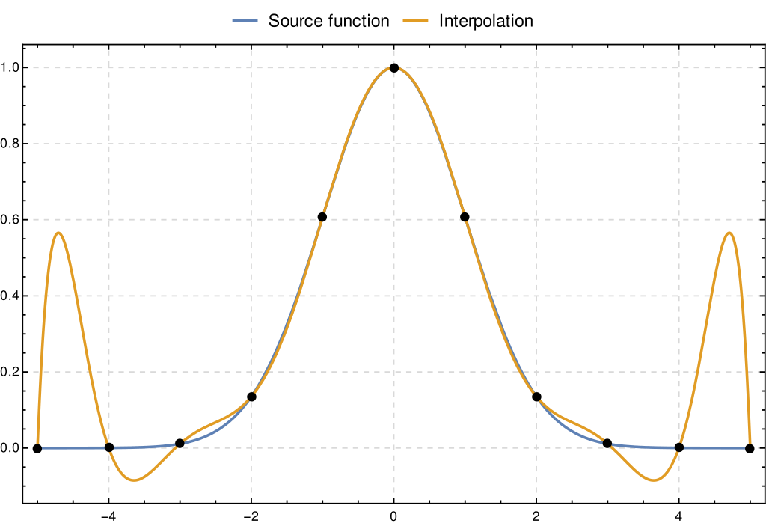
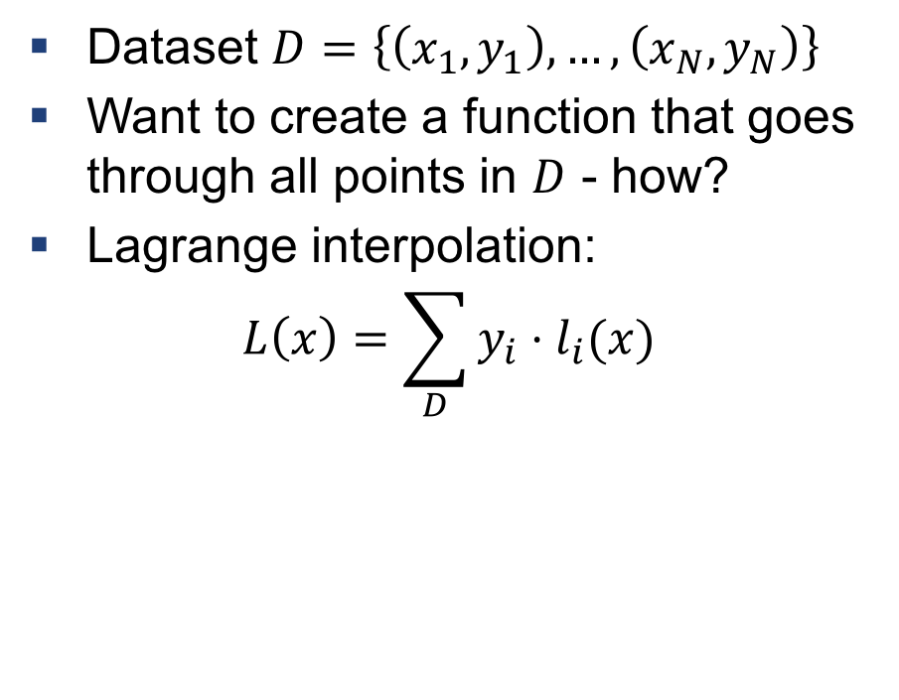
Lagrange Interpolation
Dataset $D=\left\{\left(x_{1}, y_{1}\right),…,\left(x_{N},y_{N}\right)\right\}$
Want to create a function that goes through all points in $D$ - how?
Lagrange interpolation:
$$L\left(x\right)=\sum_{D}{y_{i}⋅l_{i}(x)}$$
https://en.wikipedia.org/wiki/Lagrange_polynomial#/media/File:Runge%27s_phenomenon_in_Lagrange_polynomials.svg

Slide 11

Example 1: Lagrange Polynomial
$D=\left\{\left(1, 1\right), \left(2, 2\right)\right\}$
How many degrees will the Lagrange polynomial have?
Can you guess the function?
Write down the Lagrange Polynomial

Slide 12

Degree of Lagrange Polynomial
Lagrange Polynomial has a degree of $N−1$
High degree polynomial tend to oscillate: BAD!
This is called Runge’s phenomenon
https://en.wikipedia.org/wiki/Lagrange_polynomial#/media/File:Runge%27s_phenomenon_in_Lagrange_polynomials.svg

Slide 13
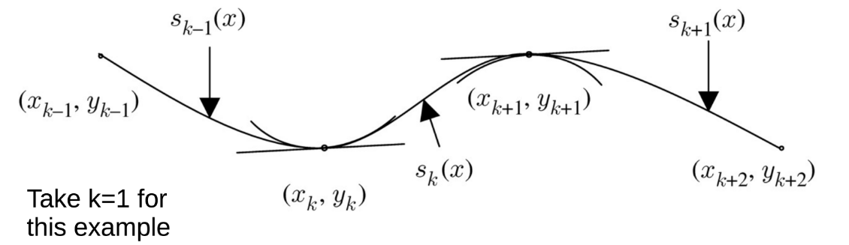

Solution to Runge’s: Cubic Splines
Set of piecewise third-order polynomials
Force them to be $C^{2}$ continuous – what does this mean?

Slide 14
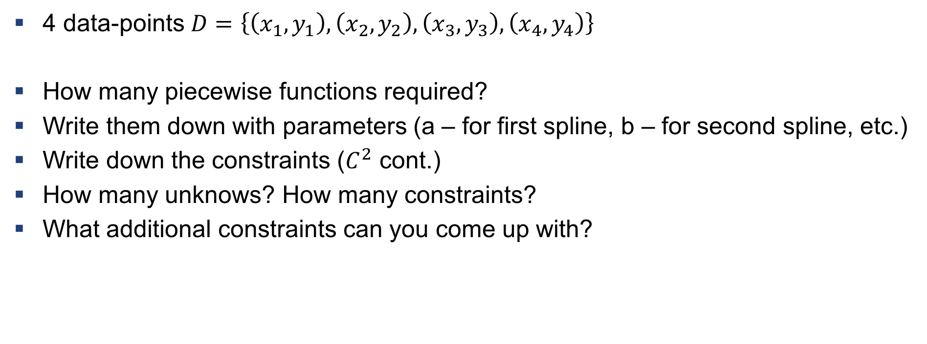
Example 2: Cubic Spline
4 data-points $D=\left\{\left(x_{1}, y_{1}\right), \left(x_{2}, y_{2}\right), \left(x_{3}, y_{3}\right), \left(x_{4}, y_{4}\right)\right\}$
How many piecewise functions required?
Write them down with parameters (a – for first spline, b – for second spline, etc.)
Write down the constraints ($C^{2}$ cont.)
How many unknows? How many constraints?
What additional constraints can you come up with?

Slide 15
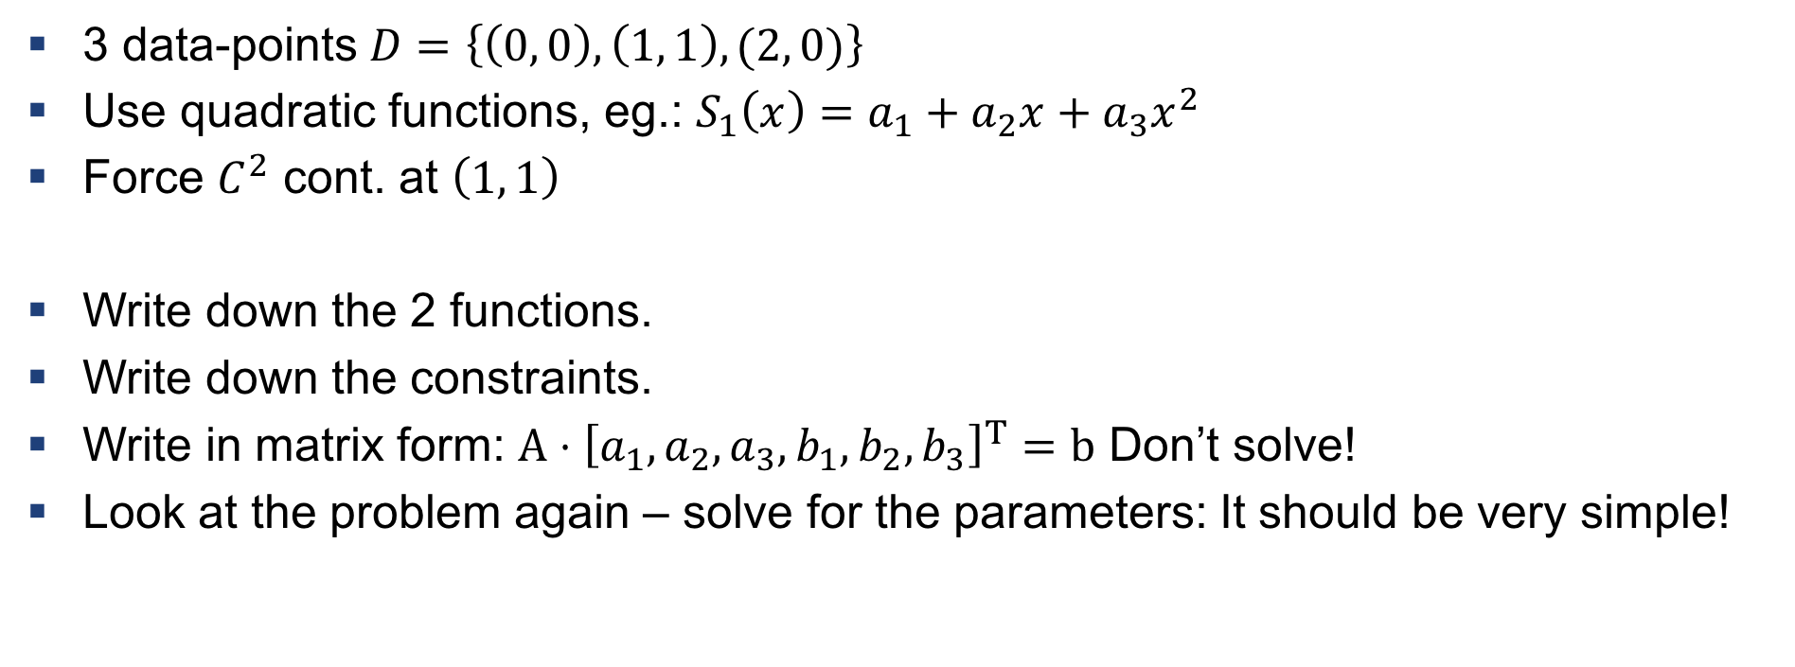
Example 3: Quadratic spline with 3 datapoints
3 data-points $D=\left\{\left(0, 0\right),\left(1, 1\right), (2, 0)\right\}$
Use quadratic functions, eg.: $S_{1}\left(x\right)=a_{1}+a_{2}x+a_{3}x^{2}$
Force $C^{2}$ cont. at $\left(1, 1\right)$
Write down the 2 functions.
Write down the constraints.
Write in matrix form: $A⋅{\left[a_{1}, a_{2},a_{3},b_{1},b_{2},b_{3}\right]}^{T}=b$ Don’t solve!
Look at the problem again – solve for the parameters: It should be very simple!

Slide 16
Exercises

Slide 17
Q1
Implement Lagrange Interpolation
Revisit Runge’s phenomenon

Slide 18
Q2
Derive Cubic Splines

Slide 19
Q3
Implement Cubic Splines

Slide 20

Questions?

