Slide 1
Title
Text

Slide 2
Exercise 5: B-Splines & NURBS
MAD
bacdavid@student.ethz.ch

Slide 3
Outline
Information
Goals
Theory/ Recap
Exercises

Slide 4
Information

Slide 5
General
Lecture material & problem sets available here
Tutorial material available here

Slide 6
Goals

Slide 7
Goals of Today
Know how to construct B-Splines
Know some properties of B-Splines
Know what NURBS are and how to construct them
Know how B-Splines are used in NURBS

Slide 8
Theory / Recap

Slide 9
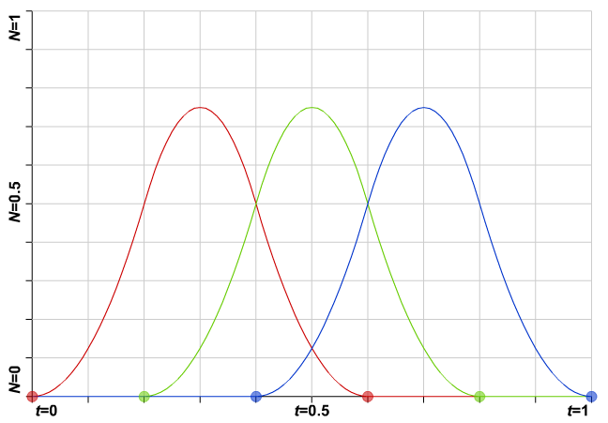

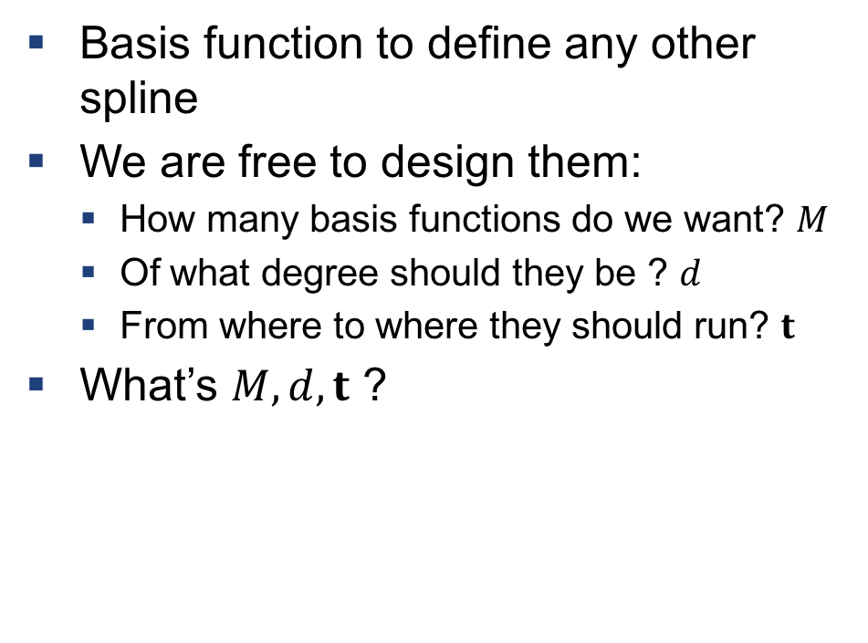
$$B_{i,d,t}\left(x\right)$$
B-Splines
Basis function to define any other spline
We are free to design them:
How many basis functions do we want? $M$
Of what degree should they be ? $d$
From where to where they should run? $t$
What’s $M, d, t$ ?

Slide 10
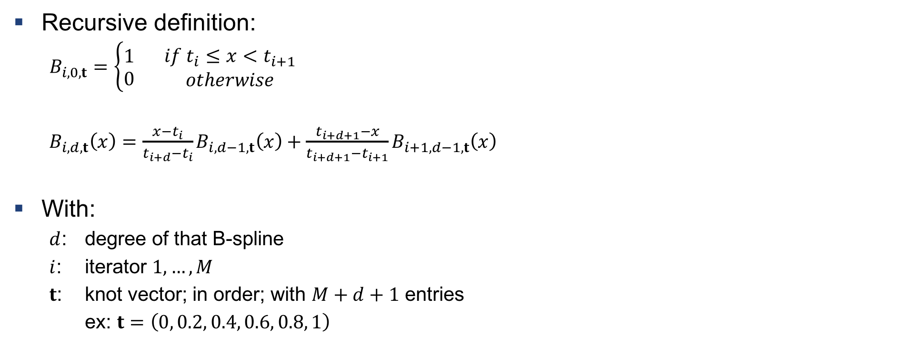
Construction of B-Splines
Recursive definition:
$B_{i,0,t}=\left\{\begin{aligned}1 \\ 0\end{aligned}\right. \begin{matrix}if t_{i}≤x<t_{i+1} \\ otherwise\end{matrix}$
$B_{i,d,t}\left(x\right)=\frac{x−t_{i}}{t_{i+d}−t_{i}}B_{i,d−1,t}\left(x\right)+\frac{t_{i+d+1}−x}{t_{i+d+1}−t_{i+1}}B_{i+1,d−1,t}\left(x\right)$
With:
$d$: degree of that B-spline
$i$: iterator $1, …, M$
$t$: knot vector; in order; with $M+d+1$ entries
ex: $t=\left(0, 0.2, 0.4, 0.6, 0.8, 1\right)$

Slide 11
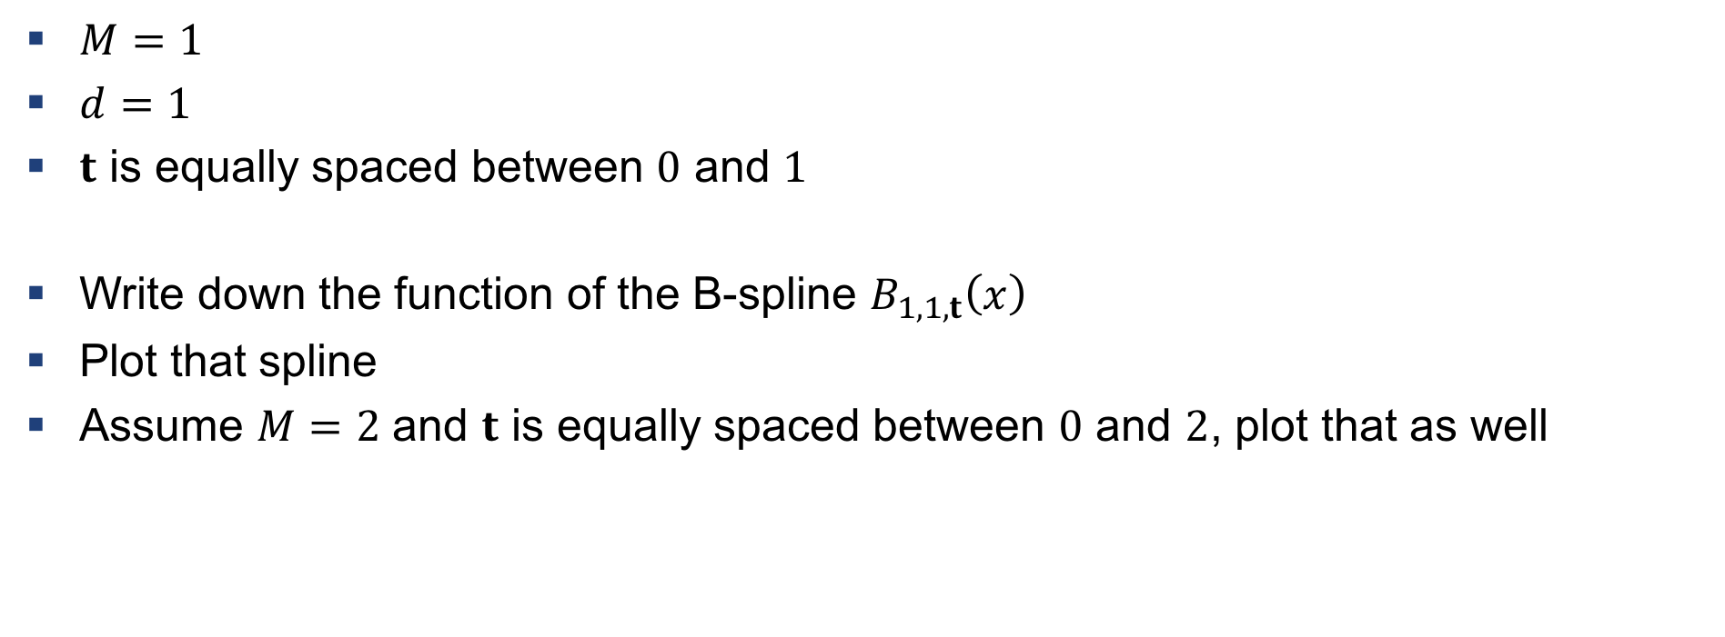
Example 1: Construction of B-Splines
$M=1$
$d=1$
$t$ is equally spaced between $0$ and $1$
Write down the function of the B-spline $B_{1,1,t}\left(x\right)$
Plot that spline
Assume $M=2$ and $t$ is equally spaced between $0$ and $2$, plot that as well

Slide 12

A few things on B-Splines
Only non-zero between $t_{i}≤x≤t_{i+d+1}$
Continuous derivatives up to degree $d−1$, if not overlapping knots
If overlapping, derivative continuity drops by $1$
Use $0/{0=0}$ if knot values are repeated

Slide 13
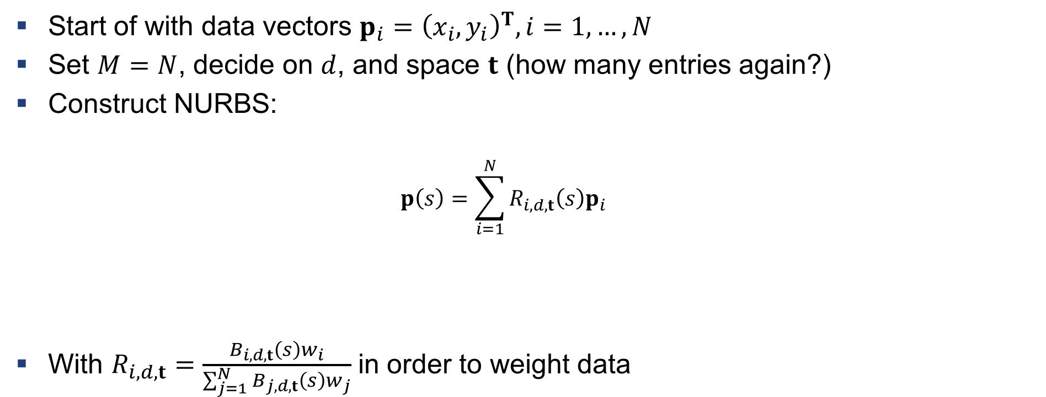
Non-Uniform Rational B-Splines (NURBS)
Start of with data vectors $p_{i}={\left(x_{i}, y_{i}\right)}^{T}, i=1,…, N$
Set $M=N$, decide on $d$, and space $t$ (how many entries again?)
Construct NURBS:
$$p\left(s\right)=\sum_{i=1}^{N}{R_{i,d,t}\left(s\right)p_{i}}$$
With $R_{i,d,t}=\frac{B_{i,d,t}\left(s\right)w_{i}}{\sum_{j=1}^{N}{B_{j,d,t}\left(s\right)w_{j}}}$ in order to weight data

Slide 14
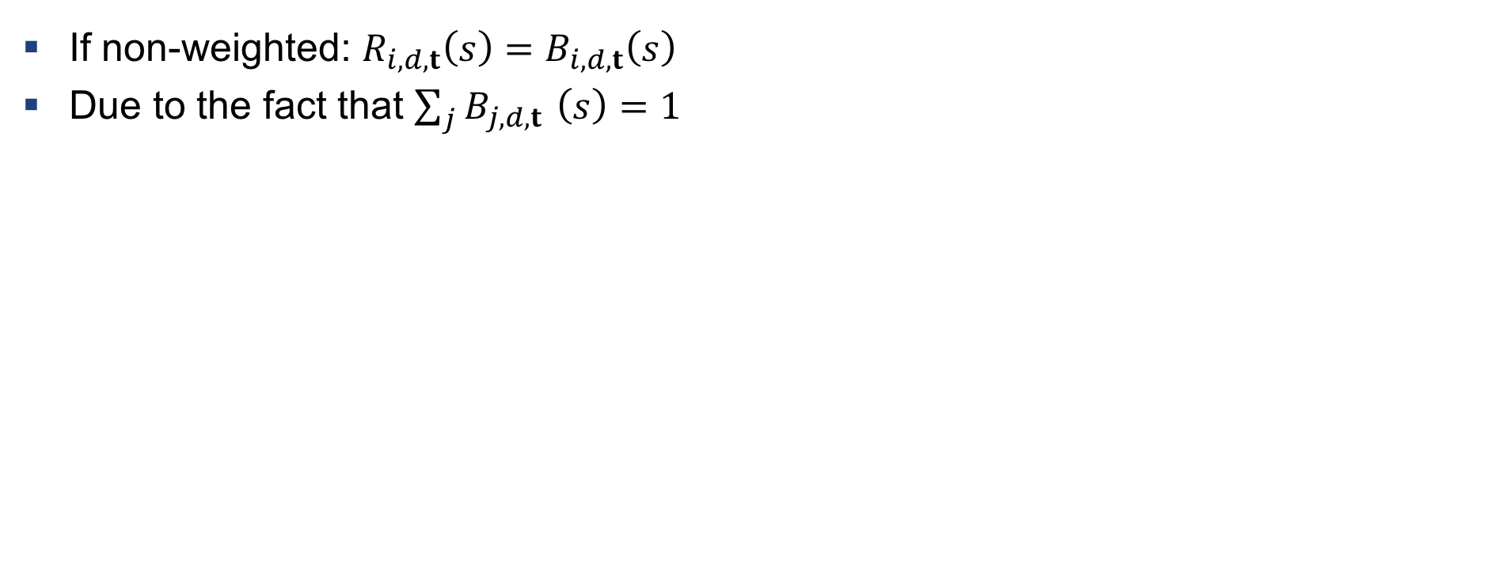
A few things on NURBS
If non-weighted: $R_{i,d,t}\left(s\right)=B_{i,d,t}\left(s\right)$
Due to the fact that $\sum_{j}{B_{j,d,t }}\left(s\right)=1$

Slide 15
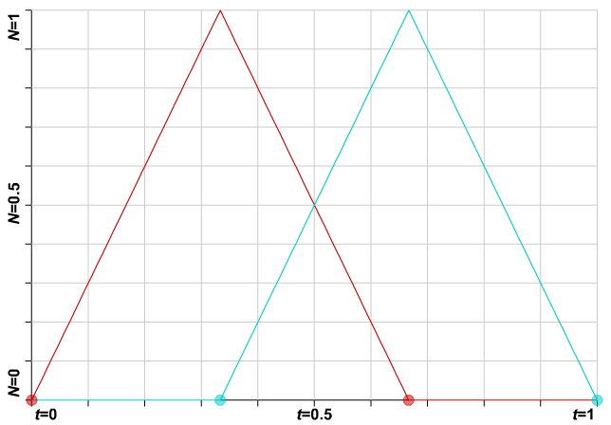





Example 2: Construction of NURBS
$$p_{1}=(0,1)$$
$$y$$
$$x$$
$$p_{0}=(1,0)$$
$$t=(0, 0.33, 0.67, 1)$$
Draw the NURB

Slide 16




Example 2: Construction of NURBS
Inspect a few points
$$p_{1}=(0,1)$$
$$y$$
$$x$$
$$p_{0}=(1,0)$$

Slide 17




Example 2: Construction of NURBS
Inspect a few points
$$p_{1}=(0,1)$$
$$y$$
$$x$$
$$p_{0}=(1,0)$$

Slide 18




Example 2: Construction of NURBS
Inspect a few points
$$p_{1}=(0,1)$$
$$y$$
$$x$$
$$p_{0}=(1,0)$$

Slide 19
Example 2: Construction of NURBS
Inspect a few points
$$p_{1}=(0,1)$$
$$y$$
$$x$$
$$p_{0}=(1,0)$$

Slide 20




Example 2: Construction of NURBS
Inspect a few points
$$p_{1}=(0,1)$$
$$y$$
$$x$$
$$p_{0}=(1,0)$$

Slide 21

Example 3: Intuition for NURBS
http://geometrie.foretnik.net/files/NURBS-en.swf (enable flash)
Select «Non-Uniform B» from presets
If we move $p_{4}$ which parts of the curve are uneffected?

Slide 22
Exercises

Slide 23
Q1
Write down B-Splines

Slide 24
Q2
Construct NURBS on a data-set

Slide 25

Questions?

