Slide 1
Title
Text

Slide 2
Exercise 6: Orthonormal Functions & Radial Basis Functions
MAD
bacdavid@student.ethz.ch

Slide 3
Outline
Information
Goals
Theory/ Recap
Exercises

Slide 4
Information

Slide 5
General
Lecture material & problem sets available here
Tutorial material available here

Slide 6
Goals

Slide 7
Goals of Today
Know what an orthonormal basis is
Know what the benefit of orthonormal functions is
Know how to fit orthonormal functions to data
Know what radial basis functions (RBF) are
Know how to fit RBFs to data

Slide 8
Theory / Recap

Slide 9



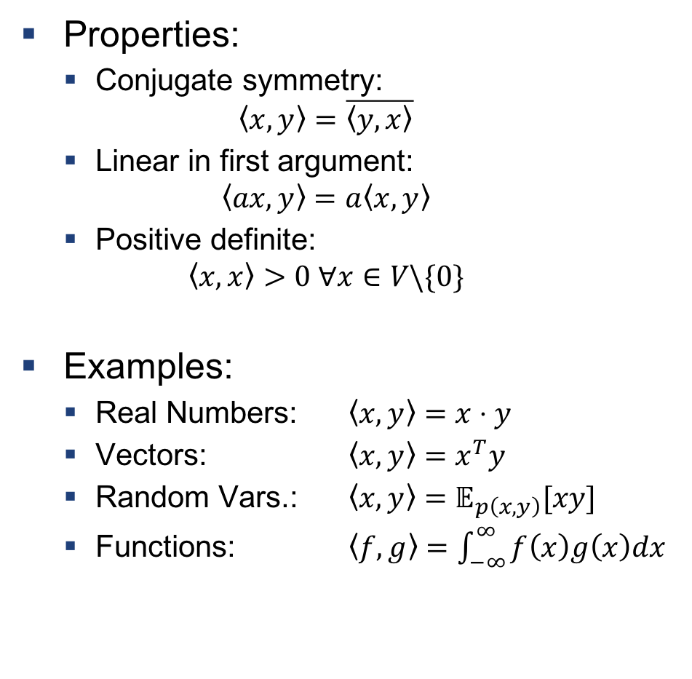
Inner Product
Properties:
Conjugate symmetry:
$$\left\langle x,y\right\rangle =\overline{\left\langle y, x\right\rangle }$$
Linear in first argument:
$$\left\langle ax,y\right\rangle =a\left\langle x,y\right\rangle$$
Positive definite:
$$\left\langle x,x\right\rangle >0 ∀x∈V\backslash \{0\}$$
Examples:
Real Numbers: $\left\langle x,y\right\rangle =x⋅y$
Vectors: $\left\langle x,y\right\rangle =x^{T}y$
Random Vars.: $\left\langle x,y\right\rangle =𝔼_{p\left(x,y\right)}[xy]$
Functions: $\left\langle f,g\right\rangle =\int_{−∞}^{∞}{f\left(x\right)g\left(x\right)dx}$
Projection:
$$b$$
$$a$$
$$\frac{a^{T}b}{\left\|b\right\|}$$

Slide 10
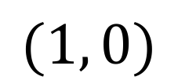
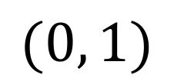

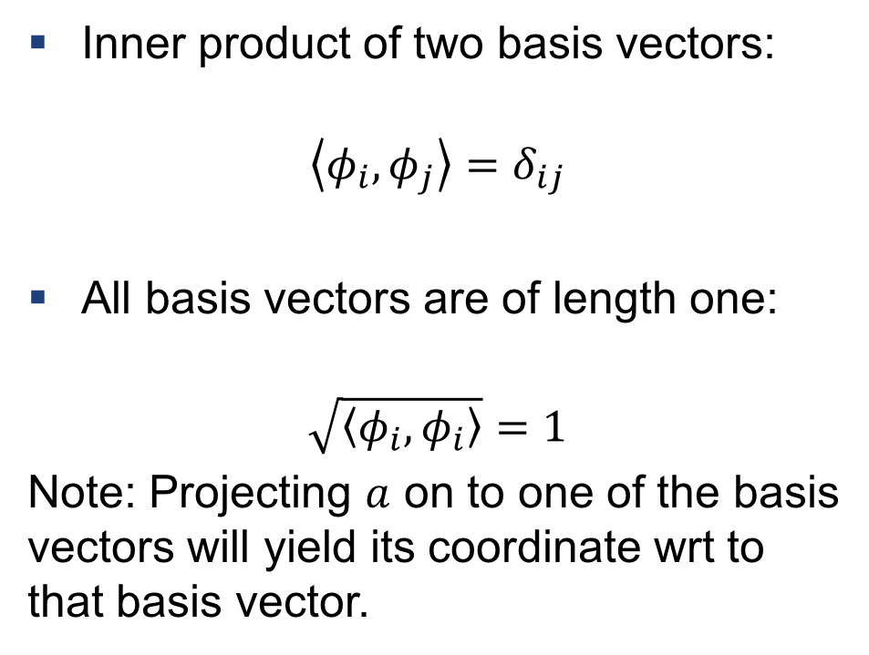
Orthonormal Basis
$$(0, 1)$$
Inner product of two basis vectors:
$$\left\langle φ_{i}, φ_{j}\right\rangle =δ_{ij}$$
All basis vectors are of length one:
$$\sqrt{\left\langle φ_{i}, φ_{i}\right\rangle }=1$$
Note: Projecting $a$ on to one of the basis vectors will yield its coordinate wrt to that basis vector.
$$a$$
$$(1, 0)$$

Slide 11
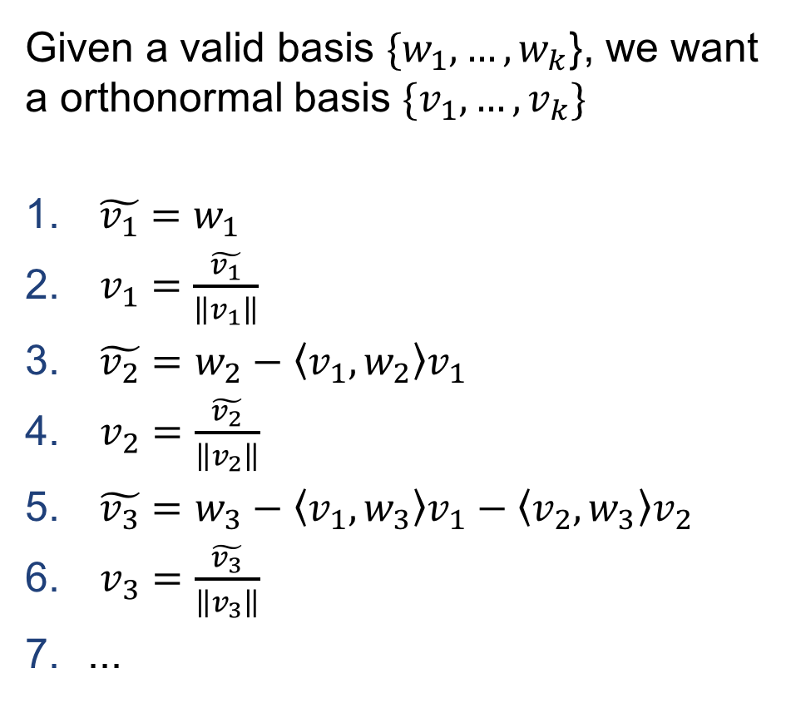
Gram Schmidt Orthonormalization
Given a valid basis ${\{w}_{1}, …, w_{k}$}, we want a orthonormal basis $\{v_{1},…, v_{k}\}$
$\tilde{v_{1}}=w_{1}$
$v_{1}=\frac{\tilde{v_{1}}}{\left\|v_{1}\right\|}$
$\tilde{v_{2}}=w_{2}−\left\langle v_{1},w_{2}\right\rangle v_{1}$
$v_{2}=\frac{\tilde{v_{2}}}{\left\|v_{2}\right\|}$
$\tilde{v_{3}}=w_{3}−\left\langle v_{1},w_{3}\right\rangle v_{1}−\left\langle v_{2},w_{3}\right\rangle v_{2}$
$v_{3}=\frac{\tilde{v_{3}}}{\left\|v_{3}\right\|}$
...

Slide 12
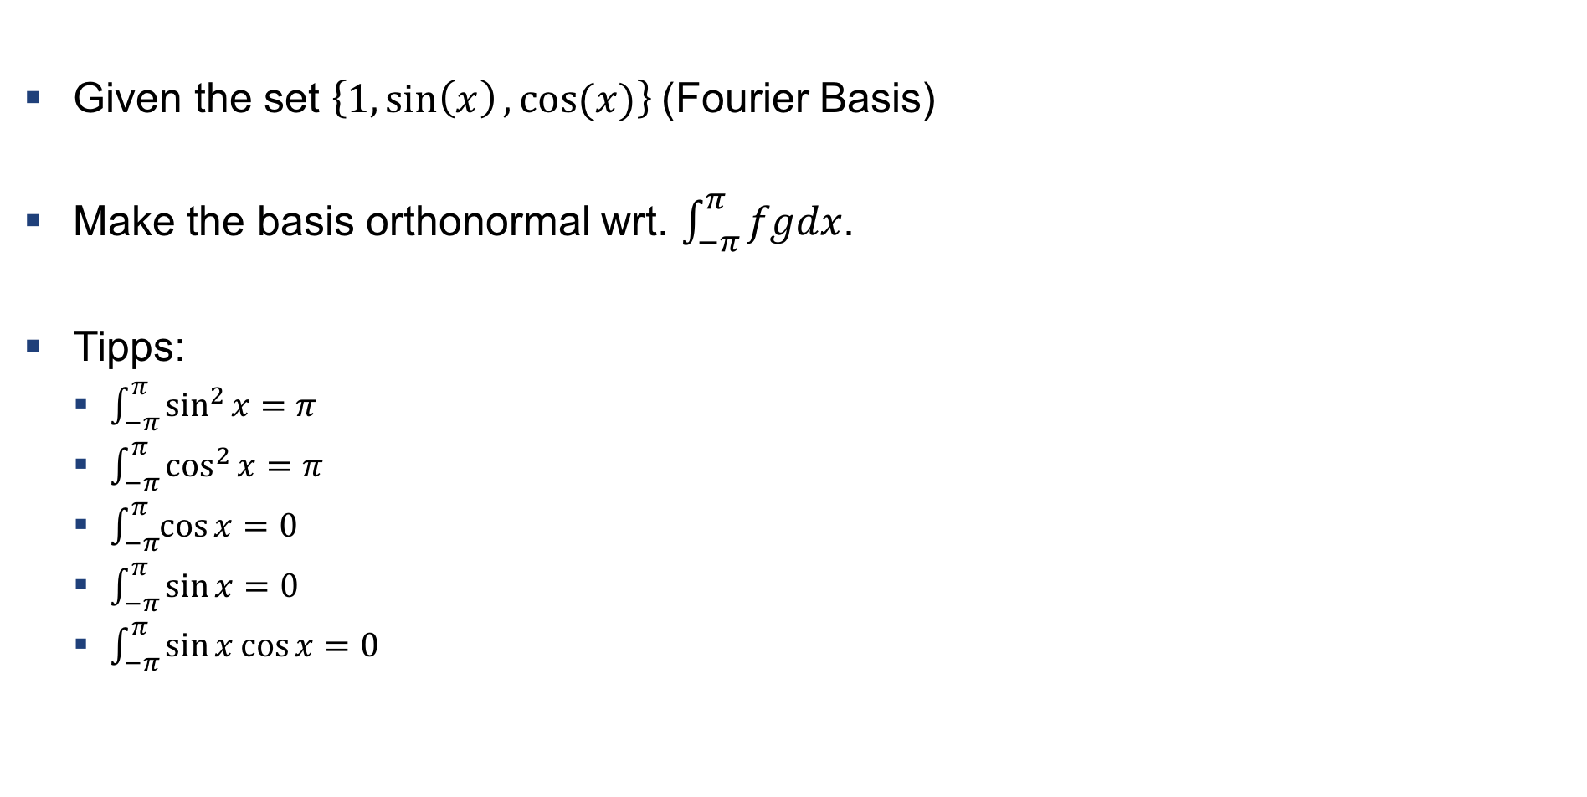
Example 1: Gram Schmidt for Fourier
Given the set $\left\{1,\sin\left(x\right), cos⁡(x)\right\}$(Fourier Basis)
Make the basis orthonormal wrt. $\int_{−π}^{π}{fgdx}$.
Tipps:
$\int_{−π}^{π}{\sin^{2}{x}}=π$
$\int_{−π}^{π}{\cos^{2}{x}}=π$
$\int_{−π}^{π}{\cos{x}}=0$
$\int_{−π}^{π}{\sin{x}}=0$
$\int_{−π}^{π}{\sin{x\cos{x}}}=0$

Slide 13
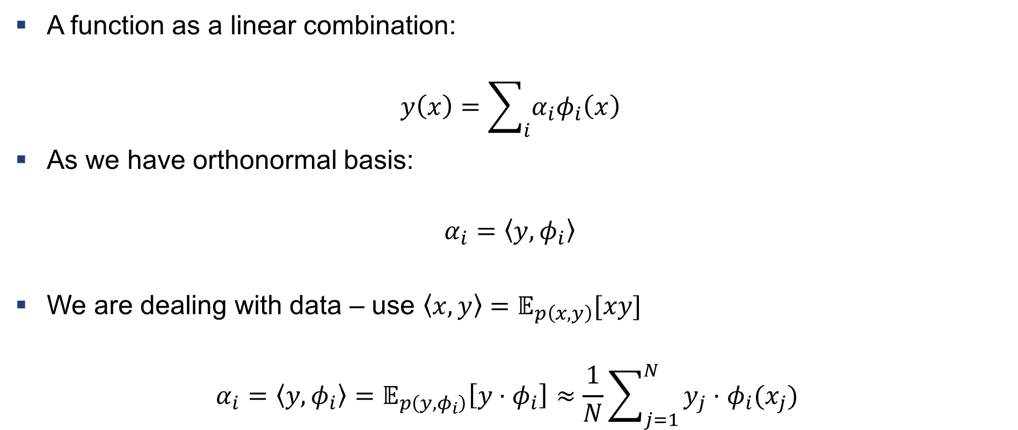
Data Fitting with Orthonormal Basis
A function as a linear combination:
$$y\left(x\right)=\sum_{i}{α_{i}φ_{i}\left(x\right)}$$
As we have orthonormal basis:
$$α_{i}=\left\langle y, φ_{i}\right\rangle$$
We are dealing with data – use $\left\langle x,y\right\rangle =𝔼_{p\left(x,y\right)}[xy]$
$$α_{i}=\left\langle y, φ_{i}\right\rangle =𝔼_{p\left(y, φ_{i}\right)}\left[y⋅φ_{i}\right]≈\frac{1}{N}\sum_{j=1}^{N}{y_{j}⋅φ_{i}(x_{j})}$$

Slide 14
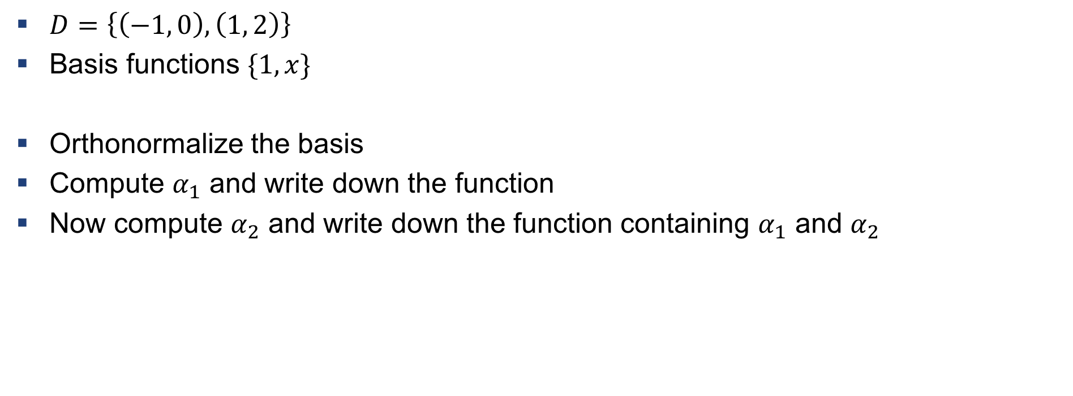
Example 2: Fitting with orthonormal functions
$D=\left\{\left(−1, 0\right), \left(1, 2\right)\right\}$
Basis functions $\{1, x\}$
Orthonormalize the basis
Compute $α_{1}$ and write down the function
Now compute $α_{2}$ and write down the function containing $α_{1}$ and $α_{2}$

Slide 15
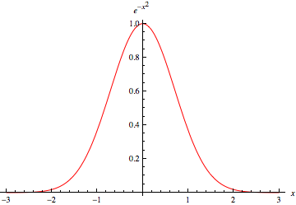
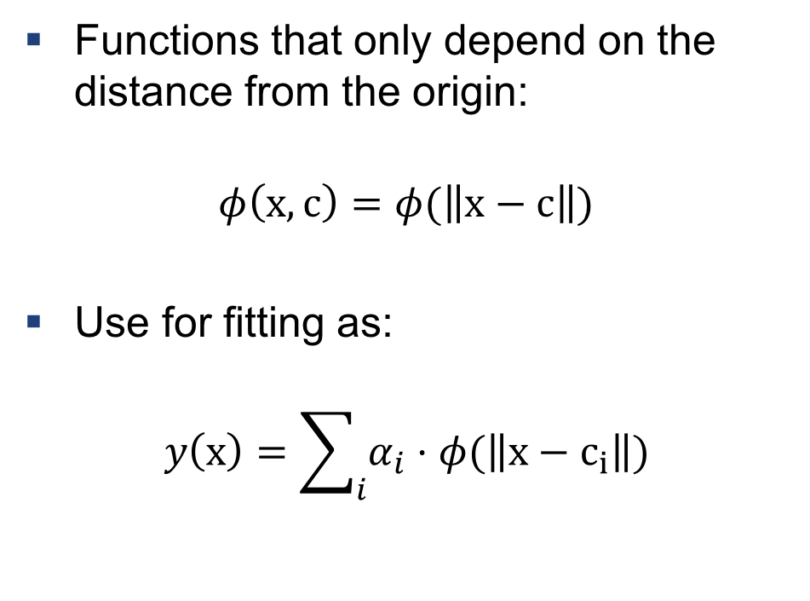
Radial Basis Functions
Functions that only depend on the distance from the origin:
$$φ\left(x, c\right)=φ(\left\|x−c\right\|)$$
Use for fitting as:
$$y\left(x\right)=\sum_{i}{α_{i}⋅φ(\left\|x−c_{i}\right\|)}$$
Typical example: Gauss function

Slide 16

Example 3: RBF fitting
$D=\left\{\left(0, 2\right), \left(3, 10\right)\right\}$
Use $φ\left(x\right)=1−\left|x−c_{i}\right|$ as basis function
Each RBF is centered at $x_{i}$
Find $α_{1}$ and $α_{2}$ st. $y\left(x\right)=\sum_{i}{α_{i}⋅(1−\left|x−c_{i}\right|)}$ goes through all data points exactly

Slide 17
Exercises

Slide 18
Q1
Perform Gram Schmidt
See how adding an additional orthonormal function improves performance while we do not have to recompute the parameters

Slide 19
Q2
Fit RBFs to some data points and see the resulting surface

Slide 20

Questions?

