Slide 1
Title
Text

Slide 2
Exercise 7: Neural Networks
MAD
bacdavid@student.ethz.ch

Slide 3
Outline
Information
Goals
Theory/ Recap
Exercises

Slide 4
Information

Slide 5
General
Lecture material & problem sets available here
Tutorial material available here

Slide 6
Specific
There is a second power point available towards the subject from last year.
Please have a look at it for more information.

Slide 7
Goals

Slide 8
Goals of Today
Know how neurons work
Know how we can stack neurons to a neural network
Understand how we can optimize neural networks efficiently

Slide 9
Theory / Recap

Slide 10
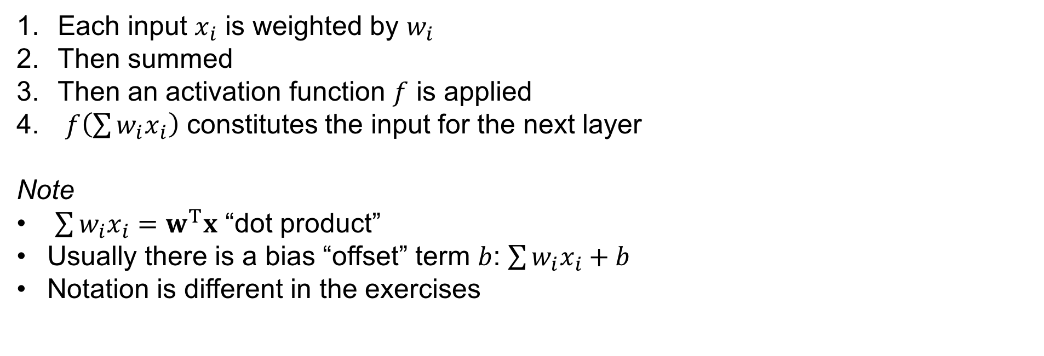
Neurons
Each input $x_{i}$ is weighted by $w_{i}$
Then summed
Then an activation function $f$ is applied
$f\left(\sum{w_{i}x_{i}}\right)$ constitutes the input for the next layer
Note
$\sum{w_{i}x_{i}}=w^{T}x$ “dot product”
Usually there is a bias “offset” term $b$: $\sum{{w_{i}x}_{i}+b}$
Notation is different in the exercises

Slide 11



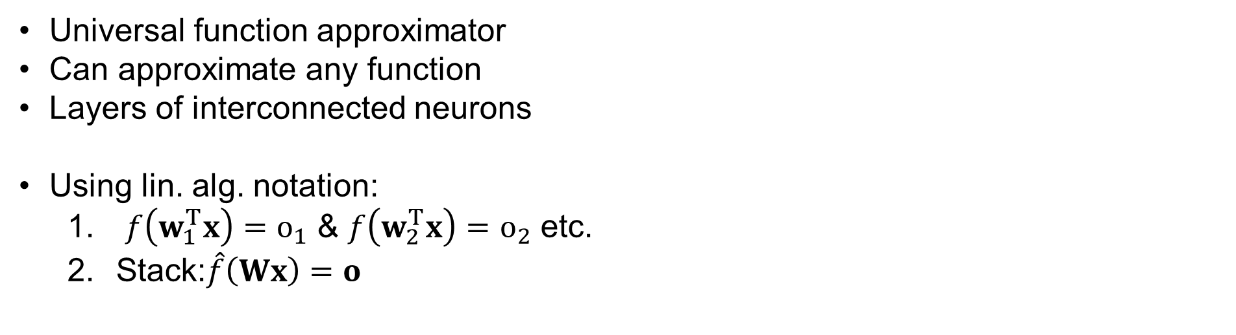
Neural Networks
$$x$$
$$o$$
Universal function approximator
Can approximate any function
Layers of interconnected neurons
Using lin. alg. notation:
$f\left(w_{1}^{T}x\right)=o_{1}$ & $f\left(w_{2}^{T}x\right)=o_{2}$ etc.
Stack:$\hat{f}\left(Wx\right)=o$
$$W$$

Slide 12
Operations on Neural Network
Forward Pass
Forward pass: read out $y=F^{NN}\left(x\right)$
Backward pass: gradient descent
Backward Pass

Slide 13
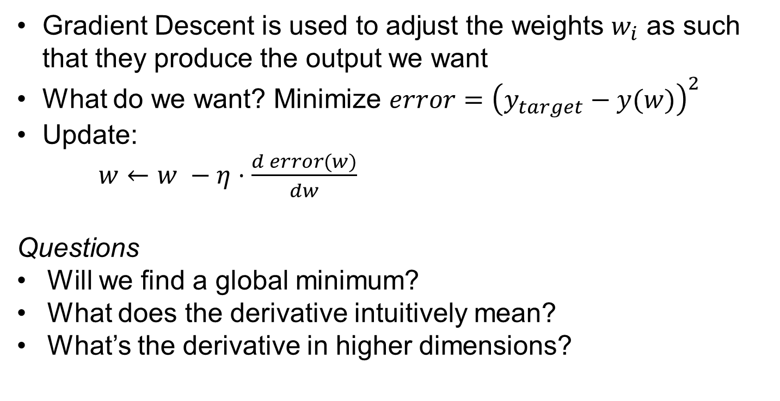
Gradient Descent
error
Gradient Descent is used to adjust the weights $w_{i}$ as such that they produce the output we want
What do we want? Minimize $error={\left(y_{target}−y(w)\right)}^{2}$
Update:
$w←w −η⋅\frac{d error(w)}{dw}$
Questions
Will we find a global minimum?
What does the derivative intuitively mean?
What’s the derivative in higher dimensions?
x
weight

Slide 14
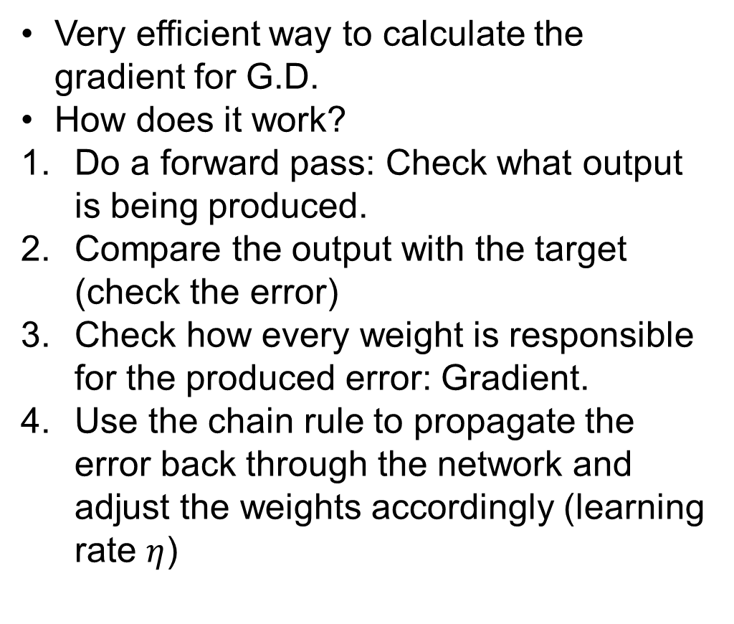
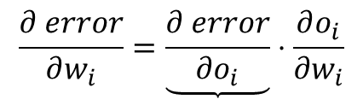






$$\frac{∂ error}{∂w_{i}}=\underbrace{\frac{∂ error}{∂o_{i}}}⋅\frac{∂o_{i}}{∂w_{i}}$$
Back Propagation
$$\frac{∂ o_{i+1}}{∂ o_{i}}⋅\frac{∂ error}{∂ o_{i+1}}$$
Very efficient way to calculate the gradient for G.D.
How does it work?
Do a forward pass: Check what output is being produced.
Compare the output with the target (check the error)
Check how every weight is responsible for the produced error: Gradient.
Use the chain rule to propagate the error back through the network and adjust the weights accordingly (learning rate $η$)
$$\frac{∂ o_{i+1}}{∂ o_{i}}$$
$$\frac{∂ error}{∂o_{i}}$$
$$\frac{∂ error}{∂ o_{i+1}}$$
$$\frac{∂o_{i}}{∂w_{i}}$$
$$\frac{∂ error}{∂w_{i}}$$

Slide 15









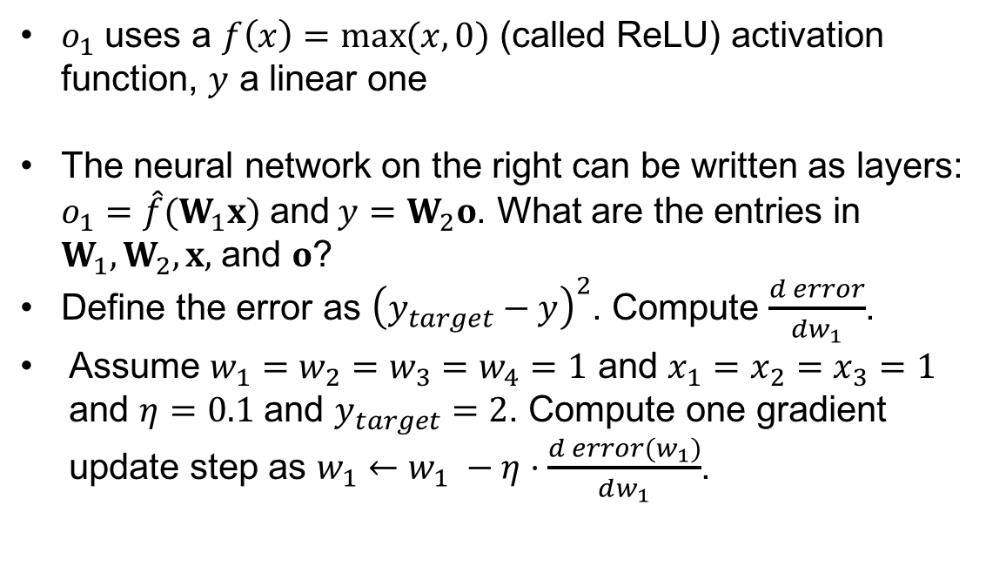
Example 1: Neural Network computations
$o_{1}$ uses a $f\left(x\right)=\max{(x, 0)}$ (called ReLU) activation function, $y$ a linear one
The neural network on the right can be written as layers: $o_{1}=\hat{f}(W_{1}x)$ and$y=W_{2}o$. What are the entries in $W_{1}, W_{2}, x,$ and $o$?
Define the error as ${\left(y_{target}−y\right)}^{2}$. Compute $\frac{d error}{dw_{1}}$.
Assume $w_{1}=w_{2}=w_{3}=w_{4}=1$ and $x_{1}=x_{2}=x_{3}=1$ and $η=0.1$ and $y_{target}=2$. Compute one gradient update step as $w_{1}←w_{1} −η⋅\frac{d error(w_{1})}{dw_{1}}$.
$$x_{3}$$
$$w_{3}$$
$$x_{1}$$
$$w_{1}$$
$$o_{1}$$
$$y$$
$$w_{4}$$
$$x_{2}$$
$$w_{2}$$

Slide 16
Exercises

Slide 17
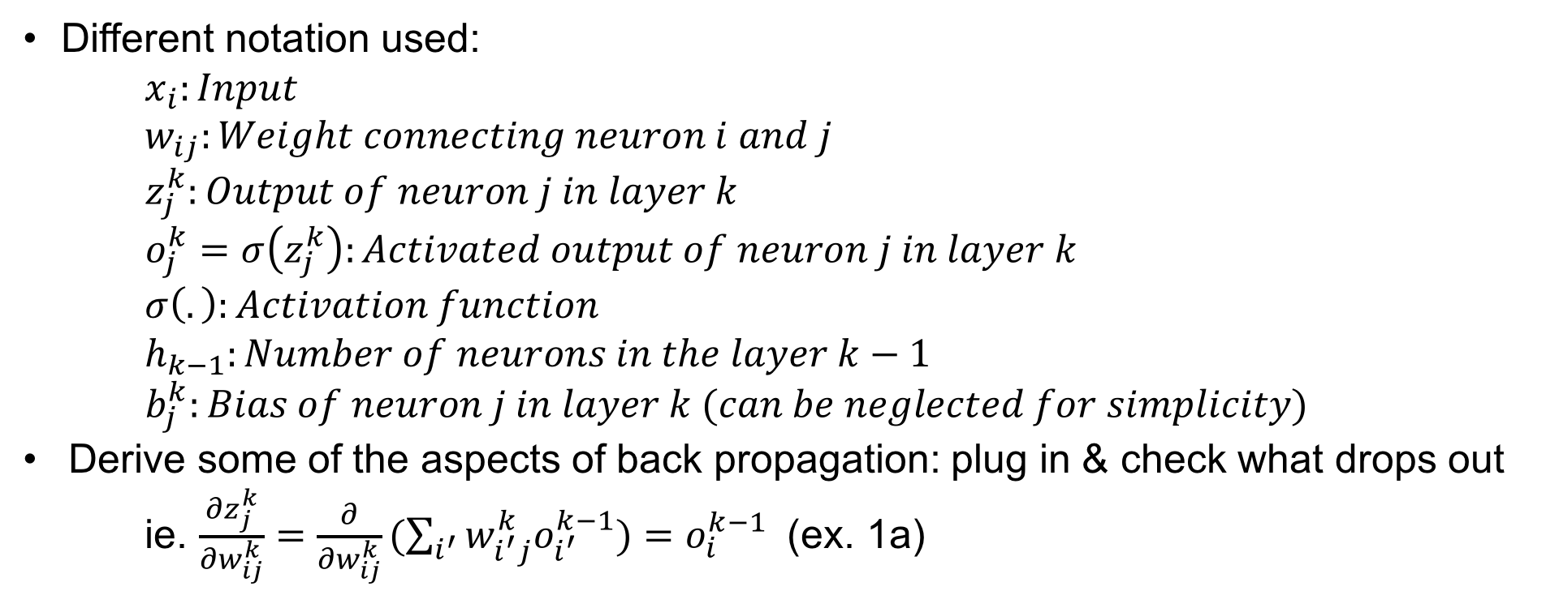
Exercise 1
Different notation used:
$x_{i}:Input$
$w_{ij}:Weight connecting neuron i and j$
$z_{j}^{k}:Output of neuron j in layer k$
$o_{j}^{k}=σ\left(z_{j}^{k}\right):Activated output of neuron j in layer k$
$σ\left(.\right):Activation function$
$h_{k−1}:Number of neurons in the layer k−1$
$b_{j}^{k}:Bias of neuron j in layer k (can be neglected for simplicity)$
Derive some of the aspects of back propagation: plug in & check what drops out
ie. $\frac{∂z_{j}^{k}}{∂w_{ij}^{k}}=\frac{∂}{∂w_{ij}^{k}}(\sum_{i^{′}}{w_{i^{′}j}^{k}o_{i^{′}}^{k−1})=o_{i}^{k−1} }$ (ex. 1a)

Slide 18
Exercise 2
Simple introduction to tensorflow
Tensorflow is different than what you are used to terms programming:
Set up a graph with all the functions that you will use afterwards
Feed values into the graph; Values «travel» through graph and are returned
Please have a look at the additional material: There is an example file.

Slide 19

Questions?

