Slide 1
Title
Text

Slide 2
Exercise 9: Numerical Integration II
MAD
bacdavid@student.ethz.ch

Slide 3
Outline
Information
Goals
Theory/ Recap
Exercises

Slide 4
Information

Slide 5
General
Lecture material & problem sets available here
Tutorial material available here

Slide 6
Goals

Slide 7
Goals of Today
Understand Richardson extrapolation
Understand how to use Richardson extrapolation
Be aware that higher order approximations are not always better
Understand how Richardson extrapolation can increase accuracy for numerical integration (Romberg integration)

Slide 8
Theory / Recap

Slide 9
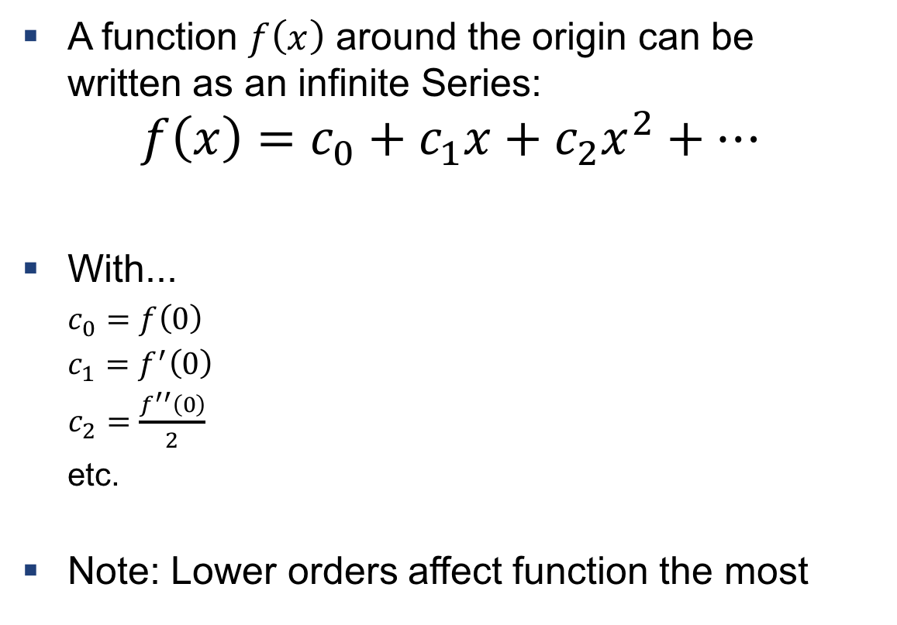
Taylor expansion
A function $f\left(x\right)$ around the origin can be written as an infinite Series:
$$f\left(x\right)=c_{0}+c_{1}x+c_{2}x^{2}+…$$
With...
$c_{0}=f\left(0\right)$
$c_{1}=f^{′}\left(0\right)$
$c_{2}=\frac{f^{′′}\left(0\right)}{2}$
etc.
Note: Lower orders affect function the most
https://en.wikipedia.org/wiki/Taylor_series#/media/File:Sintay_SVG.svg

Slide 10

Example 1: Taylor Expansion
Write down the Taylor Series around $0$ of
$$f\left(x\right)=\frac{1}{1−x}, x∈\left(−1, 1\right)$$

Slide 11
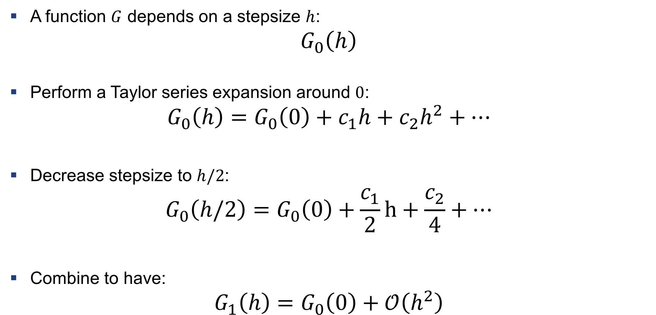
Richardson Extrapolation
A function $G$ depends on a stepsize $h$:
$$G_{0}\left(h\right)$$
Perform a Taylor series expansion around $0$:
$$G_{0}\left(h\right)=G_{0}\left(0\right)+c_{1}h+c_{2}h^{2}+…$$
Decrease stepsize to $h/2$:
$$G_{0}\left(h/2\right)=G_{0}\left(0\right)+\frac{c_{1}}{2}h+\frac{c_{2}}{4}+…$$
Combine to have:
$$G_{1}\left(h\right)=G_{0}\left(0\right)+𝒪\left(h^{2}\right)$$

Slide 12

Iterative formulation
In order to obtain $G_{n}\left(h\right)$ (order $n+1$) compute:
$$G_{n}\left(h\right)=\frac{1}{2^{n}−1}\left(2^{n}G_{n−1}\left(h/2\right)−G_{n−1}\left(h\right)\right)=G\left(0\right)+𝒪\left(h^{n+1}\right)$$

Slide 13
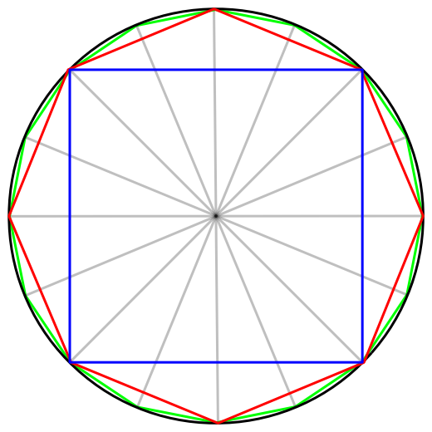
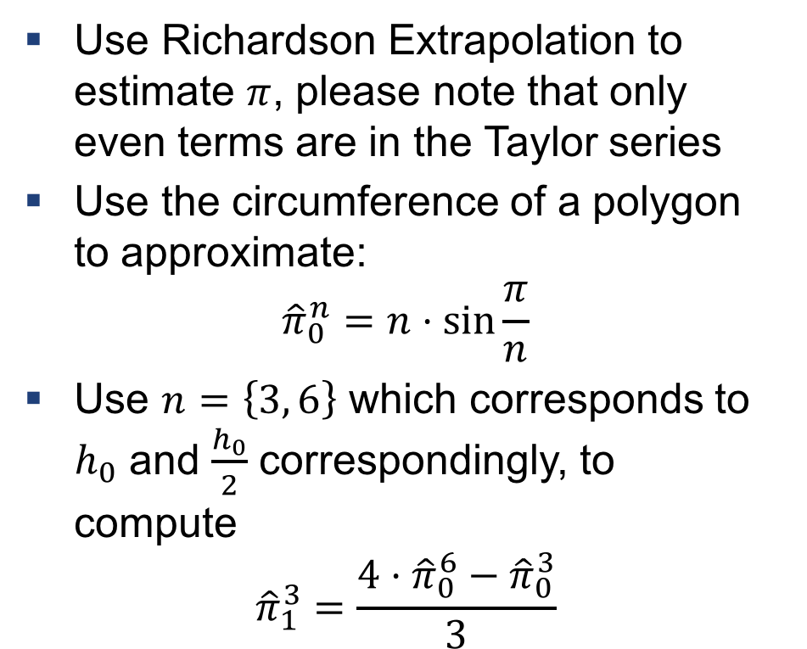
Example 2: Richardson Extrapolation for $π$
Use Richardson Extrapolation to estimate $π$, please note that only even terms are in the Taylor series
Use the circumference of a polygon to approximate:
$${\hat{π}}_{0}^{n}=n⋅\sin{\frac{π}{n}}$$
Use $n=\left\{3, 6\right\}$ which corresponds to $h_{0}$ and $\frac{h_{0}}{2}$ correspondingly, to compute
$${\hat{π}}_{1}^{3}=\frac{4⋅{\hat{π}}_{0}^{6}−{\hat{π}}_{0}^{3}}{3}$$

Slide 14
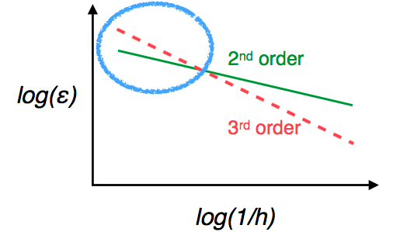
Higher order is not always better
The order defines the rate at which the error drops
However, the terms still depend on constants

Slide 15
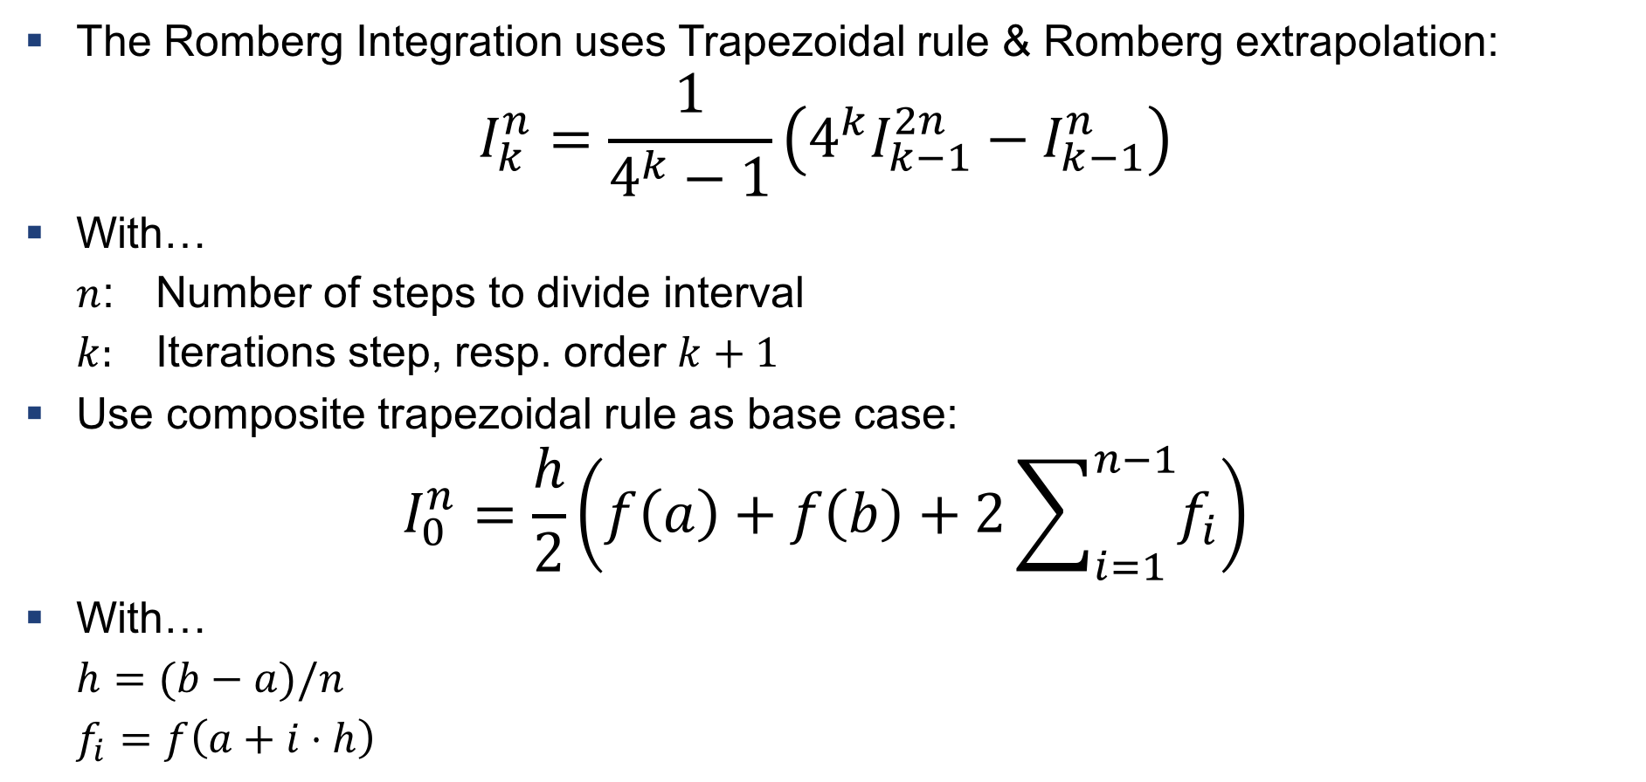
Romberg Integration
The Romberg Integration uses Trapezoidal rule & Romberg extrapolation:
$$I_{k}^{n}=\frac{1}{4^{k}−1}\left(4^{k}I_{k−1}^{2n}−I_{k−1}^{n}\right)$$
With…
$n$: Number of steps to divide interval
$k:$ Iterations step, resp. order $k+1$
Use composite trapezoidal rule as base case:
$$I_{0}^{n}=\frac{h}{2}\left(f\left(a\right)+f\left(b\right)+2\sum_{i=1}^{n−1}{f_{i}}\right)$$
With…
$h=(b−a)/n$
$f_{i}=f\left(a+i⋅h\right)$

Slide 16
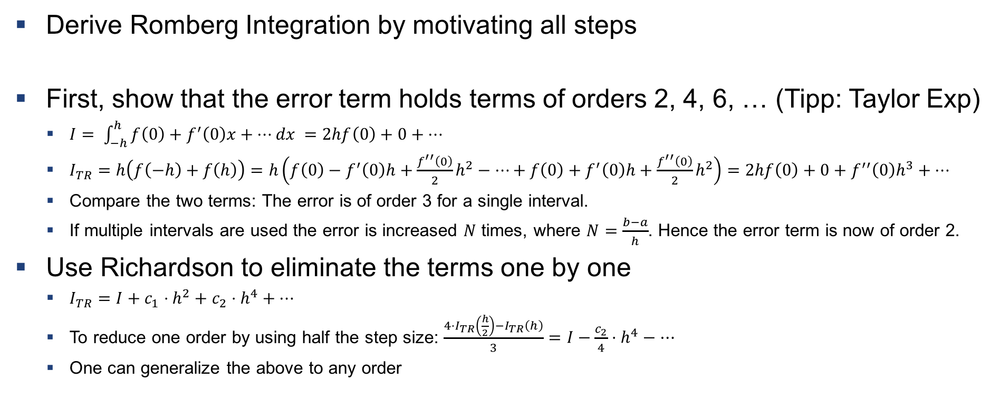
Example ‘bonus’: Derive Romberg Integration
Solutions Provided
Derive Romberg Integration by motivating all steps
First, show that the error term holds terms of orders 2, 4, 6, … (Tipp: Taylor Exp)
$I= \int_{−h}^{h}{f\left(0\right)+f^{′}\left(0\right)x+…dx }=2hf\left(0\right)+0+…$
$I_{TR}=h\left(f\left(−h\right)+f\left(h\right)\right)=h\left(f\left(0\right)−f^{′}\left(0\right)h+\frac{f^{′′}\left(0\right)}{2}h^{2}−…+f\left(0\right)+f^{′}\left(0\right)h+\frac{f^{′′}\left(0\right)}{2}h^{2}\right)=2hf\left(0\right)+0+f^{′′}\left(0\right)h^{3}+…$
Compare the two terms: The error is of order 3 for a single interval.
If multiple intervals are used the error is increased $N$ times, where $N=\frac{b−a}{h}$. Hence the error term is now of order 2.
Use Richardson to eliminate the terms one by one
$I_{TR}=I+c_{1}⋅h^{2}+c_{2}⋅h^{4}+…$
To reduce one order by using half the step size: $\frac{4⋅I_{TR}\left(\frac{h}{2}\right)−I_{TR}\left(h\right)}{3}=I−\frac{c_{2}}{4}⋅h^{4}−…$
One can generalize the above to any order

Slide 17
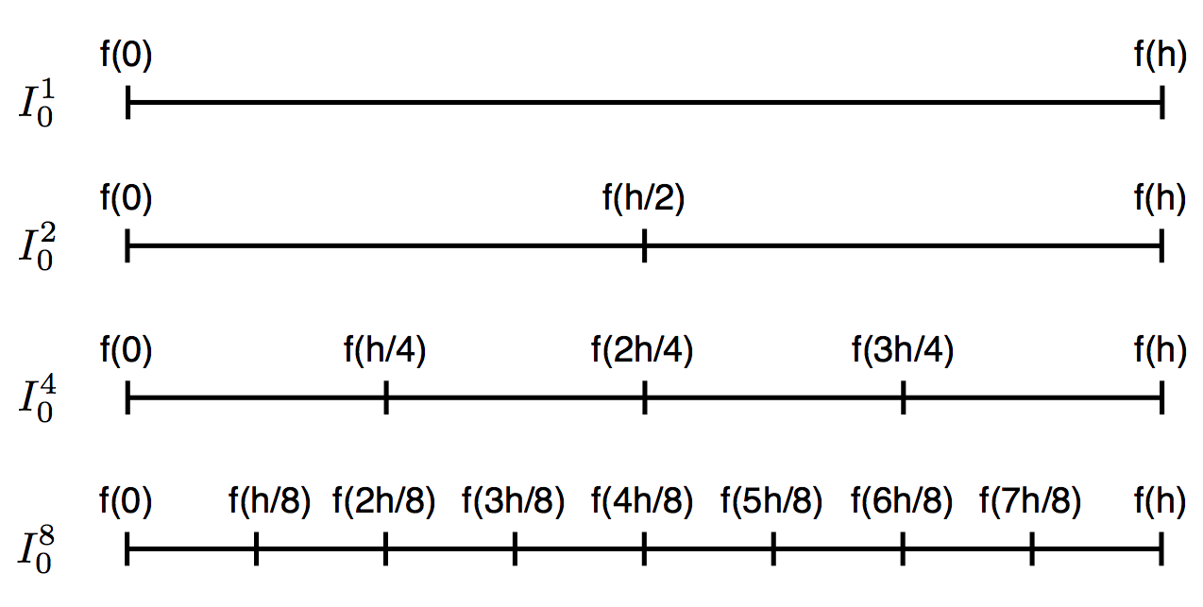
Recycle function evaluations (store in array!)

Slide 18

Example 3: Romberg Integration
Approximate
$$I=\int_{−1}^{1}{x^{2}dx}$$
with
$$I_{1}^{1}$$
Formulas:
$I_{k}^{n}=\frac{1}{4^{k}−1}\left(4^{k}I_{k−1}^{2n}−I_{k−1}^{n}\right)$
$I_{0}^{n}=\frac{h}{2}\left(f\left(a\right)+f\left(b\right)+2\sum_{i=1}^{n−1}{f_{i}}\right)$
With $h=(b−a)/n$ and $f_{i}=f\left(a+i⋅h\right)$

Slide 19
Exercises

Slide 20
Exercise 1
Use Richardson Extrapolation for derivative approximation

Slide 21
Exercise 2
Write pseudo-code for Romberg Integration

Slide 22
Exercise 3
Implement Romberg Integration

Slide 23

Questions?

