Slide 1
Title
Text

Slide 2
Exercise 10: Numerical Integration III
MAD
bacdavid@student.ethz.ch

Slide 3
Outline
Information
Goals
Theory/ Recap
Exercises

Slide 4
Information

Slide 5
General
Lecture material & problem sets available here
Tutorial material available here

Slide 6
Goals

Slide 7
Goals of Today
Recap Richardson’s Extrapolation
Understand how Richardson’s Extrapolation can be used to estimate an error
Understand recursion in programming
Understand Adaptive Quadrature
Be able to derive Gauss Quadrature
Be able to use Gauss Quadrature with tables

Slide 8
Theory / Recap

Slide 9
Adaptive Quadrature
Use adaptive stepsize
Decrease stepsize in specific region until desired accuracy is achieved
https://www.cs.uic.edu/~hogand/cs107/notes-numerical.html

Slide 10
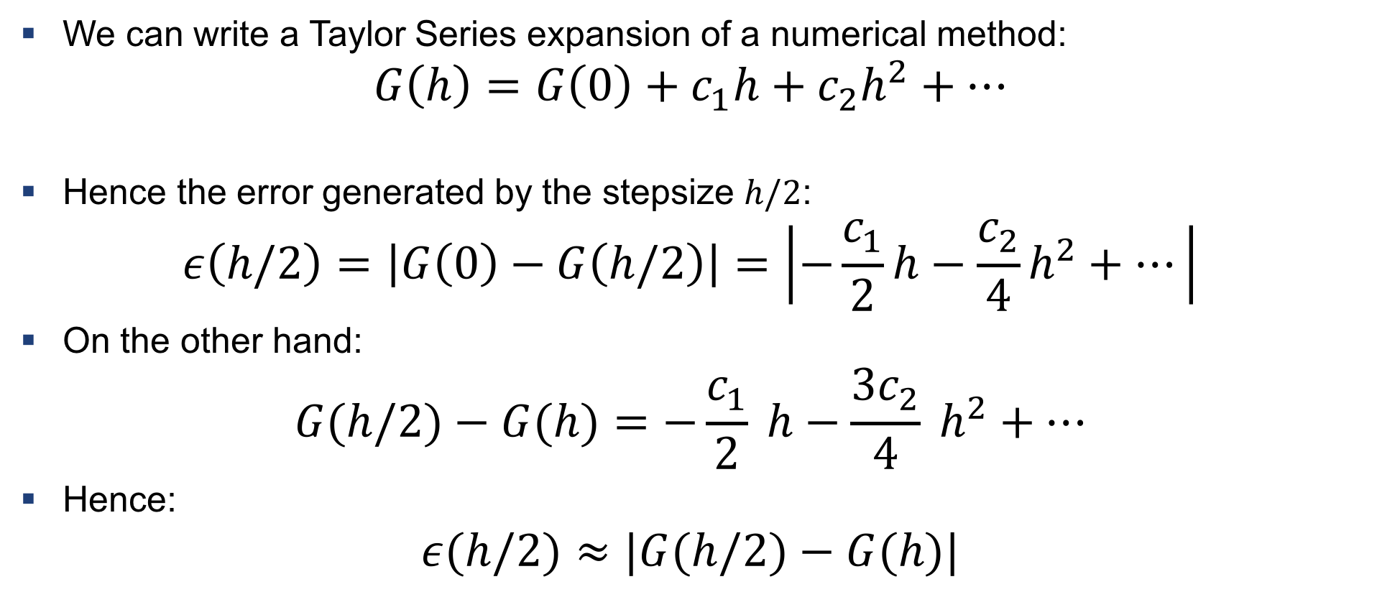
Reminder: Error Estimate with Richardson’s Extrapolation
We can write a Taylor Series expansion of a numerical method:
$$G\left(h\right)=G\left(0\right)+c_{1}h+c_{2}h^{2}+…$$
Hence the error generated by the stepsize $h/2$:
$$ε\left(h/2\right)=\left|G\left(0\right)−G\left(h/2\right)\right|=\left|−\frac{c_{1}}{2}h−\frac{c_{2}}{4}h^{2}+…\right|$$
On the other hand:
$$G(h/2)−G(h)=−\frac{c_{1}}{2} h−\frac{3c_{2}}{4} h^{2}+…$$
Hence:
$$ε(h/2)≈|G(h/2)−G(h)|$$

Slide 11
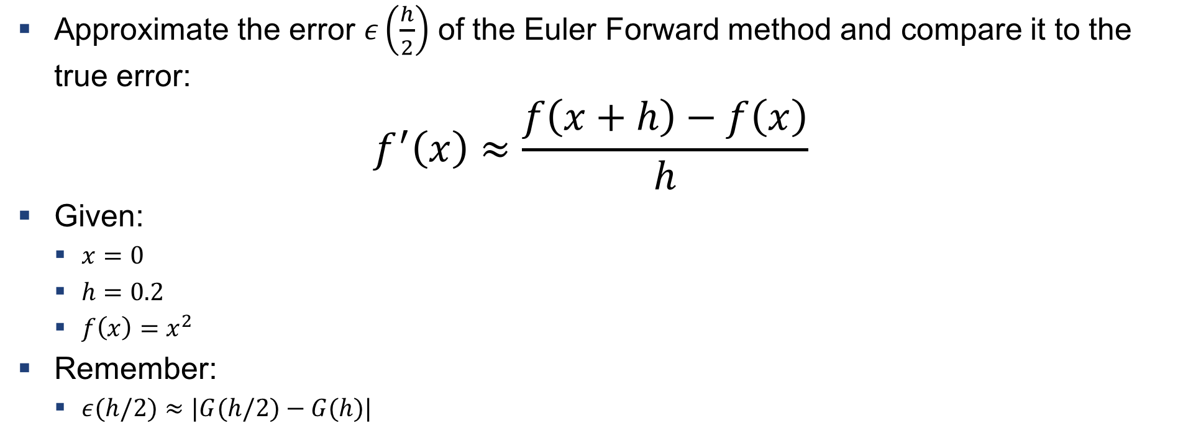
Example 1: Error estimate
Approximate the error $ε\left(\frac{h}{2}\right)$ of the Euler Forward method and compare it to the true error:
$$f^{′}\left(x\right)≈\frac{f\left(x+h\right)−f\left(x\right)}{h}$$
Given:
$x=0$
$h=0.2$
$f\left(x\right)=x^{2}$
Remember:
$ε(h/2)≈|G(h/2)−G(h)|$

Slide 12
Reminder: Recursion
The function calls itself
function f(x)
if base case then
Return base value
else
Return recursive value
end if
end function
https://stackoverflow.com/questions/8183426/factorial-using-recursion-in-java

Slide 13
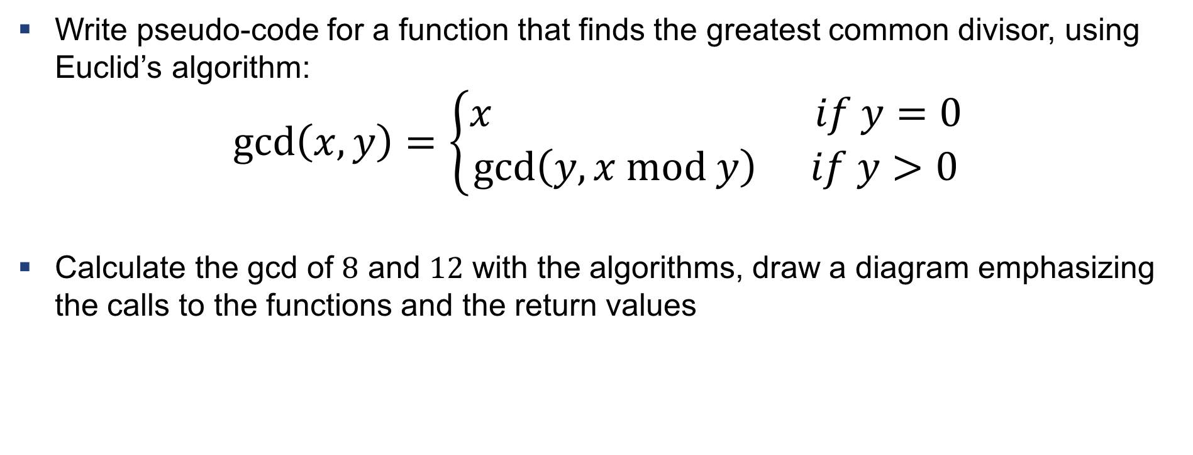
Example 2: Recursion for gcd
Write pseudo-code for a function that finds the greatest common divisor, using Euclid’s algorithm:
$$\gcd\left(x,y\right)=\left\{\begin{aligned}x if y=0 \\ \gcd\left(y, x mod y\right) if y>0\end{aligned}\right.$$
Calculate the gcd of $8$ and $12$ with the algorithms, draw a diagram emphasizing the calls to the functions and the return values

Slide 14
Solution 2
function gcd(x, y)
if y is 0 then
Return x
else
Return gcd(y, x mod y)
end if
end function

Slide 15
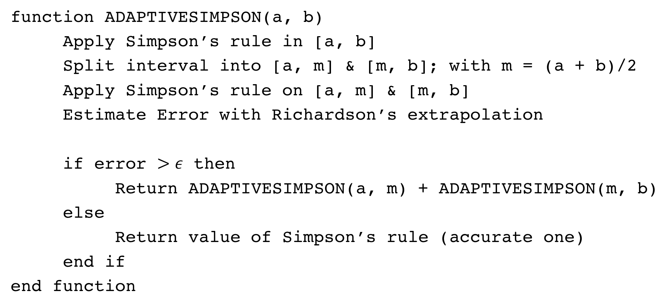
Adaptive Quadrature Algorithm
function ADAPTIVESIMPSON(a, b)
Apply Simpson’s rule in [a, b]
Split interval into [a, m] & [m, b]; with m = (a + b)/2
Apply Simpson’s rule on [a, m] & [m, b]
Estimate Error with Richardson’s extrapolation
if error $>ε$ then
Return ADAPTIVESIMPSON(a, m) + ADAPTIVESIMPSON(m, b)
else
Return value of Simpson’s rule (accurate one)
end if
end function

Slide 16

Gauss Quadrature
$n$ weights + $n$ abscissas $=2n$ parameters
Integrate $P_{2n−1}\left(x\right)$ exactly (integral increases order by one):
$$\int_{a}^{b}{f\left(x\right)dx≈\int_{a}^{b}{P_{2n−1}}\left(x\right)dx}=\sum_{i=1}^{n}{α_{i}⋅f(x_{i})}$$

Slide 17
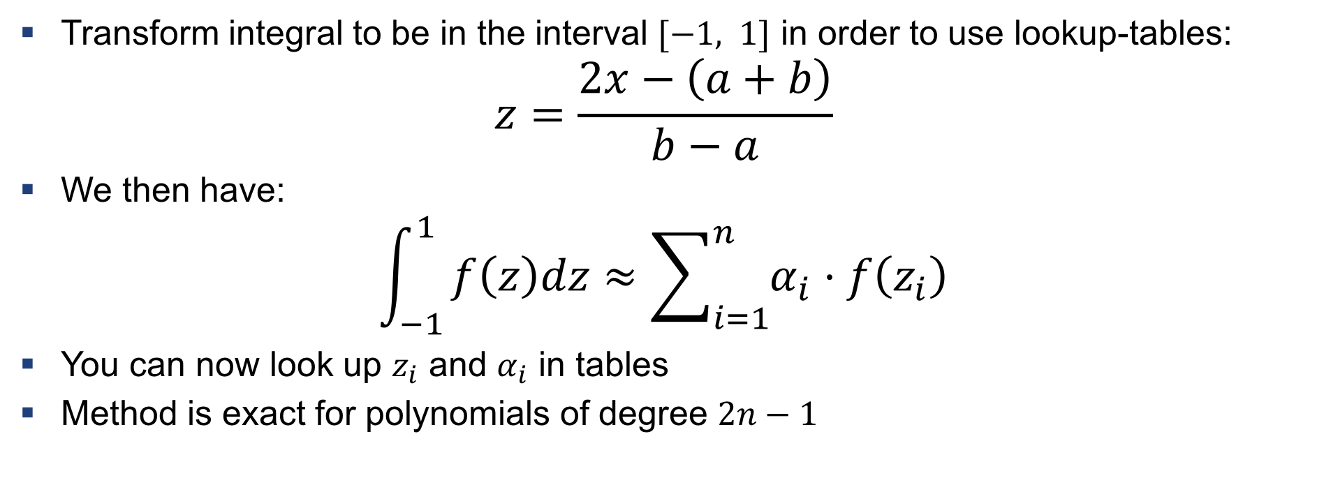
Note
Transform integral to be in the interval $[−1, 1]$ in order to use lookup-tables:
$$z=\frac{2x−\left(a+b\right)}{b−a}$$
We then have:
$$\int_{−1}^{1}{f\left(z\right)dz≈\sum_{i=1}^{n}{α_{i}⋅f\left(z_{i}\right)}}$$
You can now look up $z_{i}$ and $α_{i}$ in tables
Method is exact for polynomials of degree $2n−1$

Slide 18
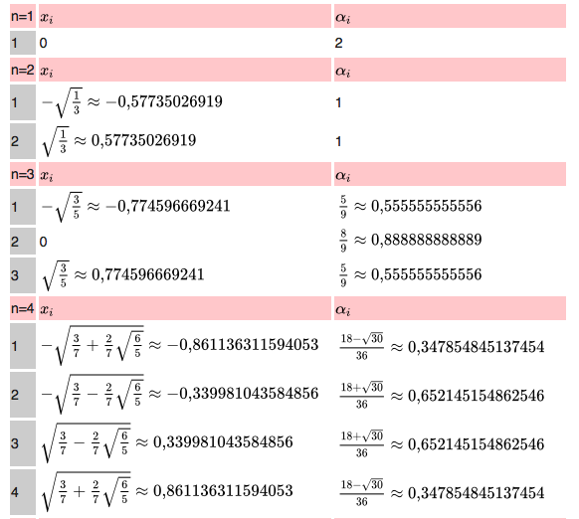
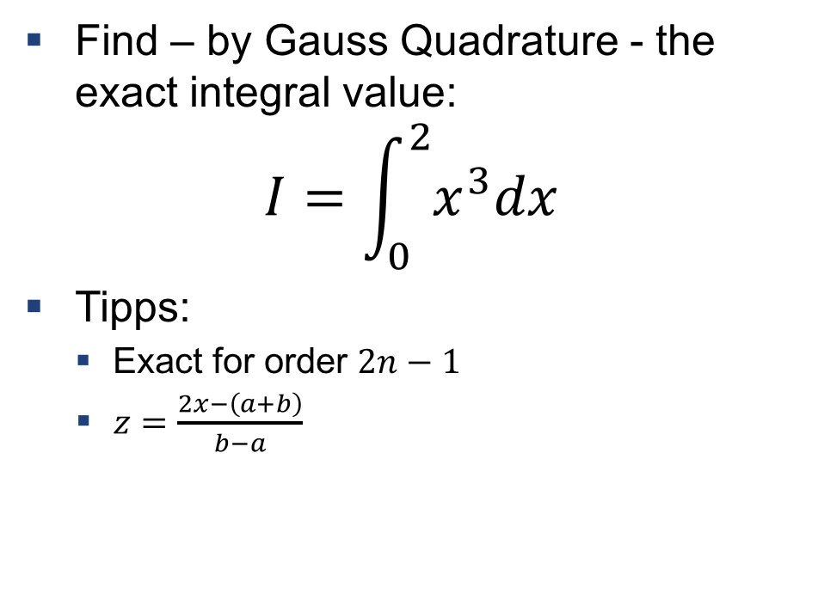
Example 3: Gauss Quadrature with lookup tables
Find – by Gauss Quadrature - the exact integral value:
$$I=\int_{0}^{2}{x^{3}dx}$$
Tipps:
Exact for order $2n−1$
$z=\frac{2x−\left(a+b\right)}{b−a}$

Slide 19
Exercises

Slide 20
Exercise 1
Use AQ to integrate „batman function“

Slide 21
Exercise 2
Use various integration schemes – think why some work better than others!

Slide 22

Questions?

