Slide 1
Title
Text

Slide 2
Exercise 11: Numerical Integration IV
MAD
bacdavid@student.ethz.ch

Slide 3
Outline
Information
Goals
Theory/ Recap
Exercises

Slide 4
Information

Slide 5
General
Lecture material & problem sets available here
Tutorial material available here

Slide 6
Goals

Slide 7
Goals of Today
Understand numerical integration for more dimensions
Understand why conventional approaches might be problematic
Know about probability basics
Understand Monte Carlo quadrature

Slide 8
Theory / Recap

Slide 9
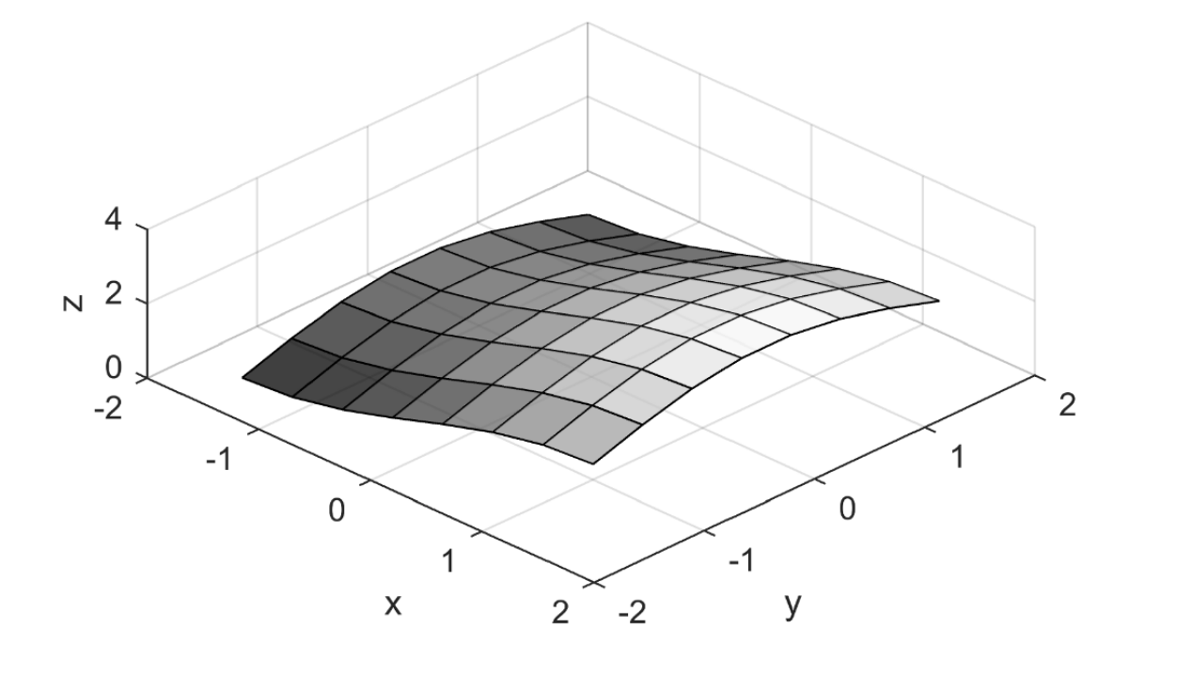

Multivariate numerical integration
The exact integral:
$$I=\int_{Ω}{f\left(x\right)dx}$$
Approximation:
$$I≈∑w_{i}f(x_{i})$$

Slide 10
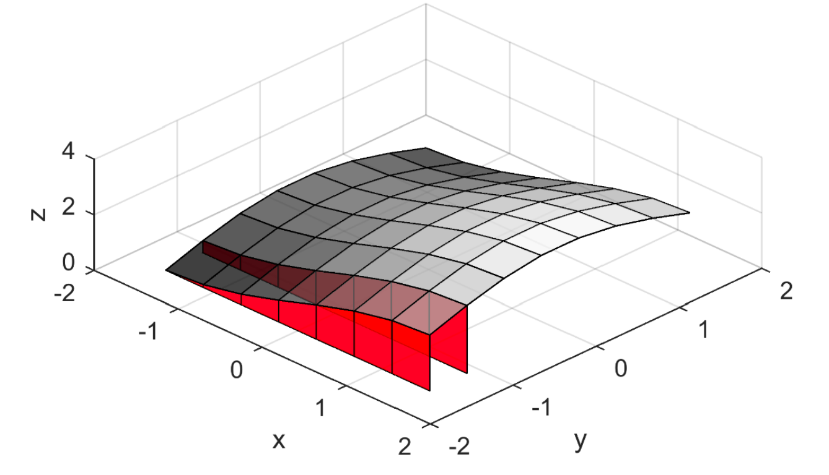
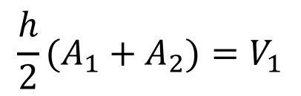
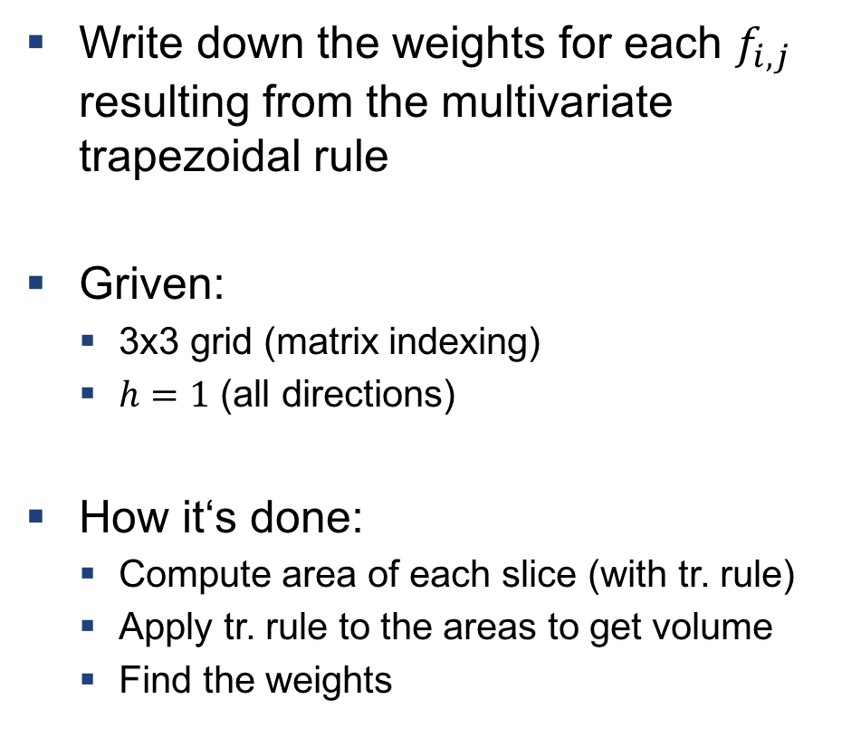
Example 1: Find weights
Write down the weights for each $f_{i,j}$ resulting from the multivariate trapezoidal rule
Griven:
3x3 grid (matrix indexing)
$h=1$ (all directions)
How it‘s done:
Compute area of each slice (with tr. rule)
Apply tr. rule to the areas to get volume
Find the weights
$${\frac{h}{2}(A_{1}+A}_{2})=V_{1}$$

Slide 11
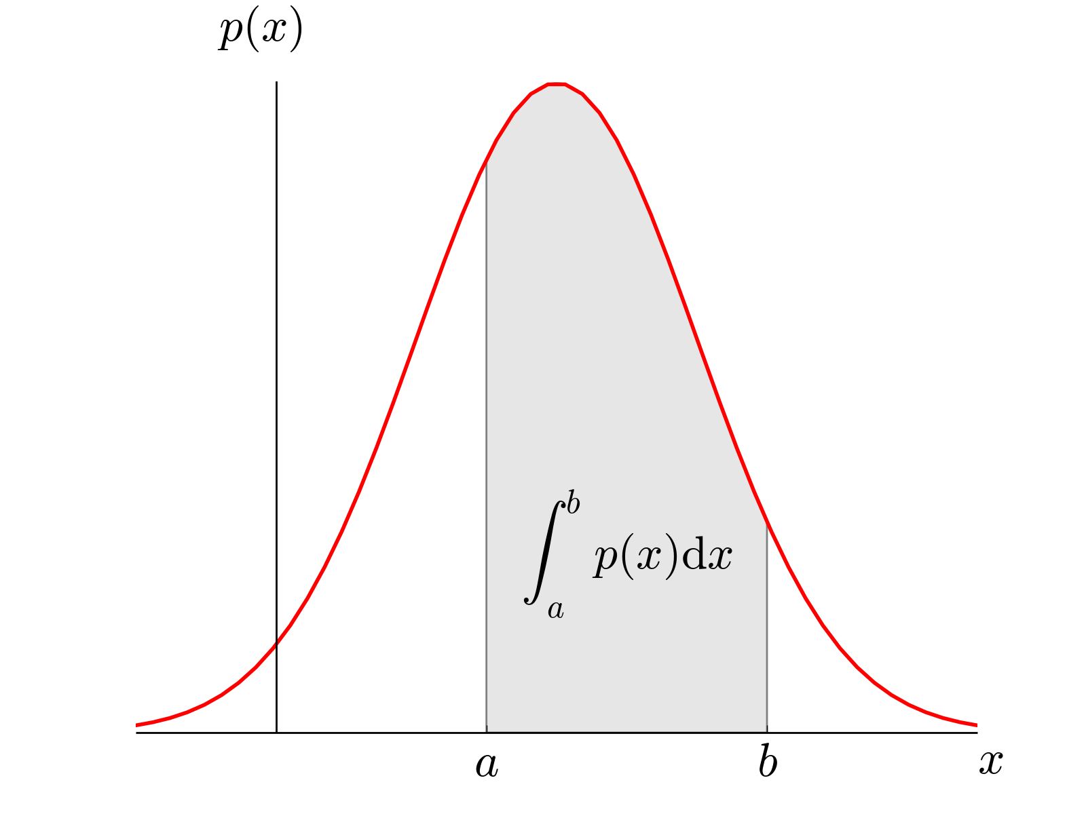

Probability Review
Discrete Random Variables
$p:Ω→ℝ$, where eg. $Ω$={0, 1, 2, …}
$\sum_{Ω}{p}=1$, $p≥0$
Continuous Random Variables
$p:Ω→ℝ$, where eg. $Ω$=[0, 1]
$\int_{Ω}{p}=1$, $p≥0$

Slide 12



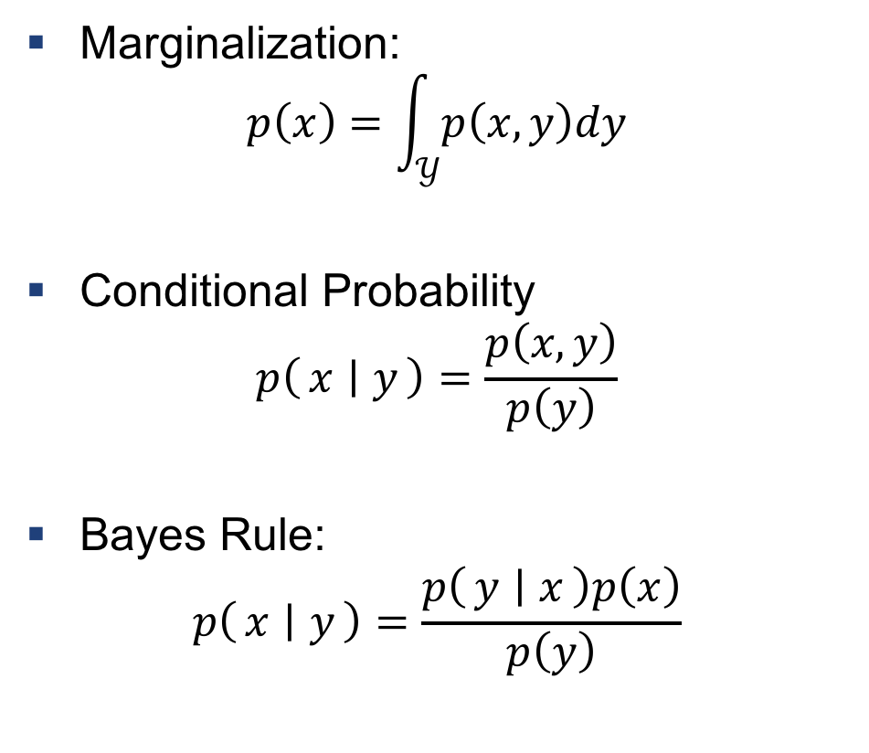
Marginalization, Conditional Probability, and Bayes Rule
Marginalization:
$$p\left(x\right)=\int_{𝒴}{p\left(x,y\right)dy}$$
Conditional Probability
$$p\left(x ∣ y\right)=\frac{p\left(x,y\right)}{p\left(y\right)}$$
Bayes Rule:
$$p\left(x ∣ y\right)=\frac{p\left(y ∣ x\right)p\left(x\right)}{p\left(y\right)}$$
$$U$$
$$A$$
$$B$$
Venn Diagram of Bayes Rule: Have a look at https://oscarbonilla.com/2009/05/visualizing-bayes-theorem/ for more info

Slide 13

Example 2: Probability Density
PDF: $p\left(x,y\right)=c, x∈\left[−1, 1\right], y∈[−1, 1]$
Find $c$ such that it’s a valid PDF
Compute the probability that $x$ is larger than 0, $P(x>0)$
Tipps:
$P\left(x>a\right)=\int_{a}^{∞}{p\left(x\right)dx}$

Slide 14

Example 3: Bayes Spam Filtering
Find the probability that an email containing the word „gold“ is spam, ie. $p(spam∣“gold“)$
Given:
$p\left(„gold“ ∣ spam\right)=0.6$
$p\left(„gold“ ∣ no spam\right)=0.01$
$p(spam)=0.2$
Tipps:
$p\left(x ∣ y\right)=\frac{p\left(y ∣ x\right)p\left(x\right)}{p\left(y\right)}$

Slide 15
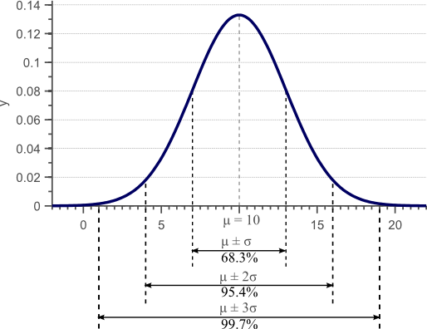

Expectation value and variance
Expectation value:
$$𝔼\left[f\left(x\right)\right]=\int_{−∞}^{∞}{f\left(x\right)p\left(x\right)dx}$$
Variance:
$$Var\left(f\left(x\right)\right)=σ^{2}=𝔼\left[f^{2}(x)\right]−𝔼^{2}\left[f\left(x\right)\right]$$

Slide 16

Example 4: Expectation of a dice
Compute the expectation value of a dice
Tipps:
$𝔼\left[f\left(x\right)\right]=\int_{−∞}^{∞}{f\left(x\right)p\left(x\right)dx}$

Slide 17
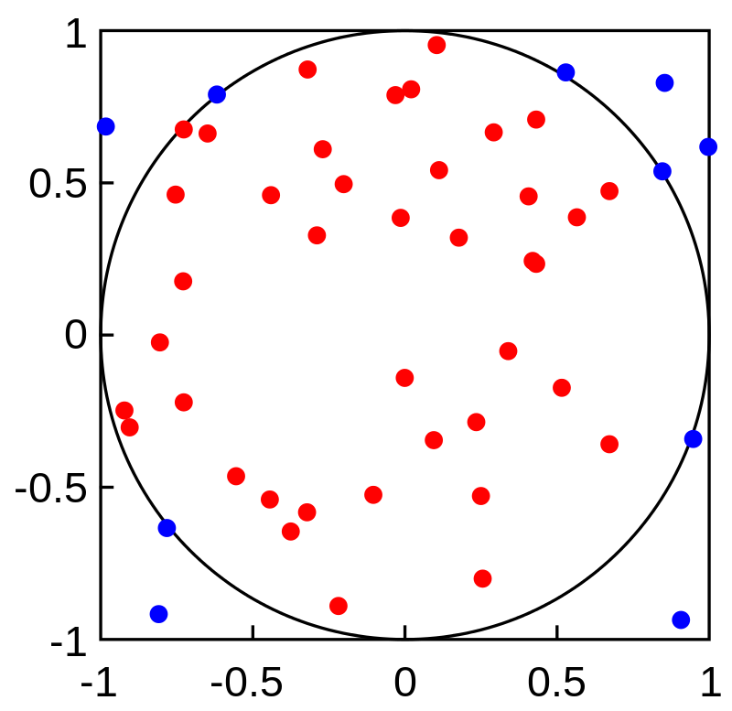
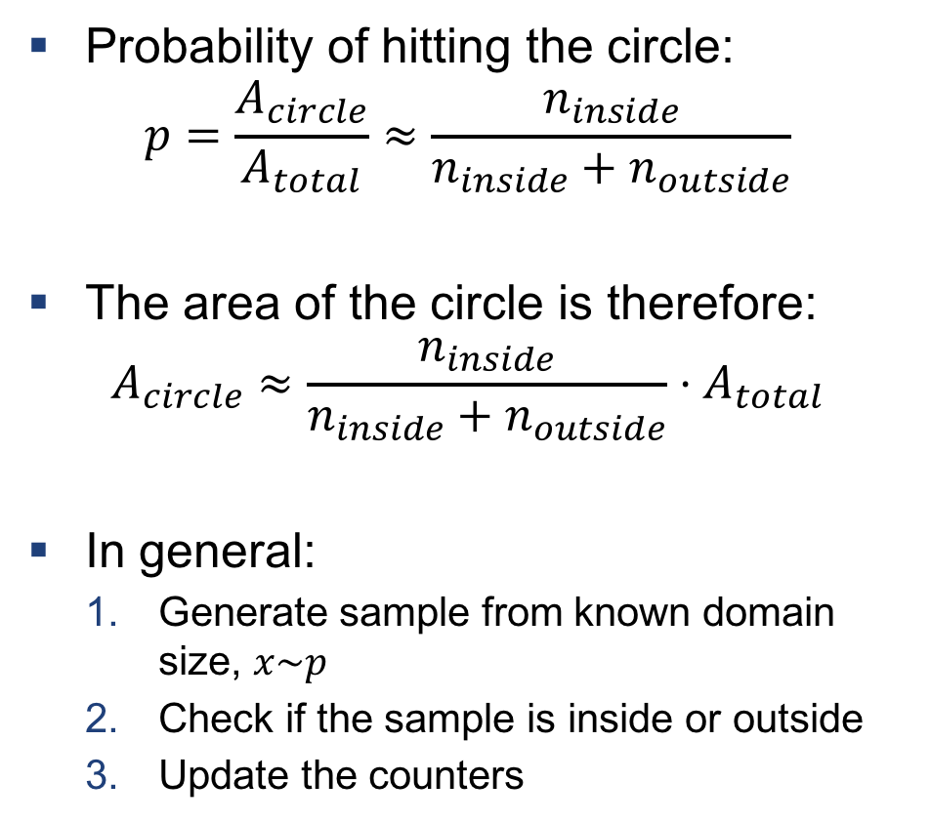
Monte Carlo Quadrature
Probability of hitting the circle:
$$p=\frac{A_{circle}}{A_{total}}≈\frac{n_{inside}}{n_{inside}+n_{outside}}$$
The area of the circle is therefore:
$$A_{circle}≈\frac{n_{inside}}{n_{inside}+n_{outside}}⋅A_{total}$$
In general:
Generate sample from known domain size, $x\sim p$
Check if the sample is inside or outside
Update the counters

Slide 18

Example 5: Monte Carlo for area
We want to evaluate the integral
$$I=\int_{−1}^{1}{x^{2}dx}$$
Define $φ\left(x,y\right)$ st. $I=\int_{ℝ^{2}}{φ\left(x,y\right)dxdy}$
Assume $x,y$ are uniformly sampled from $\left[−1,1\right]×\left[−1,1\right]$, compute $𝔼\left[φ\left(x,y\right)\right]$
Tipps:
$𝔼\left[f\left(x\right)\right]=\int_{−∞}^{∞}{f\left(x\right)p\left(x\right)dx}$

Slide 19
Exercises

Slide 20
Exercise 1
Multivariate numerical integration

Slide 21
Exercise 2
Monte Carlo Quadrature

Slide 22
Exercise 3
Mini exercise for Bayes Rule

Slide 23

Questions?

