Slide 1
Title
Text

Slide 2
Exercise 12: Sampling
MAD
bacdavid@student.ethz.ch

Slide 3
Outline
Information
Goals
Theory/ Recap
Exercises

Slide 4
Information

Slide 5
General
Lecture material & problem sets available here
Tutorial material available here

Slide 6
Goals

Slide 7
Goals of Today
Understand why we want to sample from a distribution
Understand inverse CDF sampling
Understand limitations of inverse CDF sampling
Understand rejection sampling
Understand Markov Chain Monte Carlo sampling
Difficult examples today! Don’t be intimidated!

Slide 8
Theory / Recap

Slide 9

Why do we sample?
$$F_{tot}=F^{P}+F^{R}$$
Simulate a probabilistic model
Obtain statistical insights

Slide 10
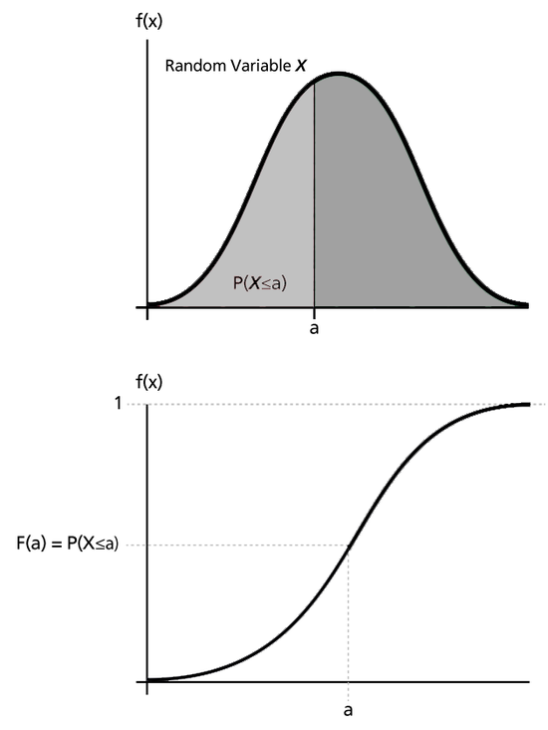
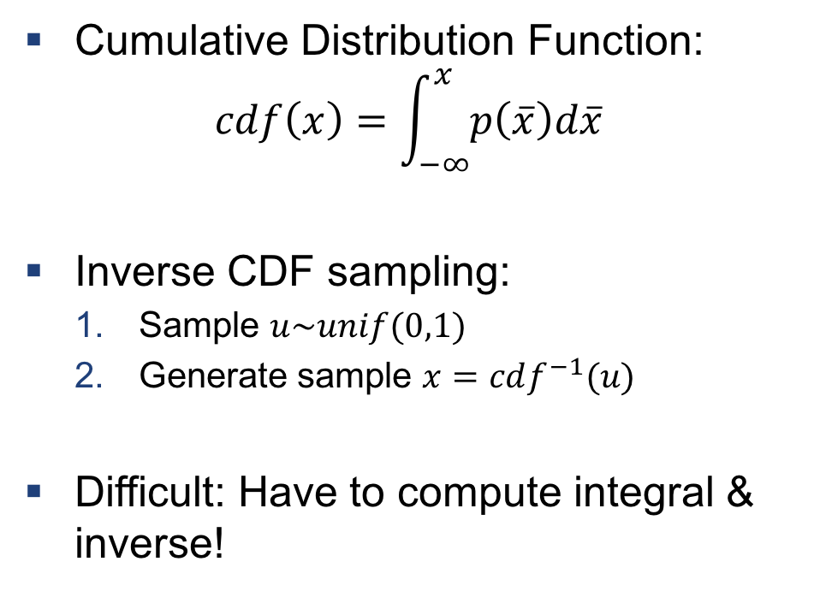
Inverse CDF sampling
Cumulative Distribution Function:
$$cdf\left(x\right)=\int_{−∞}^{x}{p\left(\overline{x}\right)d\overline{x}}$$
Inverse CDF sampling:
Sample $u\sim unif(0,1)$
Generate sample $x=cdf^{−1}(u)$
Difficult: Have to compute integral & inverse!

Slide 11
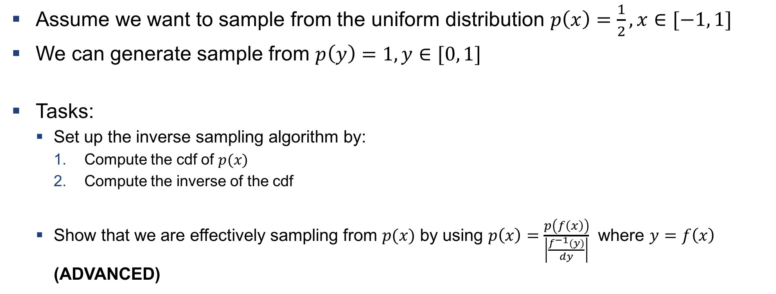
Example 1: Sampling from a uniform distribution
Assume we want to sample from the uniform distribution $p\left(x\right)=\frac{1}{2},x∈[−1, 1]$
We can generate sample from $p\left(y\right)=1, y∈[0, 1]$
Tasks:
Set up the inverse sampling algorithm by:
Compute the cdf of $p(x)$
Compute the inverse of the cdf
Show that we are effectively sampling from $p(x)$ by using $p\left(x\right)=\frac{p\left(f\left(x\right)\right)}{\left|\frac{f^{−1}\left(y\right)}{dy}\right|}$ where $y=f\left(x\right)$ (ADVANCED)

Slide 12
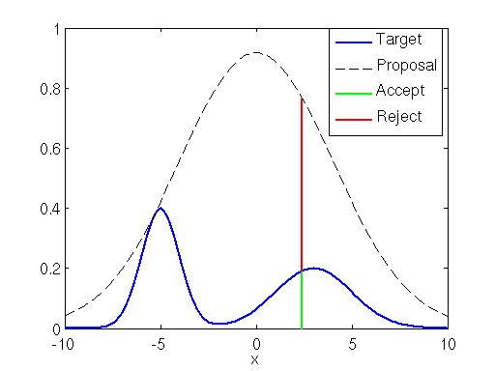
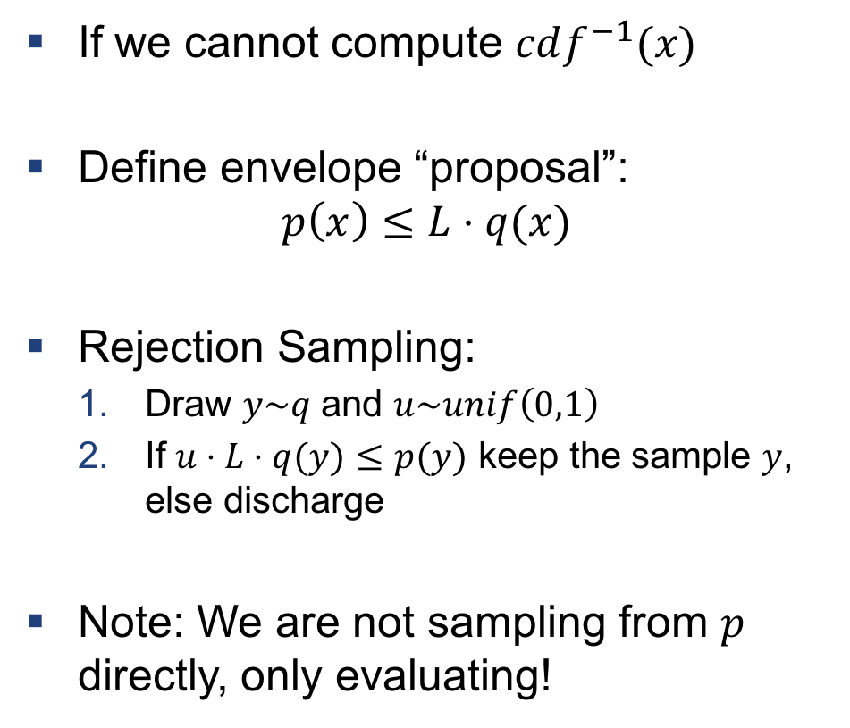
Rejection Sampling
If we cannot compute $cdf^{−1}(x)$
Define envelope “proposal”:
$$p\left(x\right)≤L⋅q(x)$$
Rejection Sampling:
Draw $y\sim q$ and $u\sim unif\left(0,1\right)$
If $u⋅L⋅q(y)≤p(y)$ keep the sample $y$, else discharge
Note: We are not sampling from $p$ directly, only evaluating!

Slide 13
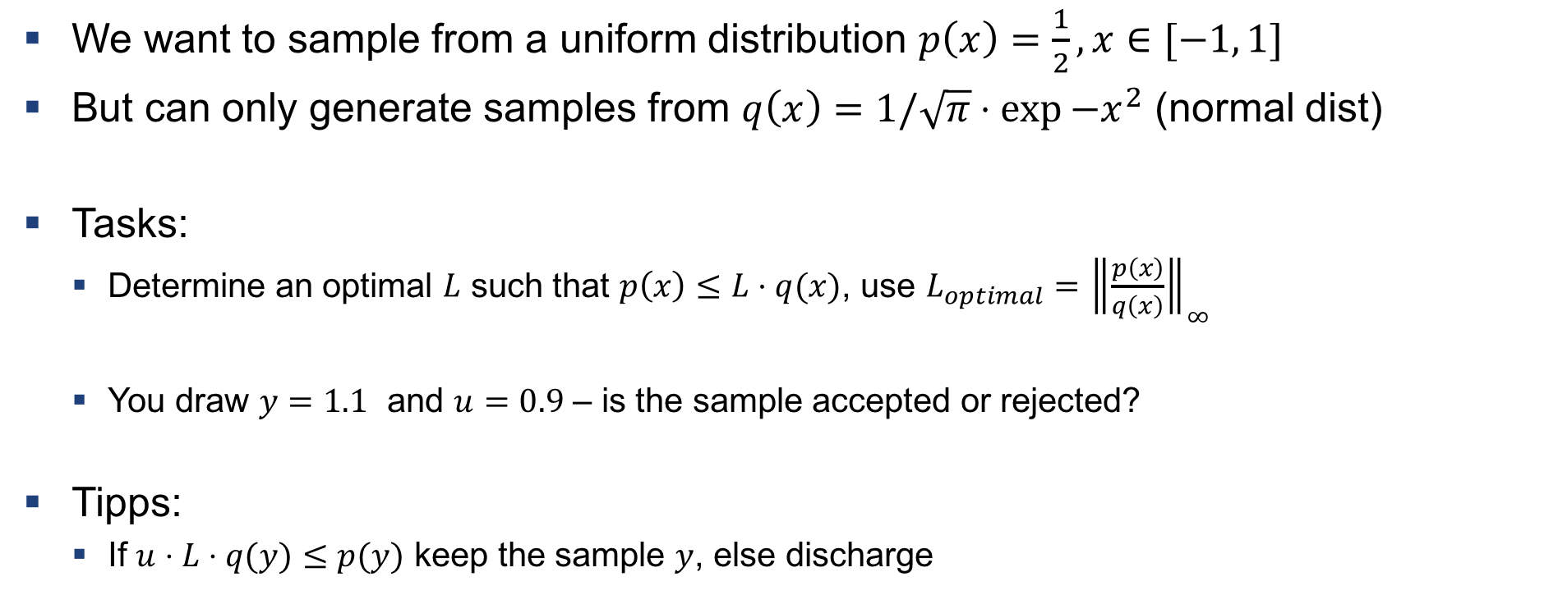
Example 2: Rejection sampling with normal proposal
We want to sample from a uniform distribution $p\left(x\right)=\frac{1}{2}, x∈[−1, 1]$
But can only generate samples from $q\left(x\right)=1/\sqrt{π}⋅\exp{−x^{2}}$ (normal dist)
Tasks:
Determine an optimal $L$ such that $p\left(x\right)≤L⋅q(x)$, use $L_{optimal}={\left\|\frac{p\left(x\right)}{q\left(x\right)}\right\|}_{∞}$
You draw $y=1.1$ and $u=0.9$ – is the sample accepted or rejected?
Tipps:
If $u⋅L⋅q(y)≤p(y)$ keep the sample $y$, else discharge

Slide 14
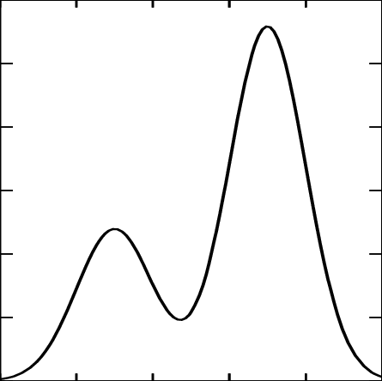
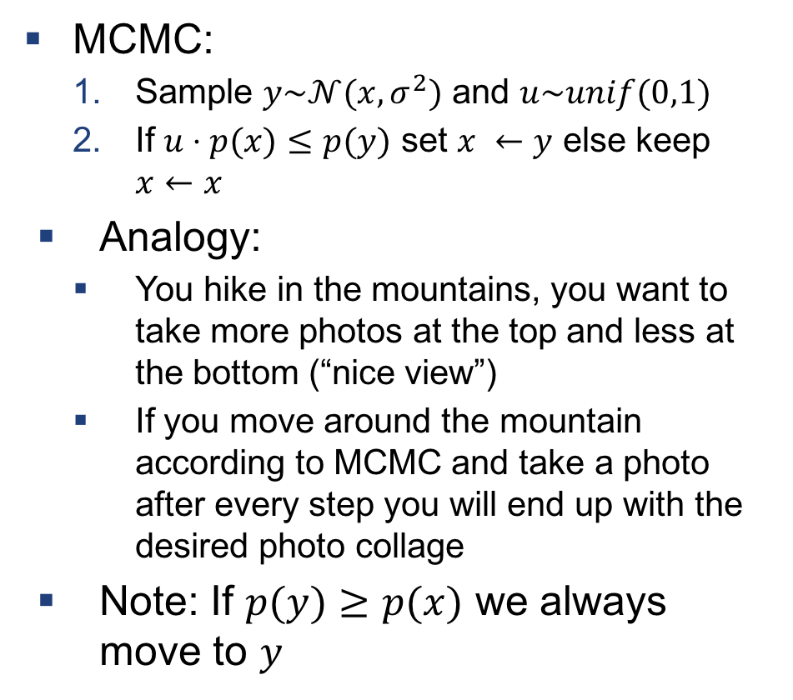
Markov Chain Monte Carlo
MCMC:
Sample $y\sim 𝒩(x, σ^{2})$ and $u\sim unif(0,1)$
If $u⋅p(x)≤p(y)$ set $x ←y$ else keep $x←x$
Analogy:
You hike in the mountains, you want to take more photos at the top and less at the bottom (“nice view”)
If you move around the mountain according to MCMC and take a photo after every step you will end up with the desired photo collage
Note: If $p(y)≥p(x)$ we always move to $y$

Slide 15
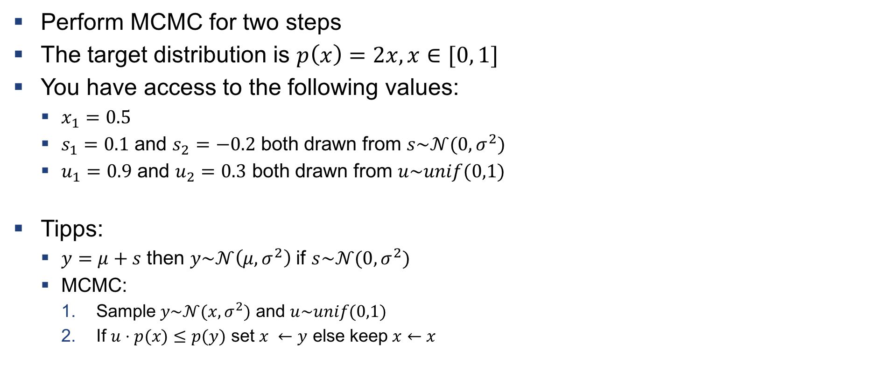
Example 3: MCMC step
Perform MCMC for two steps
The target distribution is $p\left(x\right)=2x, x∈[0, 1]$
You have access to the following values:
$x_{1}=0.5$
$s_{1}=0.1$ and $s_{2}=−0.2$ both drawn from $s\sim 𝒩(0, σ^{2})$
$u_{1}=0.9$ and $u_{2}=0.3$ both drawn from $u\sim unif(0,1)$
Tipps:
$y=μ+s$ then $y\sim 𝒩\left(μ, σ^{2}\right)$ if $s\sim 𝒩(0, σ^{2})$
MCMC:
Sample $y\sim 𝒩(x, σ^{2})$ and $u\sim unif(0,1)$
If $u⋅p(x)≤p(y)$ set $x ←y$ else keep $x←x$

Slide 16
Exercises

Slide 17
Q1
Implement rejection sampling and MCMC for the Gibbs Distribution

Slide 18

Questions?

