Slide 1
Title
Text

Slide 2
Exercise 13: Bayes Inference
MAD
bacdavid@student.ethz.ch

Slide 3
Outline
Information
Goals
Theory/ Recap
Exercises
Further proceeding wrt. Exam

Slide 4
Information

Slide 5
General
Lecture material & problem sets available here
Tutorial material available here

Slide 6
Goals

Slide 7
Goals of Today
Understand probability basics (again)
Understand Bayes Rule (again)
Understand Change of Variables (again)
Understand Maximum Likelihood (“Parameter Estimation”)

Slide 8
Theory / Recap

Slide 9
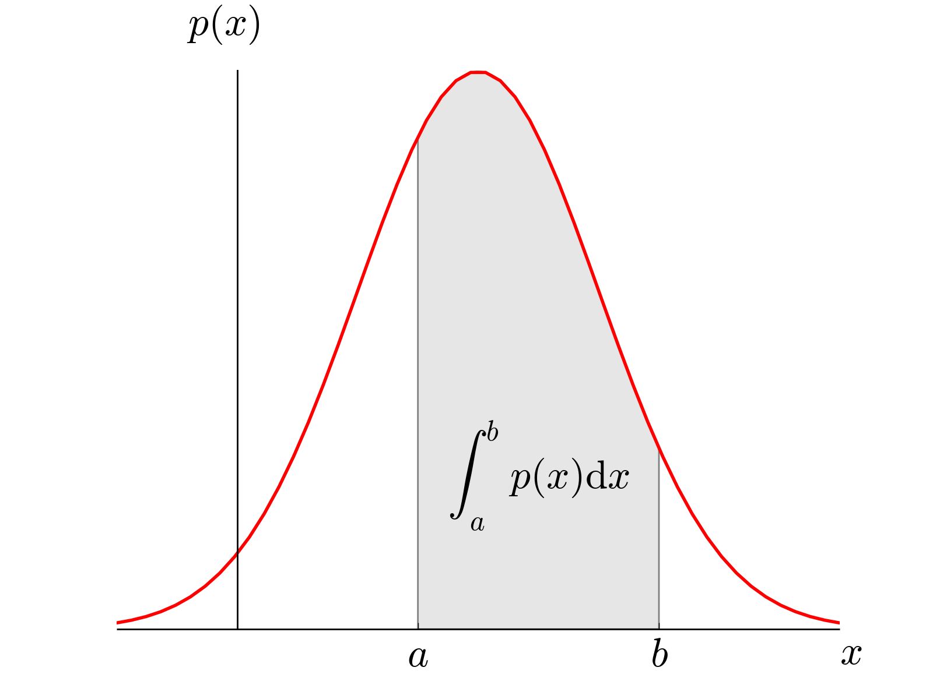

Probability Review
Discrete Random Variables
$p:Ω→ℝ$, where eg. $Ω$={0, 1, 2, …}
$\sum_{Ω}{p}=1$, $p≥0$
Continuous Random Variables
$p:Ω→ℝ$, where eg. $Ω$=[0, 1]
$\int_{Ω}{p}=1$, $p≥0$

Slide 10



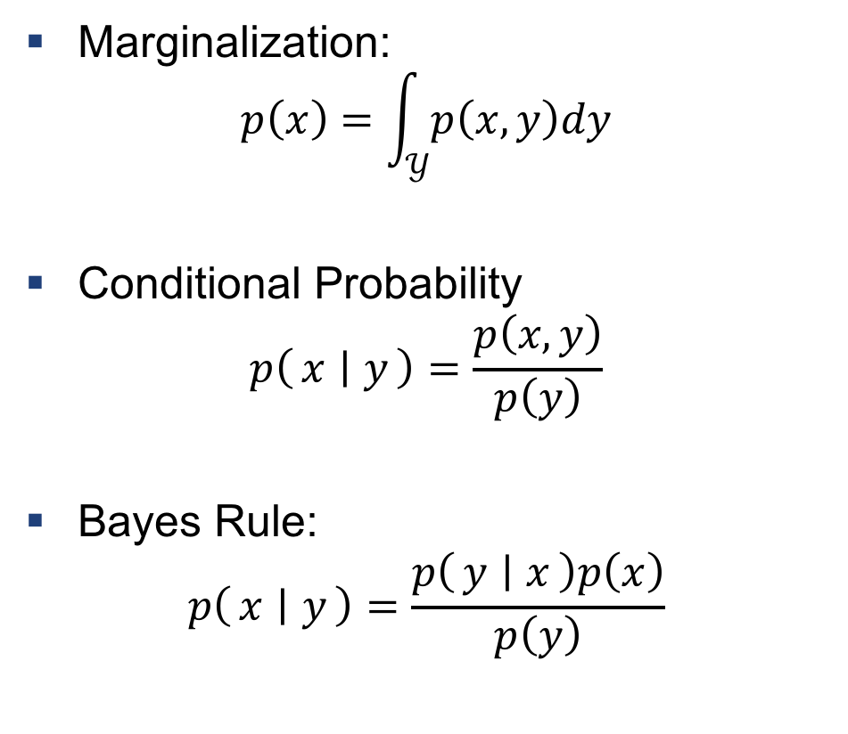
Marginalization, Conditional Probability, and Bayes Rule (again)
Marginalization:
$$p\left(x\right)=\int_{𝒴}{p\left(x,y\right)dy}$$
Conditional Probability
$$p\left(x ∣ y\right)=\frac{p\left(x,y\right)}{p\left(y\right)}$$
Bayes Rule:
$$p\left(x ∣ y\right)=\frac{p\left(y ∣ x\right)p\left(x\right)}{p\left(y\right)}$$
$$U$$
$$A$$
$$B$$
Venn Diagram of Bayes Rule: Have a look at https://oscarbonilla.com/2009/05/visualizing-bayes-theorem/ for more info

Slide 11
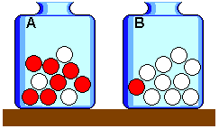
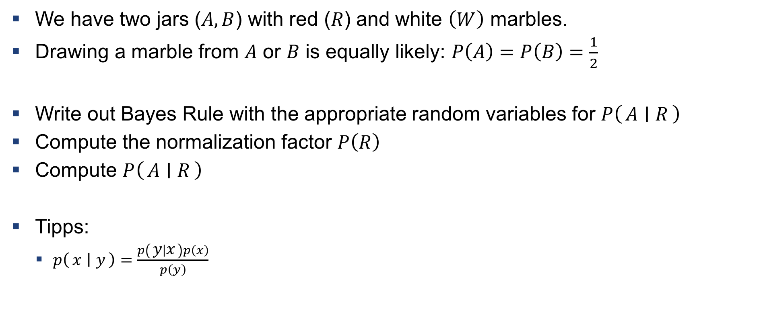
Example 1: Marbles
We have two jars ($A,B$) with red ($R$) and white $\left(W\right)$ marbles.
Drawing a marble from $A$ or $B$ is equally likely: $P\left(A\right)=P\left(B\right)=\frac{1}{2}$
Write out Bayes Rule with the appropriate random variables for $P\left(A ∣ R\right)$
Compute the normalization factor $P\left(R\right)$
Compute $P\left(A ∣ R\right)$
Tipps:
$p\left(x ∣ y\right)=\frac{p\left(y ∣ x\right)p\left(x\right)}{p\left(y\right)}$

Slide 12
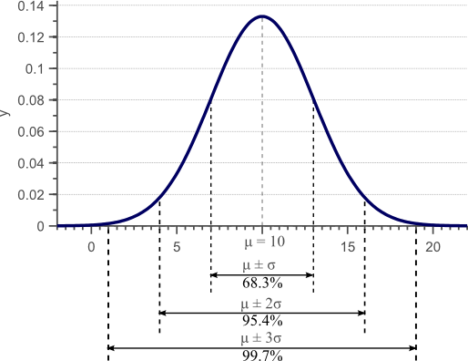

Expectation value and variance (again)
Expectation value:
$$𝔼\left[f\left(x\right)\right]=\int_{−∞}^{∞}{f\left(x\right)p\left(x\right)dx}$$
Variance:
$$Var\left(f\left(x\right)\right)=σ^{2}=𝔼\left[f^{2}(x)\right]−𝔼^{2}\left[f\left(x\right)\right]$$

Slide 13

Change of random variables (again)
We can infere the probability distribution of on random varibales from another:
$$p\left(x\right)=\frac{p\left(f\left(x\right)\right)}{\left|\frac{f^{−1}\left(y\right)}{dy}\right|}$$
Where the variables are related by $y=f(x)$

Slide 14

Example 2: Mean and variance of Gaussian distribution
Given $x=μ+σy$, where $y\sim 𝒩\left(0, 1\right)$
Show that $x\sim 𝒩\left(μ, σ^{2}\right)$
Tipps:
$p\left(x\right)=\frac{p\left(f\left(x\right)\right)}{\left|\frac{f^{−1}\left(y\right)}{dy}\right|}$
$𝒩\left(μ, σ^{2}\right)=1/\sqrt{2πσ^{2}}⋅\exp{−\frac{{\left(x−μ\right)}^{2}}{2σ^{2}}}$

Slide 15

Maximum Likelihood
Assume we have some data $D$ and a parametrized model, then
$$p(D∣θ)$$
We want our model to describe the data as well as possible
$$θ^{∗}=\arg{\max{p(D∣θ)}}$$

Slide 16
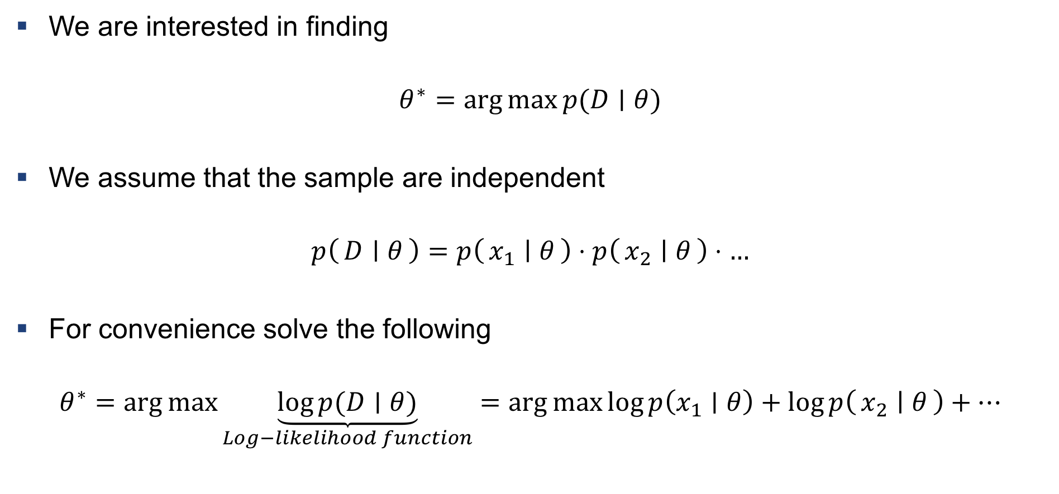
Maximum Log-Likelihood
We are interested in finding
$$θ^{∗}=\arg{\max{p(D∣θ)}}$$
We assume that the sample are independent
$$p\left(D ∣ θ\right)=p\left(x_{1} ∣ θ\right)⋅p\left(x_{2} ∣ θ\right)⋅…$$
For convenience solve the following
$$θ^{∗}=\arg{\max{\underset{Log−likelihood function}{\underbrace{\log{p(D∣θ)}}}}}=arg{\max{\log{p\left(x_{1}∣θ\right)+\log{p\left(x_{2} ∣ θ\right)+…}}}}$$

Slide 17
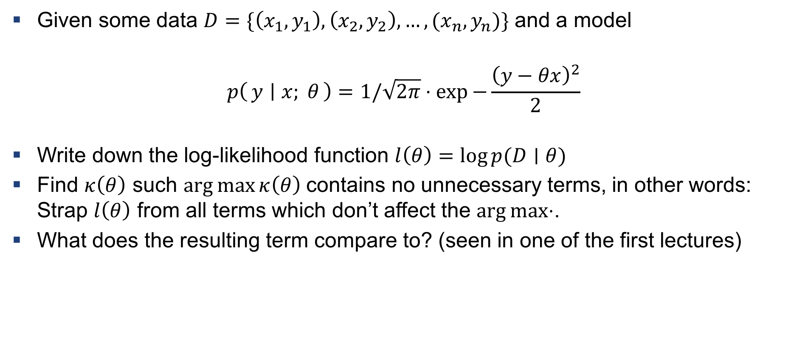
Example 3: Maximum log-likelihood for Gauss
Given some data $D=\{\left(x_{1},y_{1}\right), \left(x_{2},y_{2}\right), …, (x_{n}, y_{n})\}$ and a model
$$p\left(y ∣ x; θ\right)=1/\sqrt{2π}⋅\exp{−\frac{{\left(y−θx\right)}^{2}}{2}}$$
Write down the log-likelihood function $l\left(θ\right)=\log{p(D∣θ)}$
Find $κ\left(θ\right)$ such $\arg{\max{κ\left(θ\right)}}$ contains no unnecessary terms, in other words: Strap $l\left(θ\right)$ from all terms which don’t affect the $\arg{\max{⋅}}$.
What does the resulting term compare to? (seen in one of the first lectures)

Slide 18
Exercises

Slide 19
Q1
Compute a few things from the Gaussian distribution (similar to what was done in examples)

Slide 20
Q2
Use Bayes Rule (similar to examples)

Slide 21
Q3
Compute Maximum Log Likelihood
Compute the variance of the data (see lecture notes)

Slide 22
Further Proceedings

Slide 23
Exam Information (disclaimer: Not official, “my experience”)
PVK (2 x halfday) by me
Release of all material on AMIV (probably ~1 week before the PVK)
Questions: Email or (better) Piazza
Tipps :
Able to manually use the algorithms (“you have this and this data, compute one iteration…”)
Know about attributes of methods (“to what order accurate, etc …”)
Solve all hand-exercises, all in-class examples, & examples from TA slides
Study lecture notes (some things are not covered in exercises – might still be on exam – but focus on main concepts)

Slide 24
“Future” Information (disclaimer: Not official, “my experience”)
Computational Methods for Engineering Application (HS19)
Stochastik (HS19)
Introduction to Machine Learning (master)
At least one course of coding per semester! (Highly beneficial for almost all masters)

Slide 25

Questions?

