Slide 1

SCRUM

Slide 2
WHAT IS IT?
Scrum is a framework of rules, roles, events, and artifacts used to implement Agile projects.
It has an iterative approach, consisting of sprints that typically only last one to four weeks.
The main objective of Scrum is to satisfy the customer’s needs through an environment of transparent communication, collective responsibility and continuous progress.

Slide 3
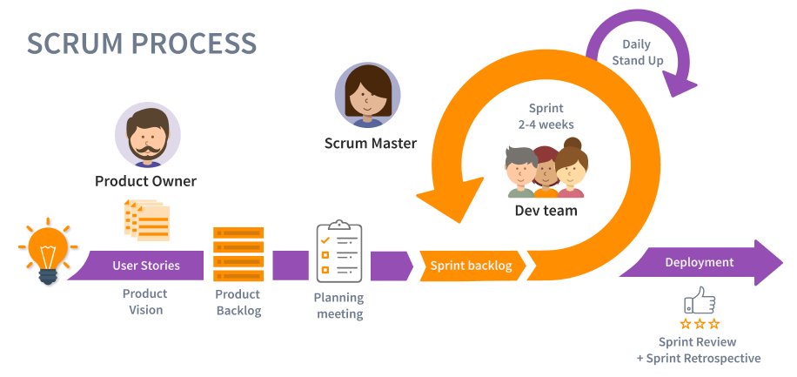
THE PROCESS

Slide 4
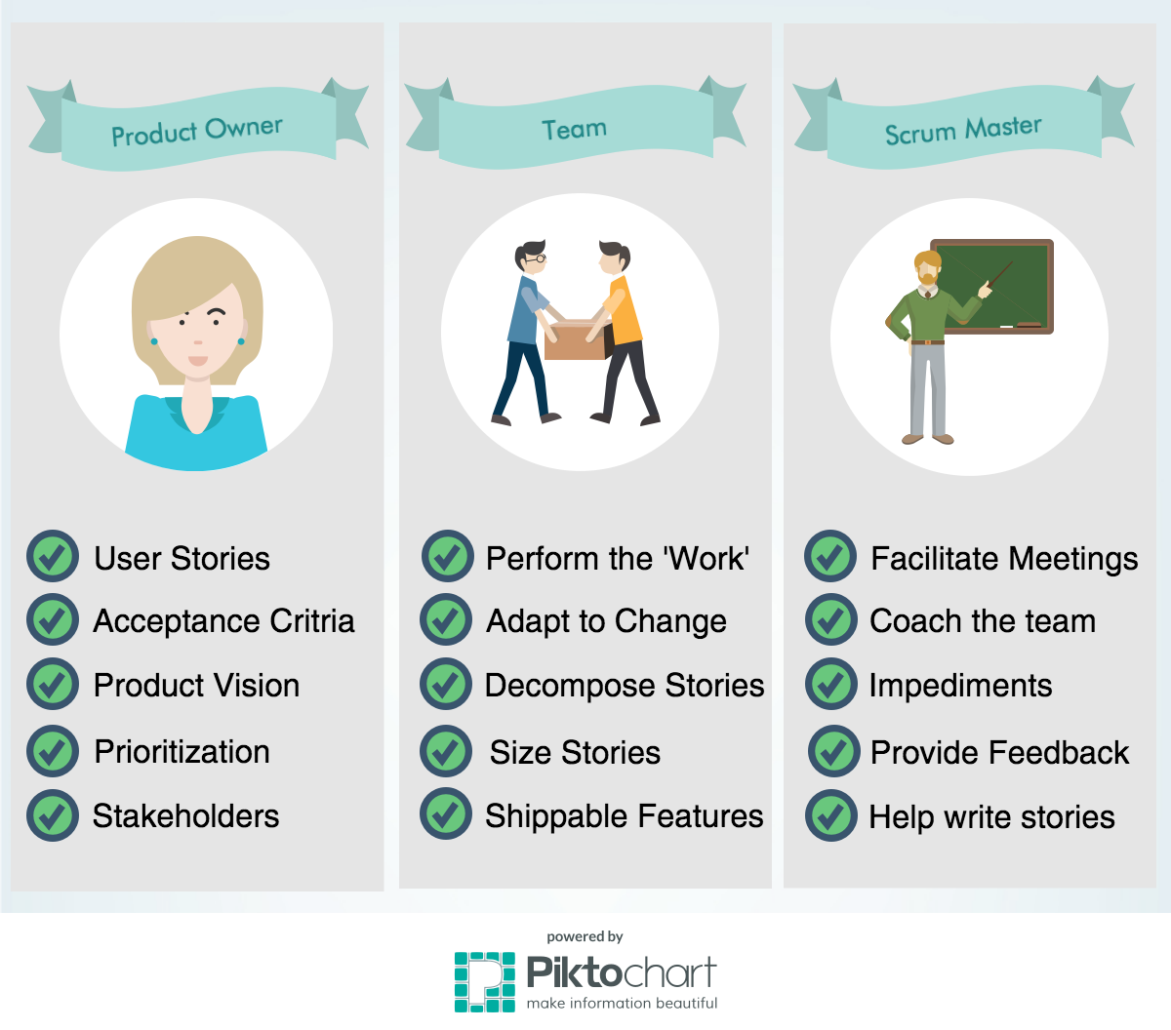
ROLES

Slide 5
SPRINT
As Scrum is an iterative model, each iteration is called Sprint.
It consists of single development cycles where each team, defines, builds, integrates and test the user stories from their backlog.
The goal is to deliver working software in the end of each iteration.

Slide 6
USER STORIES
It is a short, simple explanation of a feature.
Each US, has an Acceptance Criteria defined, so that the correct implementation of the user story is confirmed.
Template example: As I developer, I want to improve the code coverage, so that we can create a more secure code base.

Slide 7
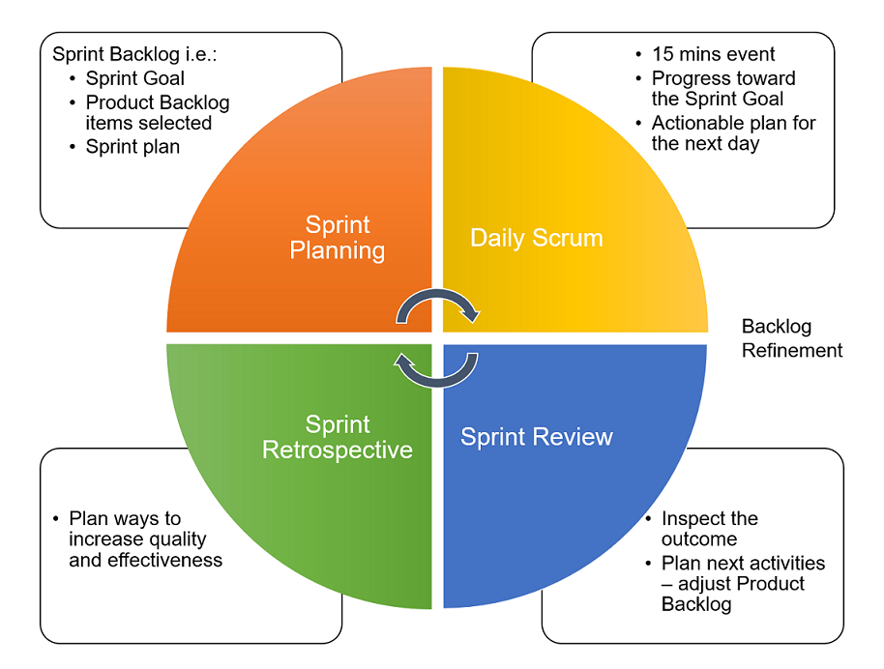
SCRUM EVENTS

Slide 8
SCRUM ARTIFACTS
Product backlog: always changing, and prioritized list of requirements ordered by the Business.
Spring backlog: contains all user stories for the current Sprint, broken down into tasks by the Team.
Burndown chart: show the amount of work remaining each Sprint. It shows the correlation between work remaining in time vs the progress of the Team.

