Slide 1
Introduction to Databases Checkpoint presented by BACEM SOUIBGUI
Introduction
Relational RDBMS MySQL
Relational RDBMS PostgreSQL
Relational RDBMS SQL SERVER
Comparison between the three RDBMS
Recap

Slide 2
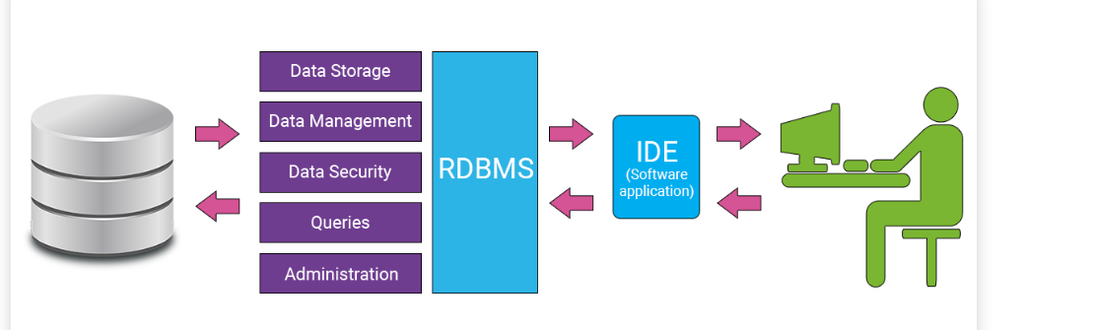
Introduction
What is Database?
Structured set of information designed and produced to be easily accessed, managed and modified by several users.
what is DBMS?
DataBase Management System allows developers to store and handle data in relational tables.
There are many components that build the core functionality of an RDBMS, each of which executes specific actions on a database.

Slide 3
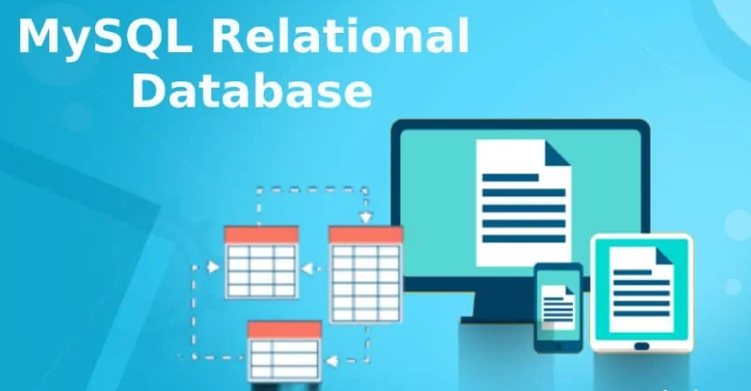
Relational RDBMS MySQL
MySQL Relational Database is an assemblage of relational data that is structured or organized in the form of tables, columns, and rows, where tables represent the objects, columns represent the fields and rows represent the records.

Slide 4
MySQL is widely used, especially by beginners. There are many things you can do with this software, and it is ideal for learning about database management. Be aware, however, that MySQL is far from perfect. Indeed, it does not always follow the official standard.
Some syntaxes can therefore be specific to MySQL and not work under other RDBMS. I will try to report this when the case arises, but be aware of this issue.
In addition, it does not implement some advanced features that you might find useful for a somewhat ambitious project. Finally, it is very permissive, and will therefore accept requests that would generate an error under other RDBMS.

Slide 5

Relational RDBMS PostgreSQL?
Like MySQL, PostgreSQL is open source software. However, it is less used, especially by beginners, because it is less known. Part of the reason for this ignorance is that PostgreSQL has long been available only under Unix. The first Windows version did not appear until version 8.0 of the software was released in 2005.

Slide 6
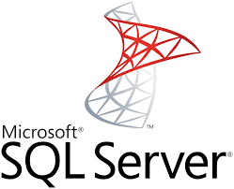
Relational RDBMS SQL SERVER
SQL Server is a Microsoft product used to manage and store information. Technically, SQL Server is a “relational database management system” (RDMS).
Broken apart, this term means two things. First, that data stored inside SQL Server will be housed in a “relational database”, and second, that SQL Server is an entire “management system”, not just a database.
SQL itself stands for Structured Query Language. This is the language used to manage and administer the database server.

Slide 7
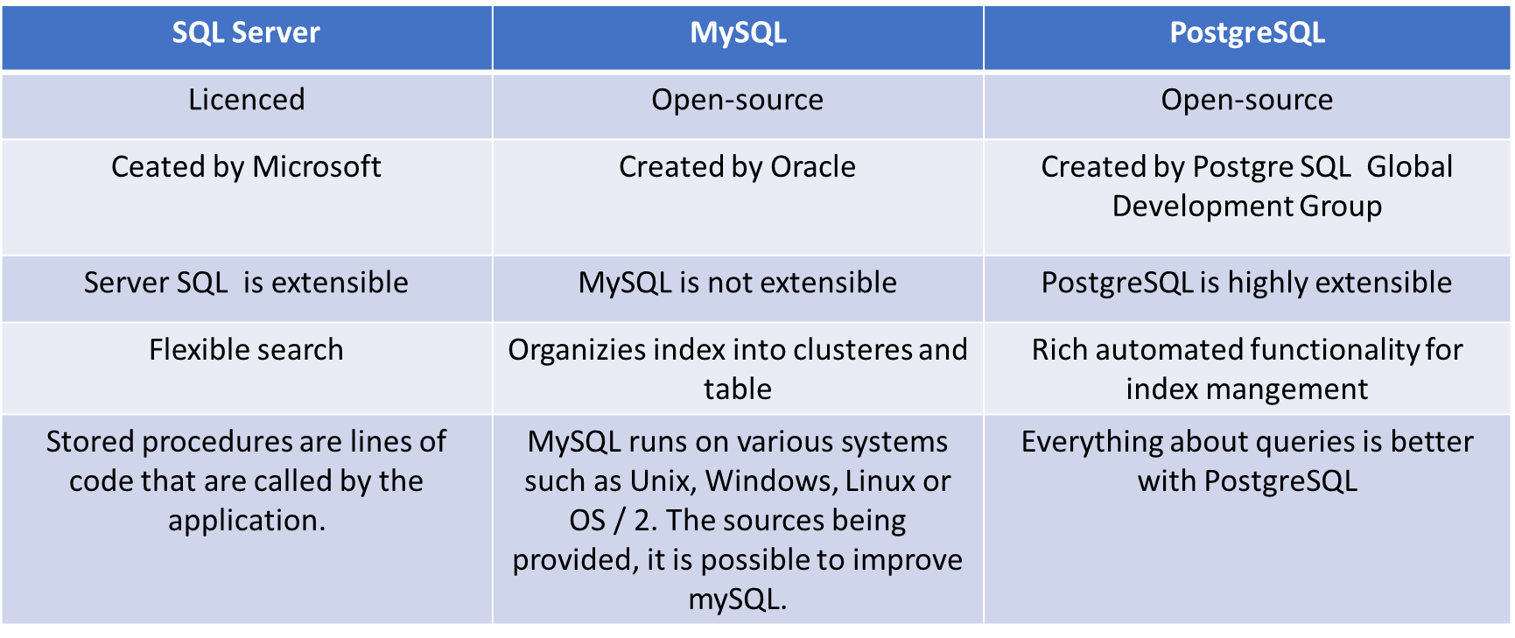
Comparison between the three RDBMS

Slide 8
Recap
The reason for choosing one database product over another should be based on your applications and the state of your development cycle.

Slide 9
Thank you

