Slide 1
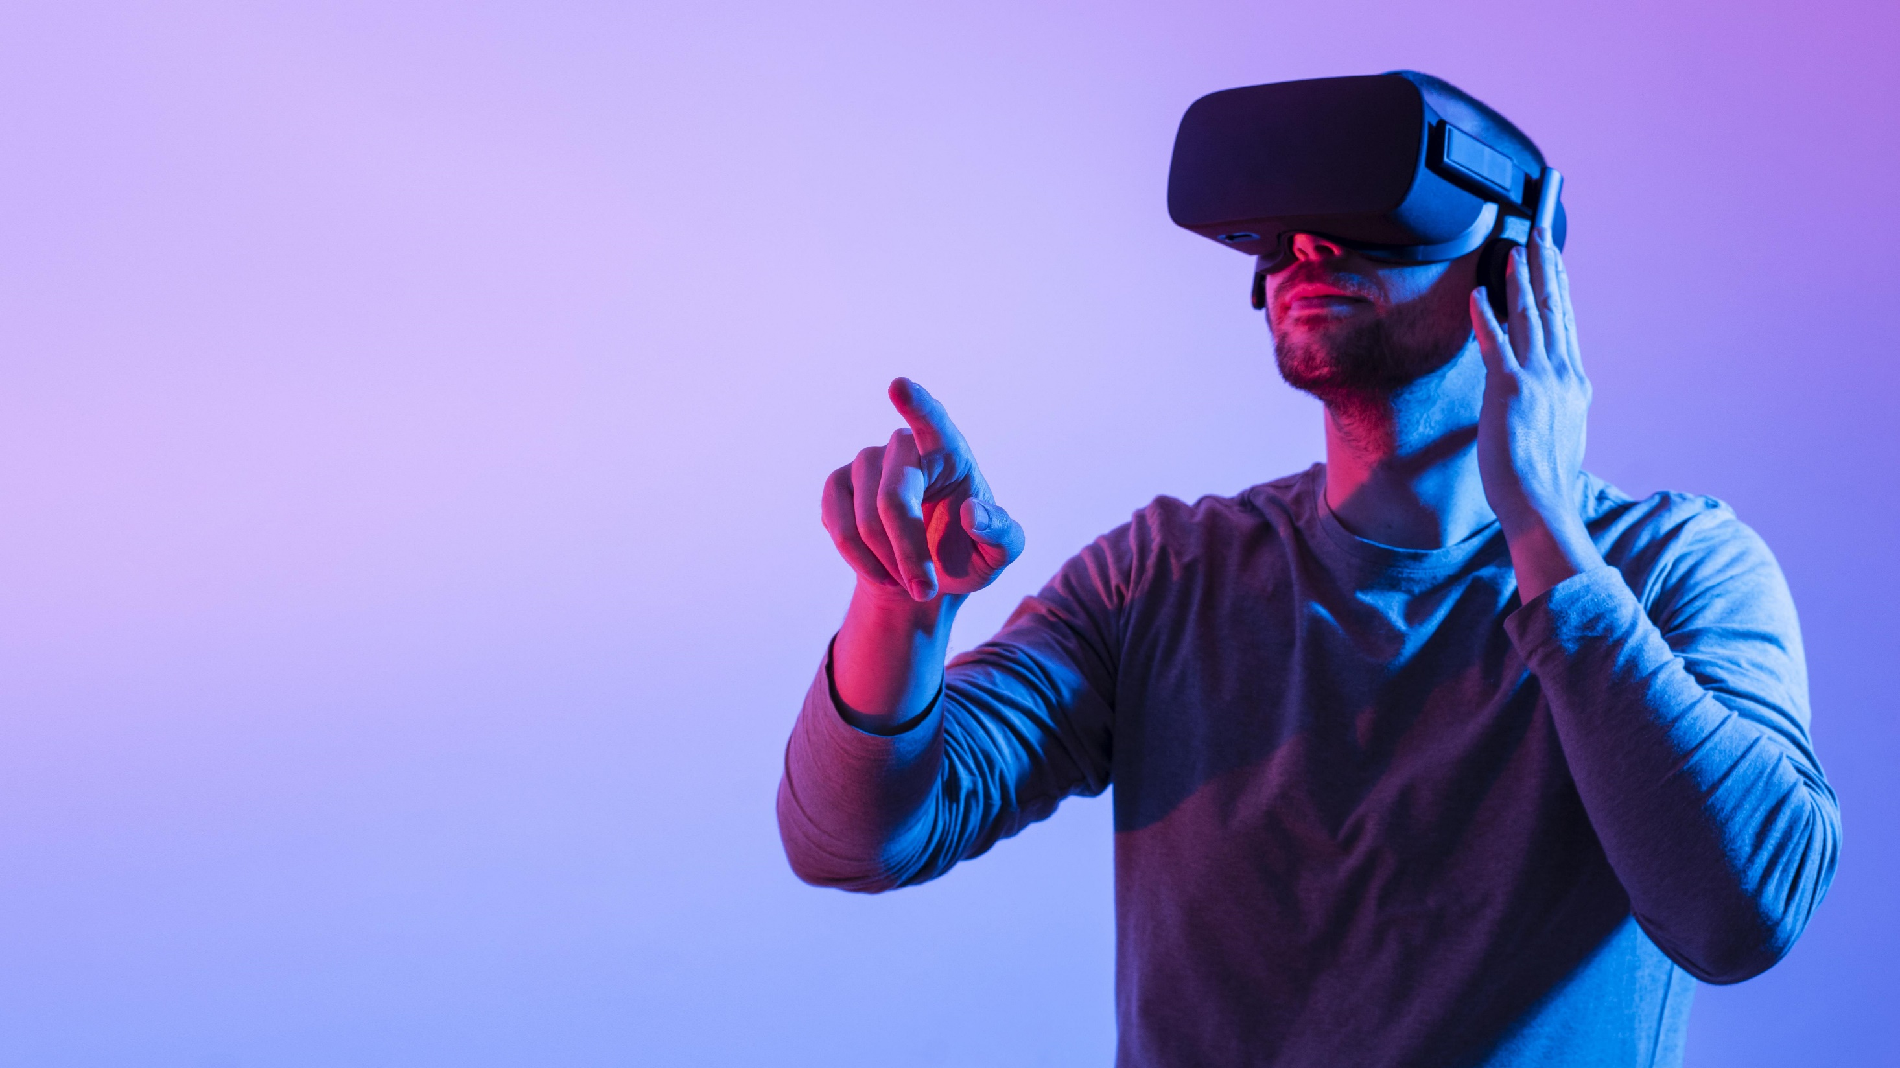

Metaverse
Presented By: Syed Arshad Ali Bacha

Slide 2
Metaverse
What is metaverse?
What are AR VR MR XR Crypto NFTs?
Types of metaverse
Uses of metaverse
What we can do in the Metaverse?
Marriage in Metaverse

Slide 3
Metaverse
Metaverse is a virtual reality space in which users can interact with a computer generated environment and other
Users Metaverse is the combination of AR, VR, XR, NFTs, Crypto currencies etc,.

Slide 4
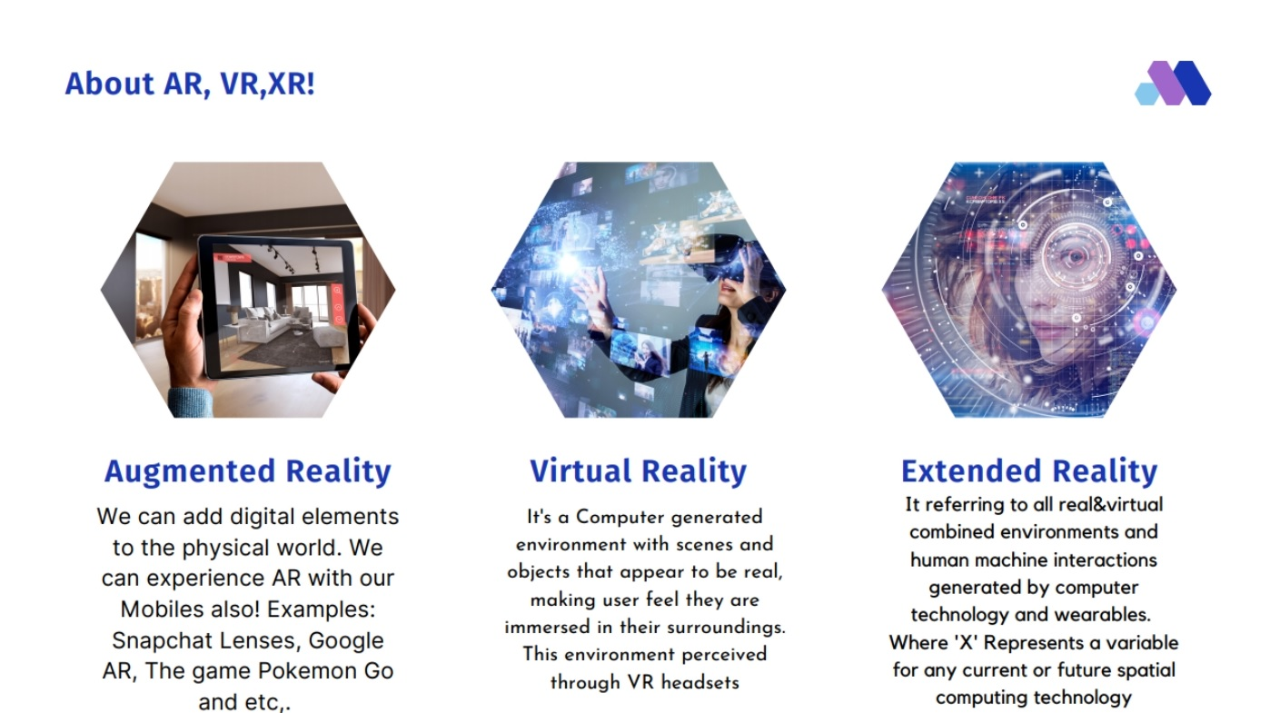
Metaverse

Slide 5
Metaverse
Firstly let's see about AR, AR stands for Augmented Reality , By using AR we can add digital elements to the physical world, we can experience AR with our mobiles also, some of the Augmented reality experiences are snapchat lenses, google AR, the Pokemon Go and Etc,.
Next coming to the VR , it's stands for Virtual reality it's a computer generated environment with scenes and objects that appears to be real and makes user feel they are immersed in their surroundings . This environment is perceived through a device known as virtual reality headset or helmet.
And Extended reality (XR) is a term Reffering to all real and virtual combined environments and human machine interactions generated by computer technology and wearables (Where 'X' Represents a variable for any current or future spatial computing technology)

Slide 6
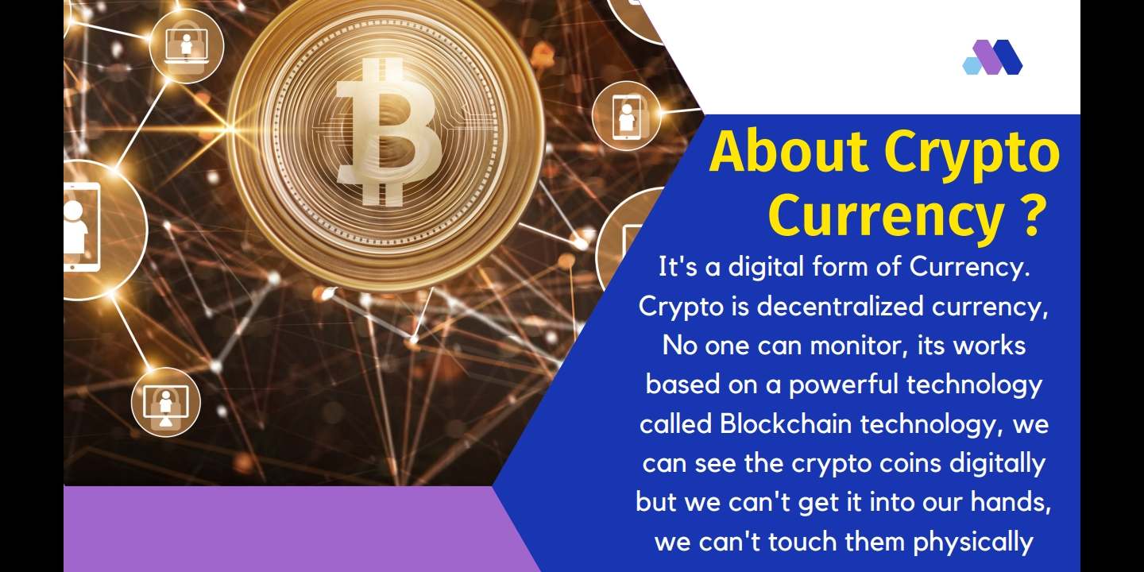

Slide 7
Metaverse
These are cryptographic assets on a block chain with a unique identification codes. Simply we can consider unique digital assets as a NFTs.
These NFTs are also digital assets so we can see them digitally but we can't touch them physically.
metaverse are of two types
Block chain based
Social world

Slide 8
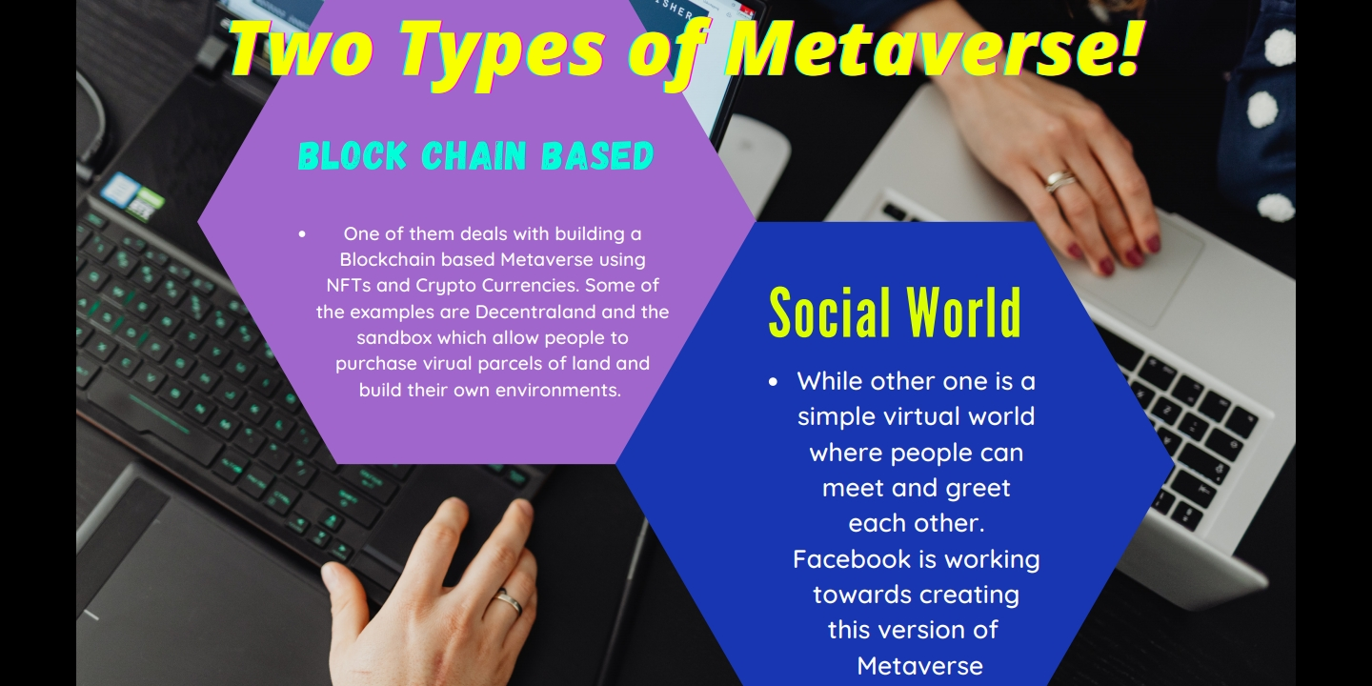
Metaverse

Slide 9
Metaverse
One of them deals with building a BlockChain based metaverse using nfts and crypto currencies. Some of the examples are Decentral land and the sandbox which allows users to purchase virtual properties and build their own environments.
While other one is a simple virtual world where people can meet and greet each other. Facebook is working towards creating this version of metaverse

Slide 10
Now let's see the use cases of metaverse
Real estate
Traveling
Education
Fitness
Shopping
Video games

Slide 11
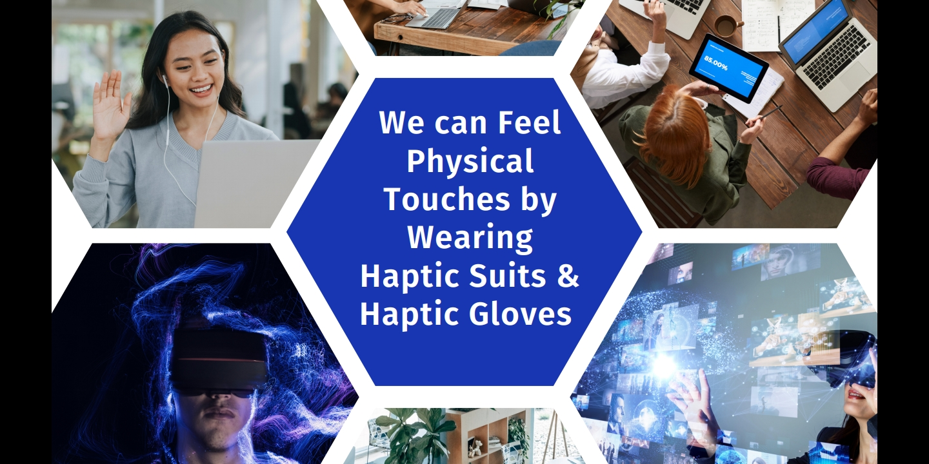

Slide 12
Here one more interesting thing is we can experience physical touches by wearing haptic gloves / haptic suits.
For suppose if you're in abroad, you and your parents got connected on metaverse with haptic suits then if your parents slaps or touches your avatar on metaverse you will feel those touches physically with the help of haptic suits.

Slide 13
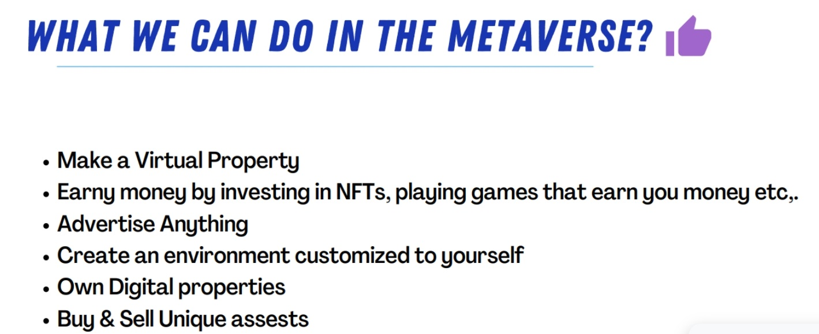
Real estate
Traveling
Education
Fitness
Shopping
Video games

Slide 14
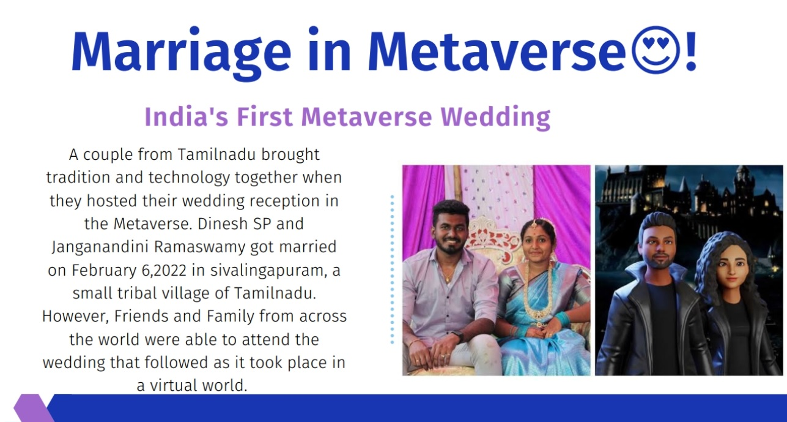
Real estate
Traveling
Education
Fitness
Shopping
Video games

Slide 15
A couple from Tamilnadu brought tradition and technology together when they hosted wedding reception in the metaverse. Dinesh SP and Janaganandini Ramaswamy got married on February ,6,2022 in sivalingapuram , a small tribal village of Tamilnadu. However friends and family from across the world were able to attend the wedding that followed as took place in a virtual world.
Here the most interesting thing is.. Actually the bride's father has passed away in the month of April 2021,but Ganesh has created his father in law's avatar, like this these couple got blessed by expired person...

Slide 16

Real estate
Traveling
Education
Fitness
Shopping
Video games

