Slide 1
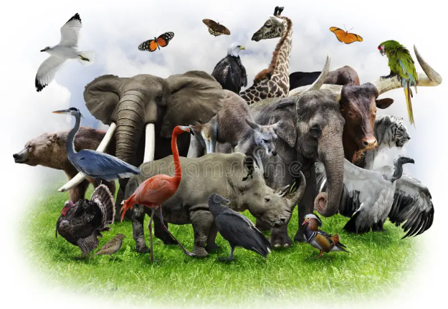
ZOO PARK
A Home for Wildlife
Zoo Park Presentation • 1/7

Slide 2
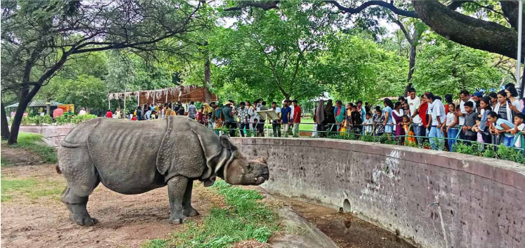
Introduction
Zoo Parks protect animals and birds.
They create awareness about wildlife.
They help students learn through real-world observation.
Zoo Park Presentation • 2/7

Slide 3
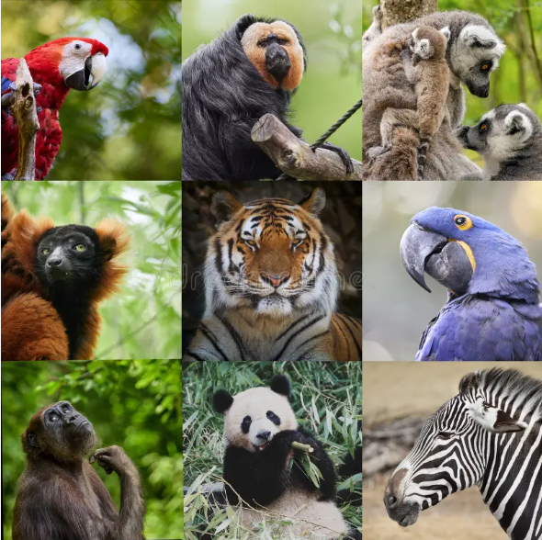
Animals in Zoo Park
Lion • Tiger • Elephant • Giraffe
Different birds, reptiles and mammals
Each species has special habits and habitats.
Zoo Park Presentation • 3/7

Slide 4

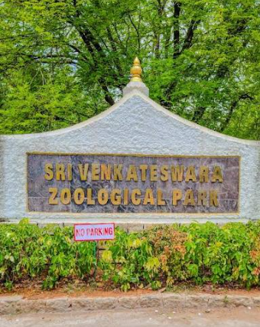


Zoo Parks in India
Nehru Zoological Park – Hyderabad
Sri Venkateswara Zoological Park – Tirupati
Arignar Anna Zoological Park – Chennai
National Zoological Park – Delhi
Zoo Park Presentation • 4/7

Slide 5

Importance of Zoo Parks
Wildlife conservation
Animal care and protection
Education and awareness
Research and breeding
Family recreation
Zoo Park Presentation • 5/7

Slide 6
Zoo Park Website Features
Home • Animals • Locations
Ticket information • Timings
Image gallery • Contact
Easy information for visitors
Zoo Park Presentation • 6/7

Slide 7

Conclusion
https://resplendent-churros-5b1810.netlify.app/
SAVE WILDLIFE • SAVE NATURE
Protect animals today for future generations.
Zoo Park Presentation • 7/7

