Slide 1

Team Lead: Bachan Nayak
AI-Powered Emergency Response Autonomous System
“Where AI meets Dharma”

Slide 2
Problem Statement
Delayed emergency response due to lack of coordination and manual reporting, resulting in loss of lives.
Ineffective resource management during crises leads to inefficiencies and slower action.
Difficulty in identifying victims at the scene causes delays in providing timely assistance.
Challenges for outsiders or visitors in finding the right resources and information during emergencies.
Existing systems lack real-time data handling and seamless communication capabilities.
Fragmented emergency services create interoperability issues, making cross-agency collaboration difficult.
Absence of a unified platform that integrates emergency services for faster, coordinated responses.

Slide 3
Solution - JagatRakshak
AI-powered multi-modal agent (Watsonx Orchestrate + FastAPI + MCP) that supports emergencies like road accidents, fire tragedies, women safety, and medical cases by informing authorities and relatives instantly.
Powered by IBM Watsonx AI to auto-generate incident reports, analyze data patterns, and provide actionable insights.
Autonomous response system that locates and alerts nearest hospitals, police, fire stations, and ambulances based on incident type and location.
Centralized emergency response platform that integrates real-time data and connects NGOs, government agencies, and community groups for faster action.
Unified user interface for reporting emergencies, accessing resources, and directly communicating with emergency services.

Slide 4
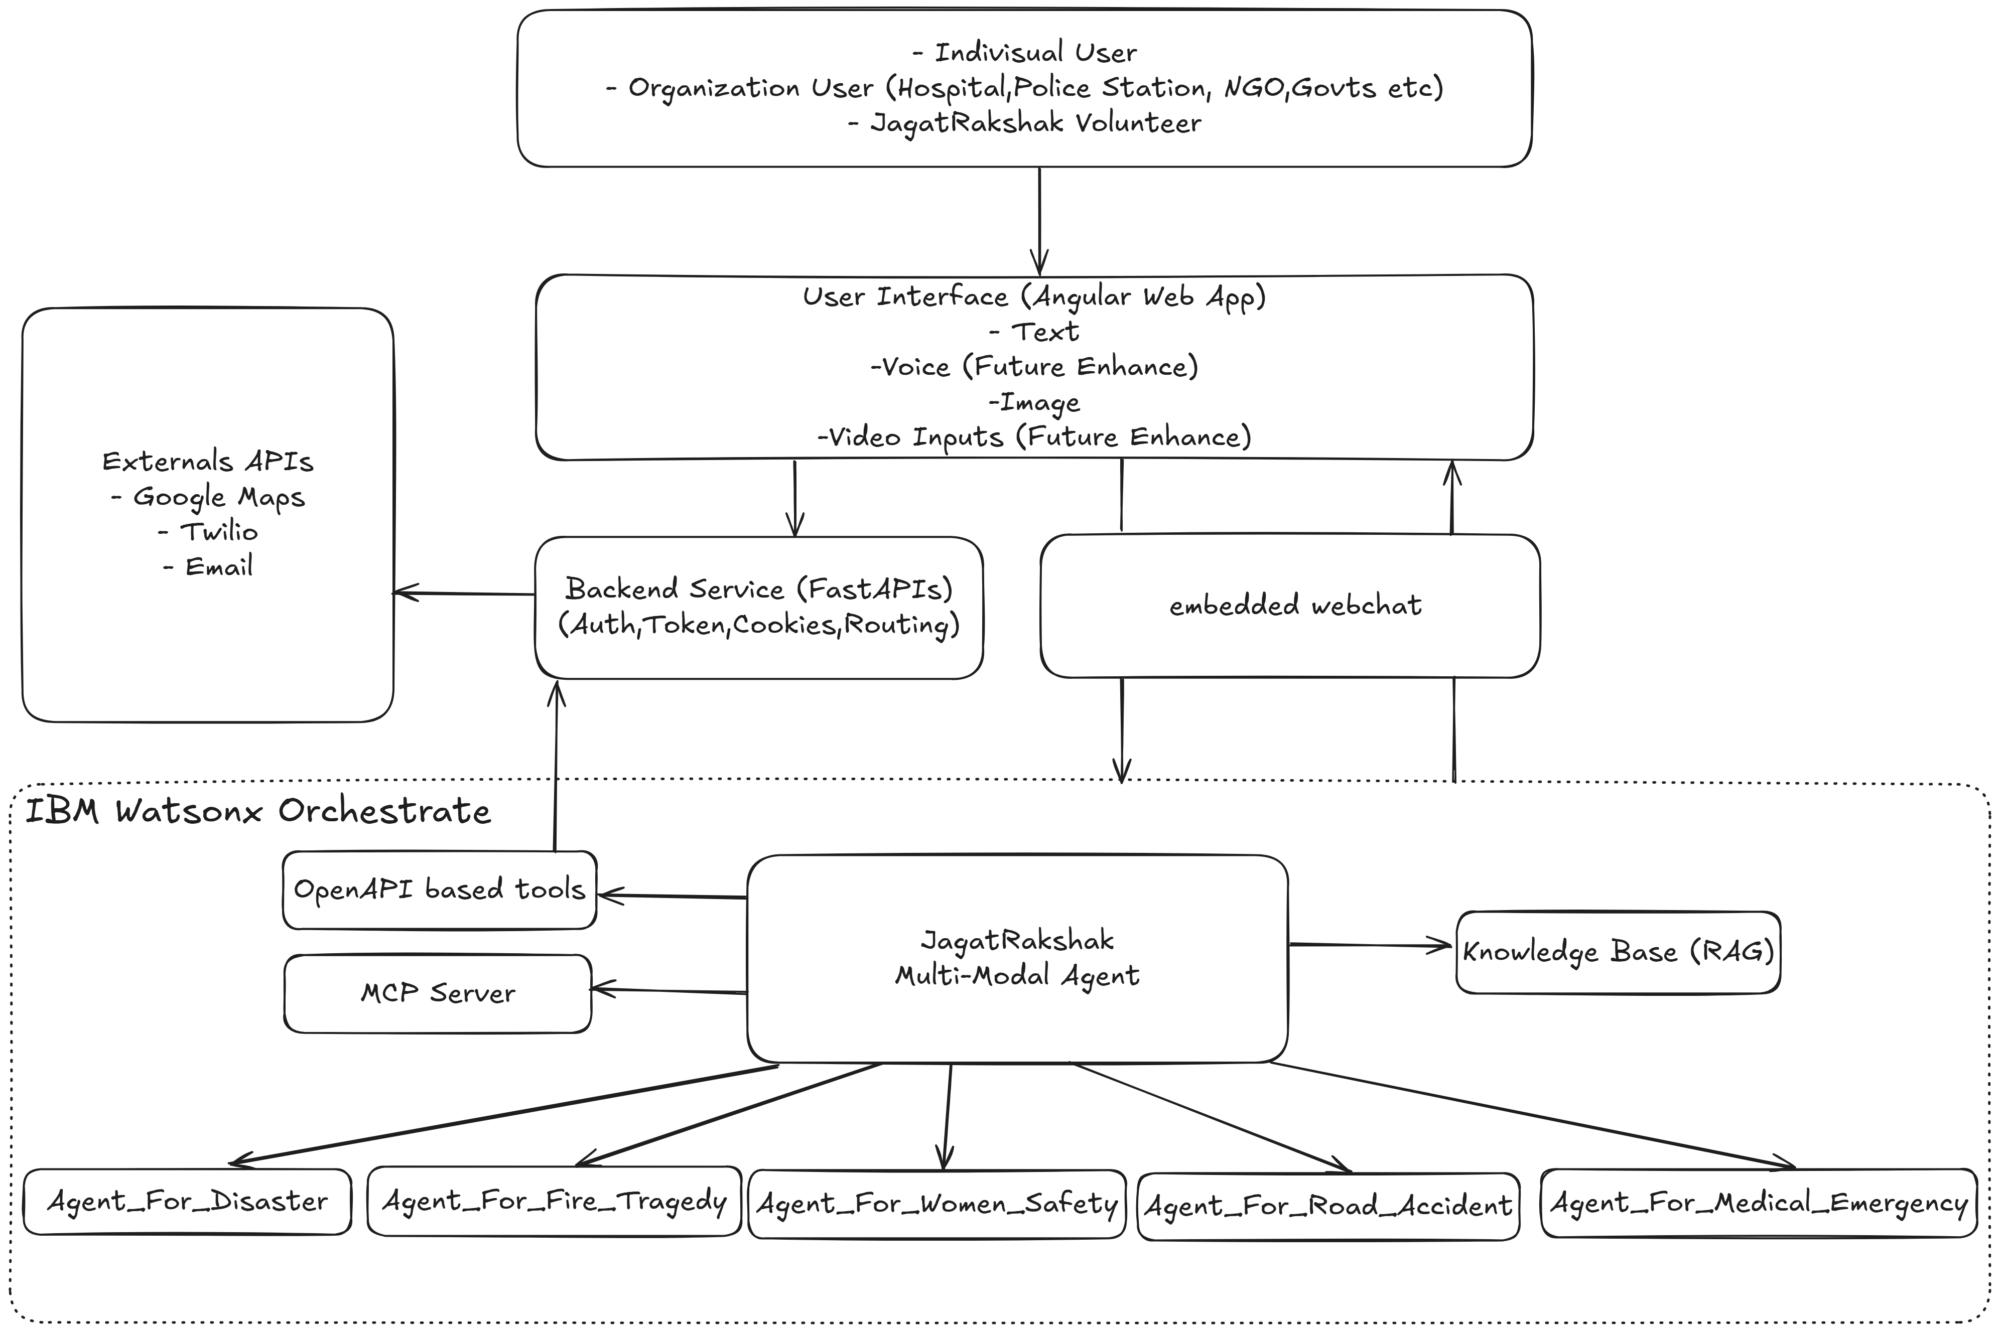
Architecture

Slide 5
Demo

Slide 6
Technologies
- Angular 18+ (UI)
- Python FastAPI (Backend)
- IBM Watsonx Orchestrate (Agent)
- Sqlite3 (database)
- Twilio (sms,call)
- Email (email notification)
- MCP server
- Google Map (Location)

Slide 7
Key Features
- Automated reporting & notifications
- Coordinate with various organization,volunteer
- Location sharing for faster response
- Providing unified platform to manage and track incidents
- Multi-modal input (text,image)
- Scalable across multiple emergency domains

Slide 8
Impact
JagatRakshak reduces emergency response delays, improves coordination, and saves lives through automation and AI-driven insights.

Slide 9
Future Enhancements
Multilingual support for wider accessibility
Support voice,video and pdf input
Drone and IoT integration for real-time monitoring
Rewarding system for JagatRakshak Volunteer/Individual/Organization
AI-driven incident classification

Slide 10
.
“JagatRakshak will listen, respond, and protect. Because this is spiritually inspired by Lord Jagannath the eternal protector of the universe”
Thank you!

