Slide 1
JUnit
Bhaskar D
May 2021

Slide 2
Agenda
What is JUnit?
Advantages and uses
JUnit Features
Setup JUnit
Simple JUnit Program
Annotations and Assert
JUnit 4 vs 5
Junit 5 Annotation Discussion
JUnit Test Framework
JUnit Exceptions
Dynamic Tests
Code Coverage - Jacoco
Best Practices

Slide 3

What is JUnit?
JUnit is an open source Unit Testing Framework for Java programming language. It is useful for Java Developers to write and run repeatable tests. It is a family of unit testing frameworks collectively known as xUnit.
JUnit promotes the idea of "first testing then coding", which emphasizes on setting up the test data for a piece of code that can be tested first and then implemented. This approach is like "test a little, code a little, test a little, code a little." It increases the productivity of the programmer and the stability of program code, which in turn reduces the stress on the programmer and the time spent on debugging.

Slide 4
JUnit Advantages and uses
Programmers become more productive
Increase the quality of the developed code
Enables writing test cases while developing the software that helps test early and detect issues.
Ensure the functionality is performing as expected every time the code is modified by the use of repeatable automated test cases.
Supported by all IDE including Eclipse, Netbeans, RAD etc.
Integrates with Ant and Maven that enables execution of test suites or test cases as part of the build process, capturing test result and reporting.
Widely adopted by many organizations around the world for performing unit testing in Java programming language

Slide 5
JUnit Features
JUnit is an open source framework, which is used for writing and running tests.
Provides annotations to identify test methods.
Provides assertions for testing expected results.
Provides test runners for running tests.
JUnit tests allow you to write codes faster, which increases quality.
JUnit is elegantly simple. It is less complex and takes less time.
JUnit tests can be run automatically and they check their own results and provide immediate feedback. There's no need to manually comb through a report of test results.
JUnit tests can be organized into test suites containing test cases and even other test suites.

Slide 6
Setup JUnit
Tool Name | JUnit version 4 or 5
Software Requirements | JDK 1.5 or above
Hardware requirements | Windows7/Linux/Mac*
Other requirements | Eclipse Mars
Processor | 1.5 GHz
RAM | 1 GB
Disk space | 5 GB
* JUnit will be executed under Eclipse, provided Eclipse IDE system requirement

Slide 7
Setup JUnit Cont…
Step 1: Verify Java Installation
OS | Command | Output
Windows | c:\>java -version | java version "1.8.0_251" Java(TM) SE Runtime Environment (build 1.8.0_251-b08) Java HotSpot(TM) 64-Bit Server VM (build 25.251-b08, mixed mode)
Linux | $java -version | java version "1.8.0_251" Java(TM) SE Runtime Environment (build 1.8.0_251-b08) Java HotSpot(TM) Client VM (build 25.251-b08, mixed mode, sharing)
Mac | ~ $ java -version | java version "1.8.0_251" Java(TM) SE Runtime Environment (build 1.8.0_251-b08) Java HotSpot(TM)64-Bit Server VM (build 251-b08, mixed mode, sharing)

Slide 8
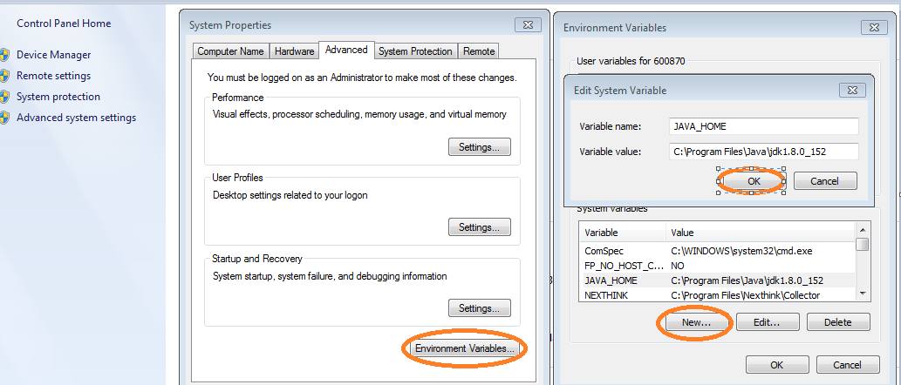
Setup JUnit Cont…
Step 2: Set JAVA Environment
Set the JAVA_HOME environment variable to point to the base directory location where Java is installed on your machine

Slide 9
Setup JUnit Cont…
Step 3: Download JUnit Archive
Download the latest JUnit jar file from https://sourceforge.net/projects/junit/files/junit/4.10/ and copied it into your local path.
Step 4: Set JUnit Environment
Set the JUNIT_HOME environment variable to point to the base directory location where JUNIT jar is stored on your machine.
Step 5: Set CLASSPATH Variable
Set the CLASSPATH environment variable to point to the JUNIT jar location.

Slide 10
Annotations and Assert Statements
Sl No | Annotations | Description
1 | @Test | The Test annotation tells JUnit that the public void method to which it is attached can be run as a test case.
2 | @Before | This annotation is used if you want to execute some statement such as preconditions before each test case.
3 | @BeforeClass | Annotating a public static void method with @BeforeClass causes it to be run once before any of the test methods in the class.
4 | @After | If you allocate external resources in a Before method, you need to release them after the test runs. Annotating a public void method with @After causes that method to be run after the Test method.
5 | @AfterClass | This will perform the method after all tests have finished. This can be used to perform clean-up activities.
6 | @Ignore | The Ignore annotation is used to ignore the test and that test will not be executed.
ANNOTATIONS is a special form of syntactic meta-data that can be added to Java source code for better code readability and structure

Slide 11
Annotations and Assert Statements
Sl No | Methods | Description
1 | void assertEquals(boolean expected, boolean actual) | Checks that two primitives/objects are equal.
2 | void assertTrue(boolean condition) | Checks that a condition is true.
3 | void assertFalse(boolean condition) | Checks that a condition is false.
4 | void assertNotNull(Object object) | Checks that an object isn't null.
5 | void assertNull(Object object) | Checks that an object is null.
6 | void assertSame(object1, object2) | The assertSame() method tests if two object references point to the same object.
7 | void assertNotSame(object1, object2) | The assertNotSame() method tests if two object references do not point to the same object.
8 | void assertArrayEquals(expectedArray, resultArray); | The assertArrayEquals() method will test whether two arrays are equal to each other.
Assert is a method useful in determining Pass or Fail status of a test case, In Junit all the assertions are in Assert class

Slide 12
JUnit 4 vs 5
JUnit 5 vs JUnit 4 – Others
FEATURE | JUnit 4 | JUnit 5
JDK Version | Min 1.5 | Min 1.8
Tagging and Filtering | @category annotation is used. | @tag annotation is used.
Test Suites | @RunWith and @Suite annotation. import org.junit.runner.RunWith; import org.junit.runners.Suite; @RunWith(Suite.class) @Suite.SuiteClasses({ ExceptionTest.class, TimeoutTest.class }) | @RunWith, @SelectPackages and @SelectClasses e.g. import org.junit.platform.runner.JUnitPlatform; import org.junit.platform.suite.api.SelectPackages; import org.junit.runner.RunWith; @RunWith(JUnitPlatform.class) @SelectPackages("com.howtodoinjava.junit5.examples")
3rd Party Integration | There is no integration support for 3rd party plugins and IDEs | Dedicated sub-project for this purpose i.e. JUnit Platform. It defines the TestEngine API for developing a testing framework that runs on the platform.

Slide 13
JUnit 4 vs 5
JUnit 5 vs JUnit 4 – Annotations
FEATURE | JUnit 4 | JUnit 5
Execute before all test methods in the current class | @BeforeClass | @BeforeAll
Execute after all test methods in the current class | @AfterClass | @AfterAll
Execute before each test method | @Before | @BeforeEach
Execute after each test method | @After | @AfterEach
Disable a test method / class | @Ignore | @Disabled
Test factory for dynamic tests | NA | @TestFactory
Nested tests | NA | @Nested
Tagging and filtering | @Category | @Tag
Register custom extensions | NA | @ExtendWith

Slide 14
JUnit Annotations
Annotations | Description
@BeforeAll | Executes a method before all tests.
@AfterAll | Executes a method after all tests
@BeforeEach | Execute before each test method
@AfterEach | Execute after each test method,
@Disabled | This is used to disable or skip tests at class or method level.
@TestFactory | Used to signal that the annotated method is a test factory method.
@Nested | Can be used to mark a nested class to be included in the test cases.
@Order | Is useful when we want to create a test pack with selected tests.
@RepeatedTest | Ability to repeat a test a specified number of times

Slide 15
JUnit Test Framework
JUnit test framework provides the following important features:
Fixtures
Fixtures is a fixed state of a set of objects used as a baseline for running tests. The purpose of a test fixture is to ensure that there is a well-known and fixed environment in which tests are run so that results are repeatable. It includes:
setUp() method, which runs before every test invocation.
tearDown() method, which runs after every test method.
Test suites
A test suite bundles a few unit test cases and runs them together. In JUnit, both @RunWith and @Suite annotation are used to run the suite test.
Test runners
Test runner is used for executing the test cases.
JUnit classes
JUnit classes are important classes, used in writing and testing JUnits. Some of the important classes are:
Assert - Contains a set of assert methods.
TestCase - Contains a test case that defines the fixture to run multiple tests.
TestResult - Contains methods to collect the results of executing a test case.

Slide 16
Exceptions
JUnit provides the facility to trace the exception and also to check whether the code is throwing expected exception or not.
Junit4 provides an easy and readable way for exception testing, you can use
Optional parameter (expected) of @test annotation and
To trace the information ,"fail()" can be used
While Testing exception, you need to ensure that exception class you are providing in that optional parameter of @test annotation is the same. This is because you are expecting an exception from the method you are Unit Testing, otherwise our JUnit test would fail.

Slide 17
JUnit Dynamic Test
What is DynamicTest?
The standard tests annotated with @Test annotation are static tests which are fully specified at the compile time. A DynamicTest is a test generated during runtime. These tests are generated by a factory method annotated with the @TestFactory annotation.
The DynamicTests are executed differently than the standard @Tests and do not support lifecycle callbacks. Meaning, the @BeforeEach and the @AfterEach methods will not be called for the DynamicTests.
.

Slide 18
JUnit Code Coverage
What is Code Coverage?
Code coverage means measuring how much of your code is executed during your unit tests. Basically, that means that after running your unit tests, you get a report showing you how many percent of the code that was executed during the tests, and also what lines precisely that were executed.
To measure code coverage you need a coverage tool. List of code coverage tools for Java:
Jacoco
EclEmma
Emma
Cobertura
.

Slide 19
JUnit – Best Practices
Test only one code unit at a time
Don’t make unnecessary assertions
Make each test independent of all the others
Don’t unit-test configuration settings
Name your unit tests clearly and consistently
All methods, regardless of visibility, should have appropriate unit tests
Put assertion parameters in the proper order
Ensure that test code is separated from production code
Do not print anything out in unit tests

Slide 20
Thank You
Bhaskar D
bhaskar.dara@cognizant.com

