Slide 1
Atlassian Crucible
DE CoE - Engineering Excellence
April 2020

Slide 2
Contents
Crucible Overview
Features
System Requirements
Pricing
Installation on Windows
Using Crucible - Add a repository
Using Crucible - Create a project
Using Crucible - Create a review
JIRA integration in Crucible & its benefits

Slide 3
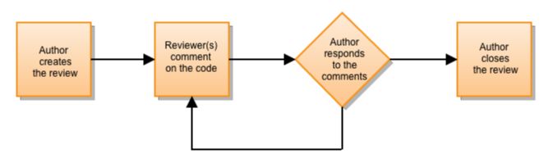
Crucible - Overview
Atlassian Crucible is the on-premises code review solution for enterprise teams. It allows your development teams to catch major defects, improve code architecture, and discuss desired improvements, without the need for meetings.
Crucible is a Java web application, that works with all modern browsers.
You can consider using Crucible if you meet any of the following:
Need to review multiple repos on one review
Not all code your reviewing is on Git
Your reviews are very large, and you need to break down commits to separate reviews
Your teams do not use a feature branch workflow
Crucible Workflow

Slide 4
Crucible - Features
Crucible is a lightweight, formal code review tool with which you can collaborate with your team to ship high quality code.
Code review tool
Catch major defects, improve code architecture, or discuss desired improvements with formal, workflow-based, or quick code reviews.
Inline discussions
Collaborate right in your code with inline comments, threaded conversations, and mentions.
Activity streams
Follow exactly what's happening throughout your projects in real time with activity streams showing recent comments and review updates.

Slide 5
Crucible - Features
Jira Software integration
Automatically update Jira Software issues based on review activity and or turn review comments into issues with one click.
Pre-commit reviews
Review code before check in and ensure any code going into production has been reviewed.
Real-time notifications
Stay on top of all the activity in your projects with personalized notifications and review reminders.
Charts and reports
Keep stakeholders informed with charts and code metrics that show lines of code (LOC) committed, top committers, the volume of changes on the project through its history, and more.
Audit and compliance
Access all code review details, down to the history of a specific code review and have traceability with issues and source code if you are utilizing Jira Software and Fisheye.
Iterative reviews
Ensure all files you are reviewing are current as code is re-factored and changed throughout the review process

Slide 6
Crucible – System Requirements
Tool Name | Crucible 4.8 (Central Instance)
Software Requirements | Oracle JDK 1.8, AdoptOpen JDK 1.8 Chrome, MySQL enterprise edition 5.6/5.7 or PostgreSQL 11, 10, 10.5, 9.6 /Oracle 12c R1, R2/SQL Server 2017/2016
Hardware requirements | Windows OS, 16 GB RAM, 300 GB Hard disk, Quad core 1.8 GHz or higher configuration
Dependencies | Git for windows(2.6.7-2.23.2)/SVN(1.8-1.10)/CVS(All versions)
Other requirements | Chrome/Firefox/Safari/MS Edge
Limitations | NA

Slide 7
Crucible – Pricing
Atlassian Crucible offers 30-day trial period with free of cost. Post that, the below license cost applies.
A Crucible commercial license entitles you to:
Deploy a single instance of Crucible in a production environment accessible by the number of users licensed
Perpetual Crucible use
Software maintenance for 12 months — including all updates and online support
JSP source code (under a developer source license which allows for broad customization)
Licensing fees are quoted per total number of 'Crucible users.' A Crucible user is by definition any user account in the Crucible system with the 'use' permission, i.e. anyone who can view the site while logged in. Unlimited 'anonymous users' are permitted on all licenses.

Slide 8
Crucible – Installation on Windows
Crucible can be installed on Windows using the below instructions:
1. Check supported platforms
Please ensure the system requirements are met before installation.
2. Create a dedicated Crucible user (recommended)
For production installations, we recommend that you create a new dedicated Windows user that will run Crucible on your system. This user:
Should not have admin privileges.
Should be a non-privileged user with read, write and execute access on the Crucible install directory and instance (data) directory. These directories are described below.
Should only have read access to your repositories.
If you created a dedicated Crucible user, ensure you are logged in as this user to complete the remaining instructions.

Slide 9
Crucible – Installation on Windows
3. Install Java
As of Crucible 4.8, JRE is no longer bundled with the installer.
Before you install Java, make sure you do not have a pre-existing installation already in place. In a command prompt, run this:
java –version
The version of Java should be 1.8.x.
4. Check that Windows can find Java
Windows uses the JAVA_HOME environment variable to find Java. To check that, in a new command prompt, run:
echo %JAVA_HOME%
You should see a path to the Java install location. We recommend that this path does not contain spaces, and that JAVA_HOME should point to the JDK home path.

Slide 10
Crucible – Installation on Windows
5. Get Crucible
The Crucible installer adds Crucible as a Windows service, and starts the service, automatically.
The express install creates, by default, a Data directory and a separate install directory in C:\Atlassian. The custom install mode allows you to choose different locations for the install and Data directories, with the restriction that the Data directory must not be contained in the install directory.
The installer creates the FISHEYE_INST system environment variable. This points to the location of the instance (data) directory.
The path to the installation location is referred to as the <Crucible install directory> in these instructions.

Slide 11
Crucible – Installation on Windows
You need separate Crucible instance (data) directories if you want to run multiple copies of Crucible.
If you expect to have a large number of users for this Crucible installation, and Crucible will be connected to an external database, consider installing Crucible on a different server from the one running the external database, for improved performance.
If you have a large number of repositories, we recommend you increase the default number of files that Crucible is allowed to open. See the following knowledge base article for more info: Subversion Indexer Paused with "Too many open files" Error.
You can edit JVM parameters for the Windows service by going to Start > All Programs > Crucible > Configure Crucible. Ensure that you restart the Crucible service when finished. Do not reference any environment variables in the settings (e.g. %FISHEYE_INST%). Instead, set the actual path.

Slide 12
Crucible – Installation on Windows
6. Visit Crucible
Give the Crucible service a minute to launch.
In a web browser on the same machine, go to http://localhost:8060/ (or, from another machine, type http://hostname:8060/, where hostname is the name of the machine where you installed Crucible).
Enter your license and administration password. Note that this is a 'root password', not assigned to any user account. You can later designate users to be administrators as well. You can log in using this root password, if necessary, by clicking the Administration link in the page footer.

Slide 13

Crucible – Add a repository
Assumptions
We're assuming that:
You have installed and started the latest version of Crucible.
You are using a supported browser.
You have admin permission in Crucible.
Add a repository
First up we're going to add a repository to Crucible.
Go to the Admin area by clicking on the 'cog' at the top right and choosing Administration:

Slide 14
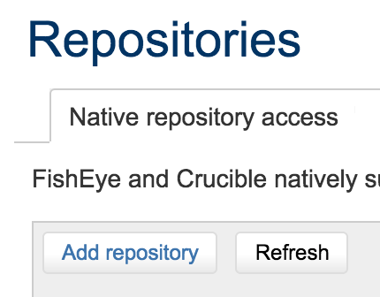
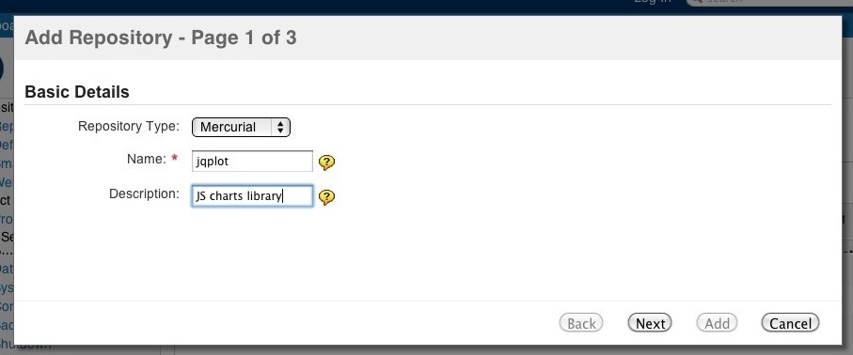
Crucible – Add a repository
Click Add repository in the Repositories listing of the Administration area:
Choose the repository type and fill in the name and description.

Slide 15
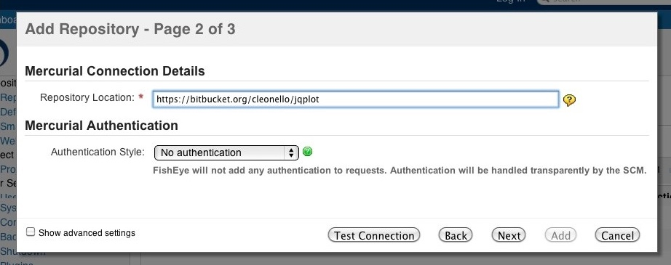
Crucible – Add a repository
In the repository configuration put the location of your repository. Fill in the authentication details if necessary.
Finally, indicate whether or not you would like diff indexing turned on and if the repository should be indexed right away, then click Add to finish the process.

Slide 16
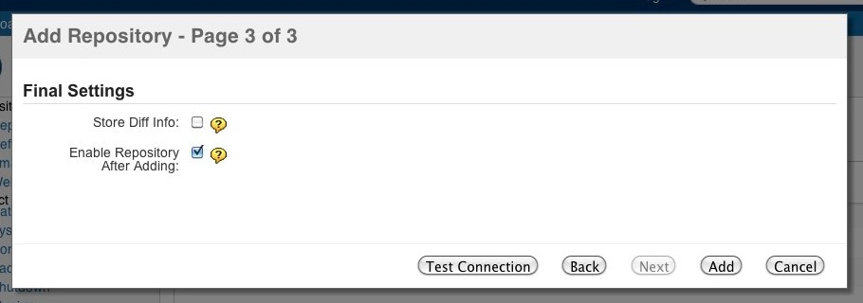
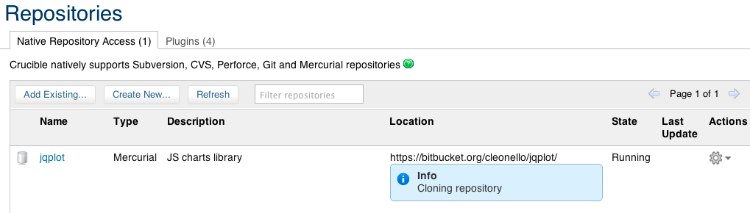
Crucible – Add a repository
Your repository is now created in Crucible and the indexing should have started.

Slide 17
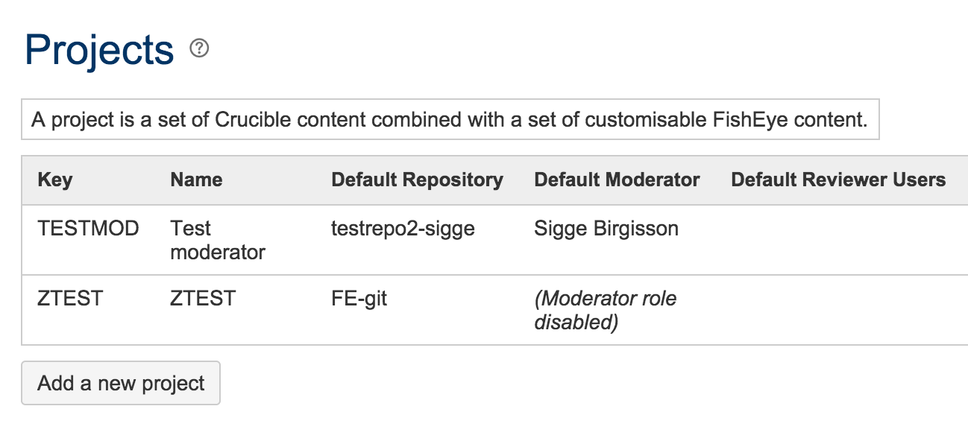
Crucible – Create a project
Crucible comes with a default project, with the key CR, but you will probably want to create your own projects to contain your reviews. This is achieved in a couple of steps.
Click Add a new project in the Projects listing of the Administration area.

Slide 18
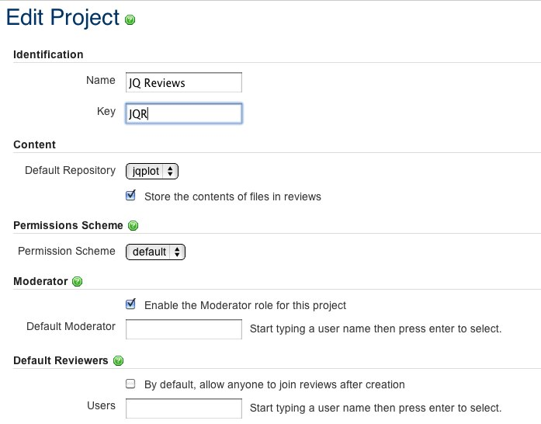
Crucible – Create a project
Fill in the form with the default settings for the project and hit Save.
You'll see your new project in the Projects listing.

Slide 19
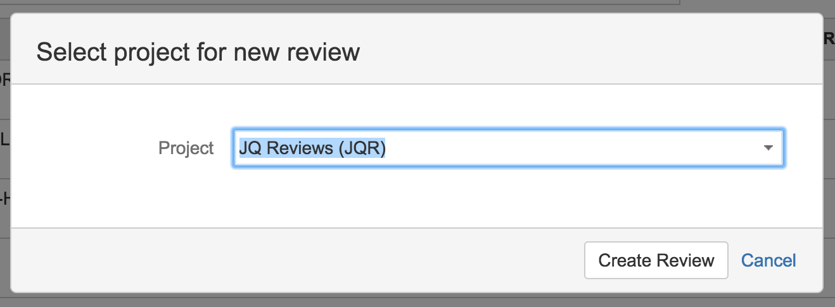
Crucible – Create a review
Now that you have your own project you can create reviews in it.
From the header, click Create review to open the review creation form:
Choose the project in which you want to create the review:

Slide 20
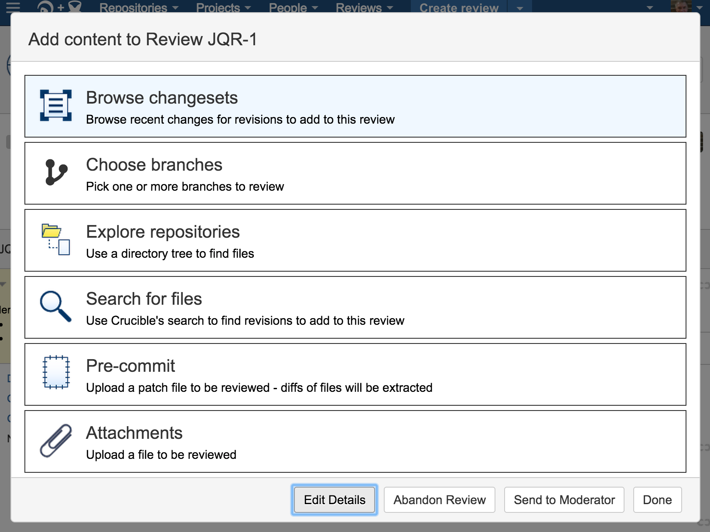
Crucible – Create a review
In the next screen, click Browse changesets to see the list of changesets available for the review.

Slide 21
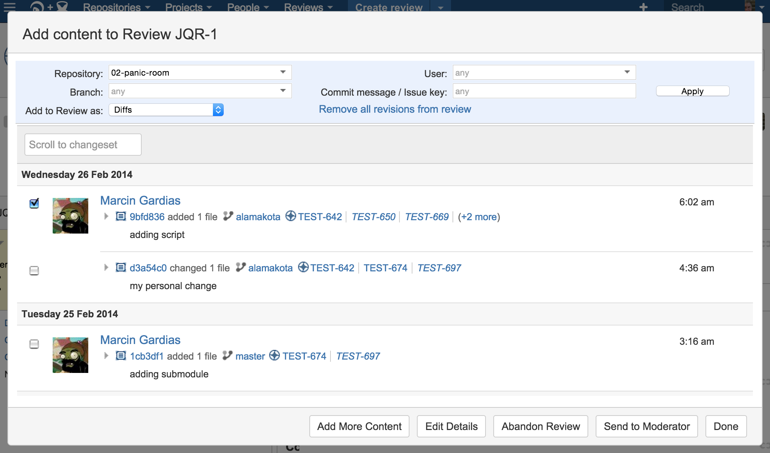
Crucible – Create a review
Select the changesets that you want to be reviewed, then click Edit Details:

Slide 22
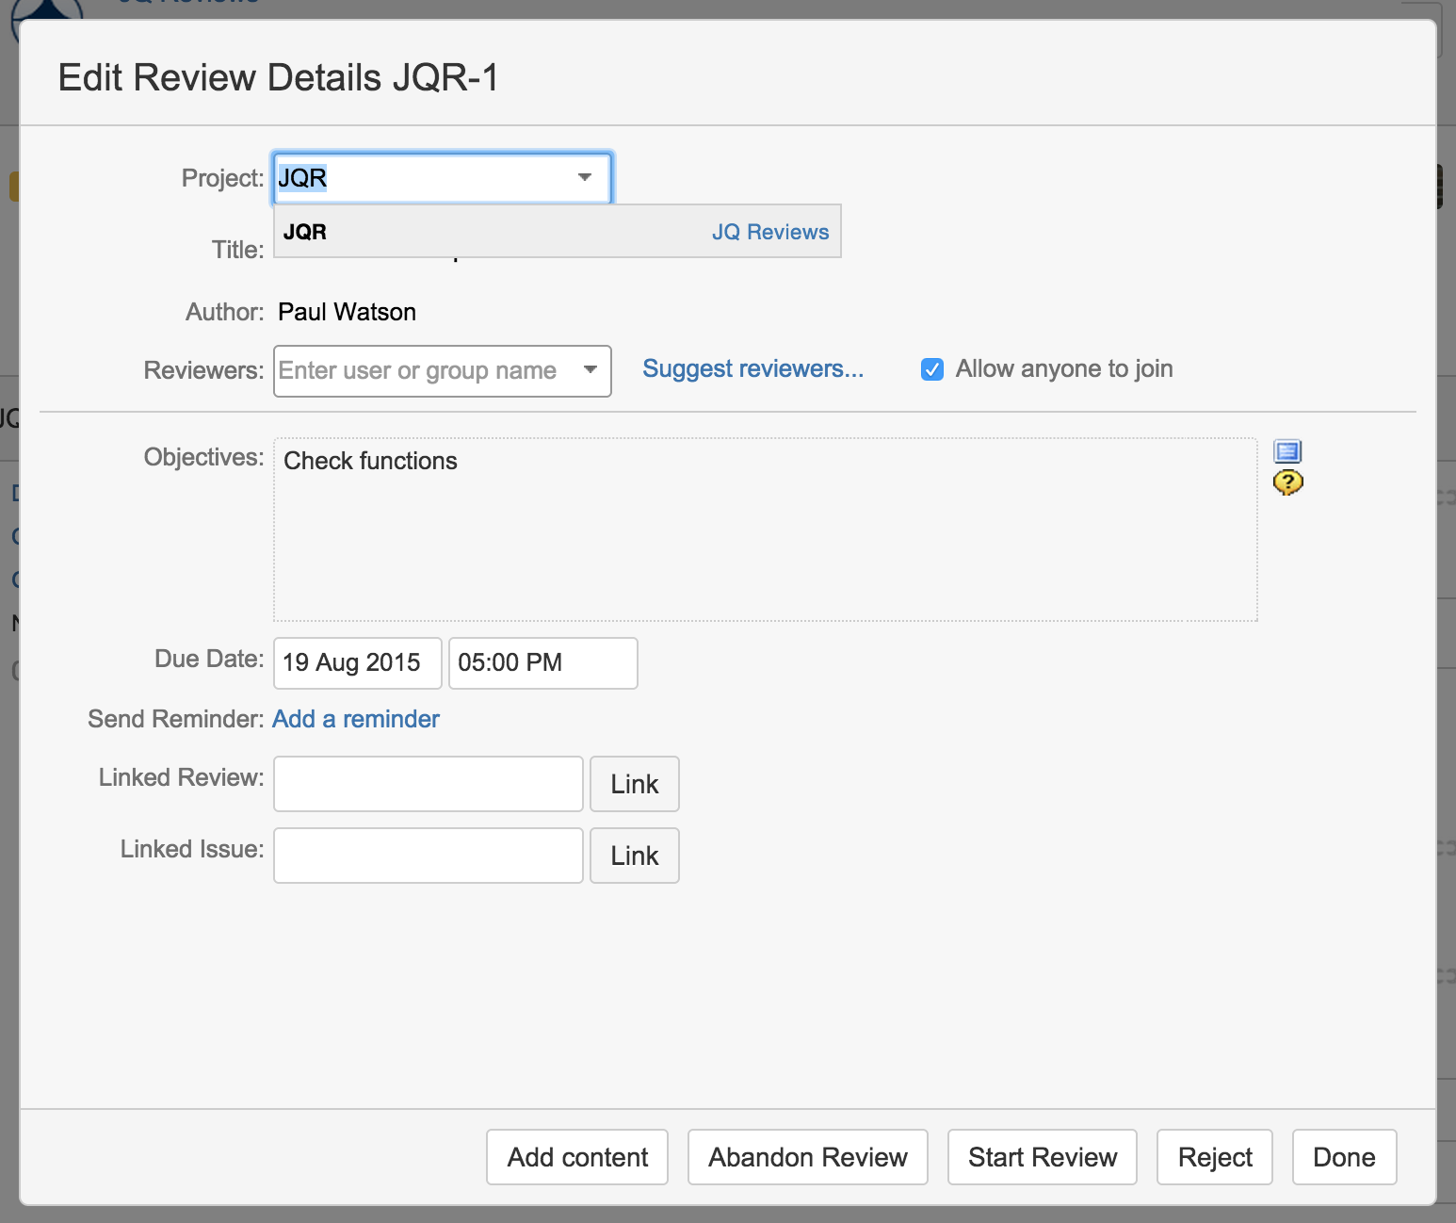
Crucible – Create a review
Now add reviewers and update the review information, then click Start Review:

Slide 23
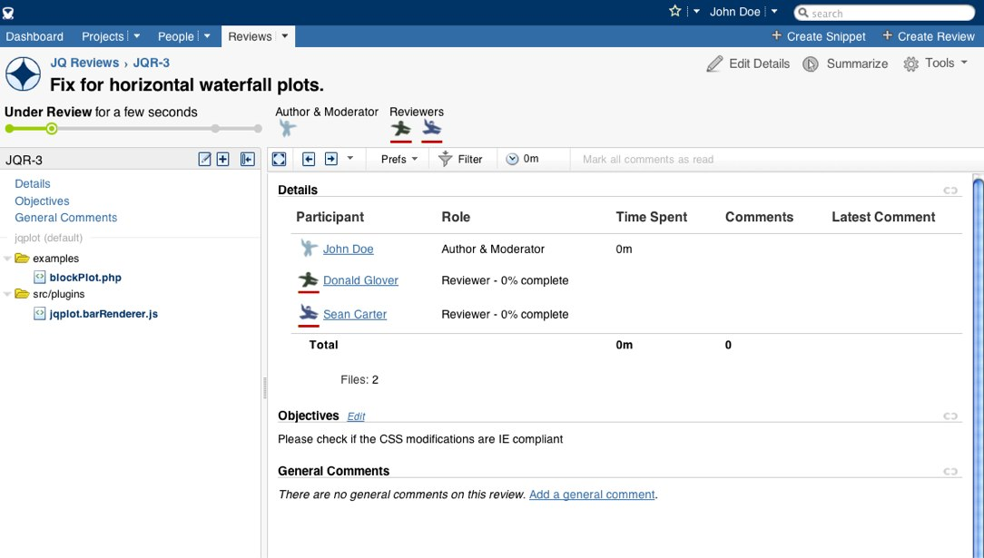
Crucible – Create a review
The review is now created and the reviewers will have been notified that a review is pending.

Slide 24
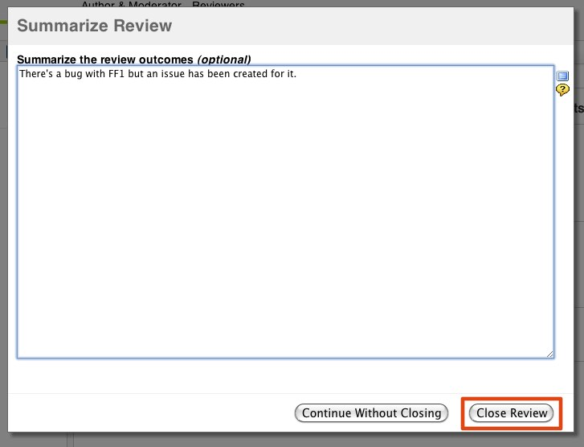
Crucible – Create a review
In order to close a review, when you are the moderator, you need to click on Summarize at the top right and then close the review from the dialog:

Slide 25
Crucible – JIRA Integration
When Crucible was first installed, Jira Software integration may have been configured using the setup wizard, which configures the Jira Software connection automatically for user management. However, Jira Software integration with Crucible can be configured at any time after installation.
The benefits when Crucible is integrated with Jira Software are as follows:
See all the Crucible reviews related to a Jira Software issue
Create a Crucible review directly from an issue in Jira Software
Link your Crucible review to a Jira Software issue
Create a Jira Software issue from a review comment
Transition Jira Software issues automatically
Transition Jira Software issues from within Crucible
See issues from multiple instances of Jira Software
See open reviews or unreviewed commits for an entire version within Jira Software

Slide 26
Thank You
DE CoE - Engineering Excellence
DETAGEnggExcellence@cognizant.com

