Slide 1
GitHub
Visalam
May 2020

Slide 2

Agenda
Version control Systems(VCS)
GitHub – An Introduction
Advantages of GitHub
Features of GitHub
Comparison : GitHub,Gitlab and Bit bucket
Branching Strategy
Create Github Repository
Create a Branch
How to use Github operations(Commit,Pull,Push and Merge)
GitHub wiki & Issues
GIT commands for windows
Software / Hardware Requirements
Visalam
April 2020

Slide 3

Version Control Systems (VCS)
Version Control system are software's that manage changes to files. e.g. documents, images ,codes, basically everything stored in a computer .
Major Benefits:
Saves you from creating multiple backups of your files
Allows multiple people work on the same file
Track changes and also who have made those changes
Easy to switch back to older versions as and when required
Makes you more productive
Two types of VCS:
Centralized Version Control System (CVCS)
Distributed Version Control System (DVCS)

Slide 4
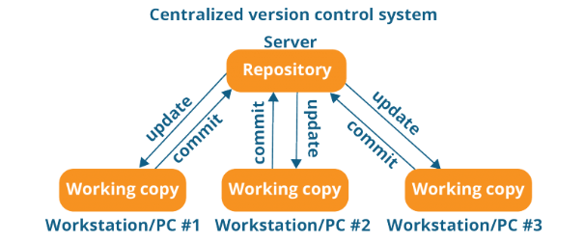
Version Control Systems (VCS)
Centralized version control system:
Client server version control systems works on a centralized model
It works on a single repository to which users check-in and check-out.
Major Drawbacks:
Version control is not available on local systems
If the central server gets corrupted the entire history is lost

Slide 5
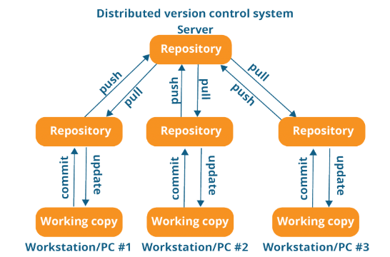
Version Control Systems (VCS)
Distributed VCS
Don’t rely on a Client server
Every contributor has a local copy or “clone” of the main repository.
Everyone maintains a local repository of their own which contains all the files
and metadata present in the main repository.
Benefits:
With DVCS version control is also available on local systems
No single point of failure as each user have the repository of the entire history
Allows you to perform all actions locally,even when not connected Internet.

Slide 6
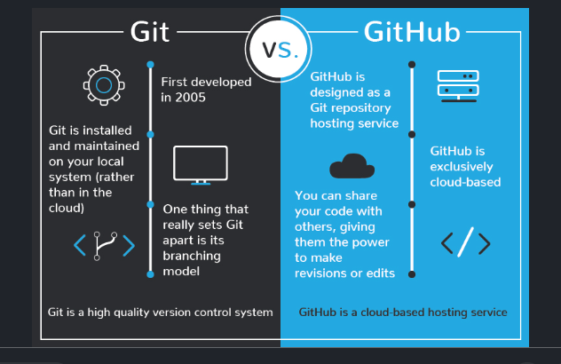
Introduction to GIThub
GitHub is a central repository and Git is a tool which allows you to create a local repository
Git is a version control tool that will allow you to perform all kinds of operations to fetch data from the central server or push data to it whereas GitHub is a core hosting platform for version control collaboration.

Slide 7
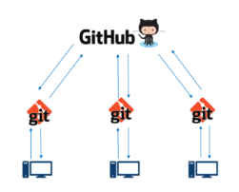




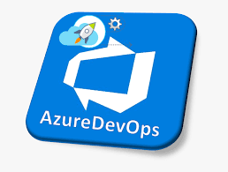





Introduction to GitHub
Who owns Github:
GitHub was developed by Chris Wanstrath, P. J. Hyett, Tom Preston-Werner and
Scott Chacon using Ruby on Rails, and started in February 2008.
It is a subsidiary of Microsoft, which acquired the company in 2018 for US$7.5 billion.
Competitors:

Slide 8
Advantages of GitHub
It is easy to contribute to open source projects via GitHub.
It helps to create an excellent document.
Version control, Release Management, CI/CD
GitHub also comes with an innovative feature called Markdown.
It can be easily integrated with Google cloud, Amazon and other common platforms.
You can track changes in your code across versions and makes collaborations easier
Provides backup & visual interface for your repository.

Slide 9
Features
GitHub is a place where programmers and designers work together. They collaborate, contribute, and fix bugs together. It hosts plenty of open source projects and codes of various programming languages.
Collaboration
Git Repositories
Project Management
Team Management
Code Hosting
Bug Tracking
Branches
Track and assign Tasks

Slide 10
Comparison : GitHub, Bitbucket & GitLab
Bitbucket
2008
GitHub
2008
GitLab
2011
Mercurial, Git
Free, unlimited
Free up to 5 users
Python and uses the Django web framework.
Feature
Launched in
Supported VCS
Public repos
Private repos
Language wriiten in
Integration
Notable features
Git
Free, unlimited
Free up to 3 collaborators
Ruby and Erlang
Asana, Zendesk, CloudBees, Travis, CodeClimate, AWS, Windows Azure, Google Cloud, and Heroku
Issue Tracking. Commit History can be seen. Graphs, pulse, contributors, commits, code frequency, members of it. Pull requests with code review and comments. Email notifications. Two-factor authentication, GitHub Pages, GitHub Gists
Git
Free, unlimited
Unlimited
Ruby and Go and Vue.jst
Jira,Redmine,Bugzilla,YouTrac
Issue Tracking. Commit graph and reporting tools. Create new issues from the Issue Board. Ease of migration from other providers. Jenkins ,Kerberos ,Akismet,Google reCAPTCHA Integration.
Jira, Crucible, Jenkins, Bamboo
Issue tracking, REST APIs to build third party applications which can use any development language. Code search is possible. Pull requests with code review and comments. Snippets that allow developers to share code segments or files. Integration with Spoon, Jira. External authentication via GitHub, Twitter, Facebook, Google.

Slide 11
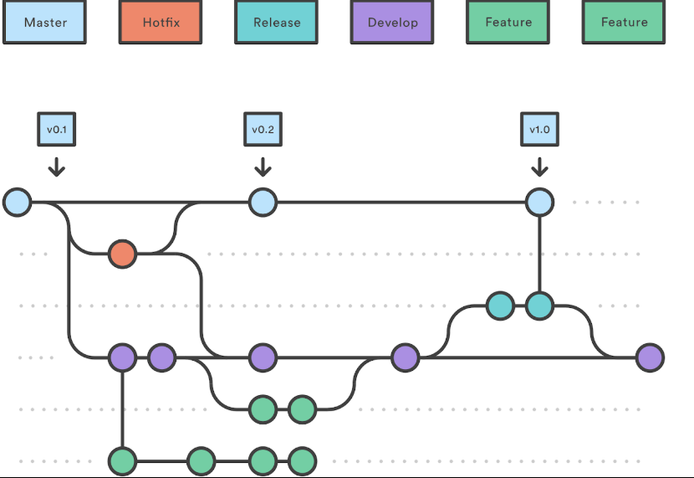
Branching Strategy
Master branch – current prod release code. Once after every release, code needs to merged from release branch to master branch to keep the code in sync.
Hot fix branch - For any urgent bug fixes, after the fix is done, code needs to be merged to develop branch and master branch.
Feature branch – developers may create this branchy for mostly every story during sprint.
Develop branch – after feature is developed, code will be merged to develop branch.
Release branch – Create this branch for every release, fix the defects raised during QA and release all the way to PROD.

Slide 12
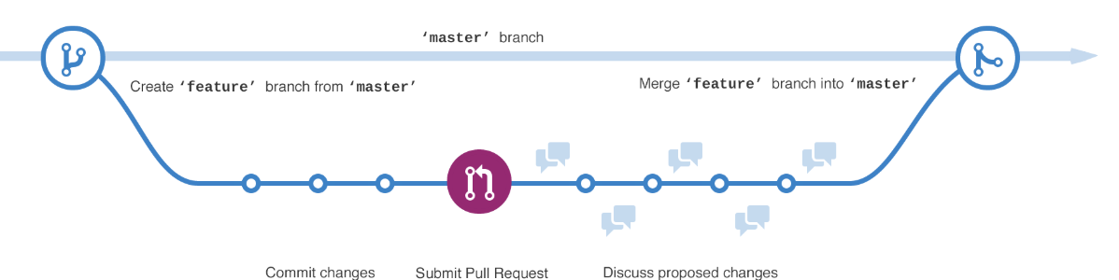
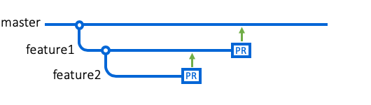
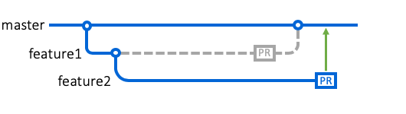
Typical day with GitHub(Feature branch)
GitHub flow is a lightweight, branch-based workflow that supports teams and projects where deployments are made regularly.

Slide 13
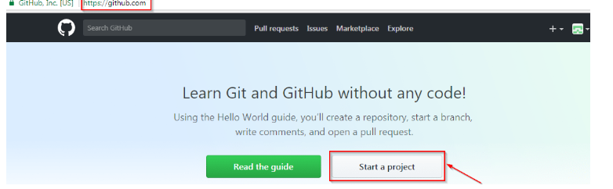
Creating GitHub Repository
Go to the link: https://github.com/ . Fill the sign up form and click on “Sign up for Github”.
Click on “Start a new project”.

Slide 14
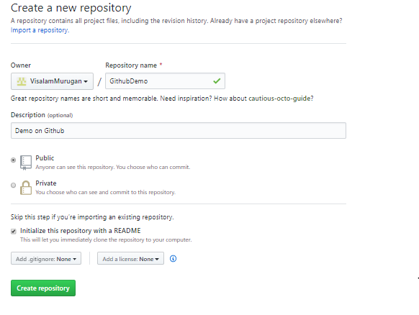
Creating GitHub Repository
Enter any repository name and click on “Create Repository”. You can also give a description to your repository (optional).
By default a GitHub repository is public which means that anyone can view the contents of this repository whereas in a private repository, you can choose who can view the content. Also, private repository is a paid version.
Initialize the repository with a README file - This file contains the description of the file and once you check this box, this will be the first file inside your repository.

Slide 15
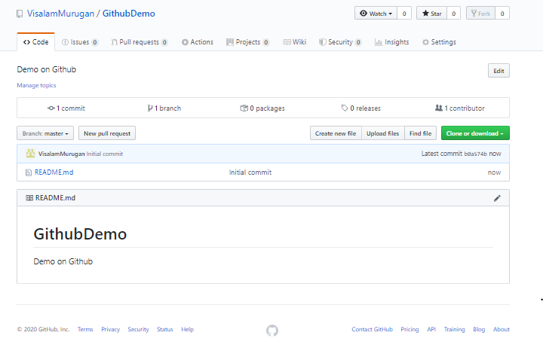
Successful creation of GitHub Repository
Central repository has been successfully created! Once this is done, you are ready to commit, pull, push and perform all the other operations.

Slide 16
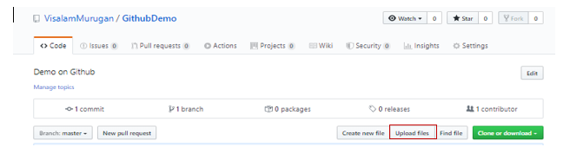
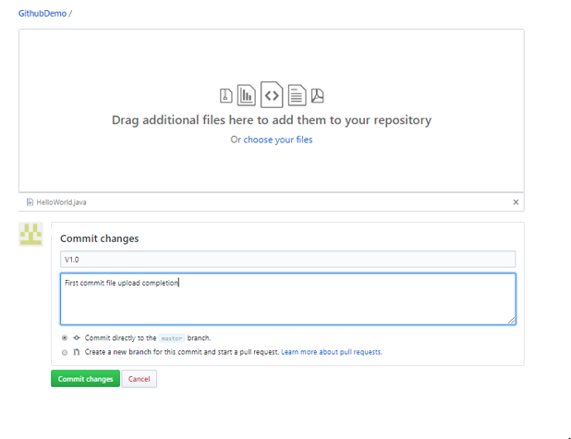
Uploading Project files
Click on “Upload files” to add new files to the repository and click on “commit changes” once the file is added

Slide 17
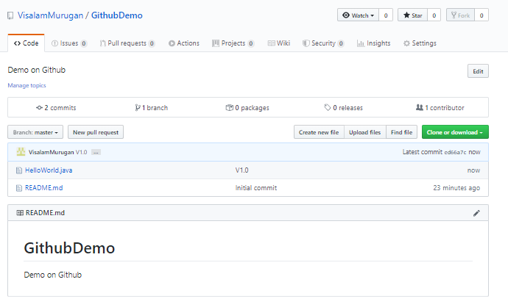
Create a Branch
By default all repository has one branch named “master” which is considered to be the definitive branch.
When you create the branch of the “master” branch you are making a copy or snapshot of master branch.
When a change is ready and then merge the branch to the master.
In this example “master” branch has two files such as Helloworld.java,README.md

Slide 18
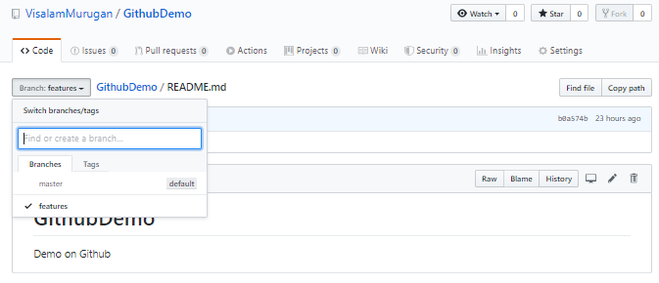
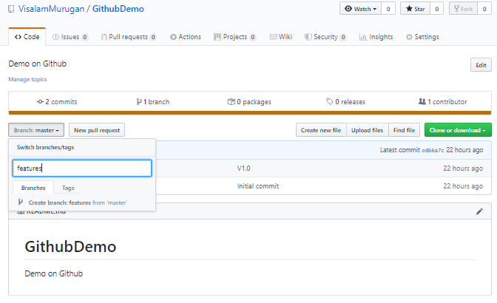
Create a Branch
Click the drop down at the top of the file list branch:master. Type a branch name “features” into the new branch text box. Select the blue Create branch box or hit “Enter” on your keyboard.
Now, you have added two branches, master and features. Both looks exactly the same. Next we’ll add our changes to the new branch(features).

Slide 19
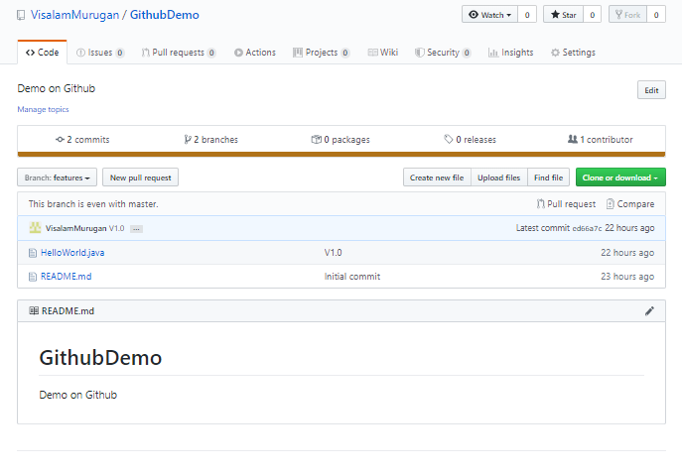
Make and commit changes
On GitHub, saved changes are called ”Commits”
Each commit has an associated commit message, which is a description explaining why a particular change was made.
Commit messages capture the history of your changes, so other contributors can understand what you’ve done and why.
Now click on “Helloworld.java” to make changes.

Slide 20
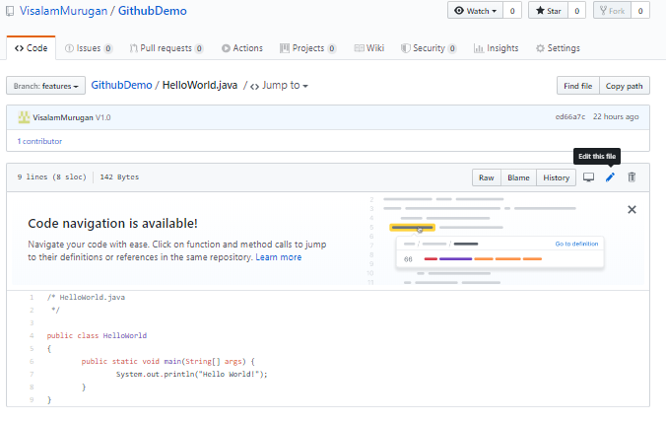
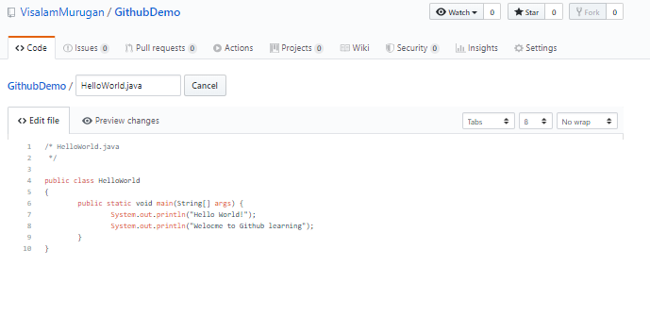
Make and commit changes
Click the pencil icon in the upper right corner of the file view to edit.
In editor, Enter the newline and add the line as “System.out.println(“Welcome to GitHub learning!");” and now closing parenthesis is moving one step down.

Slide 21
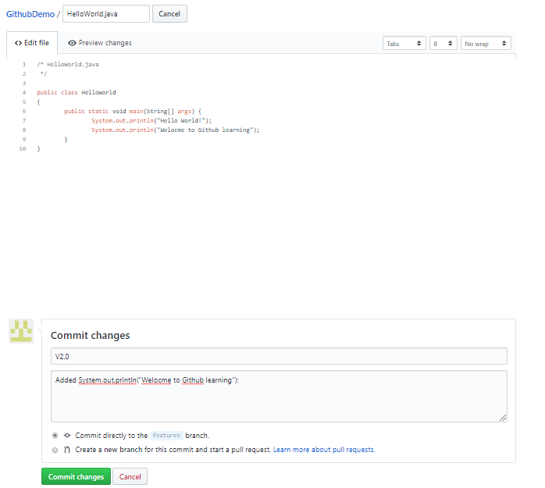
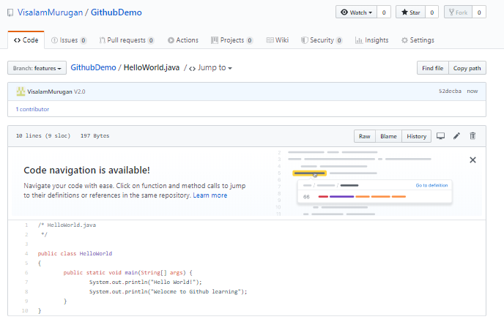
Make and commit changes
Write a commit message that describes your changes and click on Commit changes button.
These changes are updated only to “HelloWorld.java” program on “features” branch, so now this branch contains content that’s different from master.

Slide 22
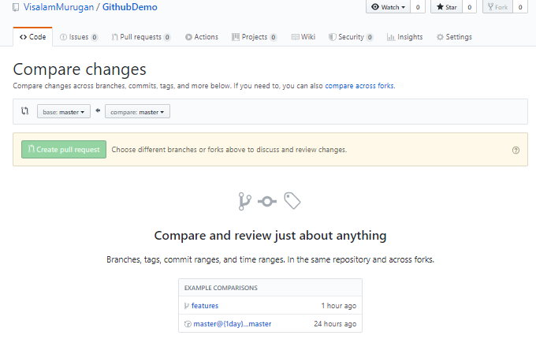
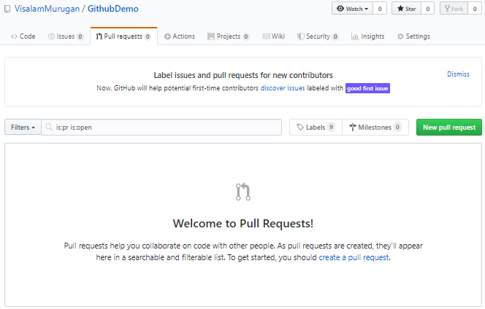
Open a Pull Request
Pull Requests are the heart of collaboration on GitHub.
Pull requests show diffs, or differences, of the content from both branches. The changes, additions, and subtractions are shown in green and red.
Click the Pull Request tab, then from the Pull Request page, click the green New pull request button.
Page is redirected to “Compare changes”

Slide 23
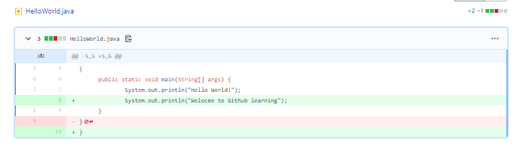
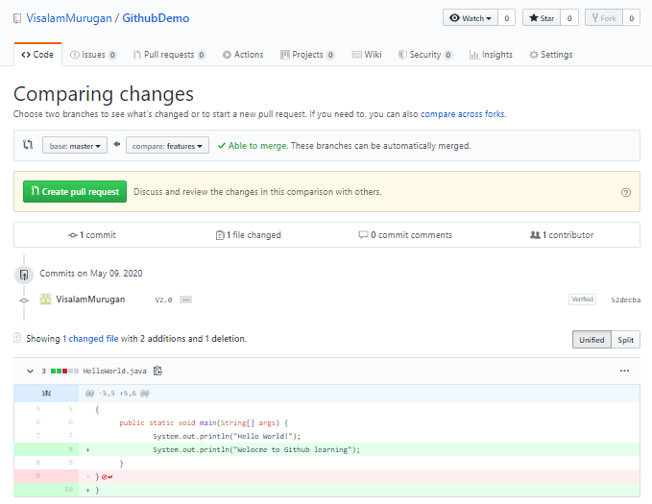
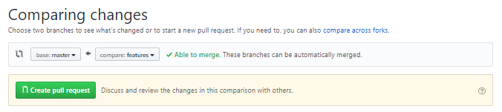
Open a pull request – Compare changes
Changes highlighted in green color are newly added lines and red color are removed lines.
When you’re satisfied that these are the changes you want to submit, click the big green Create Pull Request button.
In below sample, select the branch you made “features” to compare with master (the original).
Look over your changes in the diffs on the Compare page, make sure they’re what you want to submit.

Slide 24
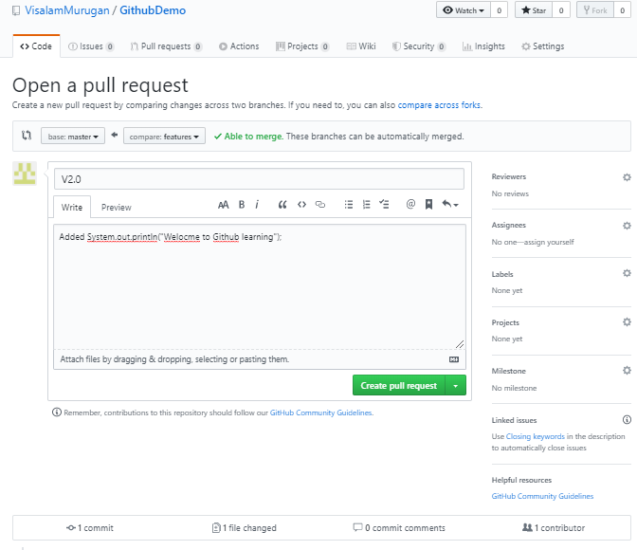
Create pull request
Give your pull request a title and write a brief description of your changes.
Click on “Create pull request”

Slide 25
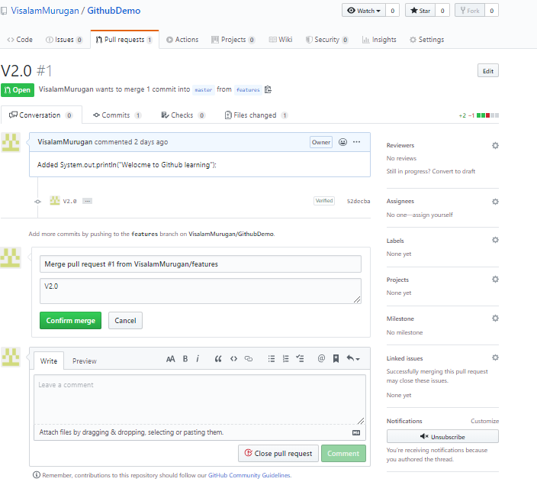
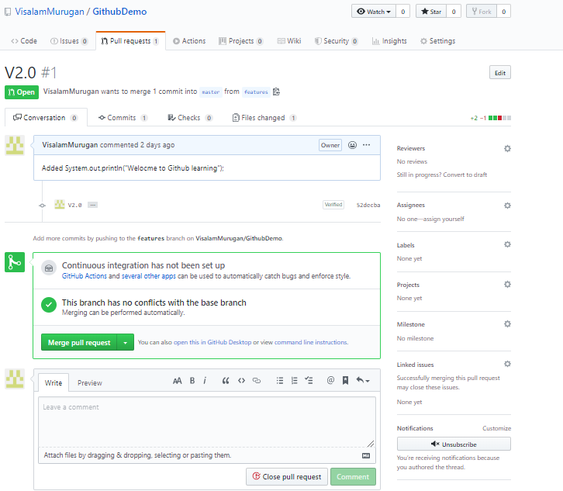
Merge your Pull Request
Merging “features” branch in to “master” branch.
Click the green Merge pull request button to merge the changes in to “master”
Click Confirm merge

Slide 26
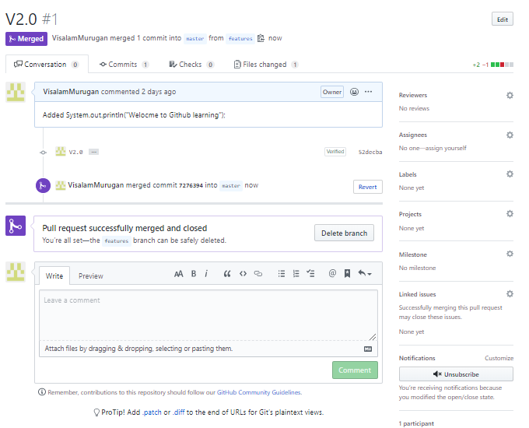
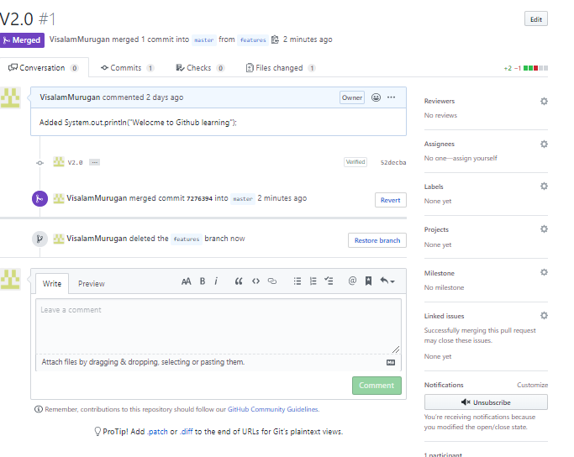
Merge your Pull Request
Go ahead and click on “Delete branch”(features), since its changes have been incorporated
Now, “master” branch has been updated with all code changes and “features” branch has been successfully deleted

Slide 27
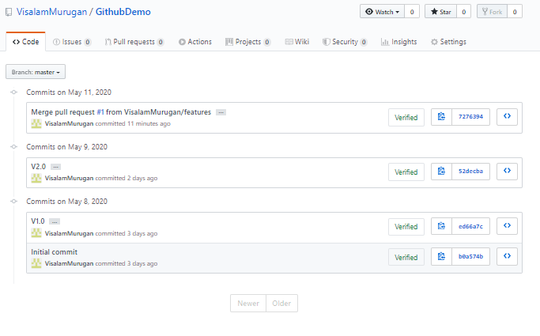
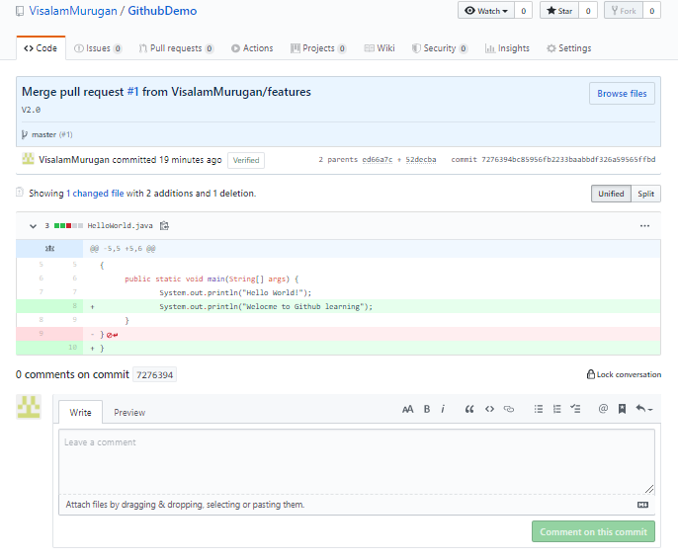
Merge your Pull Request
Validate the history of changes done so far in “master” branch
Check the changes are added in master by clicking on unique id link.

Slide 28
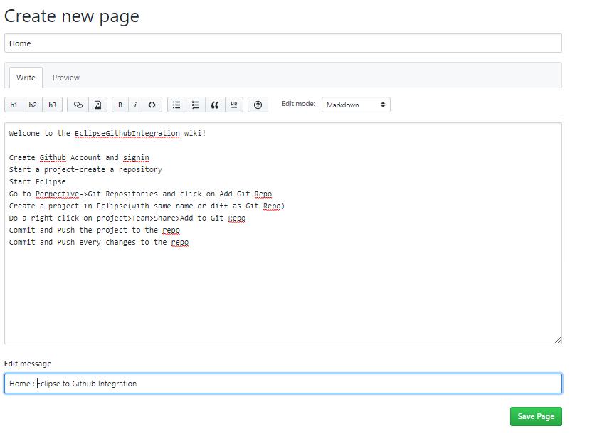
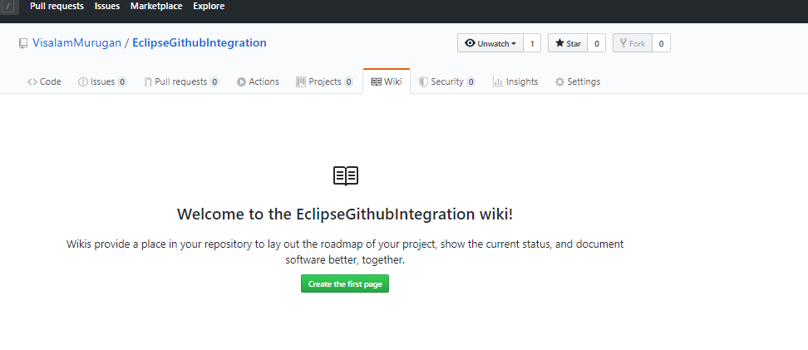
Understanding GitHub wiki
Wikis provide a place in your repository to lay out the roadmap of your project, show the current status, and document software better, together.
Click on wiki->Create the first page
Add descriptions in Home Page and click on “Save Page”

Slide 29
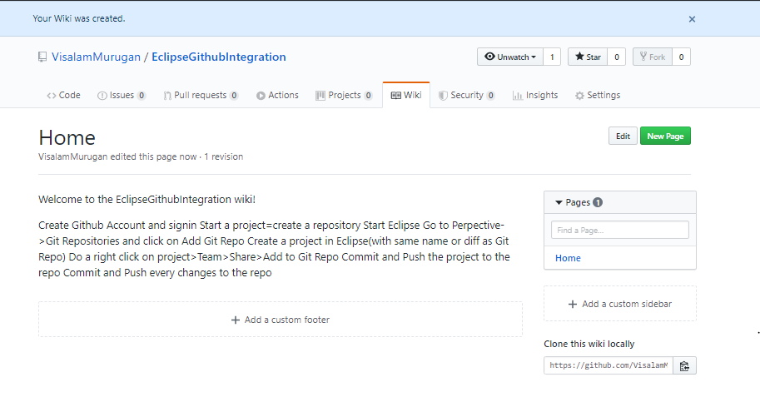
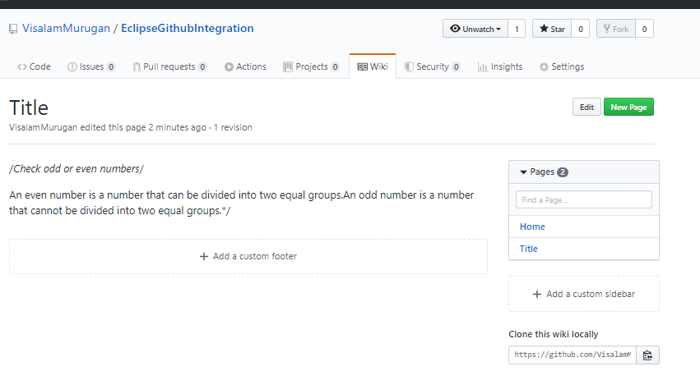
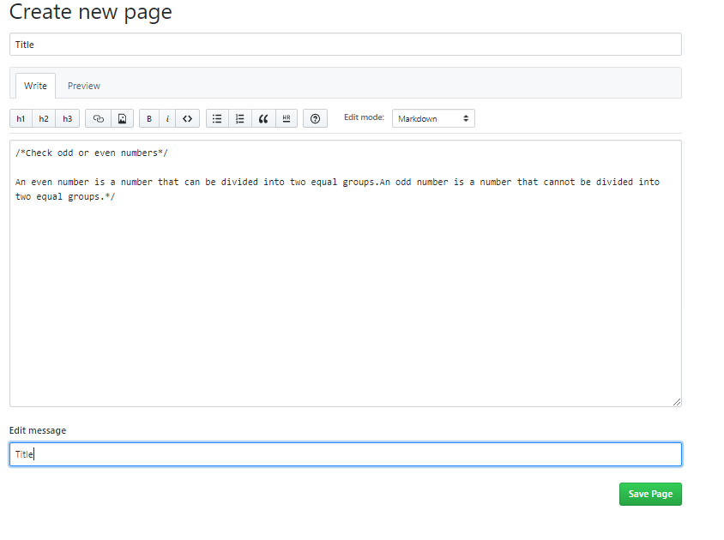
Understanding GitHub wiki
Wiki page is created
Click on “New page” to describe on Java file and Save the file
Now, new wiki page is in “EclipseGithubIntegration” repository with two links(Home , Title)

Slide 30
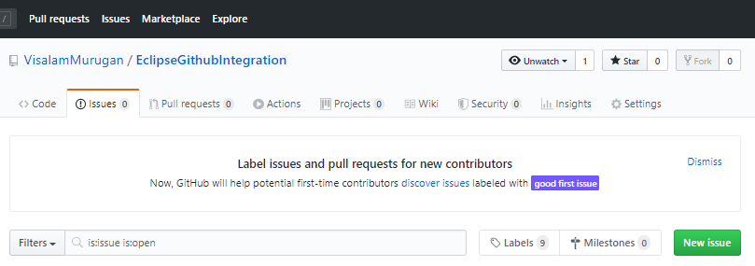
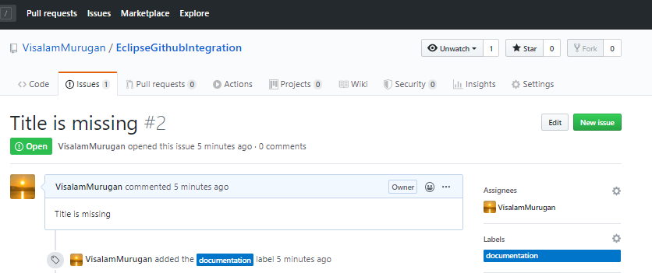
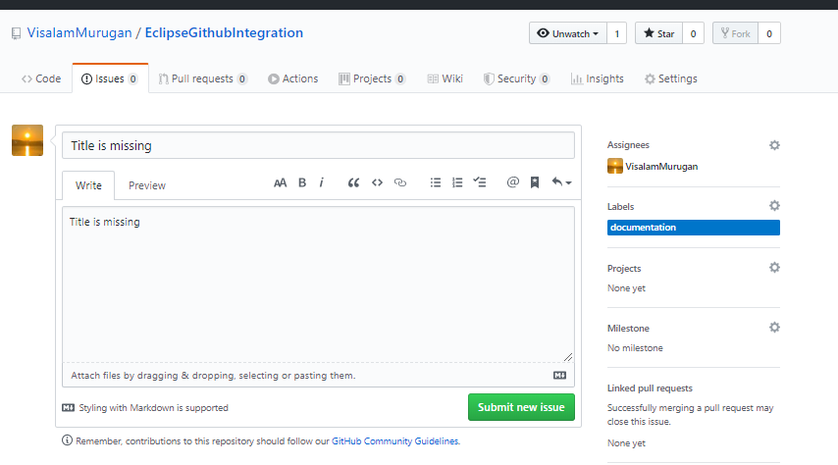
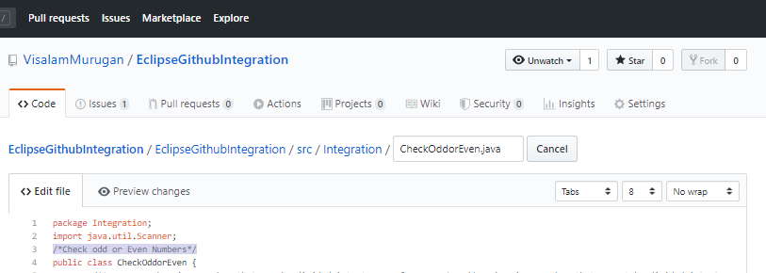
Understanding GitHub Issues
Issues->Click on New issue in GitHub repository
Click on Submit new issue
Issue has been created with “open” status with the issue id#2
Comments are updated (at LineNo:3) and click on “Save”.

Slide 31
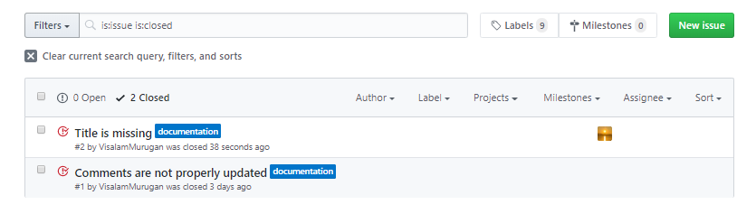
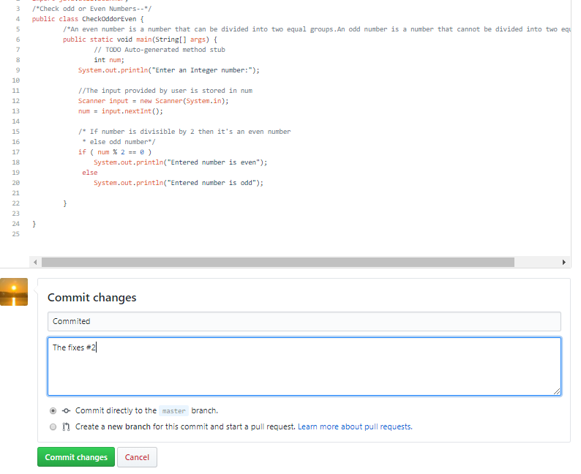
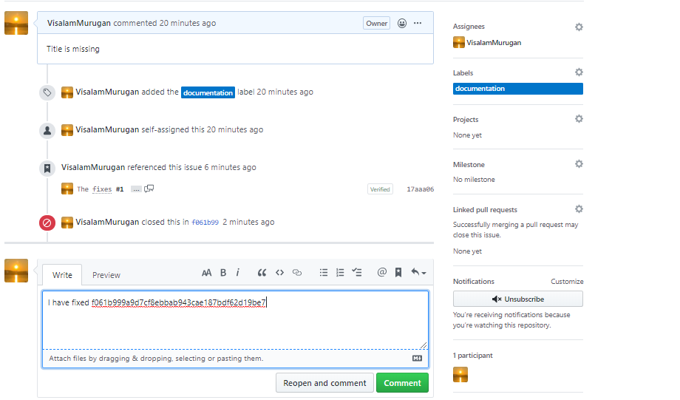
Understanding Github Issues
Enter valid Commit message(This fixes #2) and click on “commit
Note: "Fixes” act as keyword in GitHub and automatically close the issue.
Now the issue #2 is automatically closed.
.
Have added commit number and provided with comments for tracking purpose

Slide 32
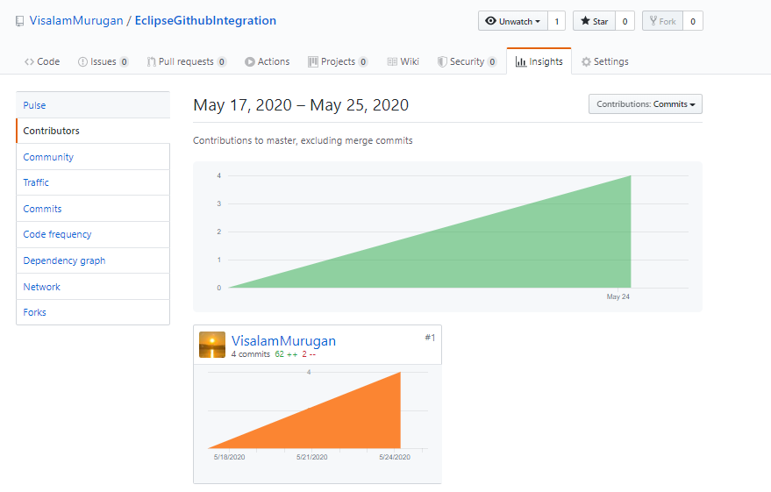
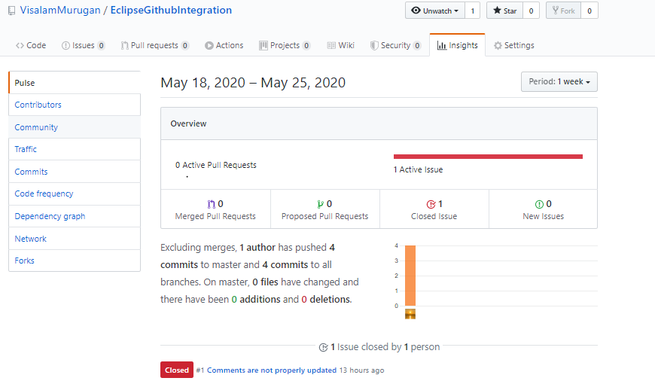
GitHub – Insights
GitHub Insights provides metrics and analytical reports to help engineering teams understand & improve their software delivery process, below are default Dashboards
Pulse:
By default, Pulse shows the last seven days of repository activity. To choose a different time period, click the period dropdown in the upper-right corner of the Pulse overview.
Contributors:
You can view the top 100 contributors to a repository in the contributors graph. Merge commits and empty commits aren't counted as contributions for this graph.

Slide 33
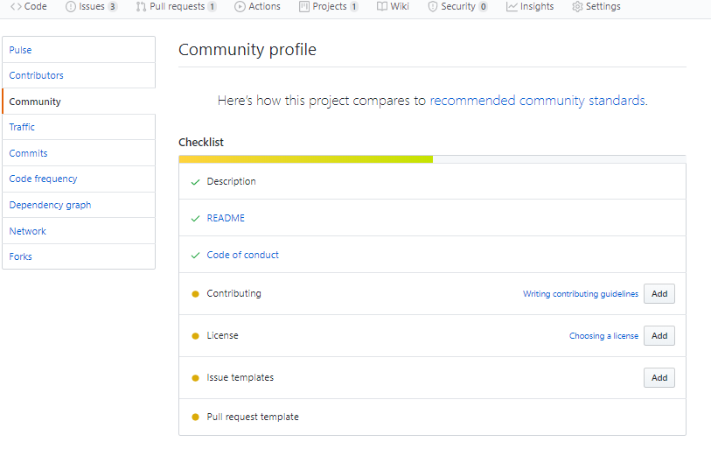
GitHub – Insights
Community:
The community profile checklist checks to see if a project includes recommended community health files, such as README, CODE_OF_CONDUCT, LICENSE, or CONTRIBUTING, in a supported location

Slide 34
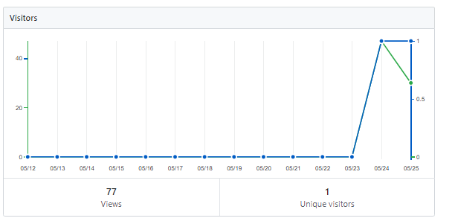


GitHub – Insights
Traffic:
Anyone with push access to a repository can view its traffic, including full clones (not fetches), visitors from the past 14 days, referring sites, and popular content in the traffic graph.

Slide 35


GitHub – Insights
Commits:
You can see all commits made to a repository in the past year (excluding merge commits) in the Commit graph.
Network Graph:
The network graph displays the branch history of the entire repository network, including branches of the root repository and branches of forks that contain commits unique to the network..

Slide 36



GitHub – Insights
Code Frequency:
The code frequency graph displays the content additions and deletions for each week in a repository's history.
Dependency Graph:
With dependency insights, users can quickly filter to view dependencies
Forks:
Forks are listed alphabetically by the username of the person who forked the repository. You can click on the username to be redirected to the user's GitHub profile page or click on the fork name to be redirected to the specific fork of the repository.

Slide 37




GIT - Windows – Installation steps
Check if Git for windows is already installed
Version is not available and now download Git for windows from https://git-scm.com/ and install.

Slide 38





GIT - Windows – Installation steps

Slide 39





GIT - Windows – Installation steps

Slide 40
GIT Commands - definitions
git init initializes a brand new Git repository and begins tracking an existing directory. It adds a hidden subfolder within the existing directory that houses the internal data structure required for version control.
git clone creates a local copy of a project that already exists remotely. The clone includes all the project’s files, history, and branches.
git add stages a change. Git tracks changes to a developer’s codebase, but it’s necessary to stage and take a snapshot of the changes to include them in the project’s history. This command performs staging, the first part of that two-step process. Any changes that are staged will become a part of the next snapshot and a part of the project’s history. Staging and committing separately gives developers complete control over the history of their project without changing how they code and work.
git commit saves the snapshot to the project history and completes the change-tracking process. In short, a commit functions like taking a photo. Anything that’s been staged with git add will become a part of the snapshot with git commit.

Slide 41
GIT Commands - Definitions
git status shows the status of changes as untracked, modified, or staged.
git branch shows the branches being worked on locally.
git merge merges lines of development together. This command is typically used to combine changes made on two distinct branches. For example, a developer would merge when they want to combine changes from a feature branch into the master branch for deployment.
git pull updates the local line of development with updates from its remote counterpart. Developers use this command if a teammate has made commits to a branch on a remote, and they would like to reflect those changes in their local environment.
git push updates the remote repository with any commits made locally to a branch.

Slide 42
GIT Commands - Contribute to an existing repository
# download a repository on GitHub.com to our machine
git clone https://github.com/me/repo.git
# change into the `repo` directory
cd repo
# create a new branch to store any new changes
git branch my-branch
# switch to that branch (line of development)
git checkout my-branch
# make changes, for example,
edit `file1.md` and `file2.md` using the text editor
# stage the changed files
git add file1.md file2.md
# take a snapshot of the staging area (anything that's been added)
git commit -m "my snapshot"
# push changes to github
git push --set-upstream origin my-branch

Slide 43
GIT Commands - Start a new repository and publish it to GitHub
# create a new directory, and initialize it with git-specific functions
git init my-repo
# change into the `my-repo` directory
cd my-repo
# create the first file in the project
touch README.md
# git isn't aware of the file, stage it
git add README.md
# take a snapshot of the staging area
git commit -m "add README to initial commit"
# provide the path for the repository you created on github
git remote add origin https://github.com/YOUR-USERNAME/YOUR-REPOSITORY.git
# push changes to github
git push --set-upstream origin master

Slide 44
GIT Commands - Contribute to an existing branch on GitHub
# assumption: a project called `repo` already exists on the machine, and a new branch has been pushed to GitHub.com since the last time changes were made locally
# change into the `repo` directory
cd repo
# update all remote tracking branches, and the currently checked out branch
git pull
# change into the existing branch called `feature-a`
git checkout feature-a
# make changes, for example,
edit `file1.md` using the text editor
# stage the changed file
git add file1.md
# take a snapshot of the staging area
git commit -m "edit file1"
# push changes to github
git push

Slide 45
Resources Required for Hands on
Tool Name | GitHub Enterprise 2.20.5
Software Requirements | GitHub Enterprise: Virtual machine environment
Hardware requirements | GitHub Enterprise: Processor: Four 3.0 GHz CPU cores (or virtual equivalent) Memory: 32 GB (minimum dependent on selected platform) Disk: 200 GB VM root partition 250 GB data partition (our recommendation, actual size depends on your data) Storage: High-performance SAN or locally attached storage
Dependencies | NA
Other requirements | GitHub Free and Team: Directly configured in https://github.com and no prerequisites are needed. But security,SAML,LDAP features are not available.

Slide 46
Limitations
Free:
Basics for teams and developers
Unlimited public/private repositories
Unlimited collaborators
2,000 Actions minutes/month Free for public repositories
500MB of GitHub Packages storage Free for public repositories
Community Support
$0 /month
Enterprise
Security, compliance, and flexible deployment for enterprises
Everything included in Team
SAML single sign-on
50,000 Actions minutes/month Free for public repositories
50GB of GitHub Packages storage Free for public repositories
Advanced auditing
$21 per user/month
Team:
Advanced collaboration and support for teams
Everything included in Free
Required reviewers
3,000 Actions minutes/month Free for public repositories
2GB of GitHub Packages storage Free for public repositories
Code owners
$4 per user/month
GitHub One
All of our best tools, support, and services
Everything included in Enterprise
Community-powered security
Actionable metrics
24/7 support
Continuous learning

Slide 47
Thank You
Visalam
GitHub

