Slide 1
SonarQube – Advanced Training
Agila, Padma, Bhaskar & Chethan
August 2020

Slide 2
Agenda
SonarQube – Architecture & Integration
SonarQube Server set up
LDAP Integration
Database Setup
SMTP Integration
SonarQube analysis for .Net application with MSBuild, NUnit & OpenCover
SonarLint for Visual Studio / Eclipse
Setup a Jenkins Pipeline for Java project with SonarQube, Maven, GitHub for Complete Automated CI

Slide 3
SonarQube Architecture & Integration

Slide 4
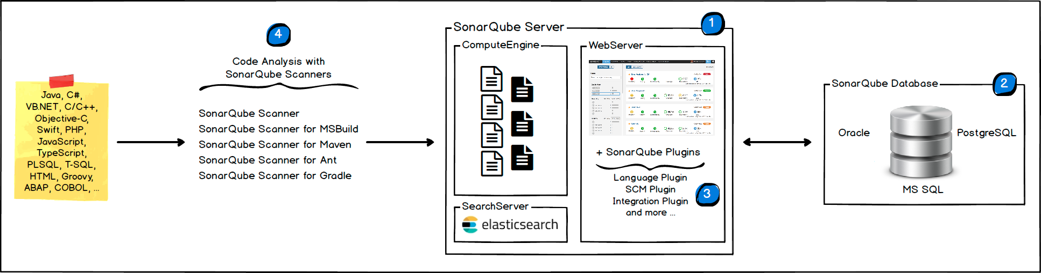
SonarQube – Architecture
The SonarQube Platform is made of 4 components:

Slide 5
SonarQube – Architecture
1. SonarQube Server is responsible for starting 3 main processes:
Web Server for developers, managers to browse quality snapshots and configure the SonarQube instance
Search Server based on Elasticsearch to back searches from the UI
Compute Engine Server in charge of processing code analysis reports and saving them in the SonarQube Database
2. SonarQube Database is responsible to store:
the configuration of the SonarQube instance (security, plugins settings, etc.)
the quality snapshots of projects, views, etc.
3. Multiple SonarQube Plugins installed on the server, possibly including language, SCM, integration, authentication, and governance plugins
4. One or more SonarScanners running on your Build / Continuous Integration Servers to analyze projects

Slide 6
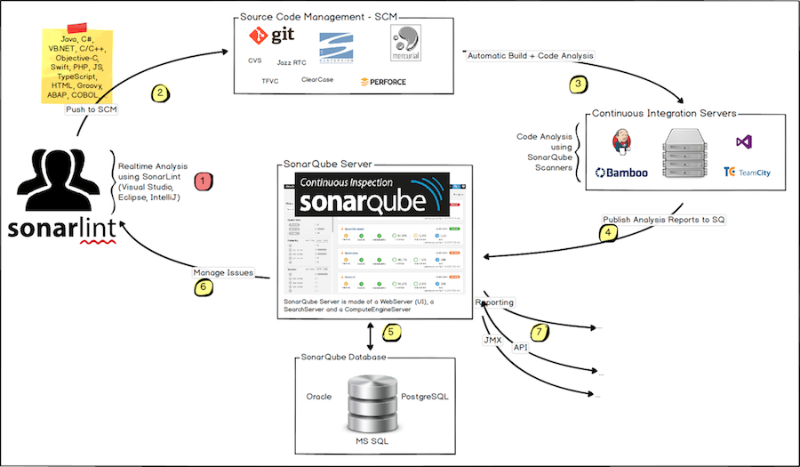
SonarQube – Integration
The following schema shows how SonarQube integrates with other ALM tools and where the various components of SonarQube are used.

Slide 7
SonarQube – Integration
Developers code in their IDEs and use SonarLint to run local analysis.
Developers push their code into their favourite SCM : git, SVN, TFS.
The Continuous Integration Server triggers an automatic build, and the execution of the SonarScanner required to run the SonarQube analysis.
The analysis report is sent to the SonarQube Server for processing.
SonarQube Server processes and stores the analysis report results in the SonarQube Database, and displays the results in the UI.
Developers review, comment, challenge their Issues to manage and reduce their Technical Debt through the SonarQube UI.
Managers receive Reports from the analysis. Ops use APIs to automate configuration and extract data from SonarQube. Ops use JMX to monitor SonarQube Server.

Slide 8
SonarQube Server Setup

Slide 9
SonarQube Setup
SonarQube Setup can be downloaded from the below link
https://www.sonarqube.org/downloads/
It is recommended to download the Long Term Support version for Large Organizations for Stability & Reliability purposes. The Last Long Term Support version is 7.9(1st Jul 2019), with latest upgrade in Mar 2020 with patch 7.9.3.
Once the Setup zip file is download, place extract the contents onto the folder where setup is desired, based on user preference.
The only Pre-requisite is to have JDK 11 installed in the system before proceeding with the setup of SonarQube

Slide 10
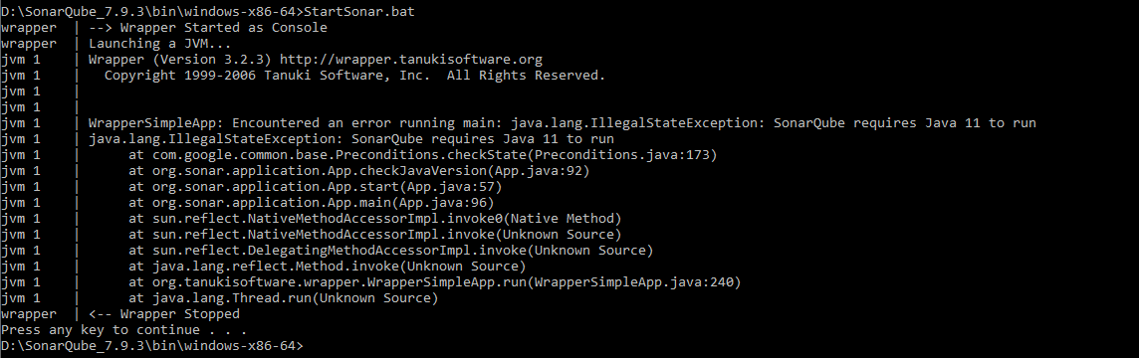
SonarQube Setup – CONTD..
To Start the SonarQube Server, login to the command line & navigate to the path
SonarQube_7.9.3\bin\windows-x86-64
Start the SonarQube with the command
StartSonar.bat
Issue that can be encountered when JDK is not installed

Slide 11

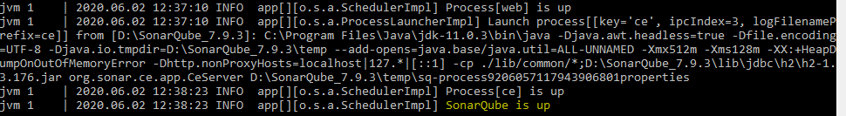
SonarQube Setup – CONTD..
To fix the issue with the Java version, set the Java version through one of the options
Java version in the system should be set to JDK 11
OR
Update the SonarQube_7.9.3\conf\wrapper.conf path with the path for JDK 11 as shown below
Now Start the SonarQube Server with the command StartSonar.bat.

Slide 12
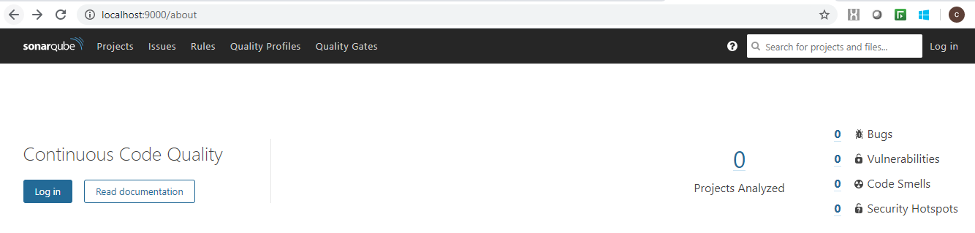
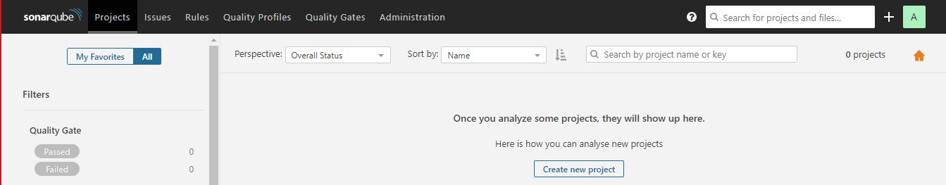
SonarQube – Validating Setup
Once the StartSonar.bat is completed as expected, launch the SonarQube Server with the below URL,
http://localhost:9000
The Below screen should appear, with option to Login.
Login with default admin/admin credentials & below Dashboard will be displayed, confirming successful SonarQube Server setup

Slide 13
LDAP Integration

Slide 14
LDAP Integration
You can configure SonarQube authentication and authorization to an LDAP server (including LDAP Service of Active Directory) by configuring the correct values in $SONARQUBE-HOME/conf/sonar.properties.
The main features are:
Password checking against the external authentication engine.
Automatic synchronization of usernames and emails.
Automatic synchronization of relationships between users and groups (authorization).
Ability to authenticate against both the external and the internal authentication systems. There is an automatic fallback on SonarQube internal system if the LDAP server is down.

Slide 15
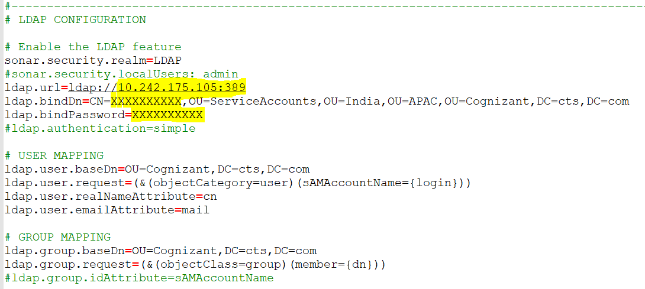
LDAP Integration – CONTD..
Setup
Configure LDAP by editing $SONARQUBE-HOME/conf/sonar.properties (see table below)
Restart the SonarQube server and check the log file for:
INFO org.sonar.INFO Security realm: LDAP ...
INFO o.s.p.l.LdapContextFactory Test LDAP connection: OK
Log into SonarQube using AD credentials

Slide 16
Database Setup

Slide 17
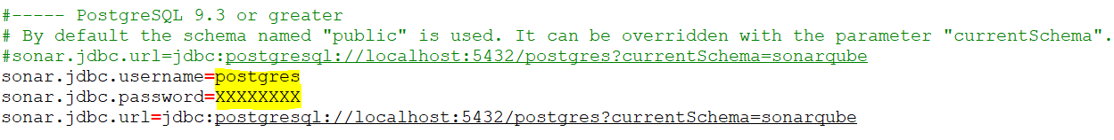
Database Setup
SonarQube uses H2 database internally to store information on Projects, Quality & other details. Embedded database should be used for evaluation purposes only. The embedded database will not scale, it will not support upgrading to newer versions of SonarQube, and there is no support for migrating your data out of it into a different database engine. So we will be using PostgreSQL Database for SonarQube instance instead of default H2 database.
Follow the below steps for Database setup:
Install PostgreSQL database version 9.3 or greater
Create an empty database with specific name to be used for SonarQube
Configure DATABASE tags by editing $SONARQUBE-HOME/conf/sonar.properties (see table below)
Restart the SonarQube server

Slide 18
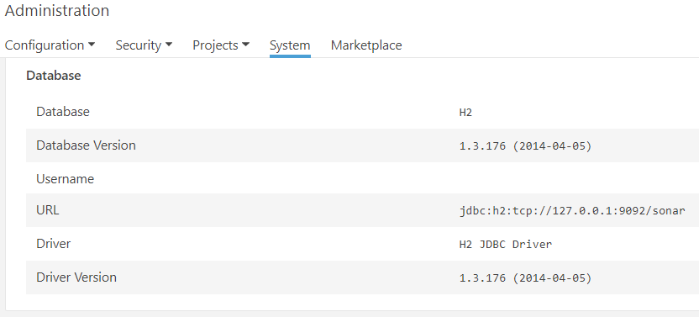
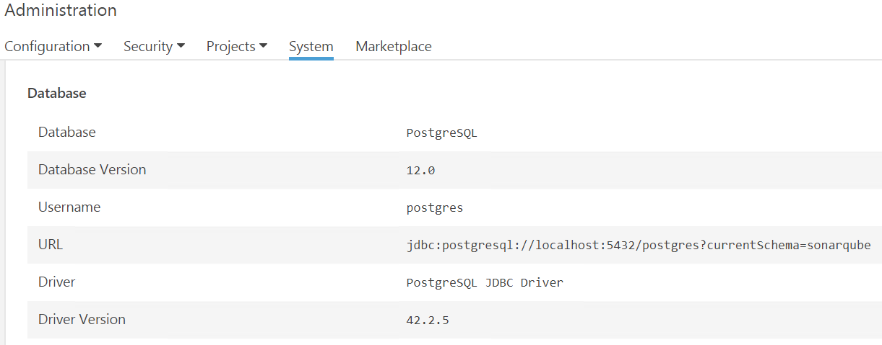
Database Setup – CONTD..
SonarQube with Default H2 Database
SonarQube with PostgreSQL Database

Slide 19
SMTP Integration

Slide 20
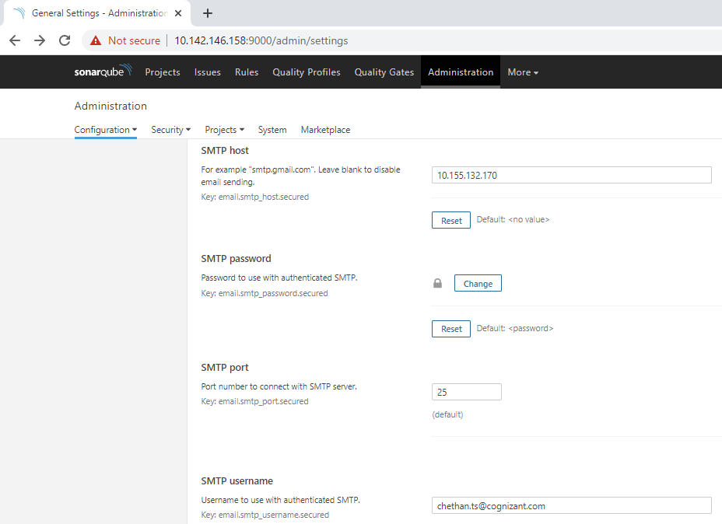
SMTP Integration
SMTP integration in Sonarqube is carried out to send notifications at the end of each analysis via Email to intended recipients.
Sonarqube does not push the notifications to the users. Only users who subscribe themselves will get notifications.
Email Configuration
Log in to the SonarQube dashboard using Admin credentials and click on the “Administration” tab.
Browse to the “Configuration -> General settings -> General” menu.
Under the “Email” section, fill out the required information.
Save the changes.

Slide 21
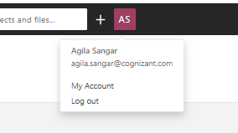
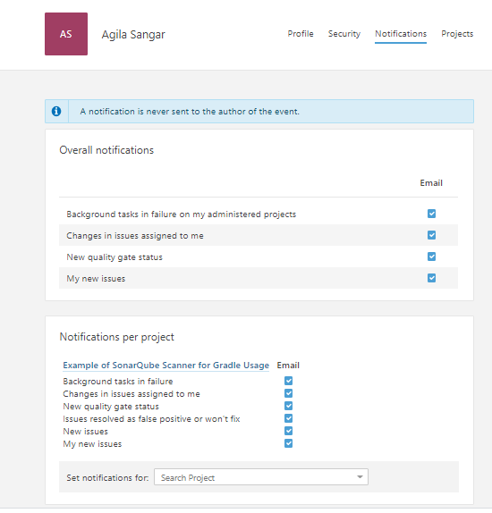
SMTP Integration
Users can login to their profile and click on “My Account”.
Go to “Notifications” tab. Select the overall notifications options or opt for notifications based on the project.
Post which, users will get notified via emails.

Slide 22
SonarQube analysis for .Net application with MSBuild, NUnit & Opencover

Slide 23
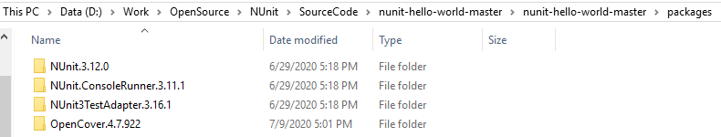
SonarQube – MSBuild, NUnit & OpenCover
Analyzing C#.Net application with Nunit & OpenCover using SonarScanner for MSBuild:
Pre-Requisites : SonarQube 7.9.3 installed, SonarScanner_MSBuild_4.9.0,.NET Framework 4.8, MSBuild 16.0, Sample C#.NET Project, Nunit Console Runner 3.11.1, OpenCover 4.7.922
Note: Include Nunit Console Runner & OpenCover in the source code folder

Slide 24
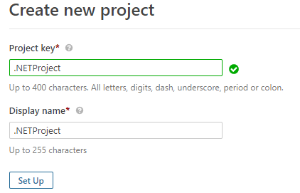
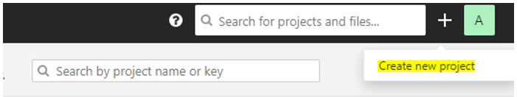
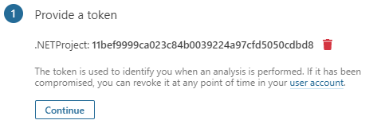
SonarQube – MSBuild, NUnit & OpenCover
Step 1: Click on + symbol & choose the Create Project option as shown below & create the Project with the corresponding Project Attributes, Project Key (Unique for a Project) & Display Name (Dashboard Display Name). The Token Generated is to identify the Project & to enable Analysis, without any Login credentials being provided.
Step 2: Choose the Option to indicate the language is C# or VB.NET based.

Slide 25
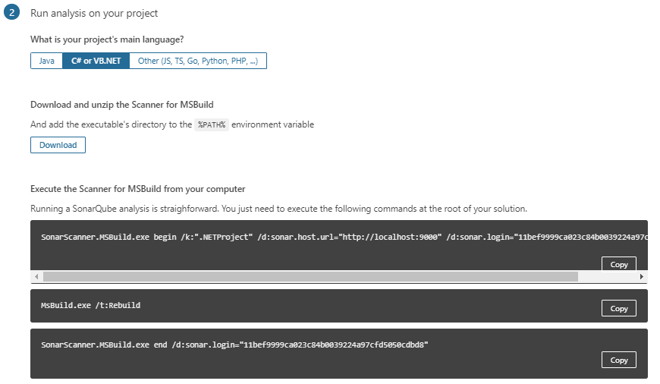
SonarQube – MSBuild, NUnit & OpenCover
Step 3: Open a Command Line Interface to execute the commands & initiate the Analysis for the Project Code. The Commands can be initiated from the Project Code Location. The following Commands need to be executed in a sequence.
Command 1: Preprocessing Project Code
SonarScanner.MSBuild.exe begin /k:"nunit_opencover" /d:sonar.host.url="http://10.142.146.158:9000" /d:sonar.login="be97ae33465186d7c92155f69fe8a4762654e5d1" /d:sonar.cs.nunit.reportsPaths=NUnitResults.xml /d:sonar.cs.opencover.reportsPaths=OpenCoverResults.xml

Slide 26
SonarQube – MSBuild, NUnit & OpenCover
Command 2: Build the Project code
"C:\Program Files (x86)\Microsoft Visual Studio\2019\Enterprise\MSBuild\Current\Bin\MsBuild.exe" /t:Rebuild
Command 3: Execute Nunit test cases
packages\NUnit.ConsoleRunner.3.11.1\tools\nunit3-console.exe --result=NUnitResults.xml "NUnitExamples.Tests\bin\Debug\NUnitExamples.Test.dll“
Command 4: Create Coverage report using Open Cover
packages\OpenCover.4.7.922\tools\OpenCover.Console.exe -output:OpenCoverResults.xml -register:user -target:"packages\NUnit.ConsoleRunner.3.11.1\tools\nunit3-console.exe" -targetargs:"NUnitExamples.Tests\bin\Debug\NUnitExamples.Test.dll“
Command 5: Initiate the Analysis through the SonarScanner
SonarScanner.MSBuild.exe end /d:sonar.login="be97ae33465186d7c92155f69fe8a4762654e5d1"

Slide 27
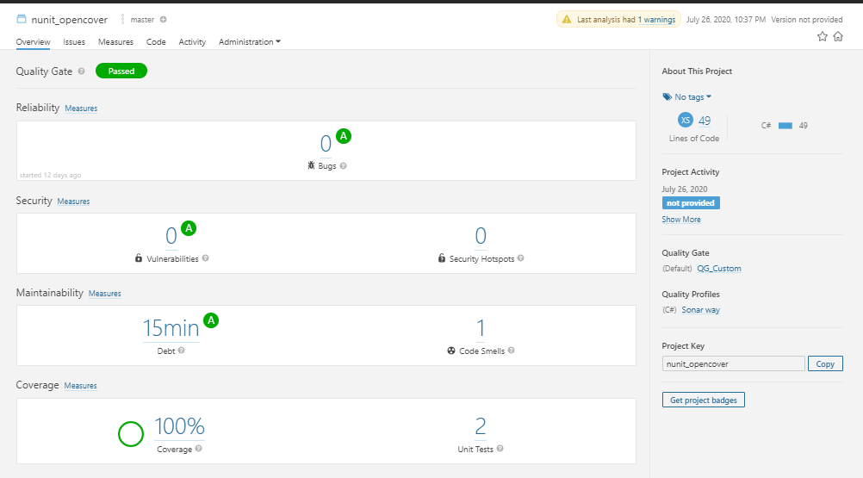
SonarQube – MSBuild, NUnit & OpenCover
Step 4 : Once SonarScanner analysis is successful, login to the Dashboard to view the Results as shown in the below screenshots.

Slide 28
SonarLint

Slide 29

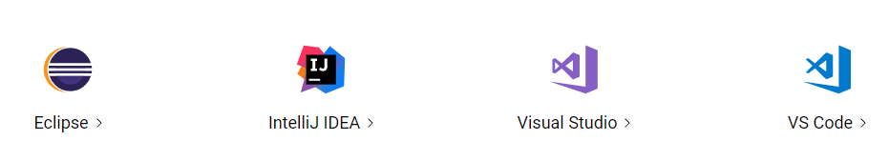

SonarLint
SonarLint is an IDE extension that helps you detect and fix quality issues as you write code. Like a spell checker, SonarLint squiggles flaws so that they can be fixed before committing code.
Supported IDE
Features

Slide 30
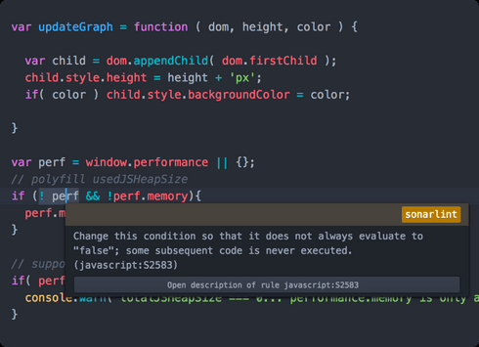
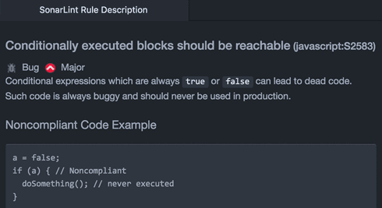
SonarLint
Bug detection
Benefit from thousands of rules which detect common mistakes, tricky bugs and known vulnerabilities.
Instant feedback
On-the-fly! Issues are detected and reported as you code, just like a spell-checker.
Know what to do
SonarLint precisely pinpoints where the problem is, and gives you recommendations on how to fix it.
Learn from your mistakes
Rich documentation lets you understand issues in detail and discover coding best practices.
Uncover old issues
See which issues were already existing, and become a hero for fixing them.

Slide 31
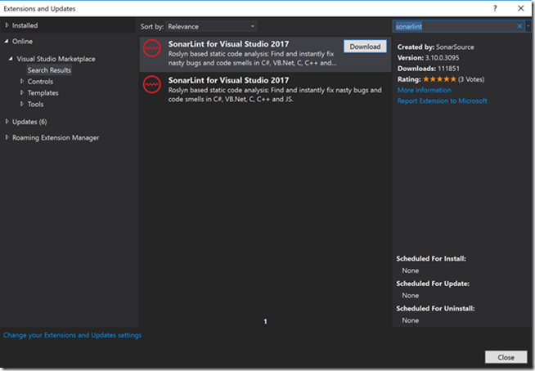
SonarLint
Adding SonarLint to Visual Studio
In Visual Studio, SonarLint is an extension that can be installed by going to the following:
Tools -> Extensions and Updates -> Online
Then in the search box, search for “SonarLint”. Once you see SonarLint, press “Download”.

Slide 32
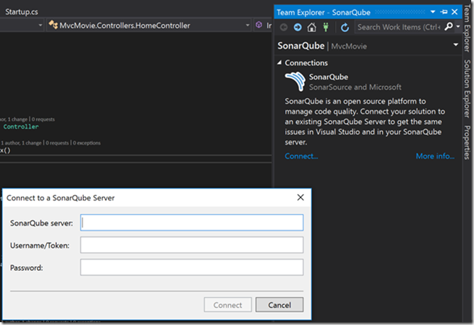
SonarLint
You must now sign out of Visual Studio to let the changes save properly. VSIX Installer will prompt you to allow for it to modify Visual Studio. After this is completed, you can now use SonarLint for your project.
Using SonarLint in your project
To connect an existing project with SonarQube, click on the following:
Analyze -> Manage SonarQube Connections
Then you will need to press “Connect” to connect to your SonarQube Server. Add in the SonarQube server, username, and password information.
Once you connect, you will see SonarLint connect to the SonarQube server. Then you will see a screen that will ask you to select a SonarQube project to bind your solution to. When you do this, your changes in SonarQube will now be synced to Visual Studio.

Slide 33
SonarLint
Analyzing your code
You can now analyze your code. You can do this with the following:
Right click solution -> Analysis -> Run Code Analysis
If there are any errors or issue with your code, you will see it in the “Error List” box built into Visual Studio.
Moreover, you will be able to see the UI line items directly in Visual Studio. Normally, you would need to log into the SonarQube web application directly to get this information.
Another benefit of SonarLint in Visual Studio is that you will see a helper notify you with errors or warnings as you write code. This allows you to fix code right away in real time. This can drastically improve efficiency for developers and it will help reduce time needed for code checks.
Overall, SonarLint will catch issues in code on an IDE such as Visual Studio. However, it will not catch issues when your code is integrated with other pieces of the project. Having SonarQube in your build pipeline is very important to ensure that code smells and issues are being detected when code integration occurs.

Slide 34
Automated CI – Maven, Git, Junit, Jacoco, SonarQube & Jenkins

Slide 35

Automated CI – Maven, Git, Junit, Jacoco, SonarQube & Jenkins
Pre-Requisites : SonarQube 7.9.3 installed, Maven Installed, Eclipse IDE, JDK 11 Installed, Junit, JACOCO maven plugin-0.8.2, SonarScanner for Jenkins plugin.
Installation:
Install the SonarScanner Plugins for Jenkins via the Jenkins Update Center

Slide 36
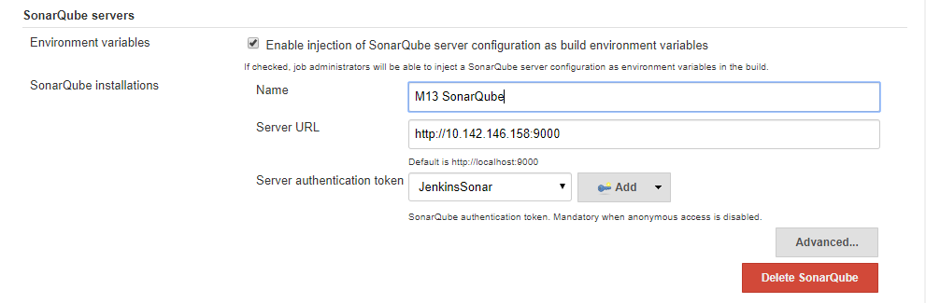
Automated CI – Maven, Git, Junit, Jacoco, SonarQube & Jenkins
Installation:
2. Configure your SonarQube server(s)
Log into Jenkins as an administrator and go to Manage Jenkins > Configure System
Scroll down to the SonarQube configuration section, click on Add SonarQube, and add the values you're prompted for.
The server authentication token should be created as a 'Secret Text' credential.
Check “Enable injection of SonarQube server configuration as build environment variables”

Slide 37
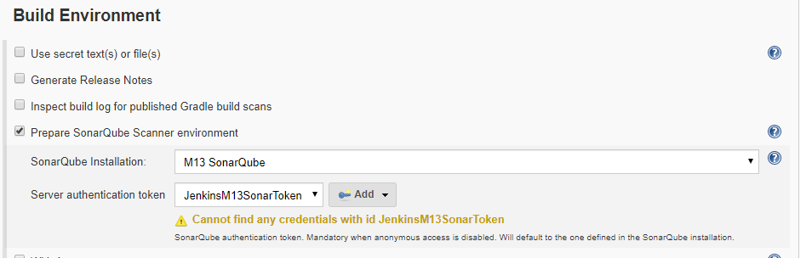
Automated CI – Maven, Git, Junit, Jacoco, SonarQube & Jenkins
Automated CI with Jenkins Freestyle project
Create a Jenkins Freestyle Job, and select the SonarQube server to be used for the analysis in the build Environment step

Slide 38
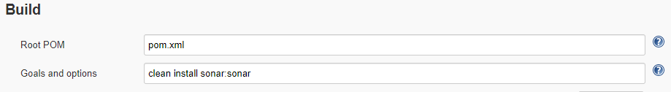
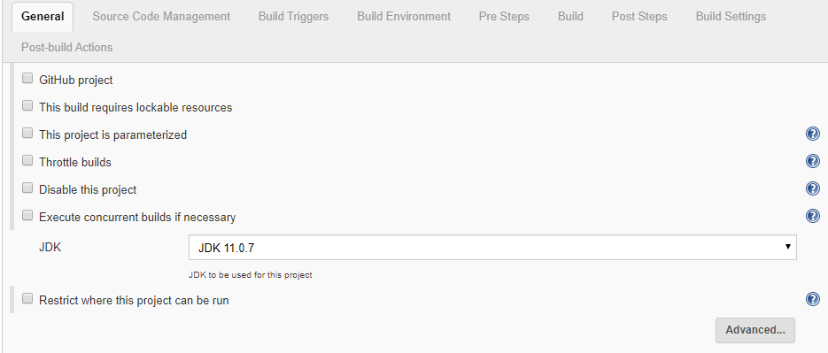
Automated CI – Maven, Git, Junit, Jacoco, SonarQube & Jenkins
Automated CI with Jenkins Freestyle project
In build step, maven build steps to be added for Clean, install and Sonar
If multiple Java version available, select JDK to be used for this analysis in the General Tab.

Slide 39
Automated CI – Maven, Git, Junit, Jacoco, SonarQube & Jenkins
Automated CI with Jenkins Pipeline Project
Create a Jenkins Pipeline Job. In the pipeline script, provide stages for SCM, maven build and Sonar as below.
node {
jdk = tool name: 'JDK 11.0.7'
env.JAVA_HOME = "${jdk}"
stage('SCM Checkout')
{
git 'https://github.com/Padmapriyak1/SampleWebProject'
}
stage('clean')
{
//get maven home path
def mvnhome = tool name: 'M3', type: 'maven'
bat "${mvnhome}/bin/mvn clean"
}
For selecting JAVA version

Slide 40
Automated CI – Maven, Git, Junit, Jacoco, SonarQube & Jenkins
Automated CI with Jenkins Pipeline Project
Create a Jenkins Pipeline Job. In the pipeline script, provide stages for SCM, maven build and Sonar as below.
stage('war') {
def mvnhome = tool name: 'M3', type: 'maven'
bat "${mvnhome}/bin/mvn install“ }
stage('Sonar') {
withSonarQubeEnv(credentialsId: 'JenkinsM13SonarToken', installationName: 'M13 SonarQube')
{
def mvnhome = tool name: 'M3', type: 'maven'
bat "${mvnhome}/bin/mvn sonar:sonar"
}
For selecting Sonar Scanner Environment

Slide 41
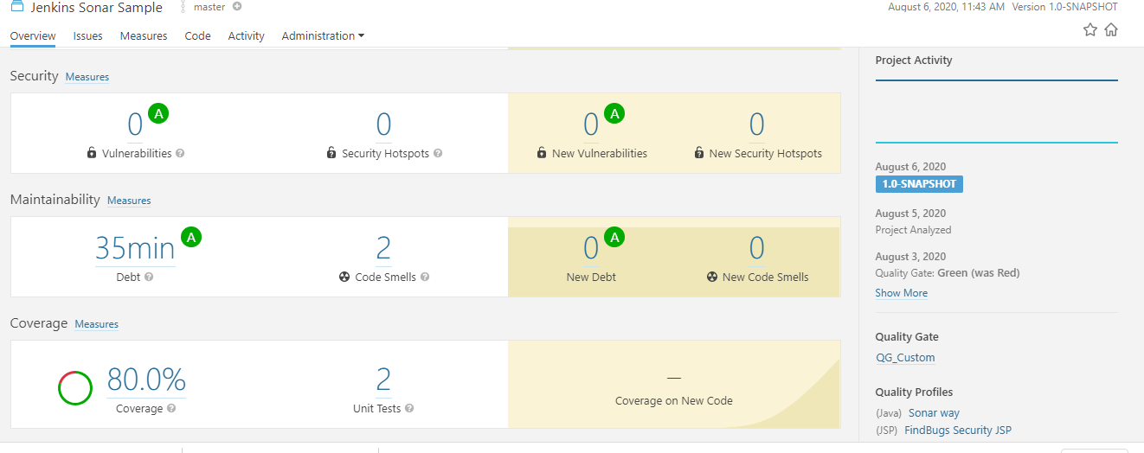
Automated CI – Maven, Git, Junit, Jacoco, SonarQube & Jenkins
Automated CI with Jenkins Pipeline Project

Slide 42
Thank You
DE Engineering Excellence
DETAGEnggExcellence@cognizant.com

