Slide 1
SonarQube
Chethan T S
June 2020

Slide 2
Agenda
Static Code Analysis & SAST
Why Static Code Analysis?
SonarSource S.A – History & Background
SonarQube Overview
SonarQube - Various Editions Comparison
SonarQube – Various Editions (Languages Supported)
SonarScanner - Overview
SonarQube Setup
SonarQube – Validating Setup
SonarScanner – Setup
Use Case : Analyzing a Simple Java Project using Sonar Runner
SonarQube Capabilities
Use Case : Analyzing a Simple PHP Project using SonarScanner
Use Case : Python, Flex & PHP Analysis
SonarQube – Reporting
SonarQube - Benefits
Appendix

Slide 3
1. Static Code Analysis & SAST
Static code analysis is a method of debugging by examining source code before a program is run. It's done by analyzing a set of code against a set (or multiple sets) of coding rules or Best practices as defined by the corresponding Industry standard/benchmark. Static code analysis is also considered as a way to automate code review process.
Static code analysis and static analysis are often used interchangeably, along with source code analysis. This type of analysis addresses weaknesses in source code that might lead to vulnerabilities.
SAST (Static Application Security Testing) is also a form Static Code Analysis but targeted towards the Security aspect of the Application Source code. To detect security specific vulnerabilities or Hotspots in code which could lead Security related violations/incidents. Static Code Analysis can be referred to all Code Analysis including Security aspect & beyond.
We will explore SonarQube tool in this training which offers the Solution for Static Code Analysis & SAST.

Slide 4
2. Why Static Code Analysis?
Before going to Static Code Analysis, let’s try & read the below Paragraph in English.
I cdnuolt blveiee taht I cluod aculaclty uesdnatnrd waht I was rdgnieg. The phaonmneal pweor of the hmuan mnid. It deosn't mttaer in waht oredr the leteerrs in a wrod are, the olny iprmoatnt tihng is taht the frist and lsat ltteer be in the rghit pclae. The rset can be a taotl msess and you can sitll raed it wouthit a porbelm. Tihs is bcuseae the huamn mnid deos not raed ervey lteter by istlef, but the wrod as a wlohe.
Though the above para is readable, it wouldn’t be considered as proper English Syntax in linguistic terms.
Similarly, to evaluate the Code written by a developer needs to be ideal & follow the convention or Best Practices defined in Programming for the corresponding Programming Language. Through Static Code Analysis we try & evaluate the Code to ensure conformance to corresponding Standard or Best Practices and find out those sections of code which do not adhere to the Standards or Best Practices to reduce effort for a developer in terms of code review.

Slide 5
3. SonarSource S.A – History & Background
SONARQUBE 2006-2007
Freddy Mallet realizes that code quality management & idea of Automated Code Review is not addressed by products
Simon Brandhof starts developing the Sonar platform by integrating best-of-breed open source tools for Java.
SONARLINT 2008
SonarLint was launched in 2008 as a free IDE extension for static analysis.
SonarLint supports the IDE’s such as Eclipse, IntelliJ, Visual Studio & VS Code
SONARCLOUD 2018
SonarCloud is a cloud-based code analysis service designed to detect code quality issues in 25 different programming languages, continuously ensuring the maintainability, reliability and security of your code.
SonarCloud is a cloud service that works by connecting to the cloud-based code repository service that you already use such as GitHub, BitBucket Cloud, Azure DevOps Services & GitLab
The two of them are joined in September 2007 by Olivier Gaudin, who was enthused by the Sonar platform’s vision and starts contributing to it.
Sonar
Source S.A

Slide 6
4. SonarQube Overview
SonarQube is an Open Web based Application Platform to manage Code Quality. It offers central place to manage Code Quality and Visual Reporting across Projects.
SonarQube is an automatic code review tool to detect bugs, vulnerabilities and code smells in your code. It can integrate with your existing workflow to enable continuous code inspection across your project.
SonarQube is a Static Analysis tool which analyses the code to detect the following for around 15 Programming Languages
Bugs
Code Smells
Vulnerabilities
SonarQube uses H2 database internally to store information on Projects, Quality & other details.

Slide 7
5.SonarQube – Various Editions Comparison
Feature | SonarQube Community Edition | SonarQube Developer Edition | SonarQube Enterprise Edition
# of Languages Supported | 15 | 22 | 27
License Cost | Free of Cost | €120 per Year for 100,000 LOC | €120 per Year for 100,000 LOC
DevOps Integration, Build Integration & Pipeline and Promotion | Yes | Yes | Yes
Code quality & security | Yes | Yes | Yes
App Security | Low | Medium | High
Addl. Features | NA | Review Security Hotspots Automatically Detect Vulnerabilities Avoid Injection Flaws in Java, C#, PHP | Get OWASP / SANS Security Reports Application & Portfolio Management
Note : Complete License cost available in below links, Enterprise Edition supports all features of Community & Developer Edition.
Developer Edition : https://www.sonarqube.org/trial-request/developer-edition/
Enterprise Edition : https://www.sonarqube.org/trial-request/enterprise-edition/

Slide 8
6. SonarQube – Various Editions (Languages Supported)
SonarQube Community Edition | SonarQube Developer Edition | SonarQube Enterprise Edition
Java JavaScript C# TypeScript Kotlin Ruby Go Scala Flex Python PHP HTML CSS XML VB.NET | ABAP C C++ Objective-C PL/SQL Swift TSQL Note: All Languages from Community Edition including the above mentioned Languages Supported | Apex COBOL PLI RPG VB6 Note: All Languages from Developer Edition including the above mentioned Languages Supported

Slide 9
7. SonarScanner Overview
Once the SonarQube platform has been installed, you're ready to install a scanner and begin creating projects. To do that, you must install and configure the scanner that is most appropriate for your needs.
SonarScanner connects to the SonarQube server to get the corresponding Quality Profiles & Analyzers specific to the Technology to run the Analysis for the corresponding Project.
There are several SonarScanners available for various Build/CI tools, they are
SonarScanner for CLI
SonarScanner for Ant
SonarScanner for Gradle
SonarScanner for Maven
SonarScanner for MSBuild
SonarScanner for Jenkins
SonarScanner for Azure DevOps
Note: In this Training we will explore the SonarScanner CLI version.

Slide 10
8. SonarQube Setup
SonarQube Setup can be downloaded from the below link
https://www.sonarqube.org/downloads/
It is recommended to download the Long Term Support version for Large Organizations for Stability & Reliability purposes. The Last Long Term Support version is 7.9(1st Jul 2019), with latest upgrade in Mar 2020 with patch 7.9.3.
Once the Setup zip file is download, place extract the contents onto the folder where setup is desired, based on user preference.
The only Pre-requisite is to have JDK 11 installed in the system before proceeding with the setup of SonarQube

Slide 11
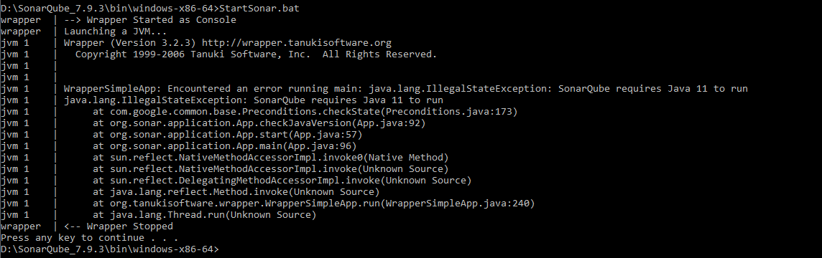
8. SonarQube Setup – CONTD..
To Start the SonarQube Server, login to the command line & navigate to the path
SonarQube_7.9.3\bin\windows-x86-64
Start the SonarQube with the command
StartSonar.bat
Issue that can be encountered when JDK is not

Slide 12

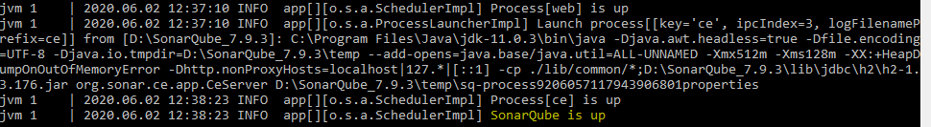
8. SonarQube Setup – CONTD..
To fix the issue with the Java version, set the Java version through one of the options
Java version in the system should be set to JDK 11
OR
Update the SonarQube_7.9.3\conf\wrapper.conf path with the path for JDK 11 as shown below
Now Start the SonarQube Server with the command StartSonar.bat.

Slide 13
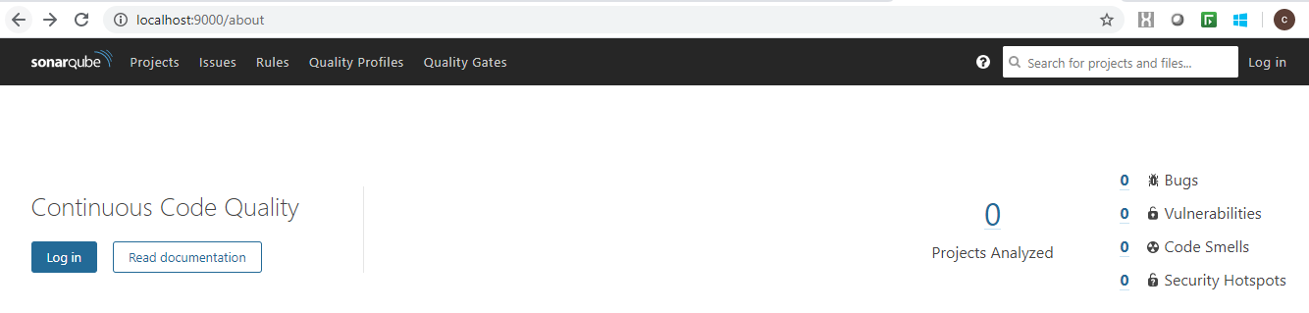
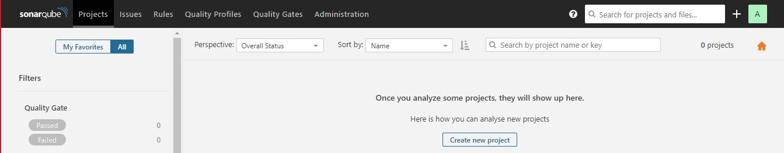
9. SonarQube – Validating Setup
Once the StartSonar.bat is completed as expected, launch the SonarQube Server with the below URL,
http://localhost:9000
The Below screen should appear, with option to Login.
Login with default admin/admin credentials & below Dashboard will be displayed, confirming successful SonarQube Server setup

Slide 14
10. SonarScanner Setup
SonarScanner CLI can be downloaded from the below link
https://docs.sonarqube.org/latest/analysis/scan/sonarscanner/
The Latest version is 4.3 & the corresponding OS version can be downloaded.
Once the Setup zip file is downloaded, extract the contents onto the folder where setup is desired.
The Project based setting needs to be done in the sonar-scanner.properties file which will be located under the /conf folder of SonarScanner folder. The contents of the sonar-scanner.properties file needs to be as follows:
#----- Default SonarQube server
sonar.host.url=http://localhost:9000
#----- Default source code encoding
sonar.sourceEncoding=UTF-8
#must be unique in a given SonarQube instance
sonar.projectKey=my:ProjectKey
# --- optional properties ---# defaults to project key
sonar.projectName=ProjectName
sonar.projectVersion=1.0
sonar.projectBaseDir=<<Folder path for Project sources>>
sonar.sources=<<folder containing Java Classes (.java)>>
sonar.java.binaries=<<folder containing Java Compiled Classes (.class)>>
This sonar-scanner.properties is a sample for Java Project

Slide 15
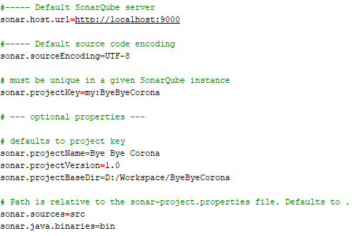
11. Use Case : Analyzing a Simple Java Project using SonarScanner
In this Use Case we look at how to Analyze a Simple Java Project through the CLI SonarScanner component.
Pre-Requisites: SonarQube 7.9.3 installed, SonarScanner 4.3 Setup, JDK 11, Sample Java Compiled Project sources.
Step 1 : Ensure a sample Java Project is Compiled & contains the compiled .class files, along with the sources.
Step 2 : Set Properties in sonar-scanner.properties file according to the Properties of the Sample Java Project. Sample below:

Slide 16
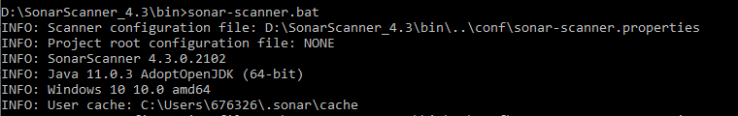
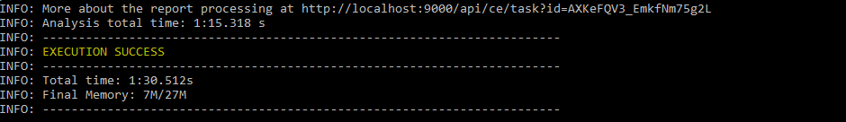
11. Use Case : Analyzing a Simple Java Project using SonarScanner
Step 3: Run the Sonar-scanner bat file from the bin folder under SonarScanner directory, as shown below & ensure you see EXECUTION SUCCESS.

Slide 17
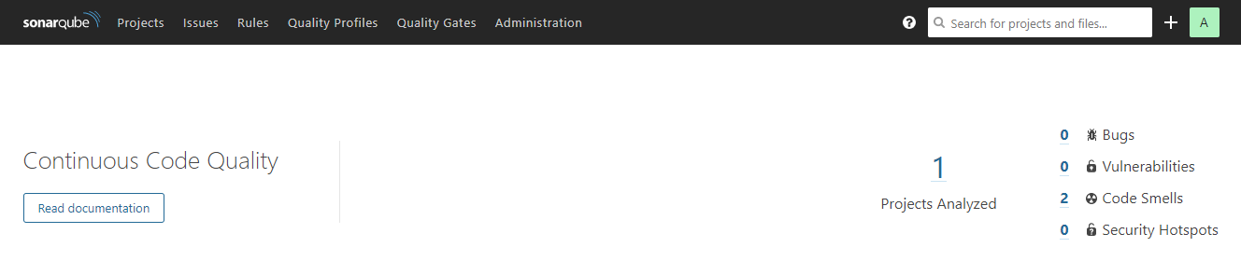
11. Use Case : Analyzing a Simple Java Project using SonarScanner
Step 4: Login to the SonarQube portal Dashboard with the link http://localhost:9000 , you should see Projects Analyzed should reflect 1 & display basic issue details.

Slide 18
12. SonarQube Capabilities
SonarQube has multiple capabilities & features, the key ones are mentioned below
SonarQube
Metrics & Issues Investigation
Quality Rules & Customization
Enforce Quality Gate
Project History
Administration & Project Management
Continuous Code Inspection

Slide 19
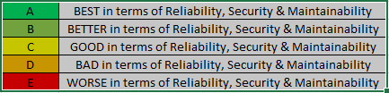
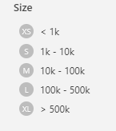
12.SonarQube Capabilities – Metrics Indicators
Several Key Metrics are generated as part of the Analysis, some of the indicators are mentioned using the Characters or rating using Alphabets as follows, each Alphabet can correspond to a color indicating the Quality of the Code in various categories. The Projects Analyzed are also categories according to Size, which are represented as XS,S,M,L & XL similar to Shirt/T Shirt Sizes.
Note: Detailed set of Metrics are addressed in the Appendix section in the corresponding Categories such as Reliability, Security, Maintainability etc.

Slide 20
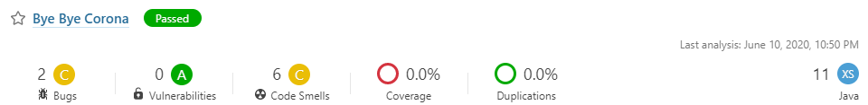
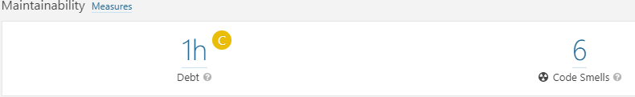
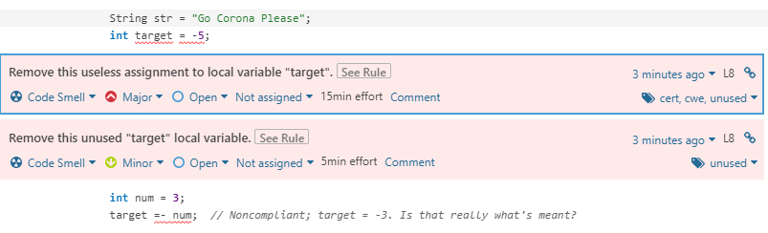
9.SonarQube Capabilities – Issue Investigation
SonarQube offers In Depth investigation or drilldown into the Quality Rules violated as per the Analysis. The Project team/developers will be able to drill down the issues to the code level to reduce the effort in pin pointing or finding code based issues. With this it further helps improve the Productivity of the Dev Team to reduce review based efforts. Below Screenshot illustrates the Issue drilldown feature in SonarQube. Sample set of screens shown below to showcase drill down to code for Code Smells in a Sample Java Project.

Slide 21
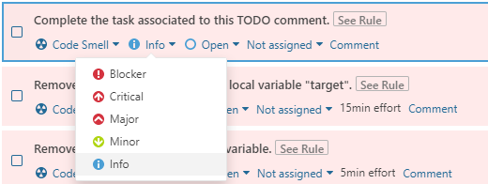
12.SonarQube Capabilities – Quality Rules & Customization
SonarQube has a provision for Quality Rules where the Quality Rules for all Languages supported are listed. A Sample for Java Programming Language is mentioned below. Each of the Rule can be Activated/Deactivated based on need. And each rule can be updated for Severity based on relevance & requirement. SonarQube also offers for Customizing Rules.

Slide 22
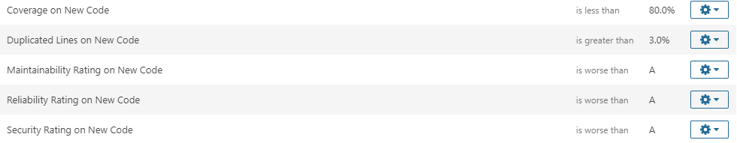
12.SonarQube Capabilities – Enforce Quality Gate
SonarQube offers ways of setting up Quality Gates for Projects. The Quality Gates can be setup based on number of conditions which can be setup, upon which the status of Release can be determined in terms of proceeding with the Deployment or Promotion of the Release to a desired environment.
The Screenshot below showcases various conditions based on the various parameters which can be defined to confirm if the Project Code for the current release adheres to the Quality Gate. For instance a Project should have
1) > 80% Coverage for Code/New Code
2) Duplicated Lines on New Code < than 3%
3) Maintainability/Reliability/Security Rating should be A
Then Quality Gate Status would be else it would be

Slide 23
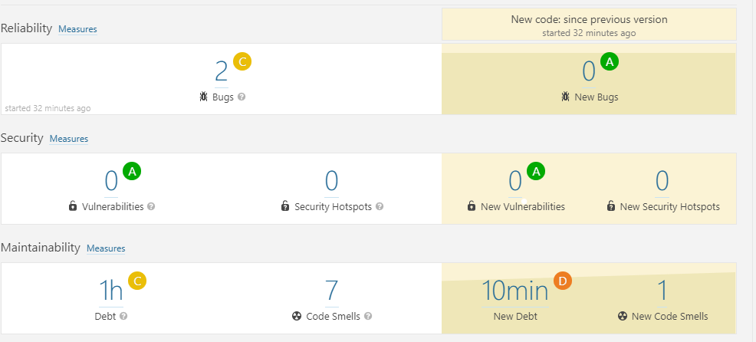
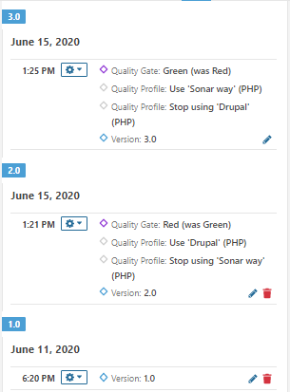
12.SonarQube Capabilities – Project History
SonarQube also has the capability to capture various versions of the Project being Analyzed and provide information in terms of trends over period of time or over a period of releases.
We can baseline a Project & capture the metrics & other Data points in terms of the issues, code smells, security vulnerabilities & other supported metrics & see how the numbers are changing over a period of time providing the trend in terms of improvement or change in the Quality of the code over a period of time.

Slide 24
12.SonarQube Capabilities – Administration & Project Management
The Administration tab in the SonarQube Web portal is the place to go for all admin related tasks, following are some of the key activities which can be performed through the Administration tab.
Global Configuration : Aspects such as SMTP for Mailer configurations, Language/Technology Configuration, DB Cleaner Configuration etc.
Security Controls : For User & Groups Management and subsequently managing permissions for the Users & Groups.
Project Management - Option to create a new Project/delete projects from Web UI. Deleting Projects is also an limited to an Administrator.
Project Visibility Controls – Visibility of a Project can be controlled through this feature, where you can make a Project either Public or Private. To control access to Projects based on need.
Marketplace – Marketplace provides the means of providing avenues for getting the various plug-ins supported by SonarQube, which will be relevant for the various Languages support for rules, External Analyzers, Integrations etc.

Slide 25
12.SonarQube Capabilities – Continuous Code Inspection
SonarQube enables Project teams to enable Code Inspection in a Continuous Manner for the Languages supported. In the growing Agile based Delivery, there is a way to Automate SonarQube Execution to ensure the following activities can be configured once & implemented Continuously over a period of time, by Integrating SonarQube with the CI/CD Pipelines such as Jenkins/Azure DevOps.
Code Inspection for Quality – Report Bugs, Code Smells & Security Vulnerabilities
Unit testing – To ensure all the Unit Tests are Initiated when SonarQube is started
Code Coverage – For all Unit tests executed, ensure Code Coverage based metrics are calculated to ensure higher degree of testing

Slide 26
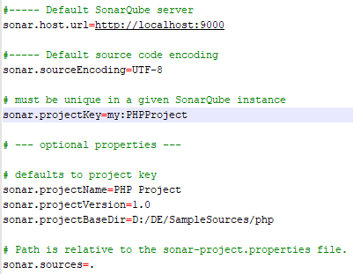
13. Use Case : Analyzing a Simple PHP Project using SonarScanner
In this Use Case we look at how to Analyze a Simple PHP Project through the CLI SonarScanner component.
Pre-Requisites: SonarQube 7.9.3 installed, SonarScanner 4.3 Setup, JDK 11, Sample PHP Code.
Step 1 : A Sample PHP Project along with the .php files to be present in the system as Sonar Scanner.
Step 2 : Set Properties in sonar-scanner.properties file according to the Properties of the Sample PHP Project. Sample below:
\
Step 3: Run the Sonar-scanner bat file from the bin folder under SonarScanner directory & ensure you see EXECUTION SUCCESS.

Slide 27
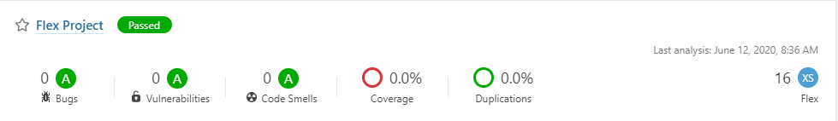
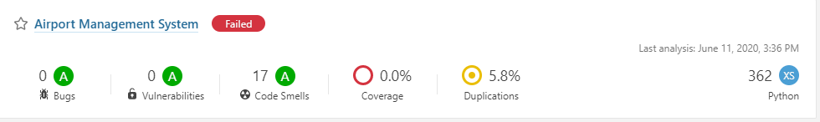
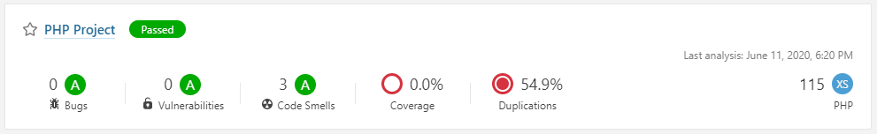
14. Use Case : Python, Flex & PHP Analysis

Slide 28
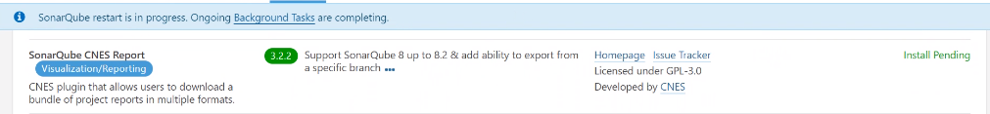
15. SonarQube – Reporting
The Reporting option is achieved through Plug-Ins, here we look at how SonarQube CNES Report Plug-in is used for the Report Generation aspect.
Step 1: Download the Plug-in from the SonarQube -> Administration -> Market place section, look for the below plug-in & Click install
Step 2: Click on Restart Server to install the Plug-in in SonarQube server, SonarQube proceeds to install post completion of Background tasks, if any running at the moment. And then installation is done with a Server Re-Start.

Slide 29
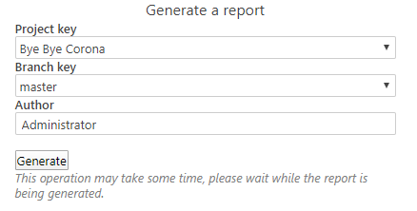

15. SonarQube – Reporting, CONTD..
Once the SonarQube CNES Reporting Plug-in installed, an additional option More is enabled next Administration section, from where Report Generation can be initiated for any Analyzed Projects within SonarQube Server. A .zip file for the Project is generated with Reports in .docx, excel & csv formats.

Slide 30
16.SonarQube - Benefits
Better Quality of Code
Multi Technology Support
Better Maintainability
Overall Cost Savings
Improved Developer Skills
Release Quality Code with GO/NOGO
Integration with CI/CD

Slide 31
17. APPENDIX

Slide 32
Deployment Requirements
Tool Name | SonarQube
Software Requirements | SonarQube 7.9.x Installable (Community Edition) JDK 8 or JDK 11
Hardware requirements | 2 GB RAM
Dependencies | SonarScanner 4.x CLI version Sample Project sources (Sample Java Project)
Other requirements | IE 11/Chrome/Firefox/Edge/Safari latest versions(Java Script enabled in Browser) Port 9000, default port used by SonarQube
Limitations | It’s not recommended running an antivirus scanner on the machine where a SonarQube analysis runs, it could result in unpredictable behavior.
Note: SonarQube can be integrated with Maven/Gradle/Jenkins so on for corresponding Projects. The Requirements would change accordingly. For Ex. A Java Project in Maven will need to have Eclipse with Maven & corresponding Setup as a Pre-Requisite to Integrate with SonarQube. Similarly for other Technologies supported

Slide 33
Deployment Requirements
Tool Name | SonarQube
Software Requirements | SonarQube 7.9.x Installable (Enterprise Edition) JDK 11/JRE11, 64 Bit OS
Hardware requirements | 8 Cores, 16 GB RAM (For Elastic Search), FAST I/O, 500 GB
Other requirements | IE 11/Chrome/Firefox/Edge/Safari latest versions(Java Script enabled in Browser) Port 9000, default port used by SonarQube
Limitations | It’s not recommended running an antivirus scanner on the machine where a SonarQube analysis runs, it could result in unpredictable behavior.
Note: SonarQube can be integrated with Maven/Gradle/Jenkins so on for corresponding Projects. The Requirements would change accordingly. For Ex. A Java Project in Maven will need to have Eclipse with Maven & corresponding Setup as a Pre-Requisite to Integrate with SonarQube. Similarly for other Technologies supported

Slide 34
SonarQube Metrics
There are numerous metrics available once a Project is Analyzed with SonarQube. The various categories of Metrics are as follows:
Reliability
Security
Maintainability
Tests & Coverage
Duplications
Size
Complexity
Issues

Slide 35
SonarQube Metrics - Reliability
The Following metrics are provided in regard to the Reliability aspect of the Project
Name | Description
Bugs | Number of bugs.
Rating | A = 0 Bug B = at least 1 Minor Bug C = at least 1 Major Bug D = at least 1 Critical Bug E = at least 1 Blocker Bug
New Bugs | Number of new bugs.(After 2nd Analysis/Re-Analysis)
Remediation effort | Effort to fix all bug issues. The measure is stored in minutes in the DB.
Reliability remediation effort on new code | Same as Reliability remediation effort on the code changed recently*. * : it means the code created/updated since the differential period selected on a Project Dashboard
Note: URL reference for all metrics, in case some are missing in the category https://docs.sonarqube.org/7.9/user-guide/metric-definitions/

Slide 36
SonarQube Metrics - Security
The Following metrics are provided in regard to the Security aspect of the Project
Name | Description
Vulnerabilities | Number of vulnerabilities.
New Vulnerabilities | Number of new vulnerabilities.
Security Rating | A = 0 Vulnerability B = at least 1 Minor Vulnerability C = at least 1 Major Vulnerability D = at least 1 Critical Vulnerability E = at least 1 Blocker Vulnerability
Security remediation effort | Effort to fix all vulnerability issues. The measure is stored in minutes in the DB.
Security remediation effort on new code | Same as Security remediation effort by on the code changed recently*. * : it means the code created/updated since the differential period selected on a Project Dashboard
Security Hotspots | (security_hotspots) Number of Security Hotspots
New Security Hotspots | (new_security_hotspots) Number of new Security Hotspots
Note: URL reference for all metrics, in case some are missing in the category https://docs.sonarqube.org/7.9/user-guide/metric-definitions/

Slide 37
SonarQube Metrics - Maintainability
The Following metrics are provided in regard to the Maintainability aspect of the Project
Name | Description
Code Smells | Number of code smells.
New Code Smells | Number of new code smells.
Maintainability Rating (formerly SQALE Rating) | Rating given to your project related to the value of your Technical Debt Ratio. The default Maintainability Rating grid is: A=0-0.05, B=0.06-0.1, C=0.11-0.20, D=0.21-0.5, E=0.51-1
Technical Debt | Effort to fix all maintainability issues. The measure is stored in minutes in the DB.
Technical Debt on new code | Technical Debt of new code
Technical Debt Ratio | Ratio between the cost to develop the software and the cost to fix it. The Technical Debt Ratio formula is: Remediation cost / Development cost Which can be restated as: Remediation cost / (Cost to develop 1 line of code * Number of lines of code) The value of the cost to develop a line of code is 0.06 days.
Technical Debt Ratio on new code | Ratio between the cost to develop the code changed recently* and the cost of the issues linked to it. * : it means the code created/updated since the differential period selected on a Project Dashboard
Note: URL reference for all metrics, in case some are missing in the category https://docs.sonarqube.org/7.9/user-guide/metric-definitions/

Slide 38
SonarQube Metrics – Tests & Coverage
The Following metrics are provided in regard to the Unit Testing aspect of the Project
Name | Description
Unit tests | Number of unit tests.
Unit tests duration | Time required to execute all the unit tests.
Unit test errors | Number of unit tests that have failed.
Unit test failures | Number of unit tests that have failed with an unexpected exception.
Unit test success density (%) | Test success density = (Unit tests - (Unit test errors + Unit test failures)) / Unit tests * 100
Coverage | It is a mix of Line coverage and Condition coverage. Its goal is to provide an even more accurate answer to the following question: How much of the source code has been covered by the unit tests?
Line coverage | On a given line of code, Line coverage simply answers the following question: Has this line of code been executed during the execution of the unit tests?. It is the density of covered lines by unit tests:
Condition coverage | On each line of code containing some boolean expressions, the condition coverage simply answers the following question: 'Has each boolean expression been evaluated both to true and false?'. This is the density of possible conditions in flow control structures that have been followed during unit tests execution.
Note: URL reference for all metrics, in case some are missing in the category https://docs.sonarqube.org/7.9/user-guide/metric-definitions/

Slide 39
SonarQube Metrics - Duplications
The Following metrics are provided for the Duplications encountered in the Project sources
Name | Description
Duplicated blocks | Number of duplicated blocks of lines. For a block of code to be considered as duplicated: Non-Java projects: There should be at least 100 successive and duplicated tokens. Those tokens should be spread at least on: 30 lines of code for COBOL 20 lines of code for ABAP 10 lines of code for other languages Java projects: There should be at least 10 successive and duplicated statements whatever the number of tokens and lines. Differences in indentation as well as in string literals are ignored while detecting duplications.
Duplicated files | Number of files involved in duplications.
Duplicated lines | Number of lines involved in duplications.
Duplicated lines (%) | Density of duplication = Duplicated lines / Lines * 100
Note: URL reference for all metrics, in case some are missing in the category https://docs.sonarqube.org/7.9/user-guide/metric-definitions/

Slide 40
SonarQube Metrics – Size
The Following basic set of metrics are provided for Project Analyzed using SonarQube
Name | Description
Classes | Number of classes (including nested classes, interfaces, enums and annotations).
Directories | Number of directories.
Files | Number of files.
Lines | Number of physical lines (number of carriage returns).
Lines of code | Number of physical lines that contain at least one character which is neither a whitespace or a tabulation or part of a comment.
Lines of code per language | Non Commenting Lines of Code Distributed By Language
Functions | Number of functions. Depending on the language, a function is either a function or a method or a paragraph.
Statements | Number of statements.
Comment lines | Number of lines containing either comment or commented-out code. Non-significant comment lines (empty comment lines, comment lines containing only special characters, etc.) do not increase the number of comment lines.
Comments (%) | Density of comment lines = Comment lines / (Lines of code + Comment lines) * 100 With such a formula: 50% means that the number of lines of code equals the number of comment lines 100% means that the file only contains comment lines

Slide 41
SonarQube Metrics - Complexity
The Following metrics are provided in terms of the Complexity of the Project
Name | Description
Cyclomatic Complexity | It is the complexity calculated based on the number of paths through the code. Whenever the control flow of a function splits, the complexity counter gets incremented by one. Each function has a minimum complexity of 1. This calculation varies slightly by language because keywords and functionalities do.
Cognitive Complexity | Cognitive Complexity offers a new measurement of how hard code is to understand. Cognitive Complexity breaks from the practice of using mathematical models to assess software maintainability. It starts from the precedents set by Cyclomatic Complexity, but uses human judgement to assess how structures should be counted, and to decide what should be added to the model as a whole. As a result, it yields method complexity scores which strike programmers as fairer relative assessments of maintainability than have been available with previous models. For further details on the WhitePaper, refer this link. https://www.sonarsource.com/resources/white-papers/cognitive-complexity.html
Note: URL reference for all metrics, in case some are missing in the category https://docs.sonarqube.org/7.9/user-guide/metric-definitions/

Slide 42
SonarQube Metrics - Issues
The Following metrics are provided in regard to the Issues in the Project sources
Name | Description
New issues | Number of new issues or Violations
New xxx issues | Number of new issues with severity xxx, xxx being blocker, critical, major, minor or info.
Issues | Number of issues.
xxx issues | Number of issues with severity xxx, xxx being blocker, critical, major, minor or info.
False positive issues | Number of false positive issues
Open issues | Number of issues whose status is Open
Confirmed issues | Number of issues whose status is Confirmed
Reopened issues | Number of issues whose status is Reopened
Note: The Severity of the issues are categorized as Blocker, Critical, Info, Major & Minor.
Blocker : Risk Level 1, Operational/Security Risk, Production Impact
Critical : Risk Level 2, Operational/Security Risk, Production Impact
Major : Risk Level 3, Productivity Impact, Project Impact
Minor : Risk Level 4, Productivity Impact, Project Impact
Info : Unknown or not yet well defined security risk or impact on productivity

Slide 43
Thank You
Engineering Excellence
DETAGEnggExcellence@cognizant.com

