Slide 1
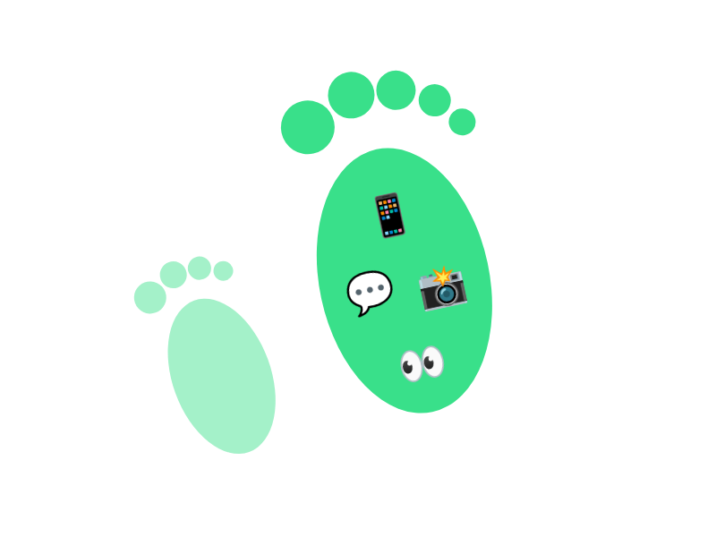
Think Before You Post
Once it's online, it's online forever.
Everything you post leaves a digital footprint. Make it a good one!
🔊 Voice-over: record 10–15 seconds and add it here (Insert → Audio)
Example made with AI (Claude)
Notes:
Voice-over script: "Hey everyone! Have you ever posted something and then regretted it? Even if you delete it, it might still be out there. Let's learn how to stay safe online."

Slide 2
One Post, Lots of People
📱
📸
💬
👀
⏳
You post a silly photo
A friend screenshots it
It gets sent to a group chat
People you don't know see it
It could still be there years later
Deleting it doesn't delete the screenshots!
Example made with AI (Claude)

Slide 3

What Would You Do?
Your friend sends you an embarrassing photo of a classmate and says: "Post it, it's funny!"
Post it
Don't post it
Tap a button to see what happens
Example made with AI (Claude)

Slide 4

Be Smart Online
🔒
⏸️
🗣️
Stay Private
Pause First
Speak Up
Keep your account private and only accept people you know.
Before you post, ask: would I be okay if my parents saw this?
Tell an adult you trust if something online feels wrong.
Need help? Visit eSafety
Credits: images and slide design made with AI (Claude). Voice-over: [your name].
Example made with AI (Claude)

Slide 5

Oh no…
The photo goes around the whole school. Your classmate feels really upset and you get in trouble. And it stays in your digital footprint.
↩ Try again
Example made with AI (Claude)

Slide 6

Good choice!
You protected your classmate and kept your digital footprint positive.
Next →
Example made with AI (Claude)

