Slide 1
Topic Summary
PC, FP, SP, ……
Text
GPRs
PCB₁
Memory Region Info
Data
PCB₂
PCB₃
PID
Heap
Process State
………
Process Control Block
Process Table
Stack
Memory Space of a Process

Slide 2
fork( )?
PC, FP, SP, ……
Hardware
Context
PC, FP, SP, ……
GPRs
Hardware
Context
GPRs
PCB_{SH}
Memory Context
PCB_{Child}
Memory Context
OS Context
PID
………
Process State
OS Context
PID
Process State
Process Table
Process Control Block
Process Control Block
Notes:
Bash g

Slide 3
Tutorial 2
Question 1

Slide 4
1. fork --- wait
 | C code:
00 01 02 03 04 05 06 07 08 09 10 11 12 13 14 | int main( ) { //This is process P if ( fork() == 0 ){ //This is process Q if ( fork() == 0 ) { //This is process R ...... return 0; } <Point α> } wait(NULL); <Point β> return 0; }
Behaviour
Process Q always terminate before P. Process R can terminate at any time w.r.t. P and Q.

Slide 5
1. fork --- wait
 | C code:
00 01 02 03 04 05 06 07 08 09 10 11 12 13 14 | int main( ) { //This is process P if ( fork() == 0 ){ //This is process Q if ( fork() == 0 ) { //This is process R ...... return 0; } wait(NULL); <Point α> } <Point β> return 0; }
Behaviour
Process Q always terminate before P. Process R can terminate at any time w.r.t. P and Q.

Slide 6
1. fork --- wait
 | C code:
00 01 02 03 04 05 06 07 08 09 10 11 12 13 14 | int main( ) { //This is process P if ( fork() == 0 ){ //This is process Q if ( fork() == 0 ) { //This is process R ...... return 0; } execl(valid executable....); <α> } wait(NULL); <Point β> return 0; }
Behaviour
Process Q always terminate before P. Process R can terminate at any time w.r.t. P and Q.

Slide 7
1. fork --- wait
 | C code:
00 01 02 03 04 05 06 07 08 09 10 11 12 13 14 | int main( ) { //This is process P if ( fork() == 0 ){ //This is process Q if ( fork() == 0 ) { //This is process R ...... return 0; } wait(NULL); <Point α> } wait(NULL); <Point β> return 0; }
Behaviour
Process P never terminates.

Slide 8
Tutorial 2
Question 2

Slide 9
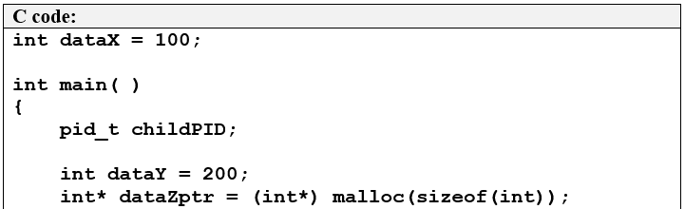
a. dataX, dataY, region pointed by dataZptr
Text
Data
Heap
Stack
Memory Space of a Process

Slide 10
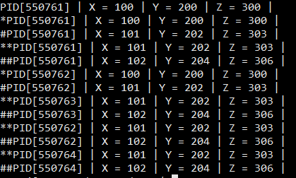
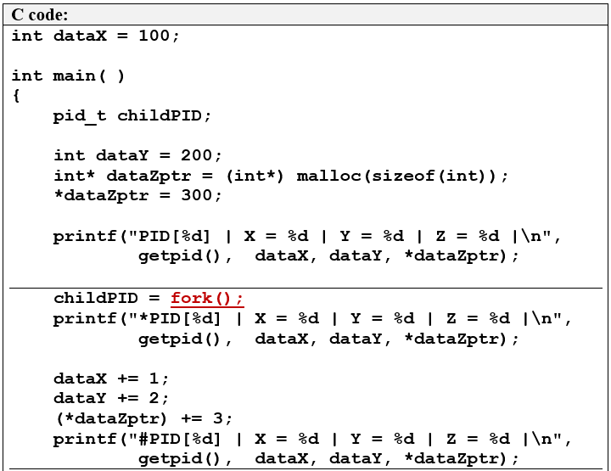
b. Memory space after fork()?

Slide 12
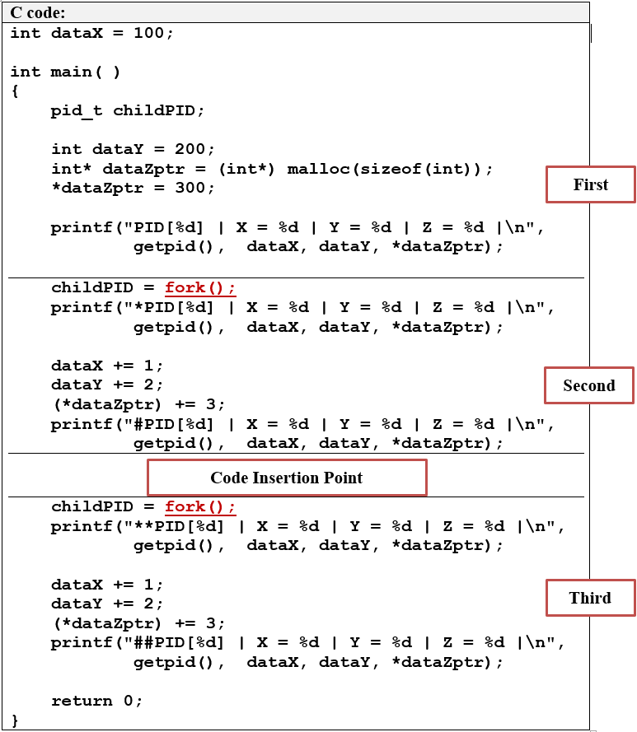
c. Process Tree
761
762
763
764
Notes:
Use the last 3-digit from the sample output as ID. Can move around and link on the spot during tutorial.

Slide 13
d, e: Message Ordering
Notes:
Use (c) to emphasize the processes are _concurrent_ after creation (concurrent = no specific order w.r.t to each other).

Slide 14
f: Sleepy Child?
if (childPID == 0){
sleep(5);
}
Notes:
Note: Original message is shown, discuss the potential impact

Slide 15
g: No Child left behind?
if (childPID != 0){
wait(NULL);
}
Notes:
Note: Original message is shown, discuss the potential impact

Slide 16
Tutorial 2
Question 3

Slide 17
int main()
{
int userInput, childPid, childResult;
//Since largest number is 10 digits, a 12 characters string is more
//than enough
char cStringExample[12];
scanf("%d", &userInput);
childPid = fork();
if (childPid != 0 ){
wait( &childResult);
printf("%d has %d prime factors\n", userInput,
WEXITSTATUS(childResult));
} else {
//Easy way to convert a number into a string
sprintf(cStringExample, "%d", userInput);
execl("./PF", "PF", cStringExample, NULL);
}
}

Slide 18
int main( int argc, char* argv[])
{
int nFactor = 0, userInput, factor;
//Convert string to number
userInput = atoi( argv[1] );
nFactor = 0;
factor = 2;
//quick hack to get the number of prime factors
// only for positive integer
while (userInput > 1){
if (userInput % factor == 0){
userInput /= factor;
nFactor++;
} else {
factor++;
}
}
return nFactor;
}

Slide 19
int main()
{
int i, j, userInput[9], nInput, childPid[9], childResult, pid;
char cStringExample[12]; scanf("%d", &nInput);
for (i = 0; i < nInput; i++){
scanf("%d", &userInput[i]);
childPid[i] = fork();
if (childPid[i] == 0){
sprintf(cStringExample, "%d", userInput[i]);
execl("./PF", "PF", cStringExample, NULL);
return 0; //Redundant. Everything from here downwards
// is replaced by PF in the child. }
}
for (i = 0; i < nInput; i++){
pid = wait( &childResult );
//match pid with child pid
for (j = 0; j < nInput; j++){
if (pid == childPid[j])
break;
}
//Special note: Original solution used childresult >> 8. Here
// we use the official WEXITSTATUS macro to ensure portability.
printf("%d has %d prime factors\n", userInput[j],
WEXITSTATUS(childresult));
}
}
Notes:
added "return 0;" in the child case for safety measure. (If execl() fails, the child can continue on! So, a return 0 is safer).

