Slide 1
Welcome!
Please rename yourself to
[Row#] Name ⬅

Slide 2
Topic Summary
IPC (Inter-Process Communication)
Shared Memory
Message Passing
Race Condition (Timing dependent bug due to sharing of a resource)
Synchronization (mechanism / technique to resolve Race Condition)

Slide 3
Tutorial 4
Question 1

Slide 4
MLFQ: Rules?
Basic rules:
If Priority(A) > Priority(B) ➔
If Priority(A) == Priority(B) ➔
Priority Setting/Changing rules:
New job ➔
If a job fully utilized its time slice ➔
If a job give up / blocks ➔

Slide 5
Q1. MLFQ: Change of Heart
Basic rules:
If Priority(A) > Priority(B) ➔ A runs
If Priority(A) == Priority(B) ➔ A and B runs in RR
Priority Setting/Changing rules:
New job ➔ Highest priority
If a job fully utilized its time slice ➔ priority reduced
If a job give up / blocks ➔ priority retained
Queues
Q2
Q1
Q0
Time

Slide 6
Q1. MLFQ: Gaming the system
Basic rules:
If Priority(A) > Priority(B) ➔ A runs
If Priority(A) == Priority(B) ➔ A and B runs in RR
Priority Setting/Changing rules:
New job ➔ Highest priority
If a job fully utilized its time slice ➔ priority reduced
If a job give up / blocks ➔ priority retained
Queues
Q2
Q1
Q0
Time

Slide 7
Q1. MLFQ: Accounting Matters!
Basic rules:
If Priority(A) > Priority(B) ➔ A runs
If Priority(A) == Priority(B) ➔ A and B runs in RR
Priority Setting/Changing rules:
New job ➔ Highest priority
If a job fully utilized its time slice ➔ priority reduced
If a job give up / blocks ➔ priority retained
Queues
Q2
Q1
Q0
Time

Slide 8
Q1. MLFQ: Timely Boost
Basic rules:
If Priority(A) > Priority(B) ➔ A runs
If Priority(A) == Priority(B) ➔ A and B runs in RR
Priority Setting/Changing rules:
New job ➔ Highest priority
If a job fully utilized its time slice ➔ priority reduced
If a job give up / blocks ➔ priority retained
Queues
Q2
Q1
Q0
Time

Slide 9
Tutorial 4
Question 2

Slide 10



a. When does FCFS (FIFO) scheduling result in the shortest possible average response time?
Suppose task A, B and C arrives in the alphabetical order.
A | B | B | B | C | C | C | C | C
Avg Response Time = $\frac{0 + 1 + 4}{3}$
A | A | A | A | A | B | B | B | C
Avg Response Time = $\frac{0 +5 +8}{3}$
A | A | A | B | B | B | C | C | C
Avg Response Time = $\frac{0 +3 +6}{3}$
So….?

Slide 11
b. When does RR behave the same as FCFS (FIFO)?
Difference =
So….?

Slide 12


c. When does RR behave poorly w.r.t FCFS (FIFO)?
Poorly =
So….
A | A | A | B | B | B | C | C | C
Avg Turnaround Time_{FIFO} = $\frac{3 +6 +9}{3}$
A | A | B | B | C | C | A | B | C
Avg Turnaround Time_{RR} = $\frac{7 +8 +9}{3}$
Notes:
Tasks with > TQ work ➔ longer avg turnaround time in RR

Slide 13
d. Reducing TQ for RR help its performance w.r.t FCFS (FIFO)?
Yes (RR better performance) =
No (RR worse performance) =
Notes:
Yes ➔ Response Time
No ➔ Overhead

Slide 14
e. CPU Intensive Job should be given higher priority for I/O? Why?
Yes (CPU Job higher Priority) =
No (CPU Job lower Priority) =
Notes:
Yes ➔ Decrease overall turnaround time
No ➔ Increase responsiveness for I/O Bound processes

Slide 15
Tutorial 4
Question 3

Slide 16
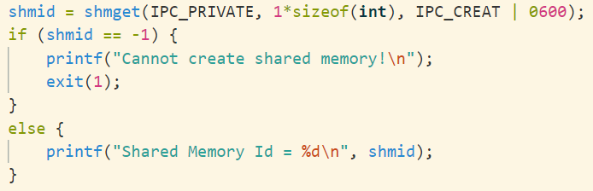
Code Walkthrough
Kernel Space
Shared Mem
Id = 1234
Process P₀

Slide 17
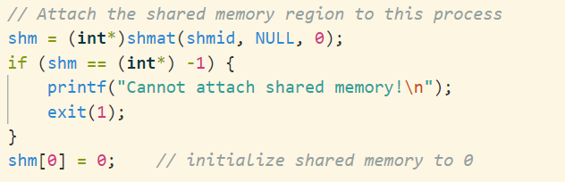
Code Walkthrough
Kernel Space
Shared Mem
Id = 1234
Process P₀
shm

Slide 18
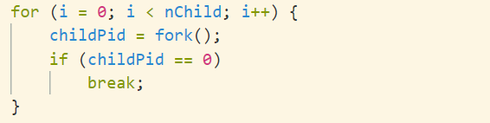
Code Walkthrough
Kernel Space
Shared Mem
Id = 1234
Process P₀
shm
Process P₁
shm

Slide 19
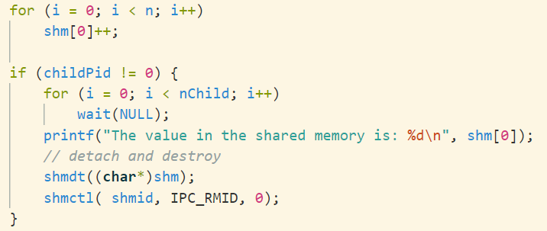
Code Walkthrough
Kernel Space
Shared Mem
Id = 1234
Process P₀
shm
Process P₁
a. Expected output given n and nChild?
shm

Slide 20
How is shm[0]++ performed?
Shared Mem
shm[0]
Process P₀
Process P₁
load shm[0] into $r1
load shm[0] into $r1
add one to $r1
add one to $r1
store $r1 into shm[0]
store $r1 into shm[0]
CPU Context P₀
CPU Context P₁
$r1
$r1

Slide 21
Timing is key…..
Shared Mem
shm[0]
Process P₀
Process P₁
load shm[0] into $r1
add one to $r1
store $r1 into shm[0]
Time
load shm[0] into $r1
add one to $r1
store $r1 into shm[0]
CPU Context P₀
CPU Context P₁
$r1
$r1

Slide 22
Timing is key…..
Shared Mem
shm[0]
Process P₀
Process P₁
load shm[0] into $r1
add one to $r1
Time
load shm[0] into $r1
add one to $r1
store $r1 into shm[0]
store $r1 into shm[0]
CPU Context P₀
CPU Context P₁
$r1
$r1
Notes:
Discuss both (b) and (c) here

Slide 23
Tutorial 4
Question 4

Slide 24
Hey, take turn!
Shared Mem
shm[0]
shm[1]
Process P₀
Process P₁
pOrder = 0
pOrder = 1
while (pOrder != shm[0]);
while (pOrder != shm[0]);
shm[1]++ // n times
shm[1]++ // n times
shm[0]++ //next!
shm[0]++ //next!

