Slide 1
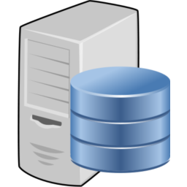
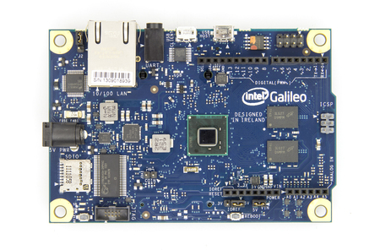
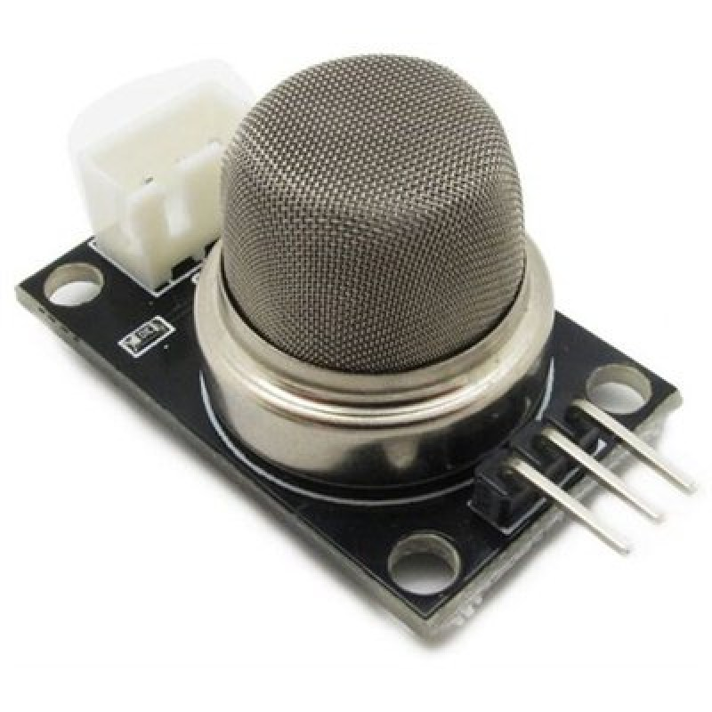
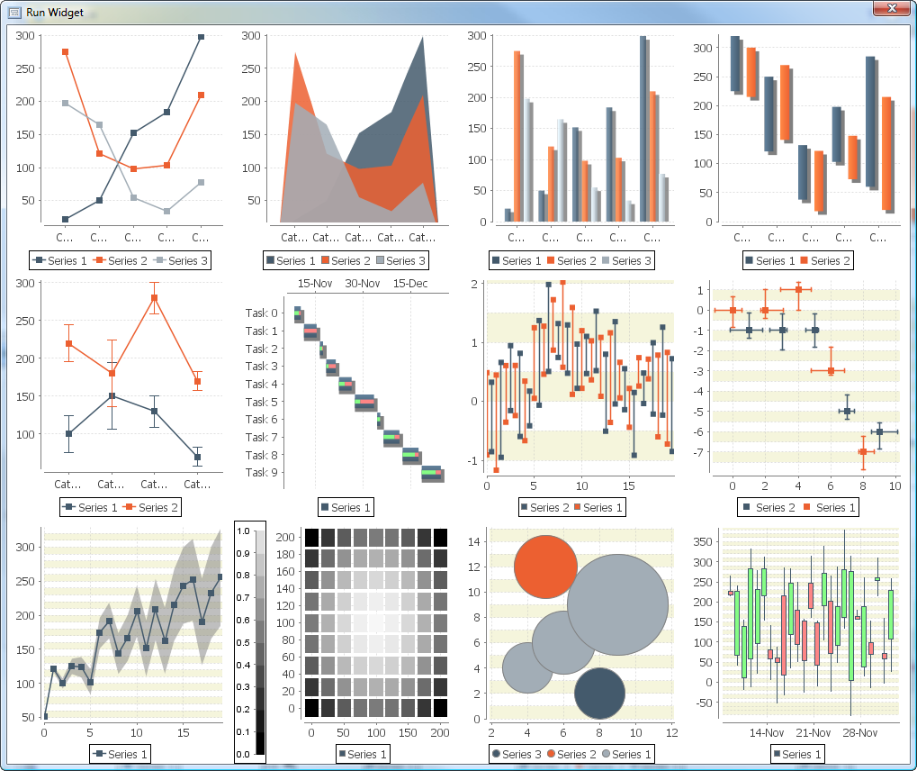
M2M-Project
Yann BLANC
Bachar NEJEM

Slide 2
PLAN
Contexte
Architectures
Composants matériels
Composants logiciels
Problèmes
Conclusion

Slide 3
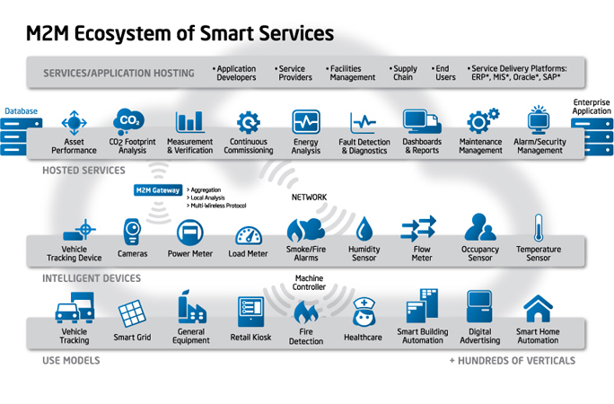
Contexte
Notes:
http://www.m2mdatasmart.com/d/What+is+M2M.html

Slide 4
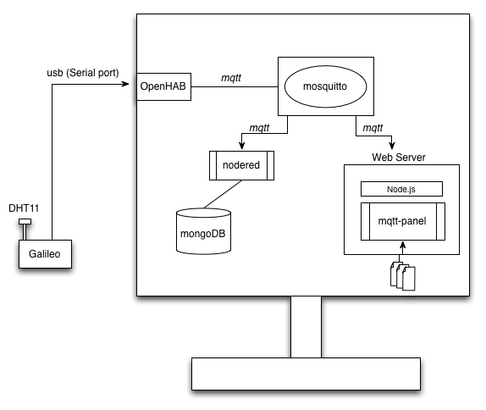
Architecture 1-2

Slide 5
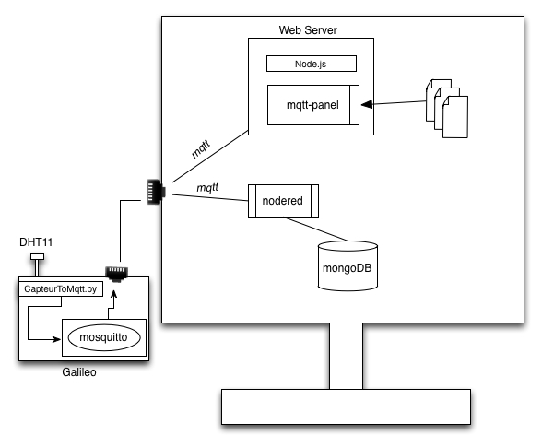
Architecture 2-2

Slide 6
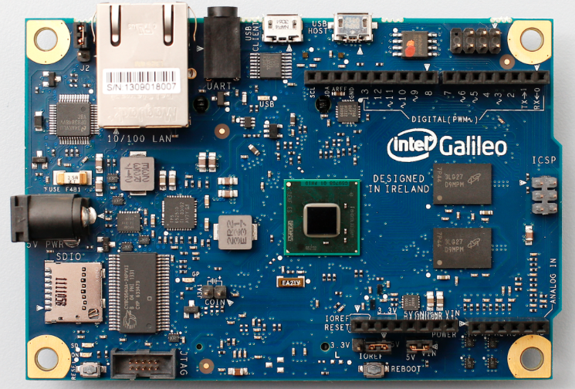
Composants matériels
PC portable
Câble micro-usb
Câble Ethernet
Carte Intel Galileo

Slide 7
Composants logiciels
Broker Mosquitto
openHAB
Nodered
Mqtt-panel
Ide Arduino
mongoDB

Slide 8
Problèmes
Capteur DHT11 non compatible avec la carte Galileo.
Notes:
In general, I think the Galileo has 100-1000x slower I/O speed. In this example it is ~500x slower which makes the sensor unusable. I hope there is a software fix for this.

Slide 9
Conclusion

