Slide 1
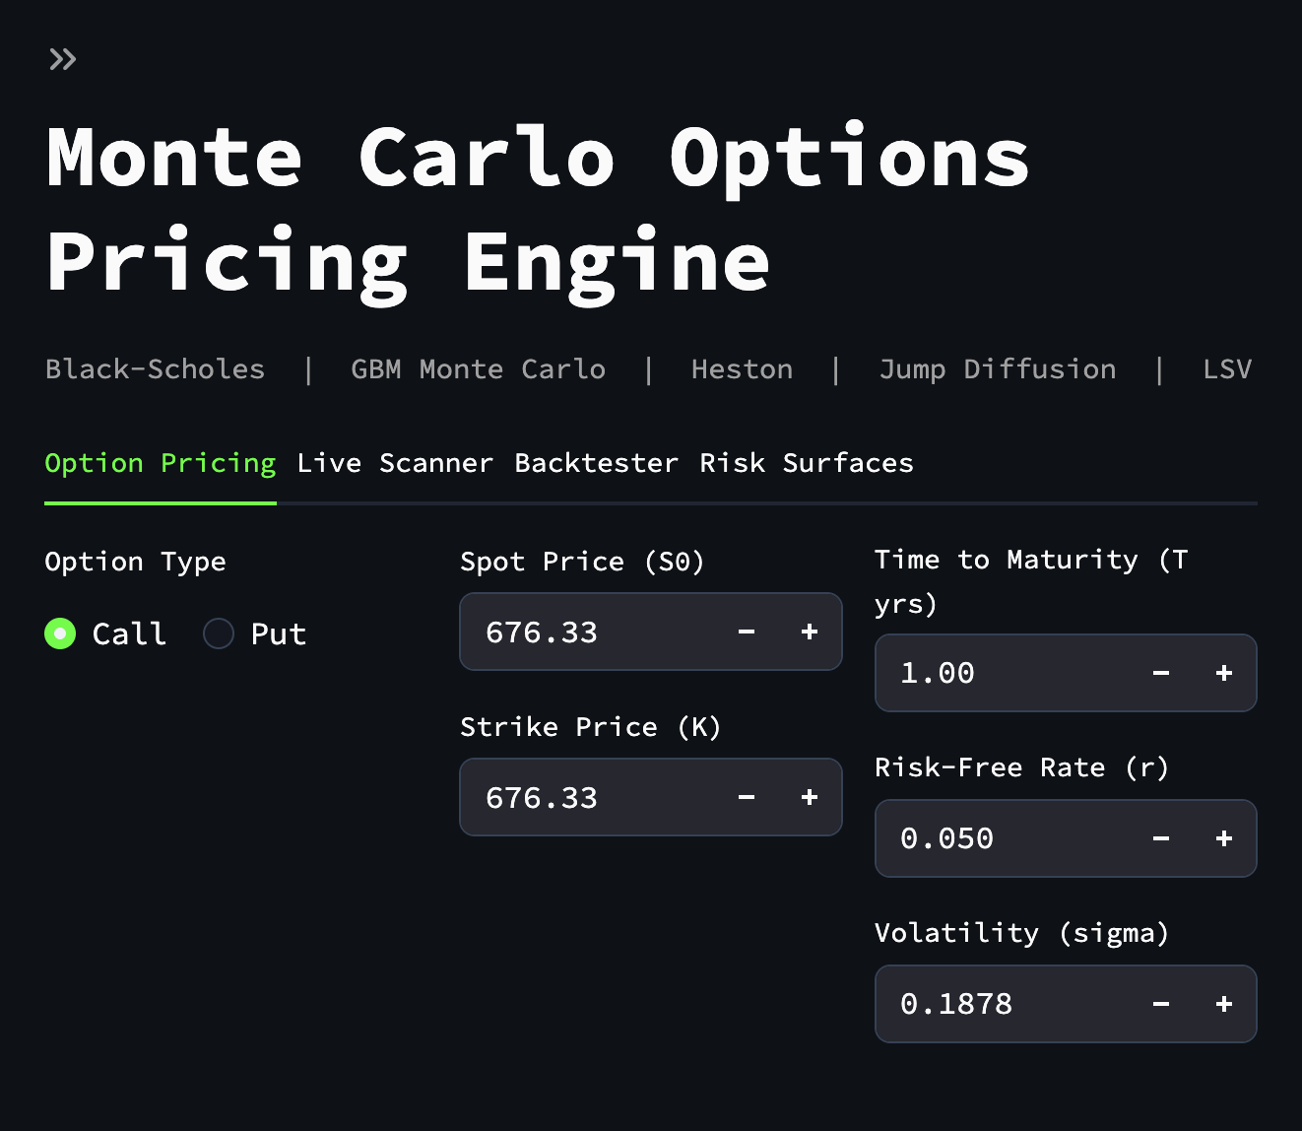
Quantitative Research Platform
for European S&P 500 Options
Combining pricing models, calibration, live opportunity scanning, and controlled backtesting.
Bach Nguyen
github.com/bachnguyennn/black-scholes-monte-carlo

Slide 2
Problem & Motivation
European index options are central to institutional hedging and volatility trading.
Black-Scholes is useful, but its assumptions are too restrictive for real markets.
Real option markets exhibit skew, smile, stochastic volatility, and jump risk.
The objective was to build a platform that compares models and makes assumptions explicit.
Why This Matters
Better pricing intuition
Transparent model comparison
Calibration tied to live data
Research workflow instead of black-box output

Slide 3
System Architecture
Frontend
Backend
Core Engines
Streamlit
Interaction, charts, diagnostics
FastAPI
API endpoints and scan execution
Pricing, calibration, scanner, backtester

Slide 4
Quantitative Models & Math
Black-Scholes
Analytical benchmark for European options.
Jump Diffusion
Adds discontinuous crash risk to diffusion dynamics.
GBM Monte Carlo
Baseline simulation engine and convergence reference.
LSV
Extends the framework toward better surface fitting.
Heston
Captures stochastic volatility and volatility skew.

Slide 5
Calibration: Connecting Theory to Data
Why Calibration Matters
RMSE
Root Mean Square Error
Without calibration, advanced model outputs are only parameter guesses.
Calibration fits model parameters to the implied volatility surface.
Weighted error minimization aligns theoretical values with live market structure.
This is the bridge between pure theory and observed option prices.

Slide 6
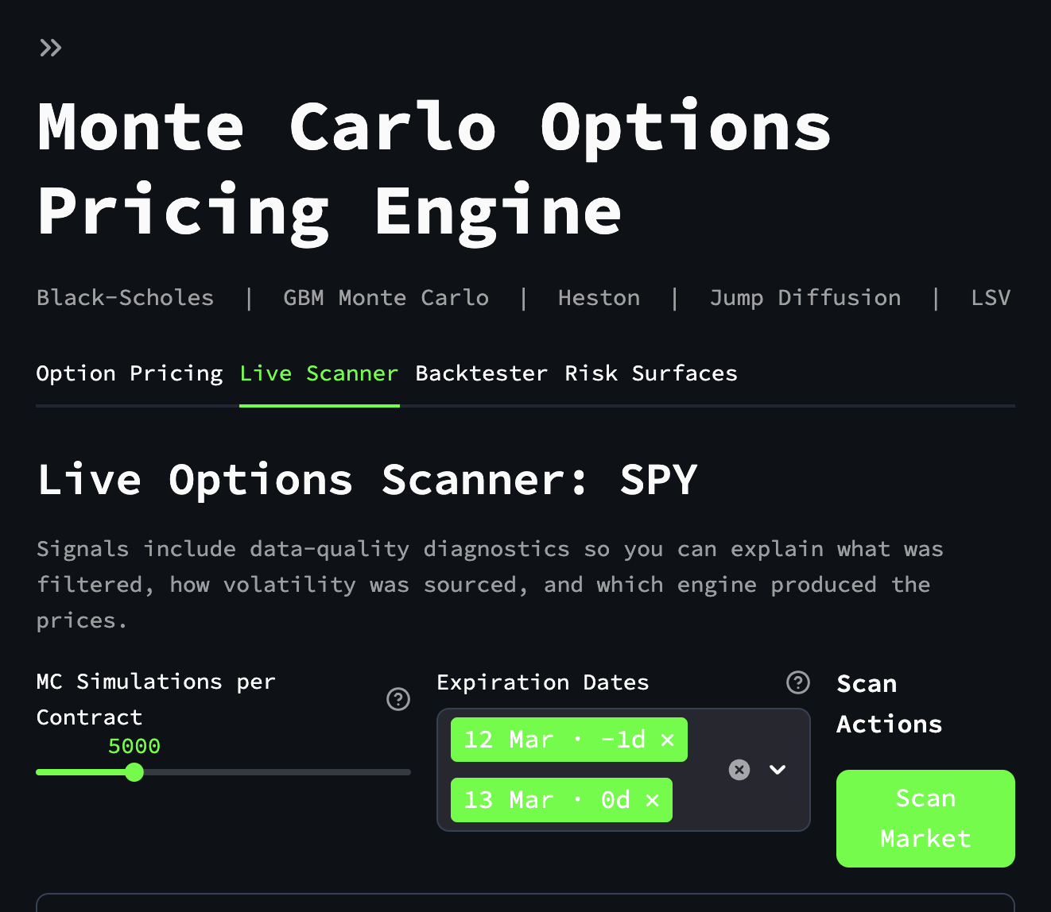
Live Scanner Logic
Strict filtering removes illiquid, inconsistent, and low-quality contracts.
Signal logic is bid/ask aware, not midpoint based.
Opportunities are only shown when model edge exceeds execution costs.
Diagnostics expose filtering reasons, volatility source, and execution mode.

Slide 7
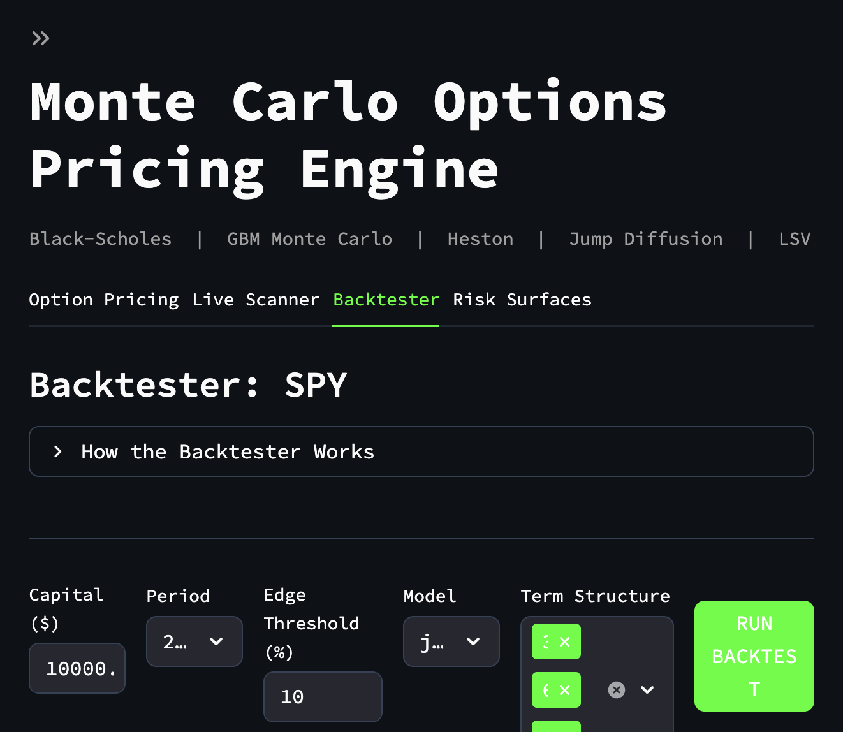
Backtester & Research Integrity
No-look-ahead volatility estimation.
Delta hedging and transaction-cost accounting.
Cost sensitivity and methodology disclosure.
Research simulator framing rather than execution-grade claim.

Slide 8
Results & Future Work
Strengths
Limitations
Future Work
Multi-model pricing framework
Calibration layer
Transparent diagnostics
Modular architecture
Depends on Yahoo Finance data
No historical option NBBO replay
Research-grade, not execution-grade
Institutional data feed
Historical options dataset
Stronger calibration validation
Automated reporting
A credible quantitative research environment combining model comparison, calibration, diagnostics, and transparent backtesting.

