Slide 1
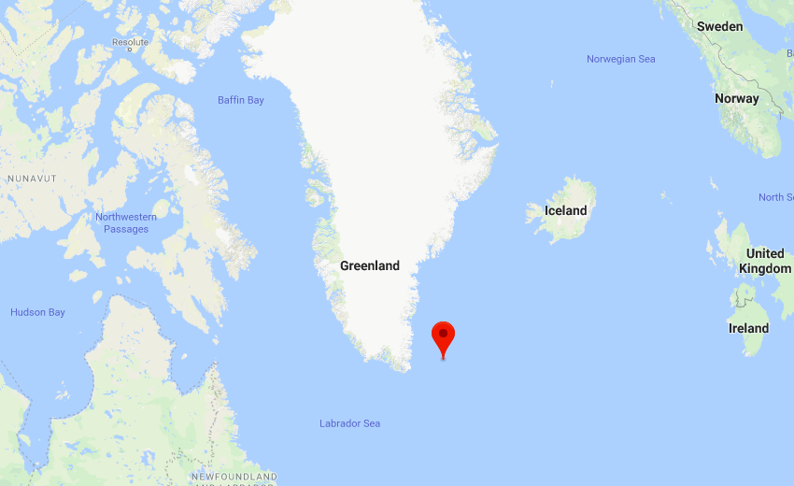
Sea Density Reading in Greenland
https://github.com/bachp2/FinalProject-450

Slide 2
Scientific Question:
Is there a change in sea density off the coast of Greenland from 2014 to 2019 ?

Slide 3
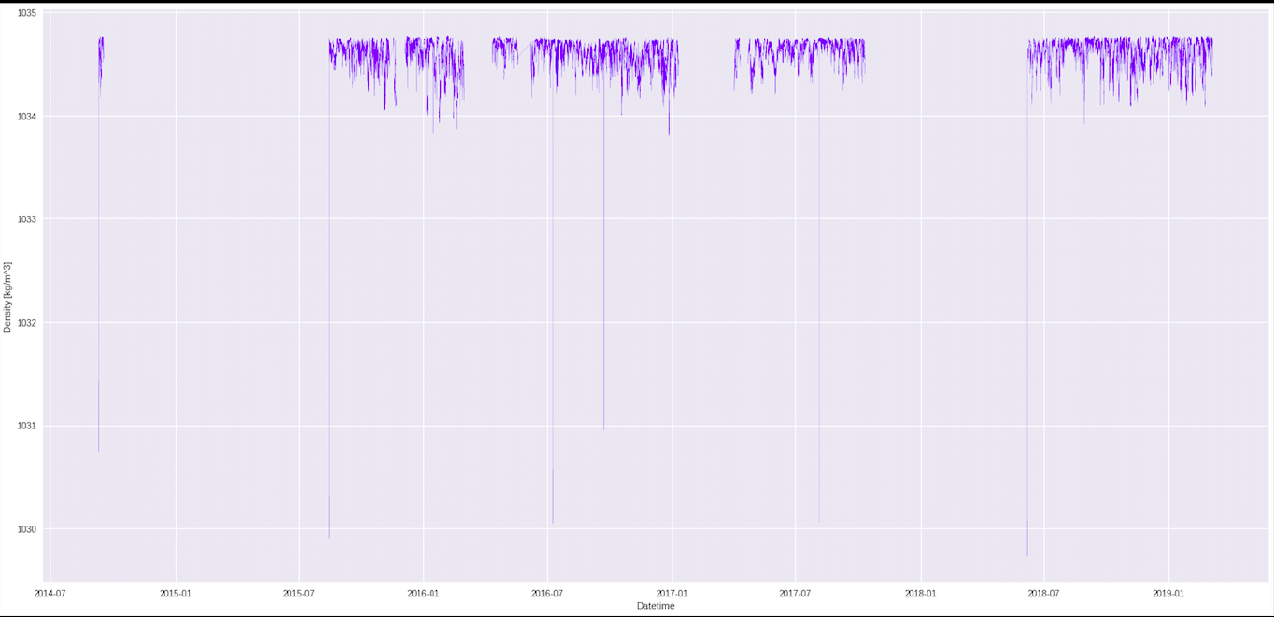
Plot: density vs. time

