Slide 1
CYBLE MTK v1.7
Overview
DEJO/UTSV
Notes:
Uses Title background with Title Only Text layout

Slide 2
Agenda
Introduction
Hardware
Firmware/software
Windows MTK application
Demo
Advanced topics – UART commands
Advanced topics – Firmware Source Code
FAQ
Support

Slide 3
INTRODUCTION

Slide 4
CYBLE MTK (Manufacturing Test Kit)
Production Testing of Cypress PSoC 4/PRoC BLE based DUTs
  What is an MTK?
  MTK or Manufacturing Test Kit allows customers to test their BLE based systems on their production line i.e. on every unit.
  Why does the customer need a CYBLE MTK when testers like Anritsu are available?
  Faster - Anritsu testing involves testing multiple RF parameters that are usually tested in a design environment. In production line, you may need only a sanity PER testing of the RF link that may be impacted by the external components on the board.
  Cheaper - Anritsu testing requires specialized testing equipment – i.e. requires investment on the customer’s part. Our MTK requires our BLE Pioneer Kit with SMA module
  Integrated - The CYBLE MTK integrates firmware programming, BD address programming capabilities into a single application
  Flexible - the CYBLE MTK can be extended to support other hardware tests like GPIO tests, CSD tests etc.
  Testers like Anritsu do complete BLE RF PHY testing. CYBLE MTK only covers a small subset. BLE RF PHY testing must be done for BLE qualification. CYBLE MTK is not a replacement it is an easy way to do limited testing on the production line.
Highlights
Cypress provides
  BLE Pioneer kit to act as MTK host
  DUT firmware to integrate with Customer Application
  Use Terminal Emulator or CYBLE MTK PC application to run automated MTK testing

Slide 5

MTK Option 1 – UART based testing
DUT and MTK host, both receive MTK commands over UART
Commands
over UART
Commands
over UART
Terminal Emulator
MTK Host on CY8CKIT-042-BLE
PRoC BLE DUT
MTK Host Firmware
MTK DUT Firmware – Option 1
DTM
DTM
BLE Radio on PRoC BLE
BLE
BLE Radio on PRoC BLE
  Needs UART lines connected to DUT and MTK host

Slide 6
MTK Option 2 – BLE link based testing
MTK host receives MTK commands over UART and configures DUT using BLE connection over L2CAP
Commands
over UART
Terminal Emulator
MTK Host on CY8CKIT-042-BLE
PRoC BLE DUT
MTK Host Firmware
MTK DUT Firmware – Option 1
  L2CAP is used for:
  Sending test configuration information to DUT
  Receiving test results form DUT
L2CAP
L2CAP
HCI
HCI
LL
DTM
LL
DTM
BLE Radio on PRoC BLE
BLE
BLE Radio on PRoC BLE
  Disadvantages:
  If serious RF problems exist with the sample, the MTK will fail to communicate since BLE connection cannot be established.

Slide 7
HARDWARE

Slide 8
HW SETUP - UART based testing
Block Diagram
RF Shield Box with DUTs
CY BLE based DUT
Antenna
BLE Link
SMA
Antenna
SMA Connector
N to SMA Adaptor
Attenuators
USB Cable
for Power
and Data
RF Shield Box with MTK Host
SMA
Cable
USB Cable
for Power
and Data
MTK Host
CY8CKIT-042-BLE
(Baseboard and
PRoC BLE Module with SMA Connector)
4
SMA Connector
N to SMA Adaptor
SMA
Cable
Terminal Emulator or Application on PC

Slide 9
HW SETUP – BLE link based testing
Block Diagram
RF Shield Box with DUTs
CY BLE based DUT
Antenna
BLE Link
SMA
Antenna
SMA Connector
N to SMA Adaptor
Attenuators
RF Shield Box with MTK Host
SMA
Cable
USB Cable
for Power
and Data
MTK Host
CY8CKIT-042-BLE
(Baseboard and
PRoC BLE Module with SMA Connector)
4
SMA Connector
N to SMA Adaptor
SMA
Cable
Terminal Emulator or Application on PC

Slide 10
HW SETUP
  HARDWARE REQUIREMENTS
Hardware | Purpose | Example Part Number
SMA Antenna | To be connected inside the RF shielded box with DUT. | MAF94271 from Laird Technologies
Attenuators | To control the transmitted/received power level at DUT. | 50DR-125 from JFW OR Combination of VAT attenuators from Mini-Circuits
SMA Cable | To provide controlled RF path from DUT to MTK host. | FLC-1M-SMSM+ from MiniCircuits
USB Cable (Type A Male to Type A Male) | For connecting the PC to the RF shield box. | 102-1020-BL-00100 from CNC Tech
2 x RF Shield Box | For controlled RF environment. (Note for accurate results a RF shield box is recommended for the MTK Host.) | STE2200 from http://www.rfshieldbox.com
2 x N to SMA adapter | To connect the SMA cable and the RF Shield Box. | 242113 from Amphenol Connex
CY8CKIT-042-BLE with SMA module | To act as MTK host. | http://www.cypress.com/?rid=109293 SMA modules will be available on web soon

Slide 11
FIRMWARE/SOFTWARE

Slide 12
MTK Firmware and Software Location
Perforce path:
//apps/Wireless/PRoC-BLE/CyBLE_MTK
MTK source code files only:
CyBLE_MTK/Source/ (Contains the files that must be added to the DUT project to support MTK functionality. Only MTK related files.)
Example firmware projects:
CyBLE_MTK/Firmware/ (Example DUT project that only contains MTK functionality and MTK host project. Both configured for option 1 i.e. UART based testing)
CyBLE_MTK/Firmware/Hex/ (Example MTK host and DUT hex files. Configured for option 1 i.e. UART based testing)
MTK Windows Application:
CyBLE_MTK/Application/CyBLE_MTK_Application/ (source code for MTK application)
CyBLE_MTK/Application/Binaries/ (MTK application binaries)
CyBLE_MTK/Application/TestProgram/ (Example test program Example.xml to load for demo)
Documentation:
CyBLE_MTK/Documentation (Contains this presentation)

Slide 13
MTK Configuration – UART based testing
  MTK Host firmware configuration:
  CYBLE_MTK_HOST must be defined to 1 (line 22 CyBLE_MTK.h)
  UART_INTERFACE_ENABLED must be defined to 1 (line 26 CyBLE_MTK.h)
  CYBLE_INTERFACE_ENABLED must be defined to 0 (line 27 CyBLE_MTK.h)
  DUT firmware configuration:
  CYBLE_MTK_HOST must be defined to 0 (line 22 CyBLE_MTK.h)
  UART_INTERFACE_ENABLED must be defined to 1 (line 33 CyBLE_MTK.h)
  CYBLE_INTERFACE_ENABLED must be defined to 0 (line 34 CyBLE_MTK.h)
Notes:
) for Option 1 (see slides 10 and 11)

Slide 14
MTK Configuration – BLE link based testing
  MTK Host firmware configuration:
  CYBLE_MTK_HOST must be defined to 1
  UART_INTERFACE_ENABLED must be defined to 1 (line 26 CyBLE_MTK.h) ( MTK host still receives commands from PC via UART)
  CYBLE_INTERFACE_ENABLED must be defined to 1 (line 27 CyBLE_MTK.h)
  DUT firmware configuration:
  CYBLE_MTK_HOST must be defined to 0
  UART_INTERFACE_ENABLED must be defined to 0 (line 31 CyBLE_MTK.h)
  CYBLE_INTERFACE_ENABLED must be defined to 1 (line 32 CyBLE_MTK.h)
  MTK Host LED indications:
LED Color | Description
Green | MTK host is connected to DUT via L2CAP
Blue | MTK host is connected to DUT via L2CAP MTK host will redirect all commands received over UART to DUT (via L2CAP link)
Red | MTK host is busy (executing current test)

Slide 15
MTK Firmware Integration
  Add CyBLE_MTK.c/h and uart_cmd_int.c/h to targeted PSoC Creator project
  Configure the MTK and DUT as shown either in option 1 (page 12) or in option 2 (page 14)
  Call MTK_mode() from the main function as shown in below code snippet
int main()
{
/* Place your initialization/startup code here (e.g. MyInst_Start()) */
CyGlobalIntEnable; /* Uncomment this line to enable global interrupts. */
if (MTK_triggered()) /* Go into MTK_mode() on trigger. */
{
MTK_mode(); /* Control does not return unless reset. */
}
/* Place your application code here */
Red_LED_Write(0); /* Sample application code, turn on red LED. */
while(1); /* Loop here forever. */
return 0;
}
  In the above code:
  MTK_mode() is called only if a trigger condition happens
  Ensure global interrupts are enabled before MTK_mode() is called
  In the example project, the MTK mode is triggered , when SW2 on the PSoC 4 BLE Pioneer Kit is held down, while kit is powered on and released just after power on. MTK_triggered() is called in that condition.

Slide 16
WINDOWS MTK APPLICATION

Slide 17
CYBLE MTK Application
Prerequisites:
.net 3.5 or above
PSoC Programmer 3.23.1 or above
Features:
Create and edit new test program
Ability to Run / Pause / Continue or Stop test program
Supervisor mode for editing tests and preferences
Auto save settings and preferences
Save test results by device / test / ‘Run’ Cycle / session

Slide 18
Available Tests
# | Name* | Description | Expected Result
1 | RX Packet Error Rate (PER) Test | Determines the Packet Error Rate (PER) between the DUT and MTK host with DUT in receive role. Running RX PER and TX PER tests back to back with varying attenuation can help determine link budget of the system | A PER result below the provided cut-off value is considered PASS A PER result above the provided cut-off value is considered FAIL
2 | TX Packet Error Rate (PER) Test | Determines the Packet Error Rate (PER) between the DUT and MTK host with DUT in transmit role. Running RX PER and TX PER tests back to back with varying attenuation can help determine link budget of the system | A PER result below the provided cut-off value is considered PASS A PER result above the provided cut-off value is considered FAIL
3 | Transmit Carrier Wave | Transmits unmodulated carrier wave for a given period of time in a given channel. This test could be used to view the TX spectrum of the DUT. Helps in determining carrier center frequency, TX power, in-band noise and can be useful in certification process | There is no measurement made by MTK setup. Unmodulated carrier wave observed via spectrum analyzer for a particular time in the specific channel
4 | Transmit Packets | Transmits a certain number DTM test packets of specified type in the specified channel and at the specified power. Helps in determining modulation index (when measured using the right device e.g.. anritsu) and can be useful in certification process | There is no measurement made by MTK setup. TX output observed via spectrum analyzer in the specific channel at the specific power output
5 | Receive Packets | Receives a certain number DTM test packets of specified type in the specified channel or timeout. Can be useful in certification process | Shows number of received packets in the specific channel
* Click on test names to see details about each test and its configuration

Slide 19
Available Tests
# | Name* | Description | Expected Result
6 | Device Programmer | Programs the currently selected DUT using the provided programmer settings and hex file | DUT programmed successfully
7 | Delay | Pauses execution of the test program for the specified amount of time in milliseconds | Test program halted for the specified amount of time in ms
8 | BD Address Programmer | Programs the currently selected DUT with the provided BD Address using the provided programmer settings | DUT programmed successfully with new BD Address
9 | Anritsu Test Program | Switches the DUT to Anritsu mode and then runs the specified Anritsu test script with settings mentioned in the preferences. This test requires an UART channel selector for connecting the correct DUT UART with Anritsu tester and the Anritsu UART to be present/connected | Selects appropriate DUT, puts it in the Anritsu mode, runs Anritsu test script and prints the test results
10 | Sleep->Wakeup->TX | Performs a link layer Tx test with sleep in between TX packets (from DUT) for the specified number of packets | Prints the number of packets successfully received by the MTK host
11 | Custom Tests | Executes the custom tests implemented by user on the DUT and validates the result against predefined rules | Test passes if all rules are validated to be correct else test fails
12 | Program All Devices | Programs all configured DUTs in parallel at the beginning of each ‘Run’ cycle | All configured DUTs programmed successfully
* Click on test names to see details about each test and its configuration

Slide 20
Available Tests
# | Name* | Description | Expected Result
13 | I2C Tests | Executes I2C commands specified by the user from the MTK Host and validates their result as defined by the user | Test passes if all results are validated to be correct as per user defined rules
* Click on test names to see details about each test and its configuration

Slide 21
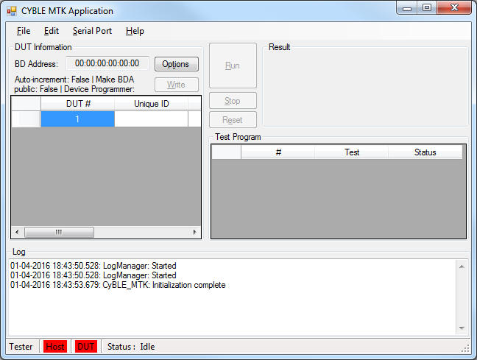
Main Window
CyBLE MTK Application Main Window
1
2
4
5
3
6
7
8

Slide 22
Main Window
1
Drop down menu:
File
  New Test Program – Creates a new test program
  Load Test Program – Open / Load an existing test program
  Close Test Program – Close / Unload an opened test program
  Save Test Program – Saves changes made to a test program
  Save Test Program As – Save test program with a new name
  Recent Test Program – Lists 5 previously opened test programs
  Exit – Exits the CyBLE MTK Application
Edit
  Supervisor Mode – Toggle between supervisor and tester modes
  Test Program – Edit currently loaded test program
  Preferences – Edit preferences (settings / options) related to the application / test / log behavior
Serial Port
  MTK Host – Serial port settings for MTK host (available in option 1 and option 2)
  DUT – Serial port settings for DUT (available only for option 1). A sub menu is provided for configuring each DUT port independently
  Anritsu – Serial port setting for Anritsu tester
  DUT Multiplexer – Serial port setting for the mux/de-mux to select desired DUT when running Anritsu tests
Help
  About – Shows information regarding CyBle MTK Application
BD Address Programmer:
Options – Open ups the BD Address Programmer Options dialog to edit BDA programmer preferences.
BD Address: – Displays the current BD address, this cannot be edited. To set the BD address click Configure and use the BD Address Programmer Options dialog. The BD Address value increments after each iteration if the “Auto increment BD address after write” option is selected in BD Address Programmer Options dialog
Write – Writes the BD Address to the PSoC 4 / PRoC BLE device connected to the configured programmer and erases the flash
Note: Please ensure you select the “Make BD address public” option in the BD Address Programmer Options dialog to get the DUT to use the new BD address
2

Slide 23
Main Window
3
DUT Information Table:
DUT # – Serial number of the listed DUTs
Unique ID – Holds the unique ID of the current DUT. This field is editable and can be used for barcode scanned unique IDs in production
Status – Test status (Queued, Testing, PASS / FAIL) of the DUT
Test Program Execution Controls:
Run – Runs the loaded test program. Once program is running the button turns to ‘Pause’. Clicking ‘Pause’ will pause the test program and changes the button text to ‘Continue’. Clicking ‘Continue’ continues the test program from previous paused state
Stop – Stops the test program, results are not cleared
Reset – Stops the test program and clears the results
Overall Test Result Area:
Displays overall test program execution result (PASS / FAIL)
Test Program Display Table:
# – Test program serial number
Test – Details of the test program displayed here. Double click on a test to edit it
Status – Shows status of the current test (Queued, PASS / FAIL or test progress through other messages)
Log Display Area:
Displays logs from the application as well as test logs
4
5
6
7

Slide 24
Main Window
8
Status Bar:
Tester – Indicates ‘Tester’ mode of the application. In this mode users can only load and initiate a test. When ‘Supervisor’ is entered this area indicates this by changing text to ‘Supervisor’ with a red background. In this mode users can create and edit test programs, change application preferences
Host – Indicates connection status with the MTK host. Red background indicates absence of MTK host device. Green indicates presence of a MTK host device
DUT – Indicates presence of DUT. Red means DUT not present. Green means DUT is present. Correctness of this indication depends on selected option under ‘Edit > Preferences > Test > DUT connected via’. Select UART for Option 1 and BLE for Option 2
Status – Displays the current status (activity) of the application

Slide 25
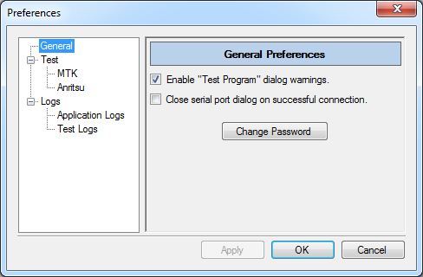
Preferences Window
General Preferences:
Enable “Test Program” dialog warnings. – when checked shows warning messages when editing test programs via the Test Program Edit dialog.
Close serial port dialog on successful connection. – when checked will close the serial port setting dialogs after connecting to a valid device.
Change Password – change password for entering the supervisor mode

Slide 26
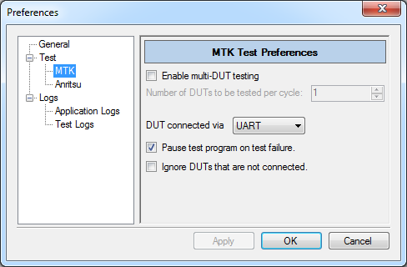
Preferences Window
Test Preferences:
Enable multi-DUT testing – when checked enables testing of more than one device per test cycle
Number of DUTs to be tested per cycle – select the number of devices to be tested per test cycle
DUT connected via BLE / UART – select the method to connect to the DUT
Pause test program on test failure – when checked pauses the test program on test failure
Ignore DUTs that are not connected. – When testing multiple devices ignore the once that are not configured
Note: Multi DUT testing is not supported when using BLE to connect with DUT

Slide 27
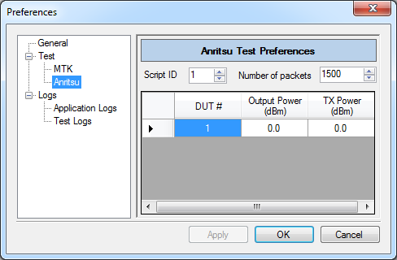
Preferences Window
Test Preferences:
Script ID – select the Anritsu script to be run
Number of packets – select the number of packets for PER testing
Output Power (dBm) – calibrate the output power for each DUT
TX Power (dBm) – calibrate the TX power for each DUT
Note: For using Anritsu tester an UART mux/de-mux setup is required to connect multiple devices at once.

Slide 28
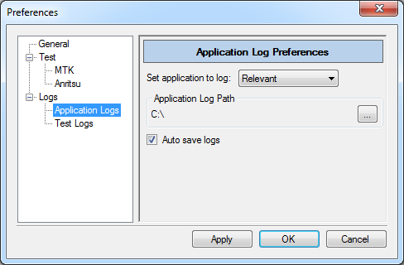
Preferences Window
Test Preferences:
Set application to log Nothing / Relevant / Everything – select the amount of application log details to print
Application Log Path – set the location at which application logs will be saved for each session
Auto save logs – when checked will start saving logs as soon as the application is launched

Slide 29
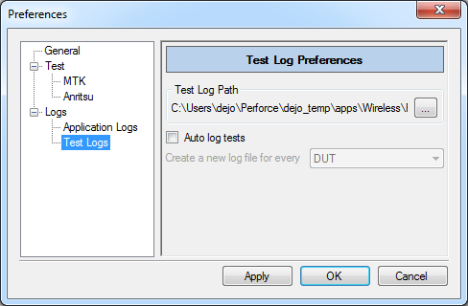
Preferences Window
Test Preferences:
Test Log Path – set the location at which test logs will be saved
Auto log tests – when checked will start saving logs as per the condition selected for ‘Create a new log file for every session / ‘Run’ Cycle / DUT / test’
Create a new log file for every session / ‘Run’ Cycle / DUT / test – sets the behavior on when to save test logs, like one log for every session / ‘Run’ Cycle / DUT / test

Slide 30
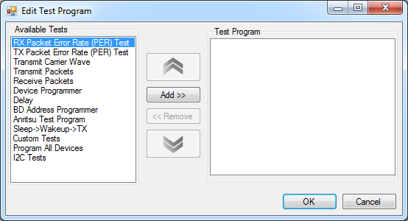


Edit Test Program Window
Edit Test Program: This is popped up on selecting File-> New Test Program or double-clicking the second column of the test program display tale in main window
Available Tests – list of un-configured tests available to add to the test program
Test Program – list of configured tests added to the test program
Add >> – add a new configured test to the Test Program list from the Available Tests. You can use right click context menu on an available test to add it. The right click context menu also gives a Batch Add option for some tests, this can be used to add multiple configurations of the same test
<< Remove – remove selected test(s) from the Test Program list. Multiple tests can be selected for removal
Test details are available in slides 27-32
Batch Add option (available on right clicking on certain tests) is explained in slide 33
– moves the currently selected test in
Test Program list up by one position
– moves the currently selected test
in Test Program list down by one position

Slide 31
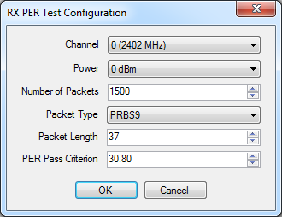
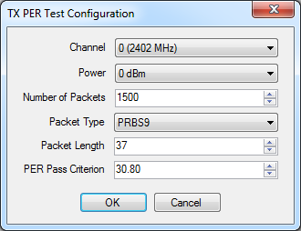
Edit Test Program Window
Edit Test Program: Available Tests
RX PER Test – Receive DTM packets and inform if pass or fail based on chosen PER criteria
TX PER Test - Receive DTM packets and inform if pass or fail based on chosen PER criteria
Multiple instances of these tests can be added to a test program.
Configuration:

Slide 32
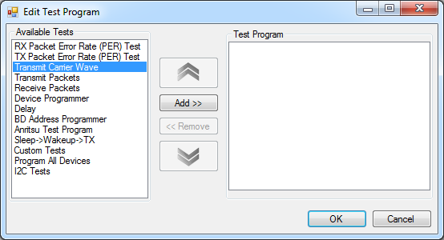
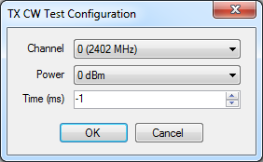
Edit Test Program Window
Edit Test Program: Available Tests
Transmit Carrier Wave – Transmits unmodulated carrier wave
Multiple instances of this test can be added to a test program
Time = -1 means transmit carrier wave infinitely
Configuration:

Slide 33
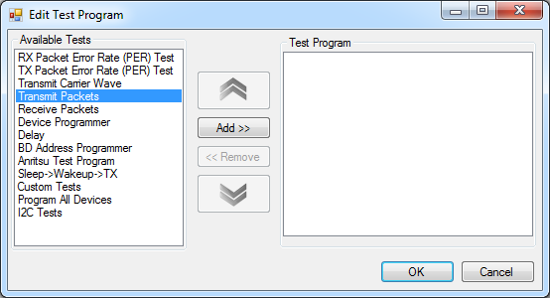
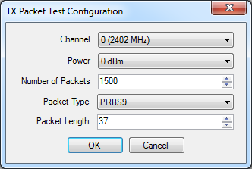
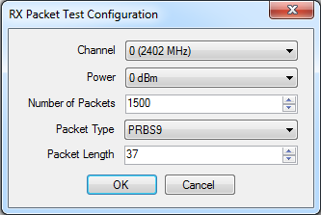
Edit Test Program Window
Edit Test Program: Available Tests
Transmit Packets – Transmit DTM packets
Receive Packets – Receive DTM packets
Multiple instances of this test can be added to a test program
These are useful for RF certifications where packets are required on a fixed channel and with a specified Tx power level
Configuration:

Slide 34
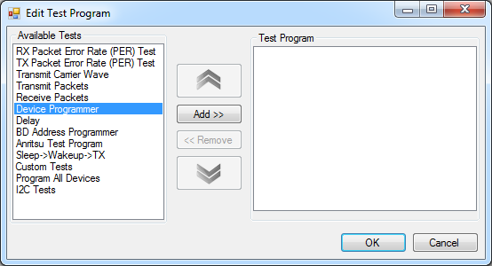
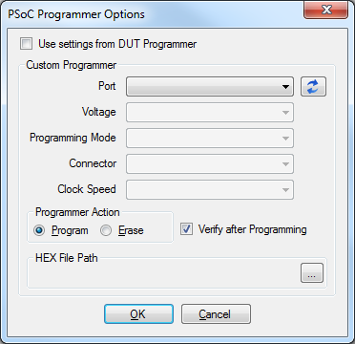
Edit Test Program Window
Edit Test Program: Available Tests
Device Programmer – Programs the chosen device with the chosen hex file or erases the flash of the chosen device
Multiple instances of this test can be added to a test program
Supports KitProg or Miniprog3 based programming
Configuration:
‘Use settings from DUT Programmer’ (when checked) will override current settings. Instead individual DUT Programmer settings from the Main Window is used. Each device must have a configured DUT Programmer attached to it in the Main Window. This feature can be used in cases where dedicated programmers are present for each DUT
Note: Please be careful not to select the MTK host’s KitProg instance as you will end up programming the MTK host leading to unpredictable behavior

Slide 35
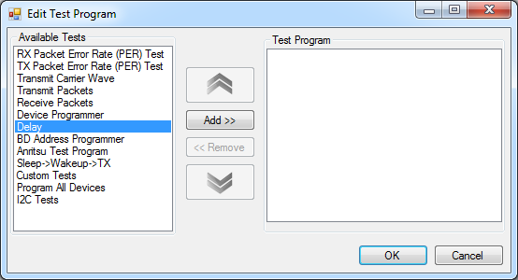
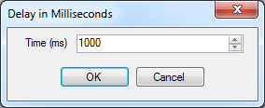
Edit Test Program Window
Edit Test Program: Available Tests
Delay – To add delays between tests
Multiple instances of this test can be added to a test program.
Configuration:

Slide 36
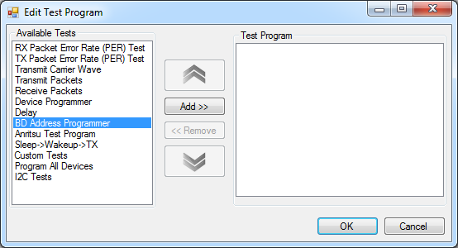
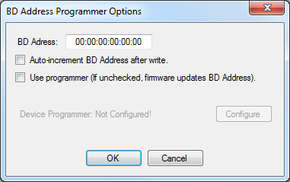
Edit Test Program Window
Edit Test Program: Available Tests
BD Address Programmer – To set the Bluetooth Device Address. Can use a programmer connected to the DUT, in this case after the BD Address is written the flash is erased. Or MTK firmware can be used to update Sflash
Note:
Please be careful not to select the MTK host’s KitProg instance as you will end up programming the MTK host leading to unpredictable behavior.
Only one instance of this test can be added to a test program.
Configuration:

Slide 37
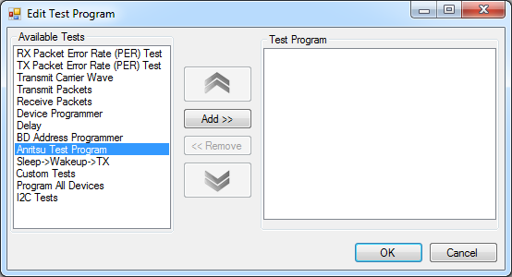
Edit Test Program Window
Edit Test Program: Available Tests
Anritsu Test Program – To run a configured Anritsu script. Configuration is done at Preferences > Test > Anritsu.
Multiple instances of this test can be added to a test program.

Slide 38
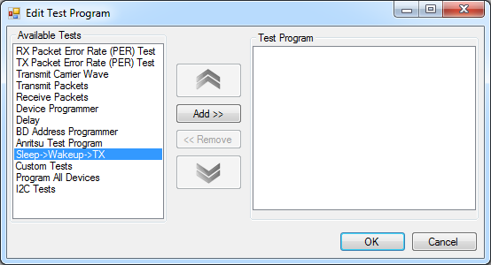
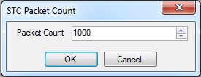
Edit Test Program Window
Edit Test Program: Available Tests
Sleep->Wakeup->TX – LL test that transmits a fixed packet count after connecting to the MTK host. In between the packet transmits the DUT is put to sleep.
Multiple instances of this test can be added to a test program.
Configuration:

Slide 39
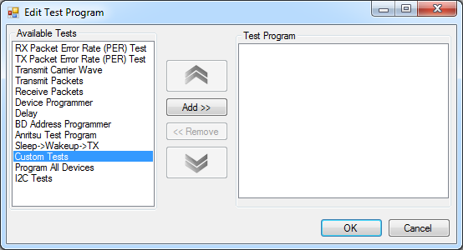
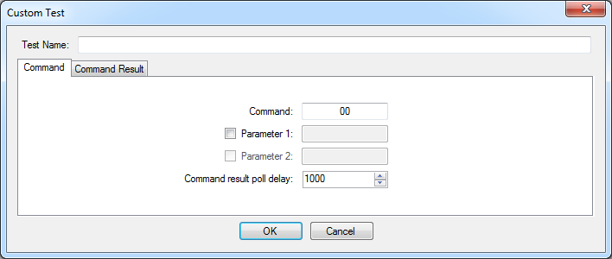
Edit Test Program Window
Edit Test Program: Available Tests
Custom Tests – Runs user implemented test in firmware (see). The software provides a way to send custom commands with two additional parameters. A delay can be configured between test start and result reading. The result can be validated by setting byte by byte rules for the result packet in the Command Result tab.
Multiple instances of this test can be added to a test program.
Note:
Lack of firmware implementations of the custom tests can cause unexpected behavior.
Configuration:

Slide 40
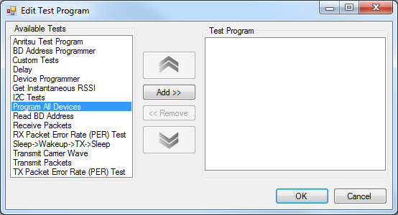
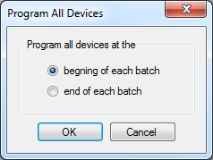
Edit Test Program Window
Edit Test Program: Available Tests
Program All Devices – Programs all devices at once (in parallel; each device must have a configured DUT Programmer attached to it in the Main Window) per test cycle. This can be scheduled at the beginning or end of the batch execution.
Multiple instances of this test can be added to a test program.
Configuration:

Slide 41
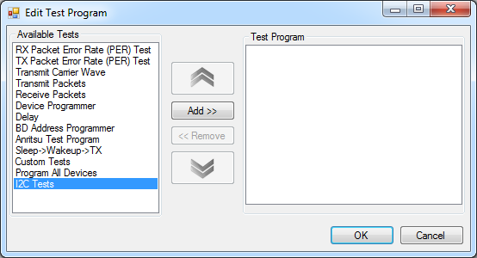
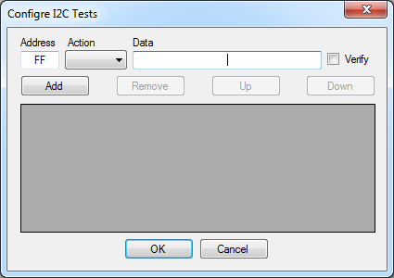
Edit Test Program Window
Edit Test Program: Available Tests
I2C Tests – Reads and writes from or to a specified I2C address using the PSoC Programmer / KitProg I2C port. A list of instructions could be queued for this purpose. When reading data, it could be verified by selecting the Verify option and providing the expected result in Data field. Other wise any input present in Data field is ignored when reading.
Multiple instances of this test can be added to a test program.
Configuration:

Slide 42
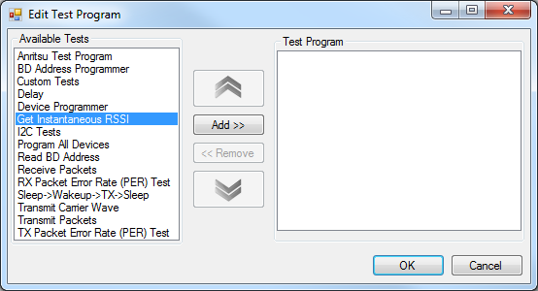
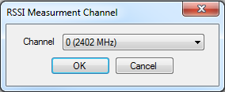
Edit Test Program Window
Edit Test Program: Available Tests
Get Instantaneous RSSI – Reads the current RSSI value at the given channel
Multiple instances of this test can be added to a test program.
Configuration:

Slide 43
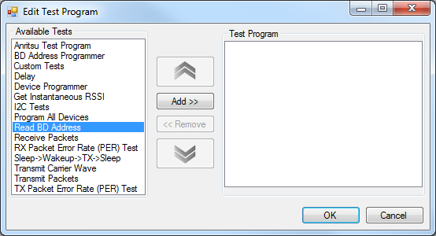
Edit Test Program Window
Edit Test Program: Available Tests
Read BD Address – Reads the BD Address stored in Sflash of the device
Multiple instances of this test can be added to a test program.

Slide 44
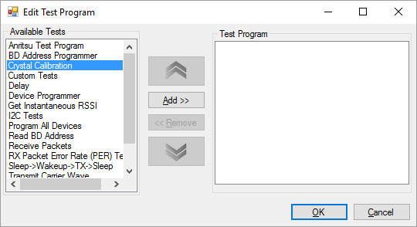
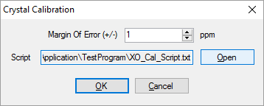
Edit Test Program Window
Edit Test Program: Available Tests
Crystal Calibration – Calibrates the ECO trim register values. Test setup requires an additional frequency counter equipment. See block diagram for details.
The final frequency tuned for a particular DUT will fall within 24MHz +/- Margin Of Error (in ppm). Script is a text file that contains instructions to connect with the frequency counter and to measure frequency. The information and instruction provided in the script will be used by the calibration algorithm to talk to the frequency counter. Information on how to write the script is provided in slides 45 and 46. A sample script is located in Application/TestProgram/XO_Cal_Script.txt
Multiple instances of this test can be added to a test program.
Block Diagram
DUT
GPIO XO Out
Frequency Counter
UART
UART
PC/Laptop

Slide 45
Edit Test Program Window
Crystal Calibration – Frequency counter script, HOWTO. . A sample script is located in Application/TestProgram/XO_Cal_Script.txt.
Introduction
The script file can contain either comments or commands in each line. "//" denotes start of comment. Comments are single line and not block of lines. A comment can also start at any location in a line, like after a command.
Any other line is that does not start with “//” will be interpreted as a command. Commands are organized in to SECTIONS depending on functionality. Also each command has to be on individual lines.
Sections
A SECTION is always starts at the beginning of a line and is immediately followed by '.' and by the section name. For example 'SECTION.SerialPort'. The current SECTION ends where the next SECTION begins. All leading and trailing white spaces will be removed for all commands within a SECTION. Possible section names are
SerialPort – Provides information regarding the frequency counter serial port. Following serial port parameters are allowed.
    PortName=COM10
    BaudRate=9600 // This can be only be a positive number. Default is 9600.
    Parity=None // Possible values: Even, Mark, None, Odd, Space. Default is None.
    DataBits=8 // Possible values: 5 to 8. Default is 8.
    StopBits=Two // Possible values: None, One, OnePointFive, Two. Default is One.
    Handshake=None // Possible values: None, RequestToSend, RequestToSendXOnXOff, XOnXOff. Default is None.
Init – Should contain a set of commands to initialize the frequency counter
Measure – Should contain a set of commands to measure and read the measured frequency value
Stop – Should contain a set of commands to stop the frequency counter and put it in idle mode

Slide 46
Edit Test Program Window
Crystal Calibration – Frequency counter script, HOWTO.
Commands
SendString - sends a set of charcters (string) between the double quotes to the serial port mentioned in SerialPort section.
SendString("*RST") // Sends *RST to the serial port
DelayMS – provides delay for certain amount of time (in milliseconds).
DelayMS(2000) // Provides 2000ms (2sec) delay
ReceiveString – receives a string from the serial port mentioned in SerialPort section and interpret it the specified format. Currently only %d is supported.
ReceiveString("%d")

Slide 47
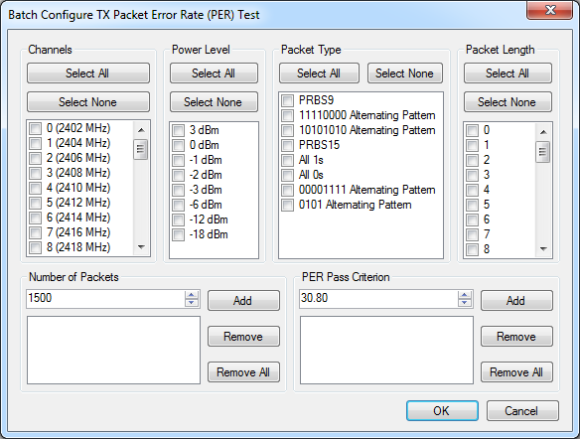
Batch Configure Window
Batch Configure Dialog: This dialog is available on right clicking and selecting Batch Add on RX PER Test, TX PER Test, Transmit Packets, Receive Packets and Transmit Carrier Wave tests
This dialog allows users to add multiple instances of a test with different configurations in one-go

Slide 48
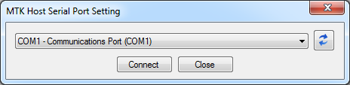
Serial Port Setting Window
Serial Port Setting: This dialog is popped up on selecting Serial Port->MTK Host or Serial Port->DUT or when executing a test program without connecting to MTK Host and DUT
– refresh the list of serial ports shown on the drop down
Connect – tries to connects to the selected serial port on the drop down. The dialog also verifies if the device its connecting to is a valid host / DUT device and will only connect to a valid device. On successful connection the button will change to Disconnect, clicking Disconnect button disconnects the serial port and changes the button text to Connect
Close – closes the dialog

Slide 49
DEMO

Slide 50
CYBLE MTK Quick Demo Instructions
  Ensure you have 2 BLE Pioneer Kits
  Program MTK host and DUT (BLE pioneer Kits) with the firmware hex files provided in CyBLE_MTK/Firmware/Hex/
  While powering on the DUT hold the SW2 for 2-3 secs on the BLE pioneer kit (this enables the DUT to enter the test mode)
  Launch CyBLE MTK Application.exe found in CyBLE_MTK\Application\Binaries\Debug
  Enter supervisor mode – Edit->Supervisor (there is no password by default)
  Open the Preferences window - Edit->Preferences
  Configure the DUT for UART based connection in the Test section of Preferences window
  Press OK to close the Preferences window
  Go to Serial Port->MTK Host and select the BLE Pioneer Kit which was programmed as the MTK Host (the Log textbox in the main application window will inform you if you selected the wrong COM port)
  Go to Serial Port->DUT and select the BLE Pioneer Kit which was programmed as the DUT (the Log textbox in the main application window will inform you if you selected the wrong COM port)
  Click File->Load Test Program and select Example.xml provided in CyBLE_MTK/Application/TestProgram/
  Click Run to execute the test program

Slide 51
ADVANCED TOPICS - UART COMMANDS

Slide 52
MTK UART Commands (1)
Commands¹ | Format | Description
TXP | TXP ‘CH’ ‘P’ ‘N’ | Transmit packet command ‘CH’ is the channel number (0 to 39) (default 0) ‘P’ is the power level (-18, -12, -6, -3, -2, -1, 0, 3) (default -18) ‘N’ is the number of packets to be transmitted (-1 to 65535) (default:1000) (-1 radio transmits packets forever)
RXP | RXP ‘CH’ ‘N’ | Receive packet command ‘CH’ is the channel (0 to 39) (default 0) ‘N’ is the number of packets to be received. The radio will calculate timeout (assuming 625µs per packet) corresponding to ‘N’ and will spend the same amount of time in receive mode (-1 to 65535) (default:1000) (-1 radio receives packets forever)
RRS | RRS | Radio reset command; stops the current test and brings the radio back to idle state. This prints the status of the last executed command.
PST | PST | Instructs the radio to print the status of the last executed command
SPL | SPL ‘PL’ | Set packet length command ‘PL’ is the packet length in bytes (0 to 37) (default 37)
VER | VER | Prints the MTK firmware version number
DUT | DUT ‘X’ | Switch to send commands to DUT or MTK host ‘X’ 1 if commands are to be executed by DUT 0 if commands are to be executed by MTK Host (default 0)
TXC | TXC ‘CH’ ‘P’ ‘T’ | Transmit carrier wave command ‘CH’ is the channel number (0 to 39) (default 0) ‘P’ is the power level (-18 to 0) (default -18) ‘T’ is the duration (in ms) for which carrier wave is transmitted (-1 to 2147483647) (default is -1 and will force radio to transmit carrier wave forever)
STC | STC ‘N’ | Sleep -> Wakeup -> TX -> Sleep test ‘N’ number of cycles the DUT goes through
  ¹ Use RRS or PST to get result or status of previous command, unless stated otherwise

Slide 53
MTK UART Commands (2)
Commands¹ | Format | Description
PCS | PCS | Print L2CAP connection status command Output: DISCONNECTED - No DUT connected CONNECTED - DUT connected
SPT | SPT ‘PT’ | Set packet type command. ‘PT’ is the packet type from PRoC BLE Registers TRM register BLE_BLELL_LE_RF_TEST_MODE (default 0) 0 for pseudo-random bit sequence 9 1 for pattern of alternating bit 11110000 2 for pattern of alternating bits 10101010 3 for pseudo-random bit sequence 15 4 for pattern of all 1 bits 5 for pattern of all 0 bits 6 for pattern of alternating bits 00001111 7 for pattern of alternating bits 01010101
WHO | WHO | Prints the role of the device. Output: HOST – When command issued to a MTK host device DUT – When command issued to a DUT device
DCW | DCW ‘N’ | Disconnect L2CAP connection and wait ‘N’ is the number of packets to be transmitted (-1 to 65535) (default: -1) (-1 wait forever)
CUS | CUS ‘CMD’ ‘PARAM1’ ‘PARAM2’ | Execute custom (user specific/implemented) command. Use RRS or PST to read result ‘CMD’ custom command code ‘PARAM1’ custom command parameter 1 ‘PARAM2’ custom command parameter 2
  ¹ Use RRS or PST to get result or status of previous command, unless stated otherwise

Slide 54
MTK UART Commands (3)
Commands¹ | Format | Description
RSX | RSX ‘CH’ | Read instantaneous RSSI ‘CH’ is the channel number (0 to 39) (default 0)
RBA | RBA | Read BD Address
WBA | WBA ‘BYTE1’ ‘BYTE2’ ‘BYTE3’ ‘BYTE4’ ‘BYTE5’ ‘BYTE6’ | Write BD Address ‘BYTE1’ is the first byte of address ‘BYTE2’ is the second byte of address ‘BYTE3’ is the third byte of address ‘BYTE4’ is the fourth byte of address ‘BYTE5’ is the fifth byte of address ‘BYTE6’ is the sixth byte of address
RTR | RTR | Reads the XO trim register and prints the value in hex
WTR | WTR ‘TR Value’ | Writes the XO trim register with the 16-bit (4 nibble) ‘TR Value’ ‘TR Value’ is the 16-bit (4 nibble) trim register value
STR | STR | Reads the trim register and stores the read value at the beginning of second row of SFlash
LTR | LTR | Reads the trim register value from the beginning of second row of SFlash and writes it into the trim register.
  ¹ Use RRS or PST to get result or status of previous command, unless stated otherwise

Slide 55
MTK UART Commands
  Notes:
  MTK responds with “ACK” (i.e. syntax of command is correct) for valid commands and with “NAC” (i.e. syntax of command is incorrect) for invalid commands
  Commands must be issued with values for all arguments. If all arguments are missing commands will use default values. If some arguments are provided and other arguments are missing the command will assign values to arguments in left to right order and assign default values for arguments whose values are missing.
  When using UART based testing - Once the RXP command is issued, the device is always in receive mode. To end the RXP command you need to issue the RRS command. This will reset the radio and return the number of received packets. This behavior ensures that the user can initiate transmit on MTK host/DUT after starting receive on MTK host/DUT.

Slide 56
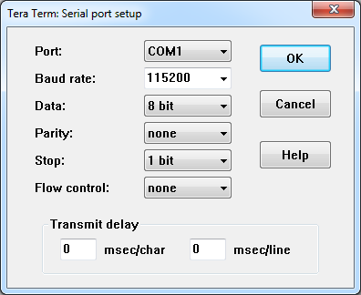
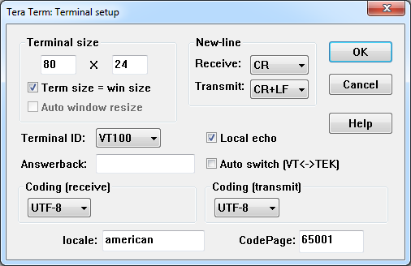
Tera Term Configuration
Example of configuration and steps when using UART commands through Tera Term to perform BLE-link based testing
  Tera Term configuration:
  Typical sequence of steps to perform tests:
  Power on MTK host (via USB cable), power on DUT in MTK mode -> Check if green LED glows on MTK host
  Open Tera Term on PC and connect to the MTK host via COM port
  Enter UART commands for the required tests (ensure DUT side commands are entered before MTK host specific commands) -> Check if RED LED glows after MTK host specific commands are entered
  When red LED switches off enter the PST command to display results of the last test
  Check if green LED is glowing before entering the new UART commands

Slide 57
Example Command Sequence
Example sequence of commands to enter on Tera Term to transmit 100 packets from MTK and receive the same on DUT while using BLE link based testing
//MTK host is connected to DUT via L2CAP on BLE
//Green LED should be on
DUT 1 ACK // Set the mode so that UART commands are redirected to DUT. Blue LED should be on
RXP 38 100 ACK //Set DUT to receive mode for the duration taken to receive 100 packets on channel 38
DUT 0 ACK //Set the mode so that UART commands are executed by MTK host. Green LED should be on
TXP 38 0 100 ACK //Set MTK host to transmit on channel 38, with 0 dBm Tx power, 100 packets
//Red LED should be on. Wait for LED to turn off. Green LED should be ON
PST ACK //Display results of the last command issued to MTK host and connect back to DUT over L2CAP
100
DUT 1 ACK // Set the mode so that UART commands are redirected to DUT. Blue LED should be on
PST ACK //Display results of the last command issued to DUT
100
//Ready for next set of commands
Key:
//XYZ – Comments to explain the commands
XYZ – Commands entered on Tera Term
XYZ – Responses from MTK

Slide 58
ADVANCED TOPICS - FIRMWARE SOURCE CODE

Slide 59
MTK Firmware Source
  Both DUT and MTK Host uses the same firmware source files
  Preprocessor directives are used to select between either DUT or MTK Host functionality
  Preprocessor directives are used to enable UART (MTK & DUT) or BLE (DUT) based communication
  Soruce Files:
  CyBle_MTK.c/h – Contains APIs for MTK functionality as well as preprocessor directives to configure and select the different modes
    void MTK_init(void) – Initializes the MTK
    void MTK_mode(void) – Initializes the MTK and enters the MTK mode. User will have to reset the devce (DUT) to get out of the MTK mode
    void set_packet_length(uint32_t length) – Sets DTM packet length
    uint32_t get_packet_length(void) – Gets current DTM packet length
    void set_packet_type(uint32_t type) – Set DTM packet type
    uint32_t get_packet_type(void) – Gets current DTM packet type
    void DTM_tx_start(uint32_t channel, CYBLE_BLESS_PWR_LVL_T power, uint32_t num_packets) – Start DTM transmit
    void DTM_rx_start(uint32_t channel) – Start DTM receive
    void stop_DTM_tests(void) – Stops all DTM tests in progress
    void transmit_carrier_wave(uint32_t channel, CYBLE_BLESS_PWR_LVL_T power) – Start carrier wave transmit
    void recover_from_TXC(void) – Stops de-initialize all registers
    CYBLE_MTK_HOST – Configures the MTK firmware for MTK host implementation
      By default if CYBLE_MTK_HOST = 1 MTK code defines UART_INTERFACE_ENABLED and CYBLE_INTERFACE_ENABLED to 1
      By default if CYBLE_MTK_HOST = 0 MTK code defines CYBLE_MTK_DUT and CYBLE_INTERFACE_ENABLED to 1 and defines UART_INTERFACE_ENABLED to 0
    CYBLE_MTK_DUT – Configures the MTK firmware for DUT implementation (by default CYBLE_MTK_DUT = !CYBLE_MTK_HOST)
    CYBLE_MTK_VERSION – MTK version printed by the VER command (currently – 1.0)
    UART_INTERFACE_ENABLED – Enables UART based command interface on the MTK for both MTK host and DUT

Slide 60
MTK Firmware Source
    CYBLE_INTERFACE_ENABLED – Enables BLE based command interface on the MTK for both MTK host and DUT
    MTK_DUT_ADDRESS – The 48-bit Bluetooth Device address (BD_ADDR) of the DUT (by default 0x11, 0x22, 0x33, 0x44, 0x55, 0x66)
  uart_cmd_int.c/h – Contains functions/ISR for implementing the UART based command interpreter (these functions should only be modified if changing the commnad interpretation logic) and enumerations/structures to enable the command interpreter to recognize commands (these should be added to for new commands)
    void CI_start() – Initializes and runs the command interpreter
    UART_CMDS_T CI_get_command(int32_t *argument_array, int32_t *num_args) – Returns the last received valid command along with the arguments and number of arguments received
    UART_CMDS_T (example) shown below contains the named values for all commands. Any new command needs a three-letter, named value added above the NUMBER_OF_COMMANDS value
      typedef enum UART_cmds
      {
        NO_CMD = 0,
        TXP,
        RXP,
        RRS,
        PST,
        SPL,
        SPT,
        VER,
        TXC,
        DUT,
        PCS,
        // NEW command to be added here
        NUMBER_OF_COMMANDS
        } UART_CMDS_T;

Slide 61
MTK Firmware Source
    Every command is associated with a structure of type cmd_def_t. This structure is shown below :
    typedef struct cmd_def_t
    {
    int8_t cmd_string[MAX_CMD_LEN];
    enum UART_cmds cmd_ID;
    uint8_t number_of_arguments;
    int32_t argument[MAX_CMD_ARG_LEN][3];
    } CMD_DEF_T;
    Any new command must be added to the array of cmd_def_t as shown below
static const CMD_DEF_T command_lookup[NUMBER_OF_COMMANDS] =
{
/* 1 2 3 0,0 0,1 0,2 1,0 1,1 1,2 2,0 2,1 2,2*/
{"TXP", TXP, 3, {{ 0, 0, 39}, { -18, -18, 3}, { -1, 1000, 65535}}},
{"RXP", RXP, 2, {{ 0, 0, 39}, { -1, 1000, 65535}, { 0, ARG_DEF_VAL, 0}}},
{"RRS", RRS, 0, {{ 0, ARG_DEF_VAL, 0}, { 0, ARG_DEF_VAL, 0}, { 0, ARG_DEF_VAL, 0}}},
{"PST", PST, 0, {{ 0, ARG_DEF_VAL, 0}, { 0, ARG_DEF_VAL, 0}, { 0, ARG_DEF_VAL, 0}}},
{"SPL", SPL, 1, {{ 0, 37, 37}, { 0, ARG_DEF_VAL, 0}, { 0, ARG_DEF_VAL, 0}}},
{"SPT", SPT, 1, {{ 0, 0, 8}, { 0, ARG_DEF_VAL, 0}, { 0, ARG_DEF_VAL, 0}}},
{"VER", VER, 0, {{ 0, ARG_DEF_VAL, 0}, { 0, ARG_DEF_VAL, 0}, { 0, ARG_DEF_VAL, 0}}},
{"TXC", TXC, 3, {{ 0, 0, 39}, { -18, -18, 3}, { -1, -1, 2147483647}}},
{"DUT", DUT, 1, {{ 0, 0, 1}, { 0, ARG_DEF_VAL, 0}, { 0, ARG_DEF_VAL, 0}}},
{"PCS", PCS, 0, {{ 0, ARG_DEF_VAL, 0}, { 0, ARG_DEF_VAL, 0}, { 0, ARG_DEF_VAL, 0}}},
{"WHO", WHO, 0, {{ 0, 0, 0}, { 0, 0, 0}, { 0, 0, 0}}},
{"DCW", DCW, 1, {{ -1, -1, 65535}, { 0, 0, 0}, { 0, 0, 0}}}
// {"NEW", NEW, 0, {{MIN, Default, MAX}, { MIN, Default, MAX}, {MIN, Default, MAX}}}
};
    Note:
    The processing required for the new command should be added as a separate function to CyBLE_MTK.c
    The new function should be called inside the MTK_mode function (in CyBLE_MTK.c) based on the return value of CI_get_command

Slide 62
MTK Firmware Source
  anritsu.c/h – Contains functions for implementing Anritsu two wire commands and protocol
  custom_MTK_commands.c/h – Contains a function that implements any custom command(s) that will be executed by the CyBLE MTK application (see). The example project implements two custom command. First one scanning GPIOs second scanning SW2.
      int32_t process_custom_command(int32_t *command, uint8_t *output_buffer, int32_t *output_buffer_length) – reimplement this function to perform custom tests.
      command is a 3 byte buffer; 1st byte is the actual command and the next 2 bytes are parameters. They can be interpreted as required for the implementation.
      output_buffer is a pointer to the were output of the command.
      output_buffer_lenght provideds the size of the output_buffer. output_buffer has to be large enough to hold the maximum return value for any custom command implemented.

Slide 63
FAQ

Slide 64
FAQ
Do you need attenuators?
For PER tests/measurements attenuators are required and the setup will be as shown in slide 8 or 9.
Do you need RF chambers/shield boxes?
For RF tests RF chambers/shield boxes are required. They help to isolate the both the tester and DUT from possible sources of interference.
Can this MTK be used for FCC and other regulatory certifications, including BLE compliance?
The MTK has tests that can be used to put the DUT in continuous packet TX, RX and unmodulated carrier wave. This may cover most of the modes required for FCC and other regulatory certifications. However the MTK is not an BLE SIG approved tester and cannot perform all tests required to get BLE RF PHY compliance.
What standard testers are available for testing?
There are many off-the-shelf BLE SIG approved testers (Anritsu MT8852B, R&S CBT Tester) available in the market currently. Anritsu is a popular choice.
How do we use MTK for Antenna selection and placement, product enclosure, industrial validation tool?
MTK is not the ideal tool for measuring performance/characterization of antennas, effect of enclosures on RF performance or for validation. There are specialized tools/equipment for measuring each of the above. MTK is indented for manufacturing testing.
Do we need a SMA module? Where do we buy the SMA module?
SMA module, for the Pioneer kit, is a requirement for a proper MTK setup. The module is expected to be orderable on Cypress website by end of April 2015.
http://www.cypress.com/?rid=109293

Slide 65
FAQ
How do we choose the attenuator values?
The table (to the right) shows attenuator values that can be used to simulate distance between the DUT and the MTK host in production. These values are not absolute but will get your test setup close to the required indoor range requirement for a product. These values have been derived by measuring the path loss in our test setup, which was found to be ~31dB.
The path loss for other setups may vary. So it is advisable to measure the path loss in your test setup first, then use the below equation to derive attenuation value for a particular distance.
Attenuation ~= (PWR_{TX} + Gain_{TX ANT} + Gain_{RX ANT} - Fade Margin * log(C/f) – 20 * log(4 * Pi * Distance)) – Path Loss
Attenuation – Attenuator value in dB
PWR_{TX} – Transmitter power in dBm
Gain_{TX ANT} – Transmitter antenna gain in dBi
Gain_{RX ANT} – Receiver antenna gain in dBi
Fade Margin – Additional loss assumed when using the system indoors (assumed as 10dB here)
C – Speed of Light in m/s (300000000 m/s)
f – Frequency in Hz (assuming center frequency 2.440 GHz)
Distance – Distance in meters
Path Loss – Measured from the test setup in dB
Distance (meters) | Attenuation (dB)
5 | 33
10 | 39
15 | 43
20 | 45
25 | 47
30 | 49
35 | 50
40 | 51
45 | 52
50 | 53
60 | 54
70 | 56
80 | 57
90 | 59
100 | 60

Slide 66
FAQ
What are the list of tests performed by MTK?
The MTK can perform the following tests:
No. | Test Name | Description | Comments
1 | TXPER test | PER test with DUT as the transmitter and MTK host as the receiver | Helps in determining link-budget of the link budget
2 | RXPER test | PER test with MTK host as the transmitter and DUT as the receiver | Helps in determining link-budget of the link budget and receive sensitivity
3 | TX packets | Puts the DUT in packet transmit mode | For debug and regulatory certification mode
4 | RX packets | Puts the DUT in packet receive mode | For debug and regulatory certification mode
5 | TXCW | Puts the DUT in unmodulated carrier wave transmit mode | For debug and regulatory certification mode
6 | Programmer | Programs the target device with a given hex file or erase the flash of the chosen device | For reprogramming the device
7 | BD Address Programmer | Programs the target device with a given BD address and erases the rest for the flash (only when using a programmer) | Set public BDA for the device
8 | Delay | Provides delay in millisecond | To provide delay between tests
9 | Get Instantaneous RSSI | Reads the instantaneous RSSI of a given channel | Helps in determining energy present in a channel at this time
10 | Custom Test | Perform a custom test implemented in the MTK DUT firmware. Then read back the result and validate the same | To provide a way to implement custom tests

Slide 67
FAQ
No. | Test Name | Description | Comments
11 | Read BD Address | Reads the BD Address present in the Sflash of a device | To confirm if a custom BDA is present
12 | Program All Devices | Programs all devices with configured programmers (in the case of multiple DUTs) | Saves time by parallel programming

Slide 68
SUPPORT

Slide 69
CyBLE MTK Support
External support requests – support@cypress.com
Internal support requests (SALES/FAEs) – cyblemtk@cypress.com
If you encounter any bugs ensure you send us
Application log file
Test log file
Procedure to reproduce
Windows generated crash report (if any)

