Slide 1

Self recommendation
CHO SUNG HOON (Tony)
The reason why you consider hiring me

Slide 2
Electrical engineering knowledge
Bachelor’s degree in Electrical, Electronic, and Communication Engineering
Over 15 years of experience in the field of development: MCU firmware, Linux kernel driver, IEEE 802.11 driver, wireless devices
Can review and understand basic circuit diagrams
Acquired two types of certifications related to electrical engineering
Engineer Radio Telecommunication Equipment on Aug. 16. 2004 from Korea Communications Agency
Engineer Electricity on Nov. 06. 2006 from Human Resources Development Service of Korea

Slide 3
R&D experience in embedded system on MCU
with C/C++ language
Engaged in various embedded system developments with the following tools:
CCS (Code Composer Studio)
AVR Studio
ARM KEIL MDK (Microcontroller Development Kit)
Visual studio for developing middleware and chipset validation applications with C++
Experience developing with various interfaces:
SPI (Serial Peripheral Interface)
I2C (Inter-Integrated Circuit)
UART (Universal Asynchronous Receiver/Transmitter)
I2S (Inter-IC Sound bus)
GPIO (General Purpose Input Output)
SDIO (Secure Digital Input/Output)

Slide 4
Experience in MCU F/W development
on Free RTOS
I have experience in developing DVB-H/T and ISDB-T chipset device driver made by DiBcom and NewportMedia inc. with various RTOS development such as:
Nucleus
Rex
WinCE
uC/OS

Slide 5
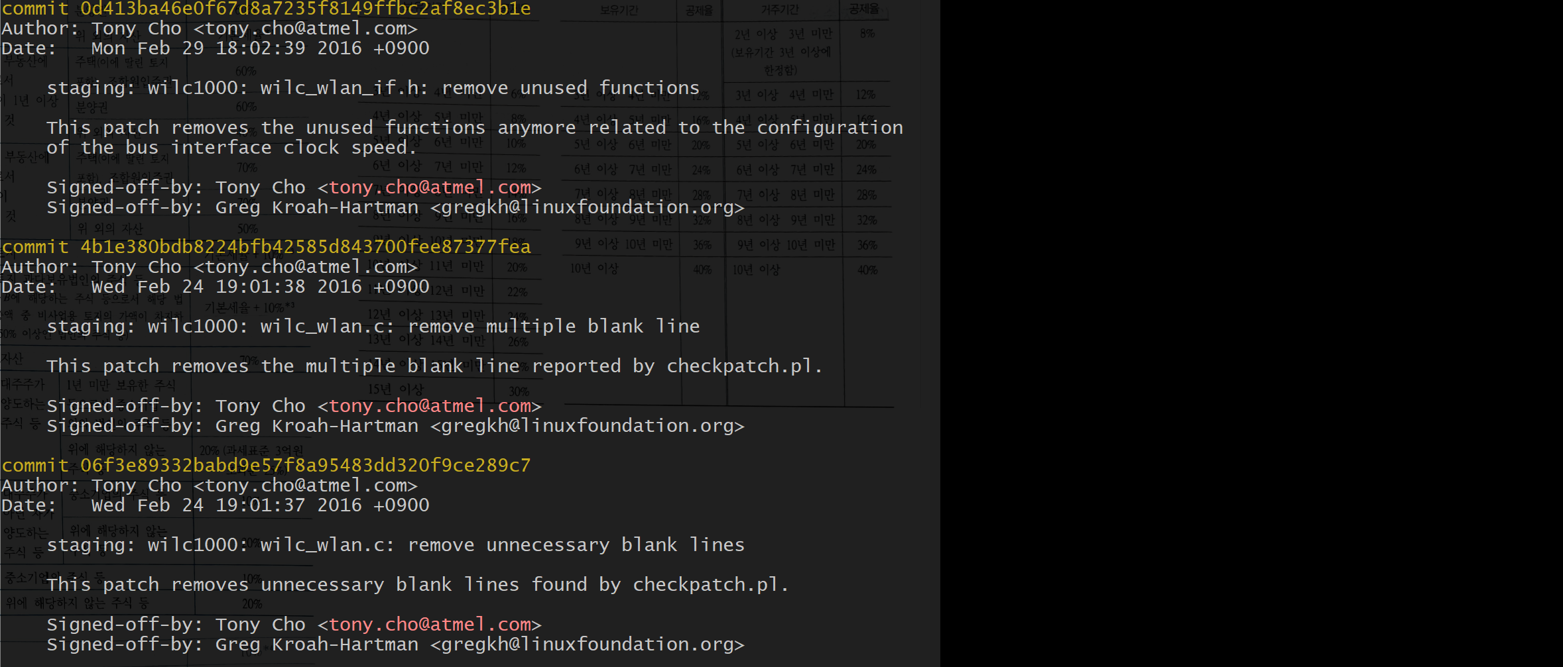
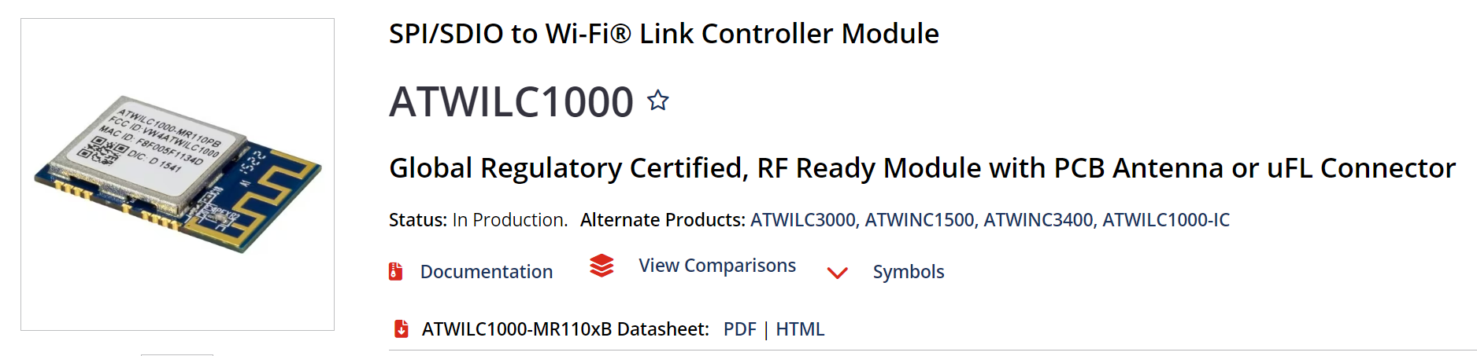
IEEE802.11 Linux kernel maintainer
I have also engaged as Linux kernel maintainer of IEEE802.11 for the Atmel chipsets (acquired by Microchip in 2016)

Slide 6
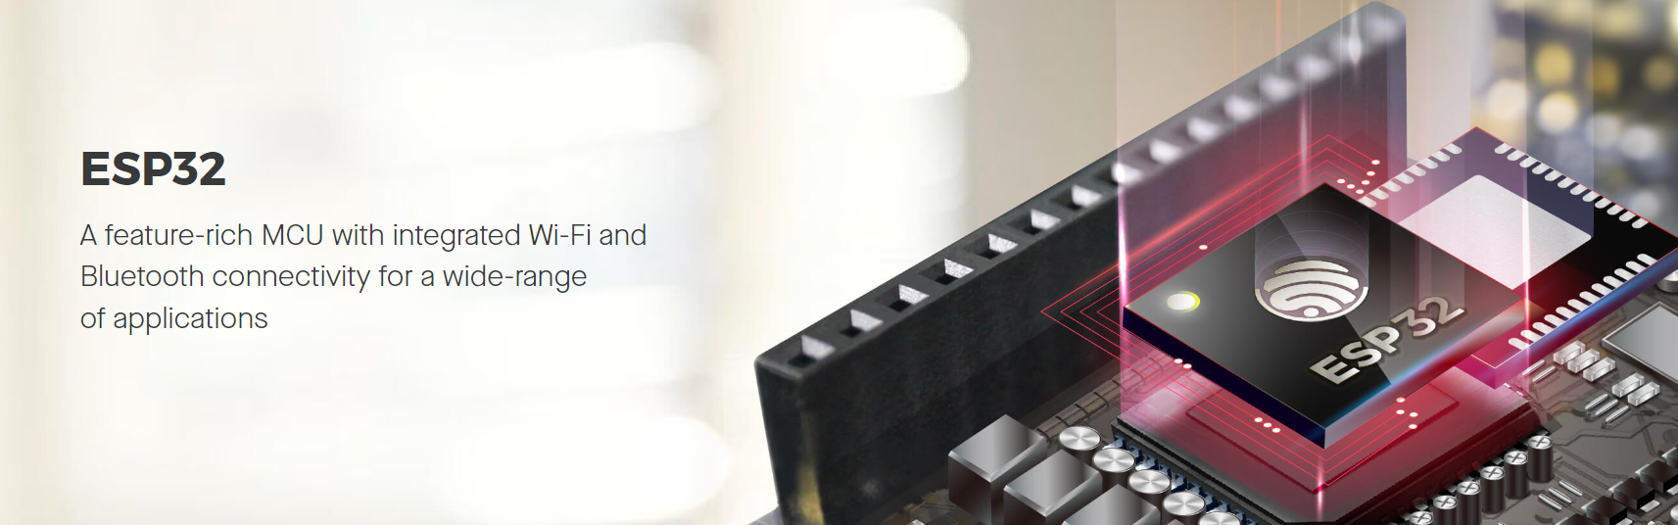
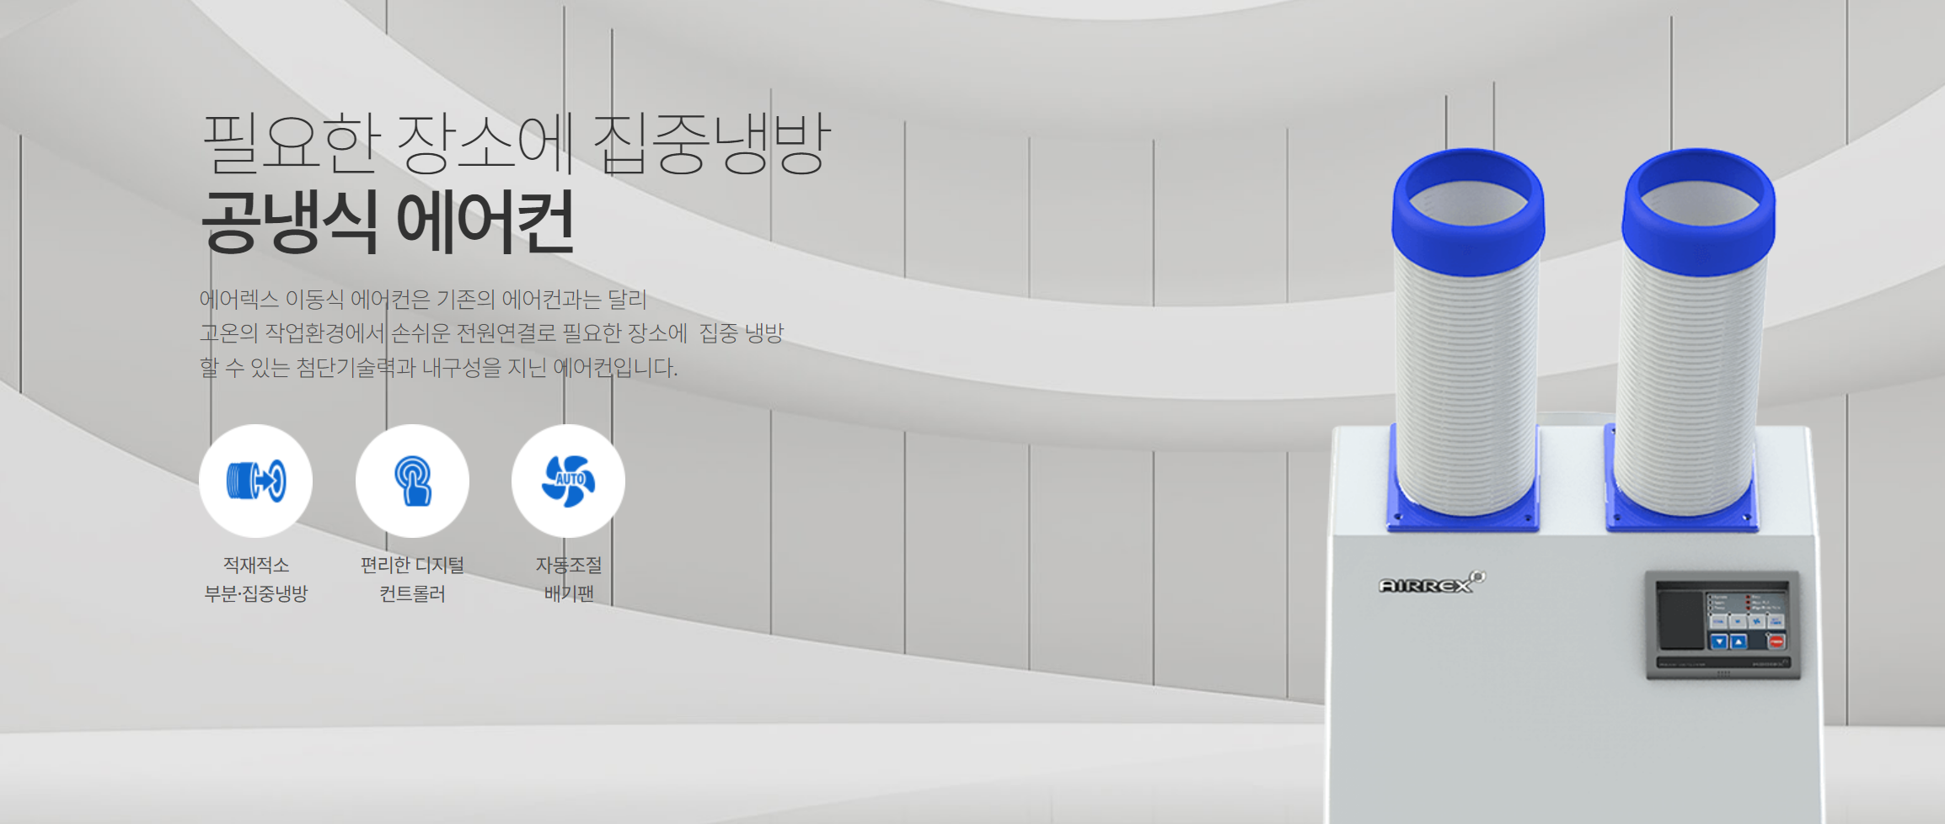
Understanding 802.11/BLE technology
Developed BLE device driver with Espressif ESP32 combo chipset to control HVAC system

Slide 7



My favorite tools

Slide 8
Thank You

