Slide 1
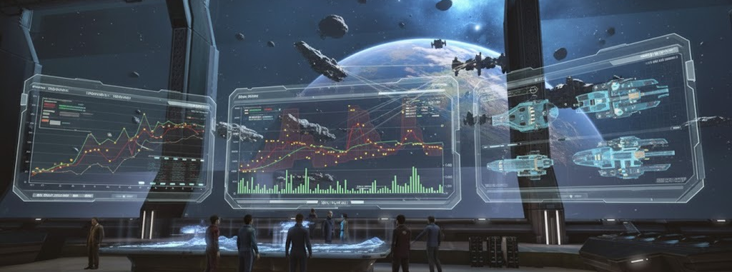
Solving Space Issues in Space
Project for the Advanced Big Data Module in CAS Machine Intelligence 2025
By Fredrik Bäckman
Code and Dataset: https://github.com/backmanai/market_data_compression
[Image Source: Gemini AI]

Slide 2

Data Context:
Eve Online – a massive multiplayer online game
PLAYER-DRIVEN ECONOMY
  Nearly everything manufactured, mined, and traded by players
  Complex supply chains spanning entire star systems
  Real economists study EVE's market dynamics
  In-Game currency ISK and Plex. 500M ISK <- 100Plex <- $5 (note: only one direction)
  $24+ million USD in circulating currency alone (total economy value likely $300M+ including all assets)
  (https://www.eveonline.com/news/view/monthly-economic-report-september-2025)
MASSIVE SCALE
  Single-shard universe with 7,000+ star systems
  Battles involving thousands of simultaneous players
  Largest battle (M2-XFE, 2021): 6,500+ pilots, losses valued at ~$378,000 USD
LONGEVITY
  Launched May 2003 (20+ years running)
  Continuous updates and expansions
[Image Source: www.eveonline.com

Slide 3
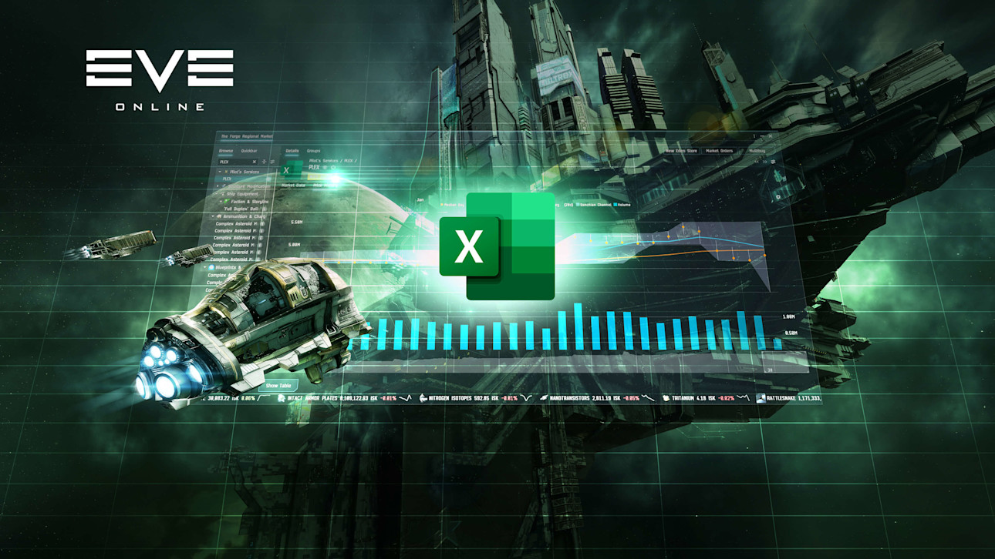
Data Context:
Eve Online – spreadsheets in space
INDUSTRY & ECONOMY COMPLEXITY
  Production Chain Tiers:
    Multi-tier manufacturing: Production chains can go 5+ levels deep
    Raw materials (ores, gases, planetary resources)
    Processed materials (minerals, P1 planetary commodities)
    Intermediate components (P2, P3 planetary commodities)
    Advanced components (P4, moon reaction products, T2 components)
    Final products (ships, modules, ammunition)
  Material Sources:
    Mining: 16+ ore types producing various minerals
    Moon Mining: Raw moon materials → Processed materials → Complex materials
    Planetary Industry: 4-tier system (P0→P1→P2→P3→P4)
    Gas Harvesting: Multiple gas types for booster and T3 production
    Reactions: Combining materials to create advanced components
  Manufacturing Types:
    Tech 1: Simpler production using mainly minerals
    Tech 2: Requires invention process + moon materials + planetary materials + T1 base items
    Tech 3: Requires wormhole materials + complex reactions
    Capital ships: Require components from multiple production chains
    Supercapitals: Multi-month build times with dozens of component types (multi-year blueprint research!)
  Data Accessibility
    Static Data Export (SDE): Complete game database dumps
    ESI API: RESTful API for real-time character, market, and universe data
    Excel: Official Excel plugin available
[Image Source: www.eveonline.com

Slide 4

Data Context:
Eve Online – real world headlines
Bloodbath of B-R5RB (2014)
  Biggest battle in gaming history, $300,000+ in losses
    https://www.eveonline.com/news/view/the-bloodbath-of-b-r5rb
    https://www.bbc.com/news/technology-25944837
    https://en.wikipedia.org/wiki/Battle_of_B-R5RB
Guiding Hand Social Club Heist (2005)
  Player spent 10+ months social engineering and climbing ranks in a coporation.
  $16’000 stolen
    https://www.pcgamer.com/murder-incorporated-ten-months-of-deception-for-one-kill-in-eve-online/
    https://www.guinnessworldrecords.com/world-records/88183-most-hostile-corporate-takeover-in-eve-online
Academic papers
  EVE Online is not for Everyone: Exceptionalism in Online Gaming Cultures
    https://minds.wisconsin.edu/bitstream/handle/1793/79143/11460%20OshScholar18%20Smith.pdf?sequence=1&isAllowed=y
  EVE: Online as a Potential Microeconomic Model
    https://www.researchgate.net/publication/337645762_EVE_Online_is_not_for_Everyone_Exceptionalism_in_Online_Gaming_Cultures
  Minerals, Titans, and Connections: The Political Economy of Empire in the World of EVE Online
    https://www.cambridge.org/core/books/abs/invisible-hand-in-virtual-worlds/minerals-titans-and-connections-the-political-economy-of-empire-in-the-world-of-eve-online/D35784F90EF7098ACD4E8582F6F77920
  …
[Image Source: www.eveonline.com

Slide 5
Business Goal
Understanding market prices and real trading volumes is key to industrial production planning and market trading.
The game does not publish the buy and sell volume and prices directly.
The games does publish the currently open orders through a REST API.
Purpose:
  Capture the order book snapshots and store the data for further analysis
  Extract market insights

Slide 6
Data Source
API: List orders in a region
  https://developers.eveonline.com/api-explorer#/operations/GetMarketsRegionIdOrders
https://esi.evetech.net/markets/{region_id}/orders
region_id: 10000002 (The Forge – most active trade region)
current snapshot is cached for 5 minutes

Slide 7
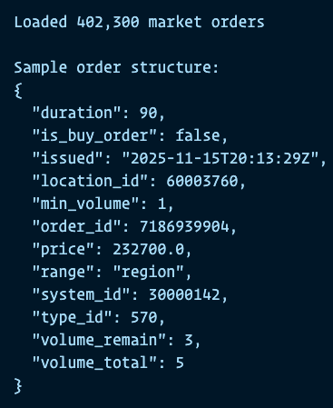

Technical Challenge
Problem:
  The market order api returns about 400k open orders for this region.
  The raw json output is huge (120MB)
Solution:
  Compression

Slide 8
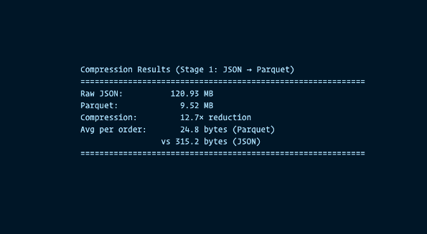
Stage 1:
JSON to Parquet
1. Dictionary Encoding:
Replaces repeated values with small integer references
Example: If the region_id appears 400k times, store it once + 400k tiny references
Extremely effective for fields with limited unique values (type IDs, locations, buy/sell flags)
2. Snappy Compression:
Fast, general-purpose compression algorithm by google, applied after encoding
Prioritizes speed over maximum compression (still achieves 2-4× reduction)
Unlike gzip/zstd, optimized for decompression speed in analytics workloads
3. Type Efficiency:
Binary encoding vs. text representation
Example: The number `123456789`
  9 bytes in JSON (ASCII) 4 bytes in Parquet (32-bit integer)
Timestamps, floats, booleans all stored in compact binary form

Slide 9

Better but not enough…
288 snapshots per day at 9.5MB still results in 2.7GB data per day.
Options A) limit the order book history.
Options B) sign up for a cloud storage and help Jeff become a trillionaire.
Option C) compress further
I choose option C.
[Image Source: gemini AI

Slide 10
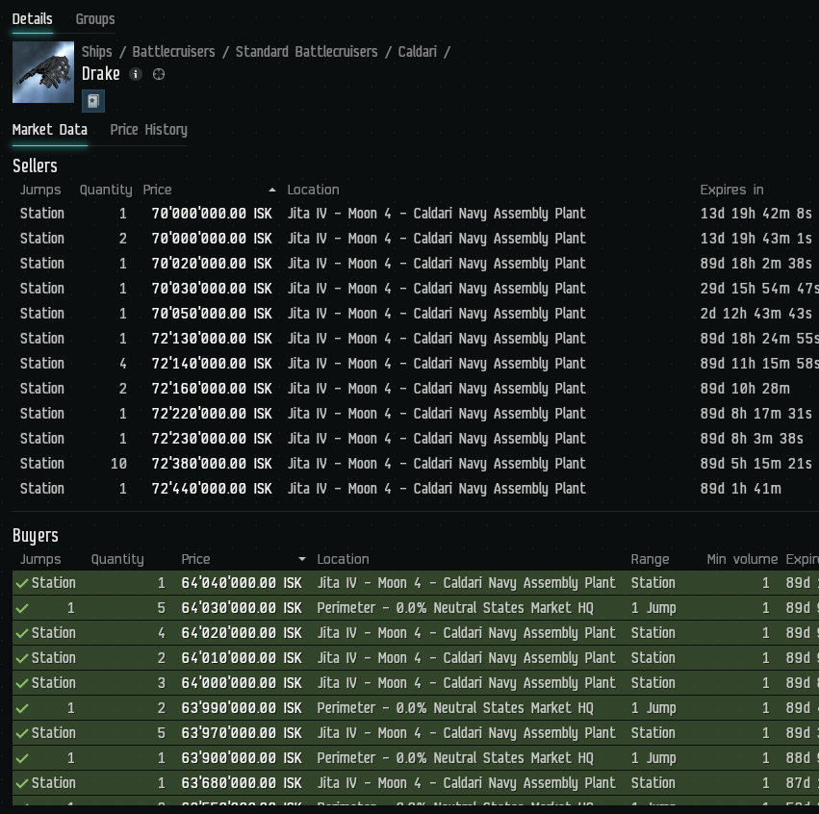
Most orders don’t change
Within a 5-minute interval, most orders remain unchanged.
Trading happens on the best priced sell and buy orders.
Occasionally a trader may update the order price stay competitive.
Occasionally orders expire or are cancelled by the trader.
[Image Source: www.eveonline.com

Slide 11
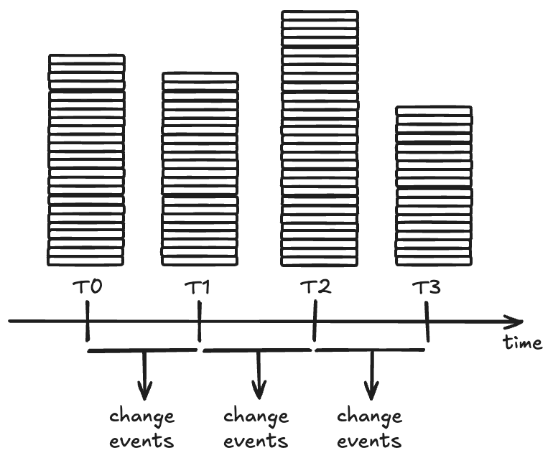
Capture changes
Apply the “event sourcing” pattern.
Event sourcing persists the state of a business entity such as an order as a sequence of state-changing events.
https://martinfowler.com/eaaDev/EventSourcing.html

Slide 12
Change Event Types
Event Type | Trigger
TRADE | Volume reduced
ORDER_OPENED | New order appeared
ORDER_CLOSED | Order disappeared with volume=0
ORDER_CANCELLED | Order disappeared with volume>0, not expired
PRICE_CHANGED | Price modified
ORDER_EXPIRED | Natural expiration time reached
The first snapshot which is processed will establish the baseline by initializing each order as “order_opened” event.

Slide 13
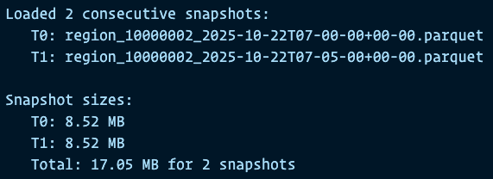
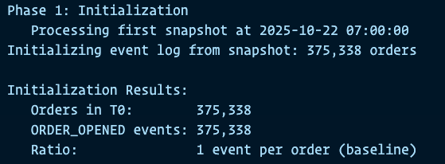
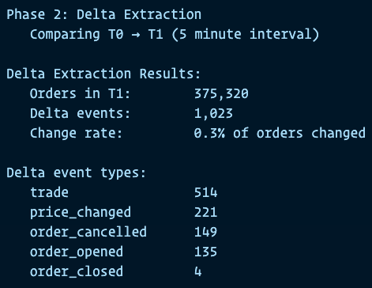
Processing one interval

Slide 14
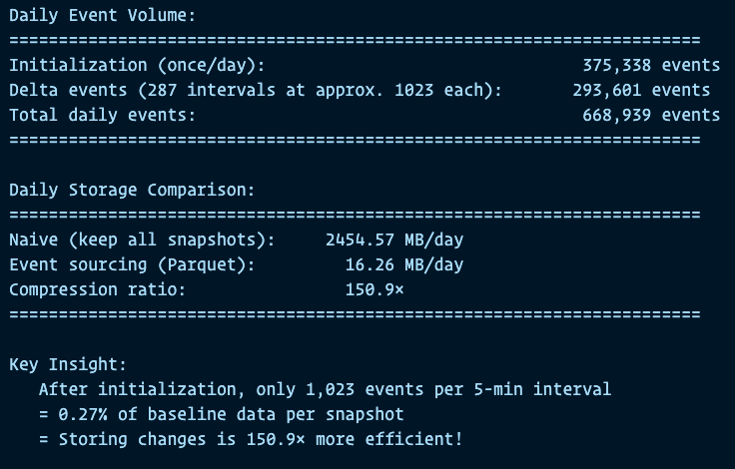
Extrapolate to one day data volume

Slide 15
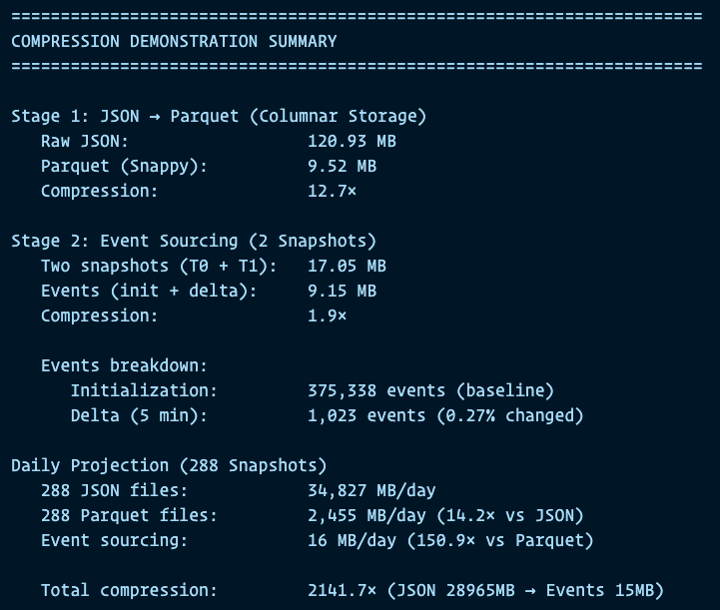
Conclusion

