Slide 1
Final Project BDA

Slide 2
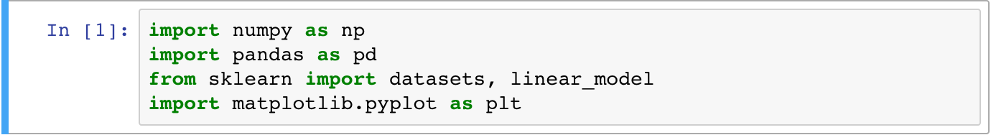
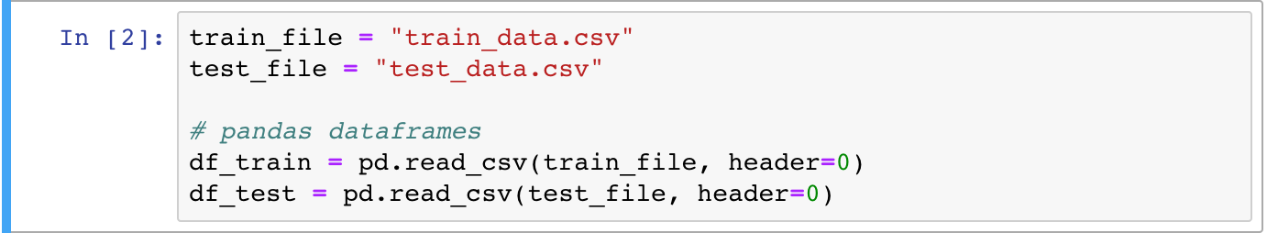
Data Preparation
First thing we need to do is get Python to read our data
Using pandas to grab the data from the cvs files and place them into the pandas dataframes

Slide 3
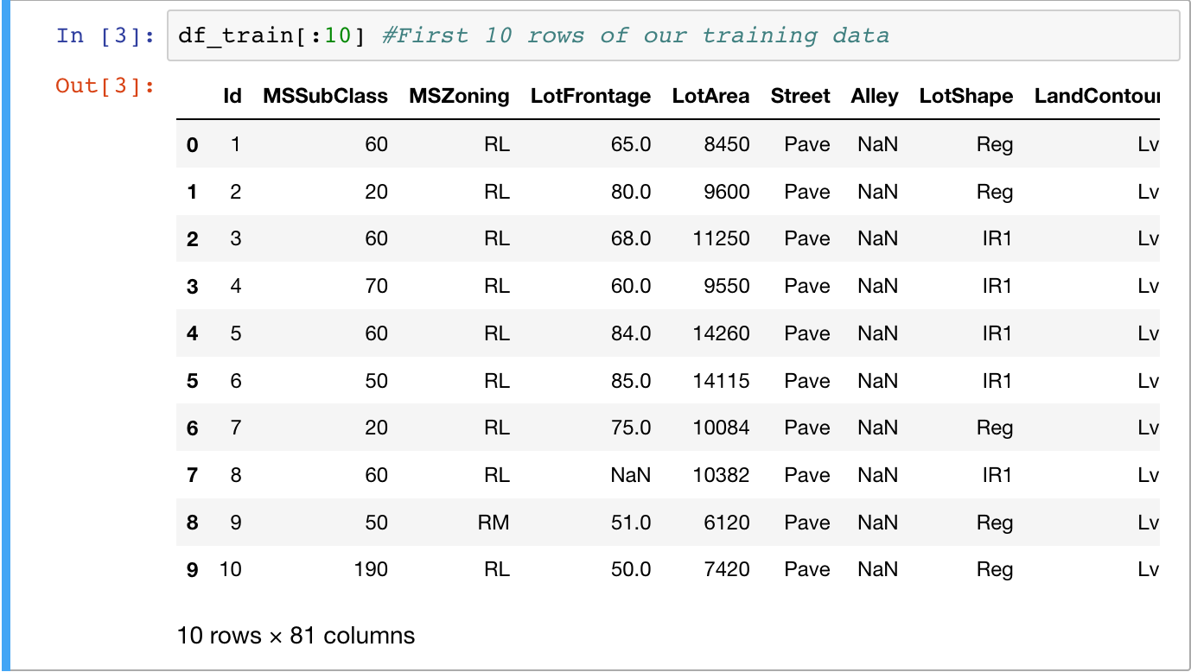
Data Preparation
An example of a pandas dataframe structure

Slide 4
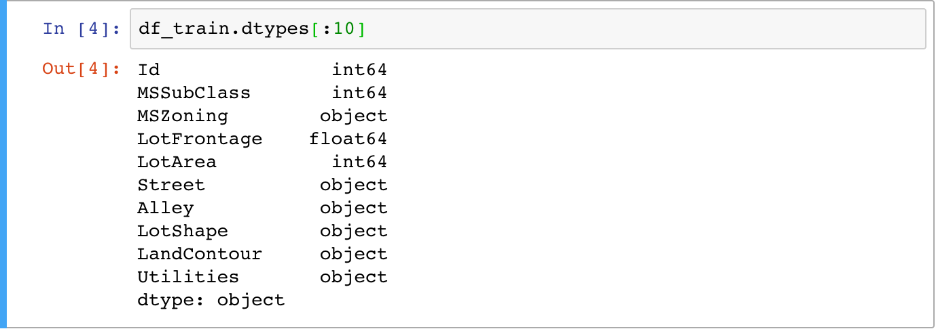
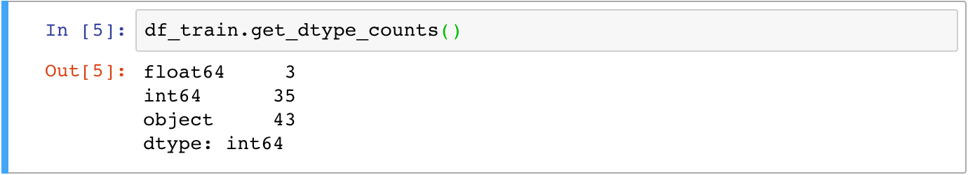
Data Preparation
Displaying datatypes will help split the data into quantitative and categorical parameters

Slide 5
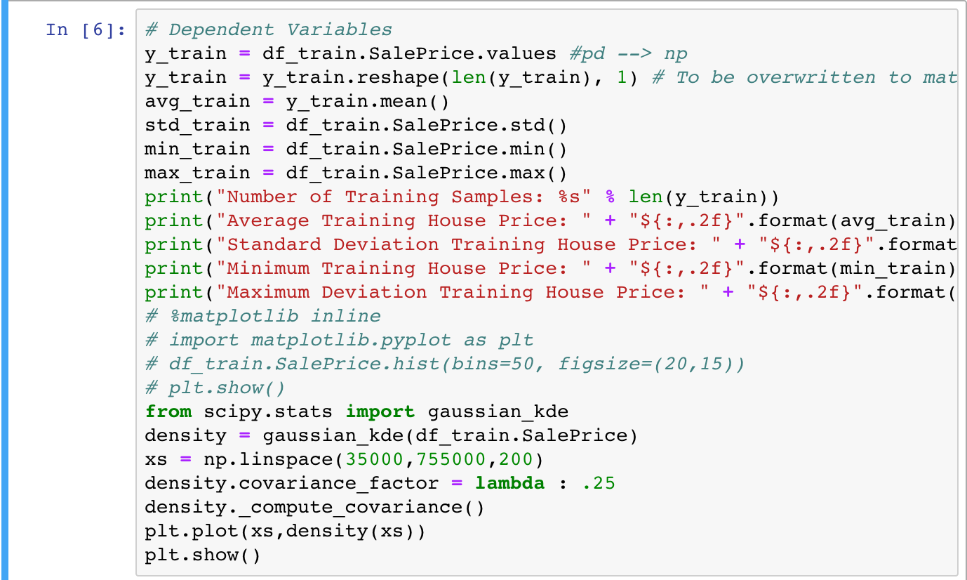
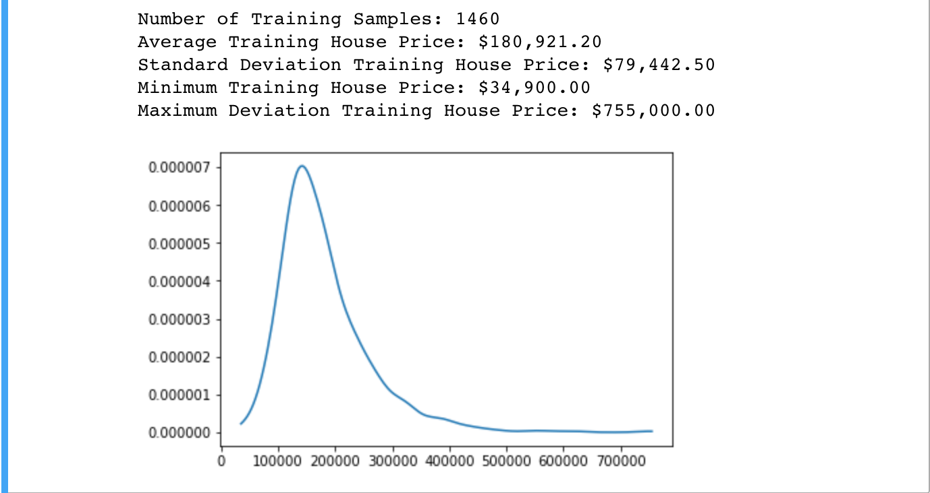
A Quick Look at the Target Variable
Our main objective is predicting housing price
Average, standard deviation, minimum and maximum give an insight into how Sale Price is distributed
The density curve shows actual distribution

Slide 6
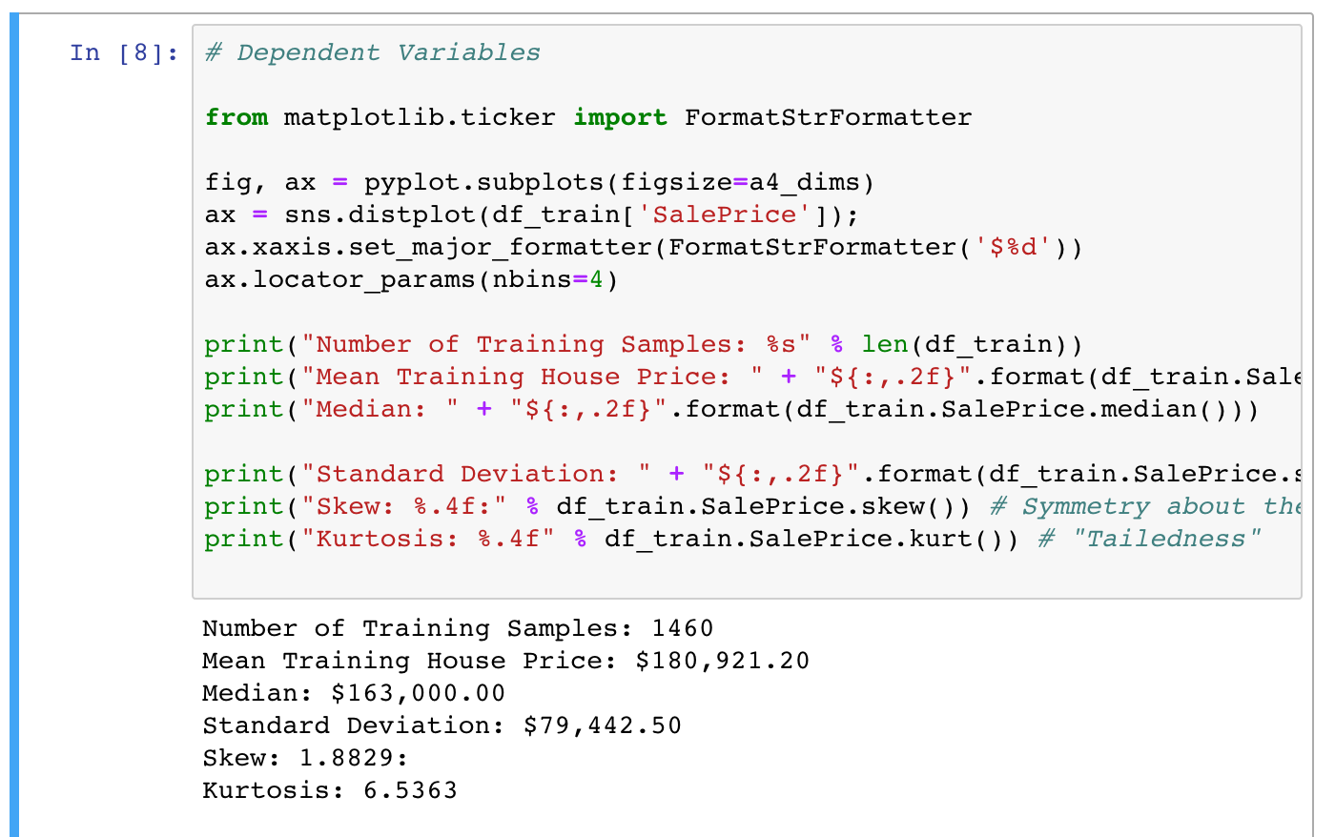
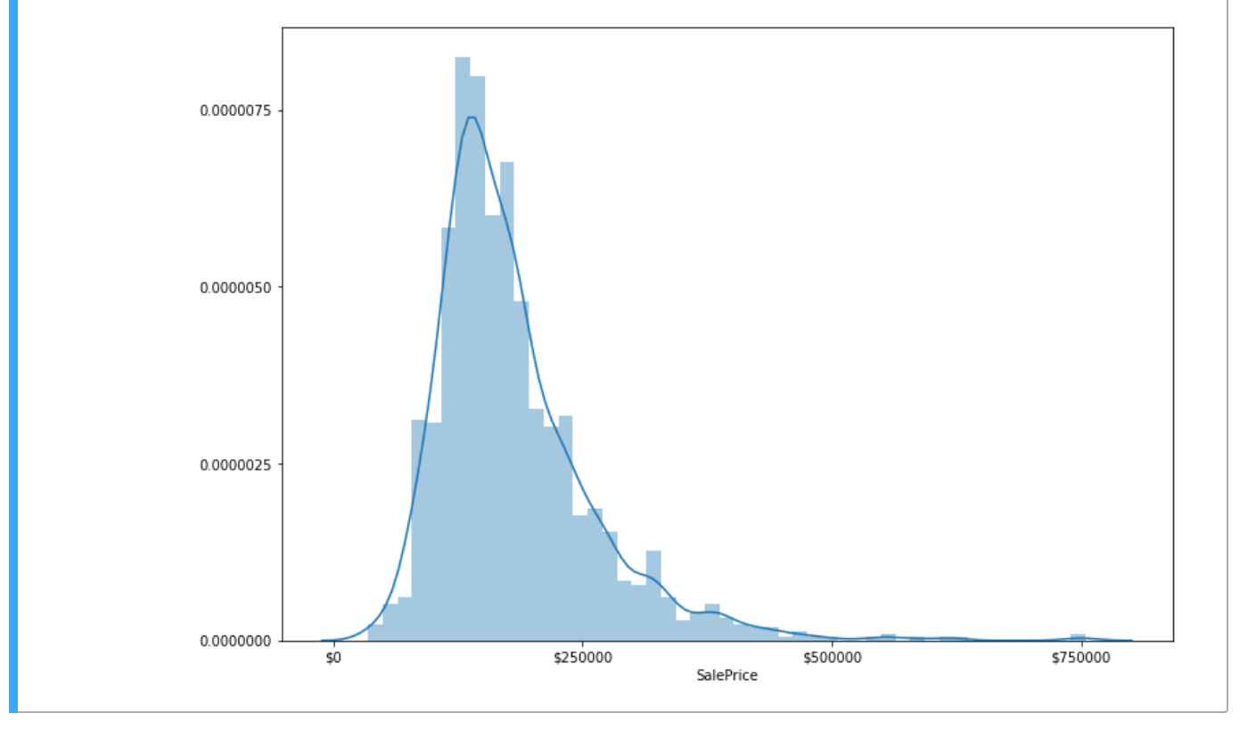
A Quick Look at the Target Response
Alternate slide

Slide 7
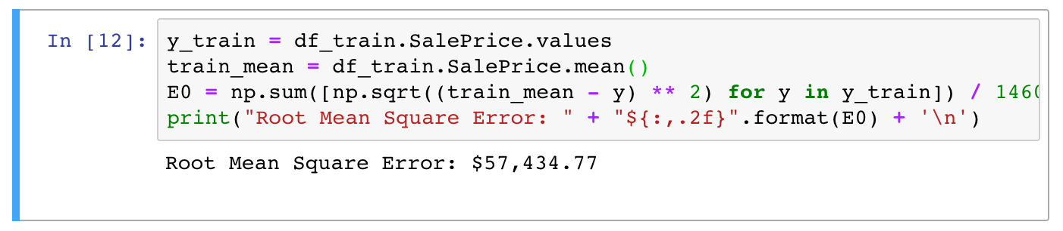

A Quick Look at Target Variable
Using the error function $E_{0}=\frac{1}{2}\sum_{i=1}^{1459}{{\left(y^{i}−\overline{y}\right)}^{2}}$ to give error just based on using mean as the predictor
Then using Mean Absolute Error Function:
$E_{0}=\frac{1}{1460}\sqrt{\sum_{i=0}^{1459}{{\left(y^{i}−\overline{y}\right)}^{2}}}$

Slide 8
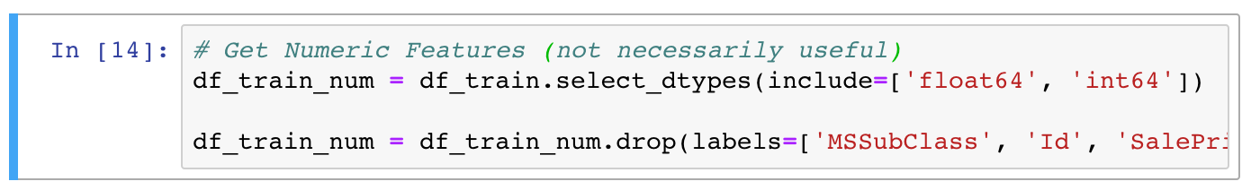
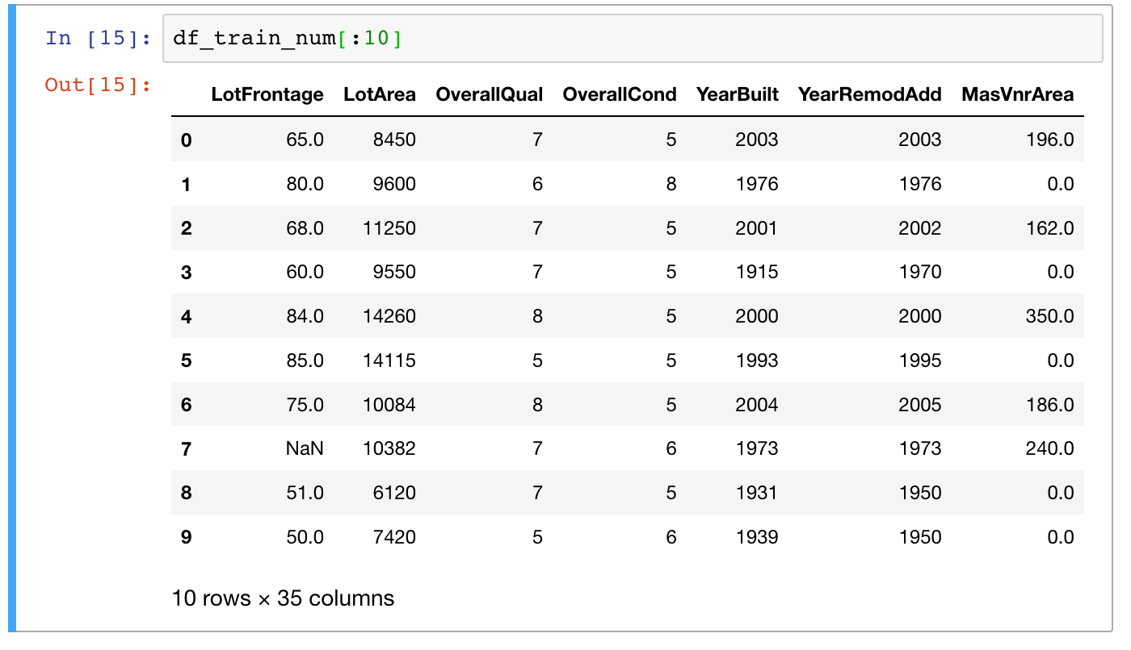
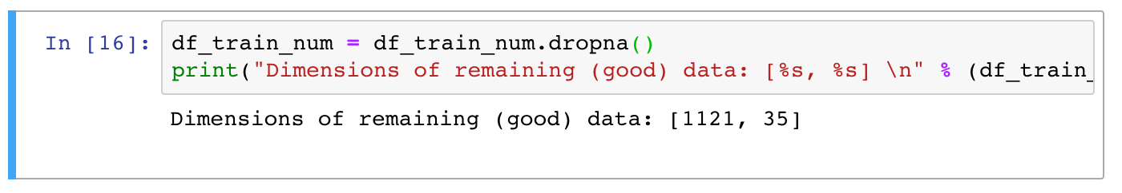
Data Cleaning
With over 80 parameters there is an overabundance of parameters
Because of this we can focus on only the quantitative parameters
We achieve this by only including ‘float64’ and ‘int64’
Also removed any subjects with NaN values

Slide 9
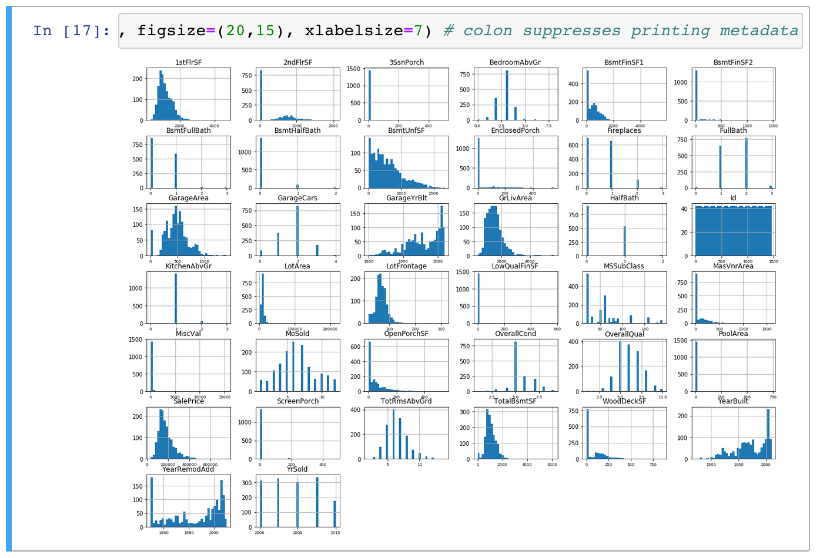
Data Exploration
After removals, our reduced model has 35 parameters
Here are the histograms of each parameter, showing distribution

Slide 10
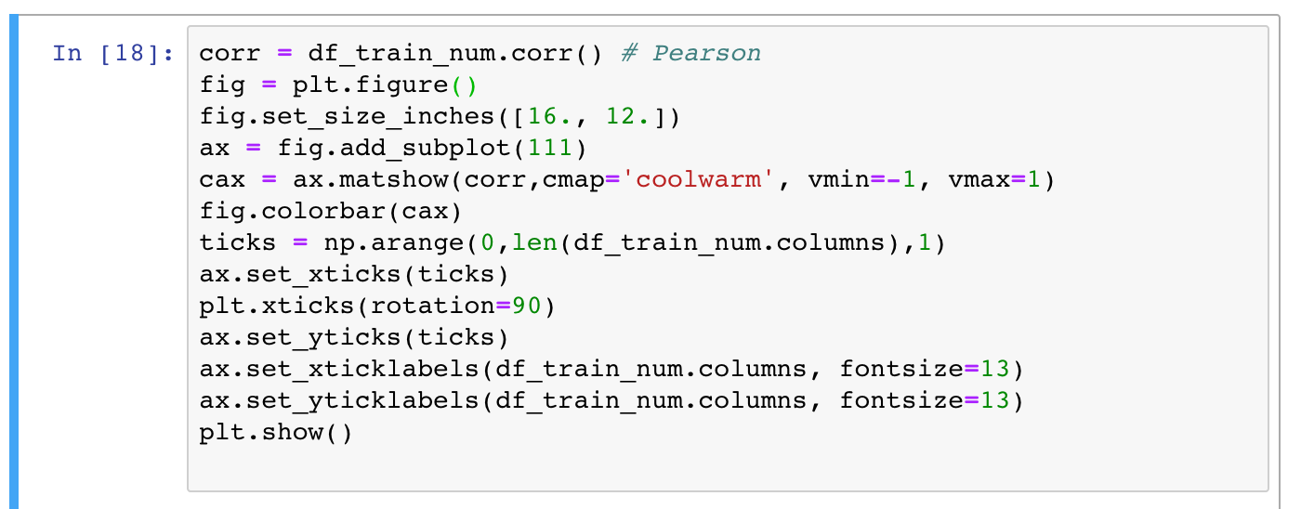
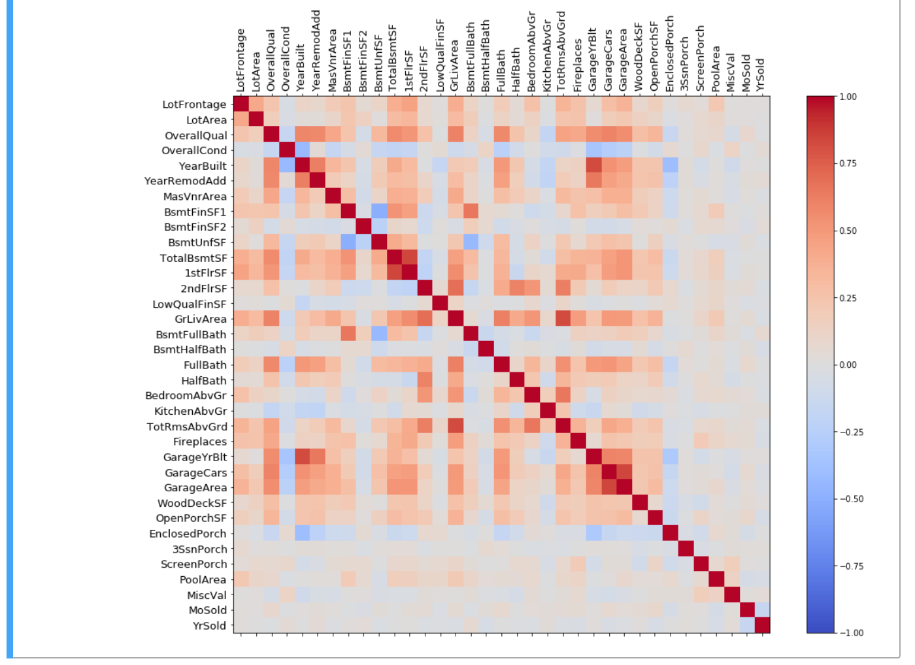
Data Exploration
Now, we take a look at the correlation between each parameter
Correlation allows us to see which parameters are redundant and save us from overparameterizing the model
Symmetric matrix with 1’s across the diameter is expected

Slide 11
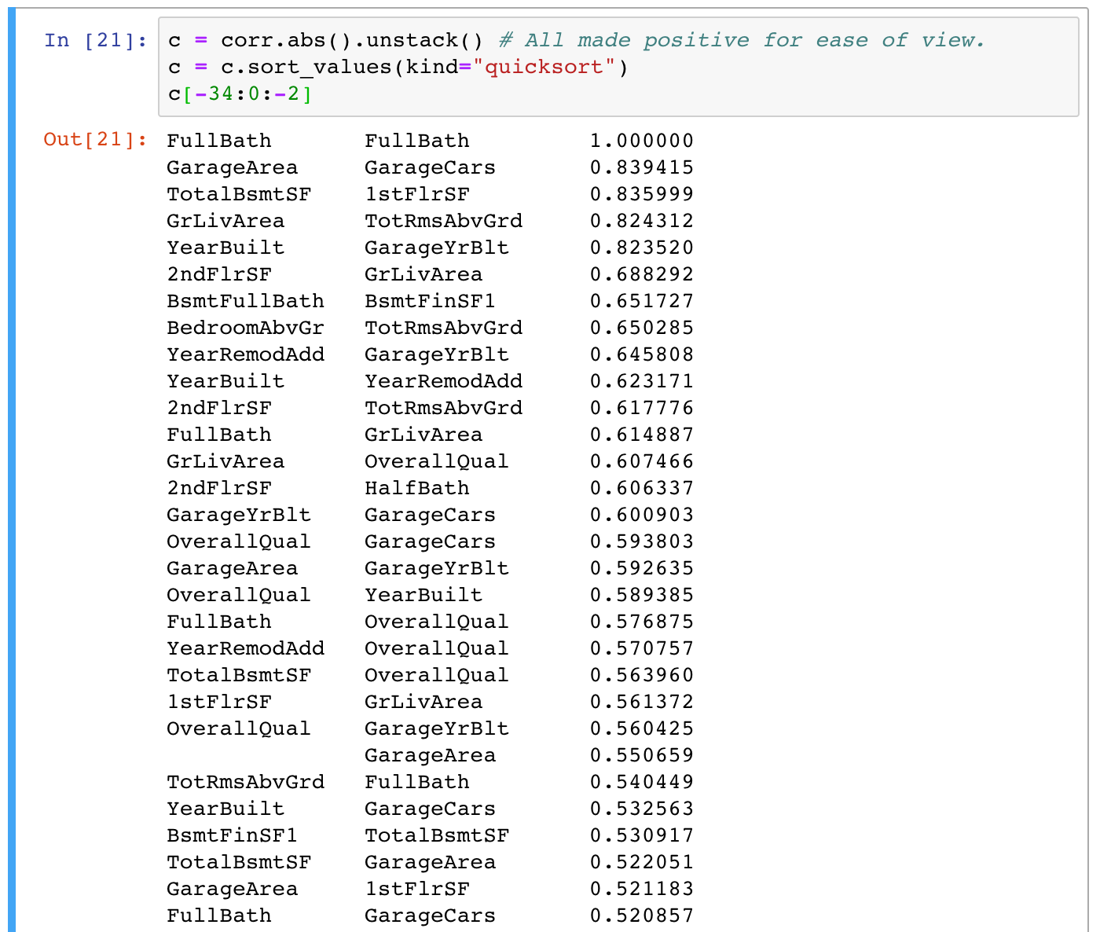
Data Exploration
Taking a closer look correlation
A high correlation shows pairs that would cause the model to be over parameterized

Slide 12
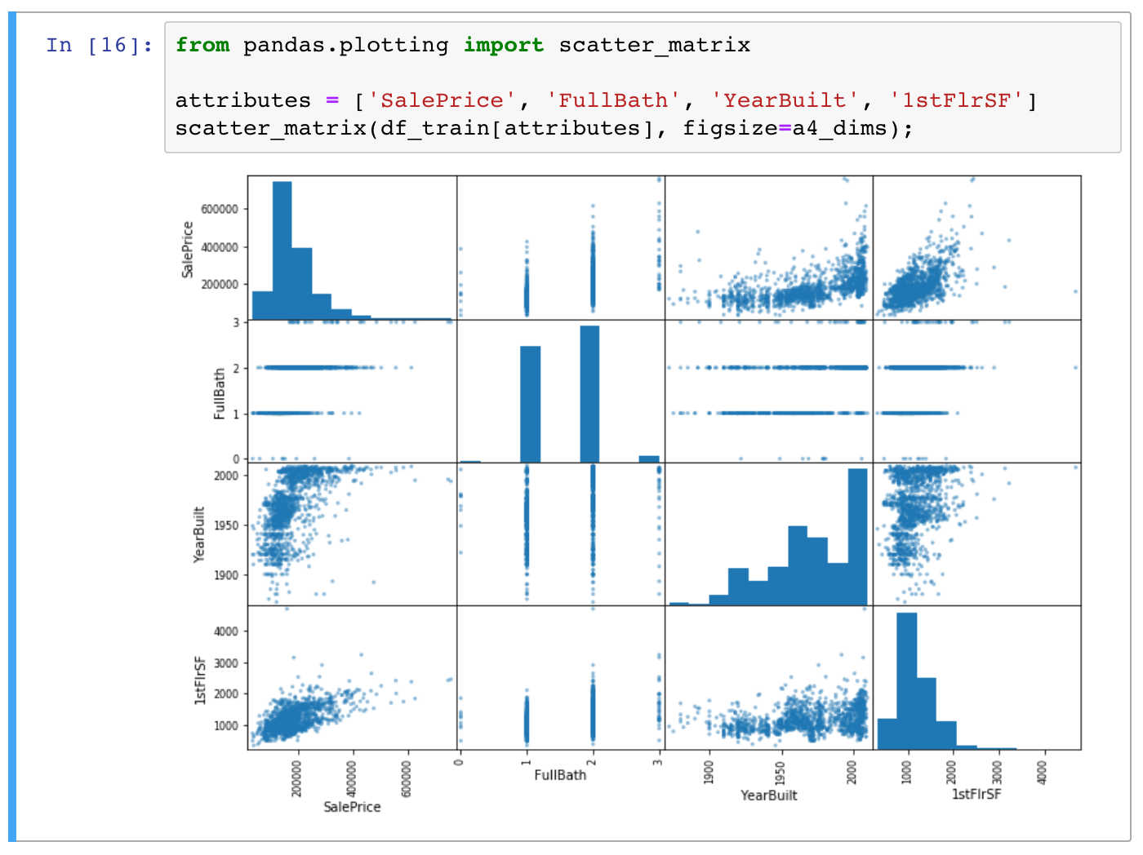
Data Exploration
Taking a few parameters and plotting them with respect to each other and SalePrice

Slide 13
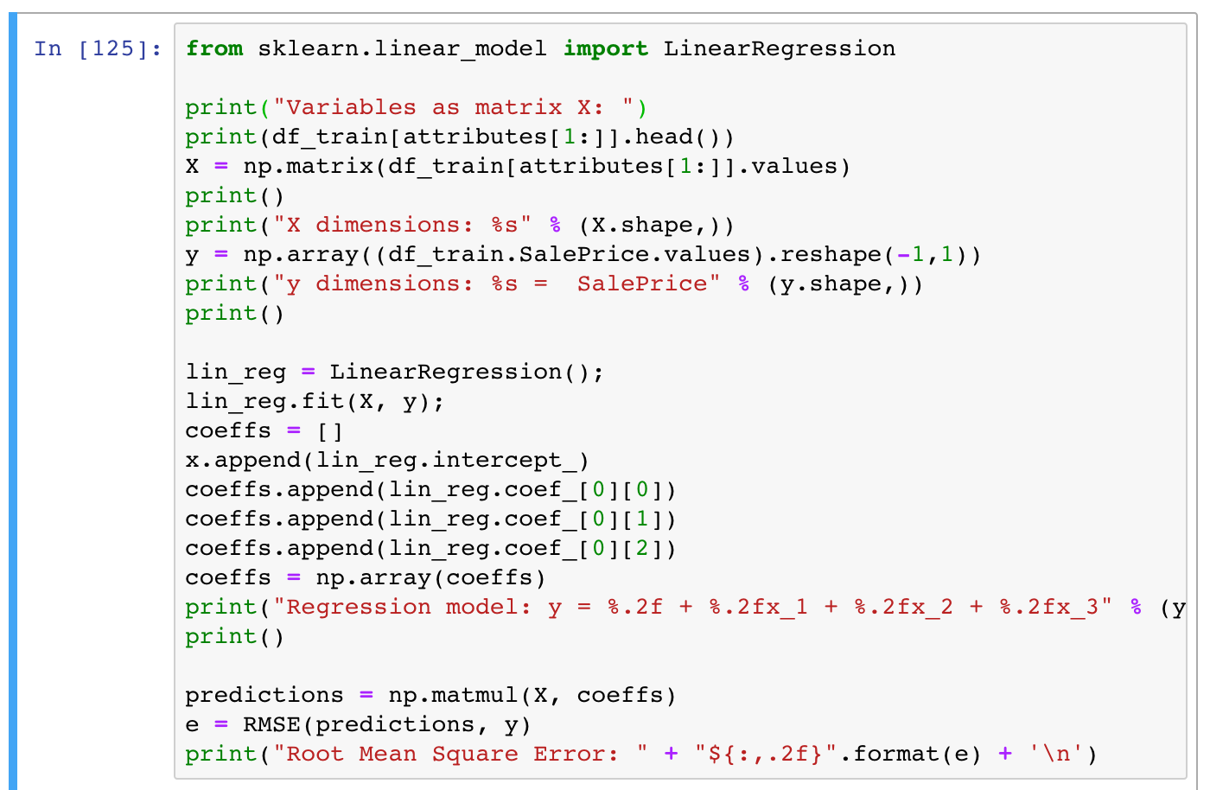
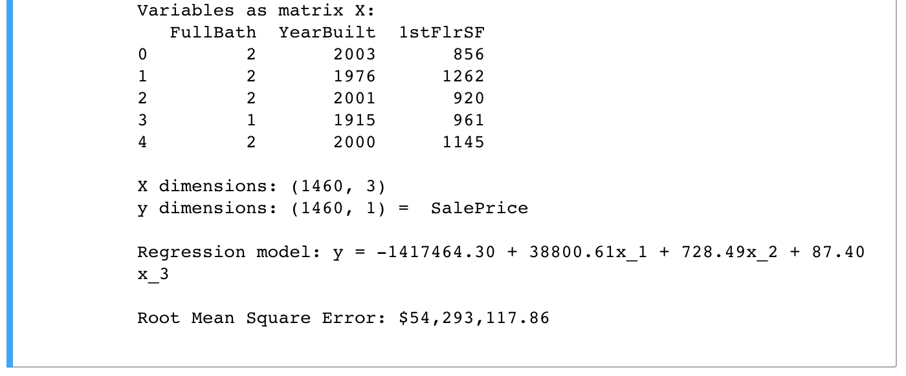
First Shot at Regression
Now that we’ve analyzed our data and removed parameters that don’t help us, we put together our first regression
This model reduces our Root Mean Square Error to $54,293,117.86

