Slide 1
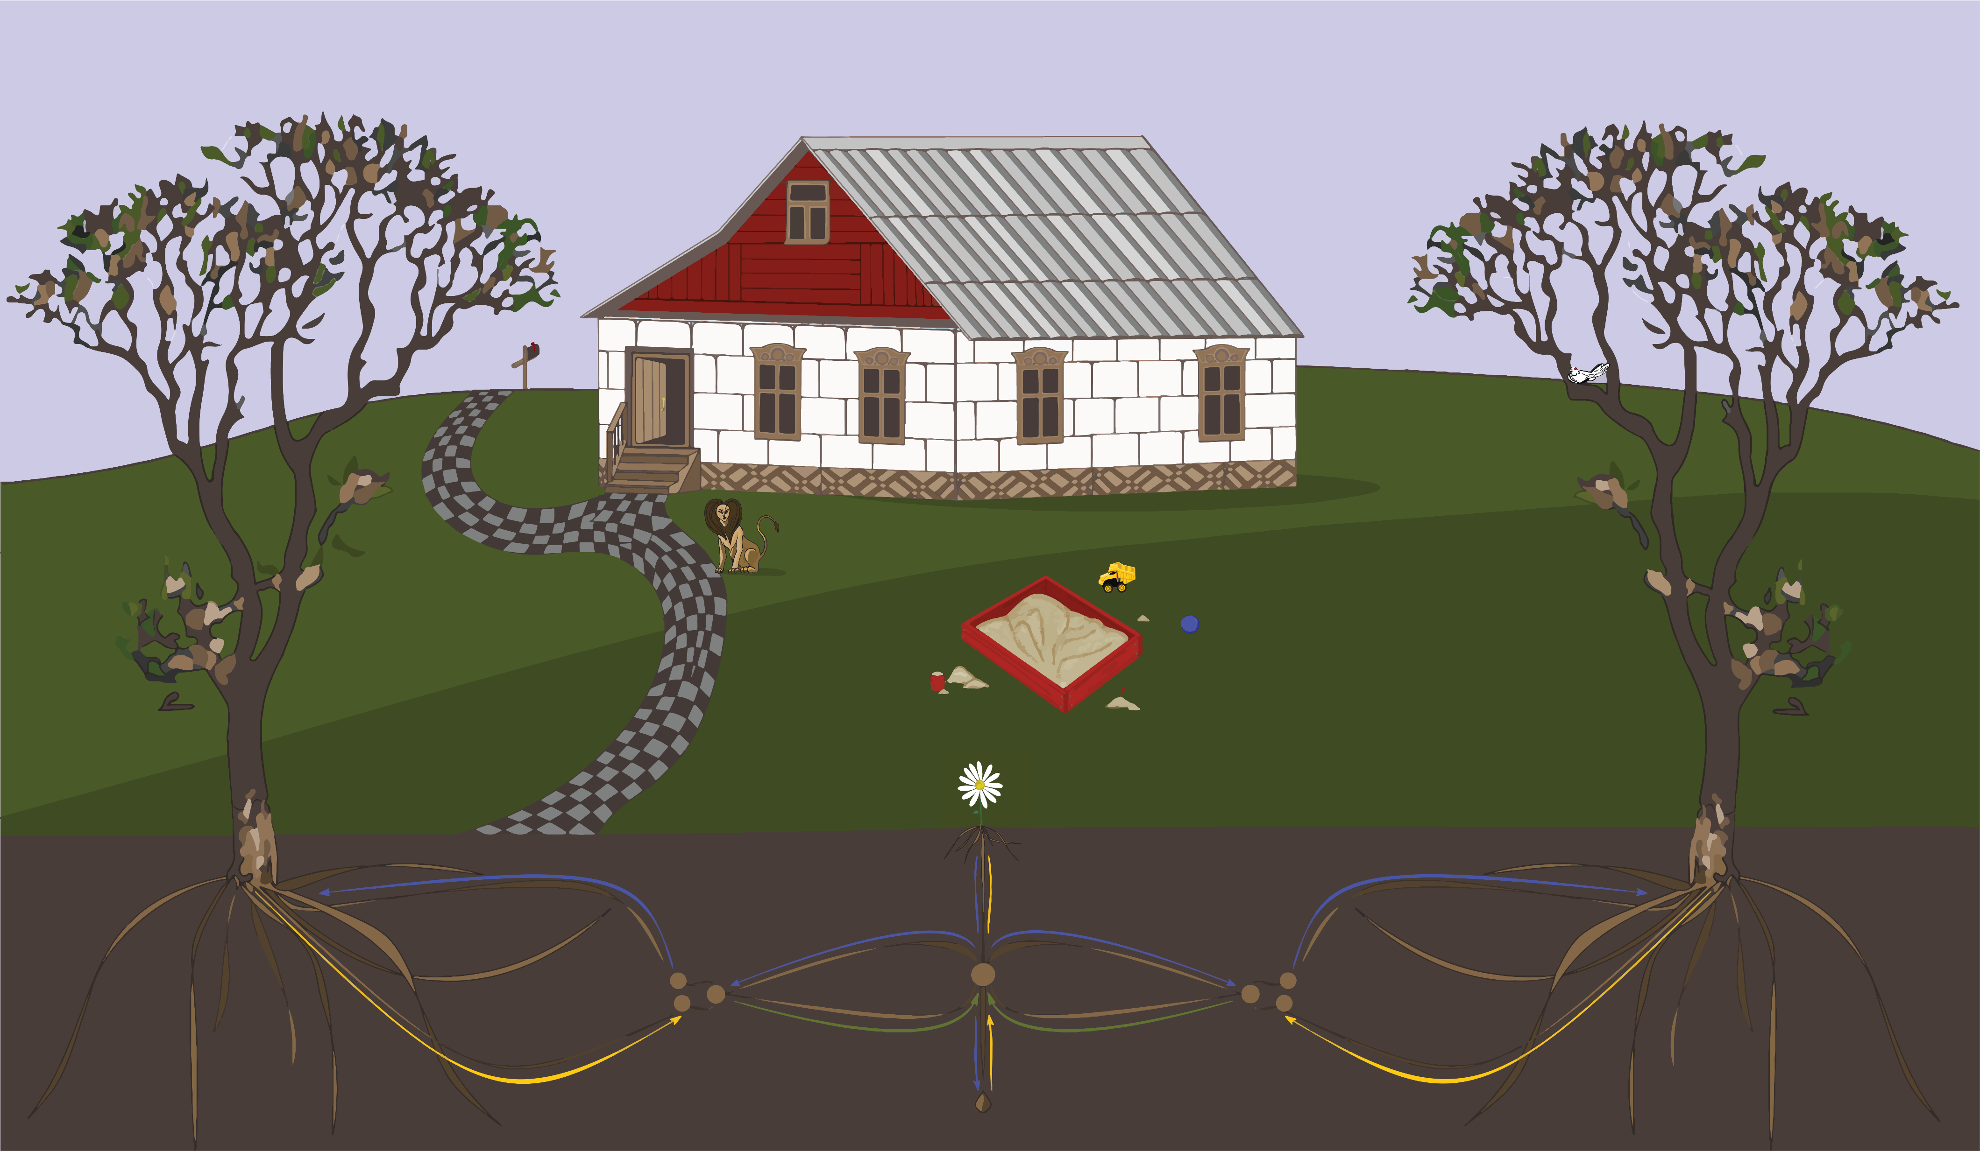
{ The MUDDLE Backyard }
DHCS 2018 – Loyola University Chicago
© Taylor Brown & Rebecca Parker

