Slide 1

Present Where You Need Us
Our customer support
Stavanger/Stord Eik/Oslo
Rotterdam
Hamburg
Bratislava
Aussaguel
Palma
Athens
Houston
Tokyo
Dubai
Manila
NOC Maritime / Enterprise
Singapore
MNOC, IT and MSS
Regional Customer Support
Competence Center for IT, VAS, MSS
Service Management
Rio de Janeiro
Security Operations Center
Tier 1 Support for Petrobas
Notes:
Failure handling, after-sales service, service system, and availability of remote service

Slide 2

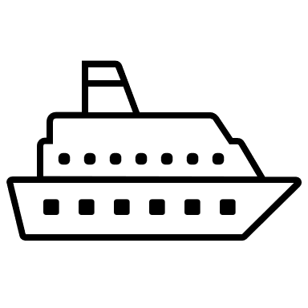
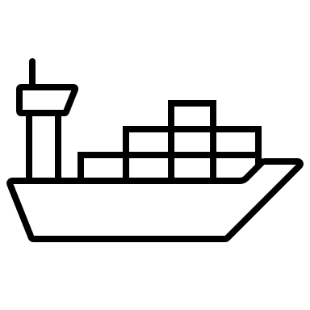
Regional Customer Support
Competence Center
Digital Solutions 3rd Line
Connectivity 3rd Line
Beyond a single point of contact
First level resolution
Incident ownership
Know your vessels
Network configuration and IT policies
Closer to your team
Regular review
MSS (Inmarsat/
Iridium)
IT Solutions
Network Operation Centers
RCS / Tech Support
– Singapore, Tokyo, Dubai, Houston, Bratislava, Athens
Customers
Notes:
2nd lines are available in our Asia time zone

Slide 3
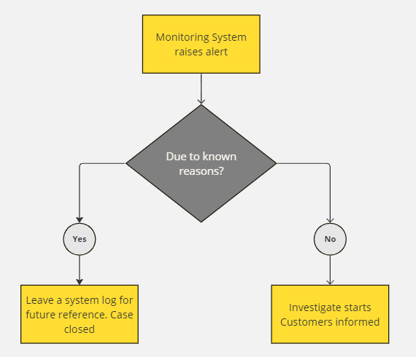
Proactive Monitoring
Alerts are raised when system is in abnormal status for more than one hour
Known reasons:
VSAT is prohibited in India
Starlink does not work in China
Vessel blockage
Weather condition

Slide 4
Rectification Process
Ticket 1466838
4th March: VSAT reported offline. Workaround applied remotely through FBB backup link. VSAT came online
Case transferred to 2nd line
5th March: Confirmed hardware failure with antenna manufacturer
6th March: Started the spare part shipment arrangement
Utilize backup link, with minimum crew involvement
Cases are followed up 24x7
Notes:
2nd lines are available in our Asia time zone

