Slide 1
Biomedical Image Enhancement using Hybrid Techniques
Presented by:
Anem GnanaGanesh
Chinthamani Manoj Ram Sai
Annam Yogitha
Contact:
backpropbrigade@gmail.com

Slide 2
Contents
Introduction
Problem Statement
FBP Metrics
Preprocessing in Sinogram Domain
Post Processing in Image Domain
TV Regularization Method
Learned Primal Dual Method
Progress
Timeline

Slide 3
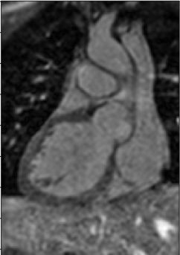
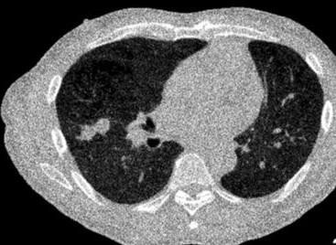
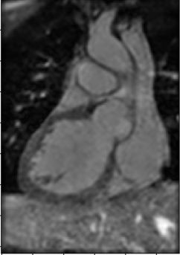
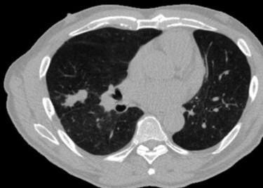
Problem statement
Why Image Enhancement is critical?
Noisy MRI
Noisy CT
Why Hybrid Techniques?
Clean MRI
Clean CT

Slide 4
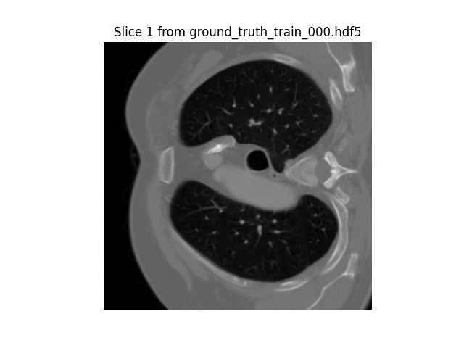
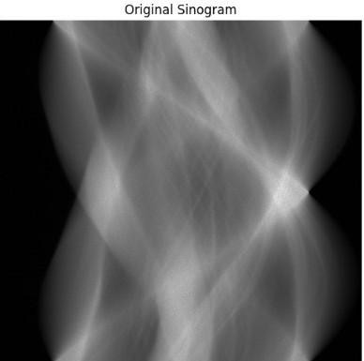
LoDoPaB - CT : Benchmark dataset for Low Dose reconstruction
Lodopab-CT
┌─────────┴────────┐
Characteristics:
Ground Truth
┌────┼────┐ Train Validation Test
Observation (Sinogram)
┌────┼────┐
Designed for evaluating reconstruction methods in low-dose settings.
Provides a standard benchmark for comparing deep learning classical methods.
~40,000 slices from 812 patients (LIDC/IDRI database).
Simulated low-dose parallel-beam CT.
Corrupted with Poisson noise → mimics real low-photo measurements.
Resolution: 362 × 362 px cropped thoracic CT slices.
Projections: 1000 angles × 513 detector pixels per slice.
Train Validation Test
&
n
Y-axis: Projection angles (degrees)
X-axis: Detector index (pixels)

Slide 5
Mean metrics for test set (different filters) - FBP reconstruction
Filter(Frequency scaling) | PSNR | SSIM
Hann_0.641 | 30.516 + 3.097 | 0.7372 + 0.1467
Hann_0.8 | 30.445 + 3.373 | 0.7088 + 0.1563
Hann_1.0 | 29.799 + 3.629 | 0.6626 + 0.1685
Hamming_1.0 | 29.507 + 3.681 | 0.6464 + 0.1714
Cosine_1.0 | 28.387 + 3.879 | 0.5904 + 1800
SheppLogan_1.0 | 25.494 + 4.078 | 0.4654 + 0.1782
RamLak_1.0 | 23.880 + 4.140 | 0.4029 + 0.1688

Slide 6
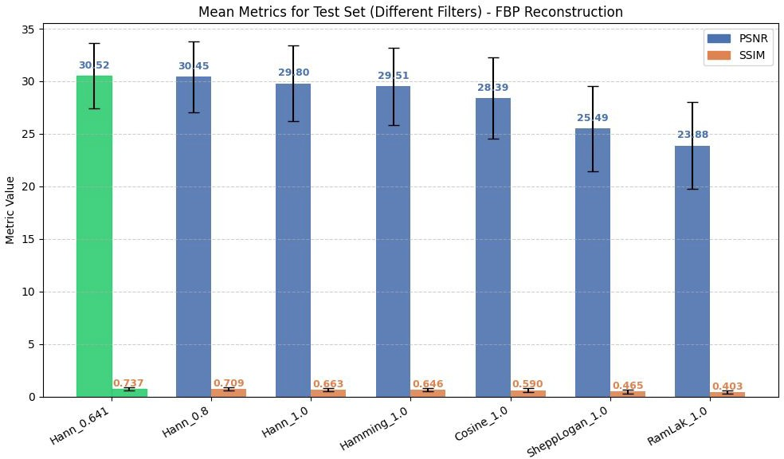
Comparison of Metrics

Slide 7
Best Mean Metrics for FBP(Hann_0.641)
Set | PSNR | SSIM
Train | 30.452 + 2.654 | 0.7415 + 0.1314
Validation | 30.752 + 2.518 | 0.7577 + 0.1231
Test | 30.516 + 3.097 | 0.7372 + 0.1467
6

Slide 8
Preprocessing with Different Filters in Sinogram Domain (Test Set Mean Metrics)
Filter | PSNR (db) | SSIM | PSNR(loss/gain) | SSIM(loss/gain) | Best Parameters
Median | 30.371 | 0.742 | -0.145 | 0.004 | kernel Size: 3
Bilateral | 30.237 | 0.745 | -0.279 | 0.007 | d: 3 sigma_color: 0.01 sigma_spatial: 10.0
Gaussian | 30.516 | 0.737 | 0 | -0.0002 | sigma: 0.1 truncate: 3.417201 filter Size: 1
Wavelet denoising | 30.527 | 0.74 | 0.011 | 0.0028 | sigma_scale: 1.1795 wavelet: bior1.3 mode: soft
TV denoising | 29.966 | 0.736 | -0.55 | -0.0012 | TV weight: 0.0010
Non Local Means | 30.516 | 0.737 | 0 | -0.0002 | h (filter strength): 0.0741 patch size: 3 Search window: 21

Slide 9
Post Processing with Different Filters in Image Domain (Test Set Mean Metrics)
Filter | PSNR (db) | SSIM | PSNR(loss/gain) | SSIM(loss/gain) | Best Parameters
Median | 30.702 | 0.753 | 0.186 | 0.0158 | kernel Size: 5
Bilateral | 31.007 | 0.755 | 0.491 | 0.0178 | d: 9 sigma_color : 0.03329 sigma_spatial: 10.0
Gaussian | 30.504 | 0.742 | -0.0012 | 0.0048 | sigma: 0.563682 truncate: 4.522496 filter Size: 7
Wavelet denoising | 30.543 | 0.739 | 0.027 | 0.0018 | sigma_scale: 3.0 wavelet: coif1 mode: soft
TV denoising | 30.761 | 0.758 | 0.245 | 0.0208 | TV weight: 0.0113
Non Local Means | 30.516 | 0.737 | 0 | -0.0002 | h (filter strength): 0.5 patch size: 3 Search window: 21

Slide 10
Why CT Reconstruction is an Inverse Problem
Equations & Explanation: Why direct inversion fails:
y=Ax+ε
FBP: direct inversion → noisy, streak artifacts
Ill-posed because:
x → unknown image (slice of body)
A → forward operator (Radon transform)
y → measured projections (sinogram)
ε→ noise (Poisson)
Noise amplified (ε≠0)
Limited angles / incomplete data
Goal: Recover x reliably → need regularization
Forward Operator (Radon Transform):
(Ax)(θ, t) = ∫_L(θ,t) x(s) ds
Integrates image values along each X-ray line
Each measurement = total attenuation along that path
Collect all lines → sinogram
CT reconstruction is an inverse problem. Noise and incomplete projections make direct inversion unstable, motivating regularized iterative methods.

Slide 11
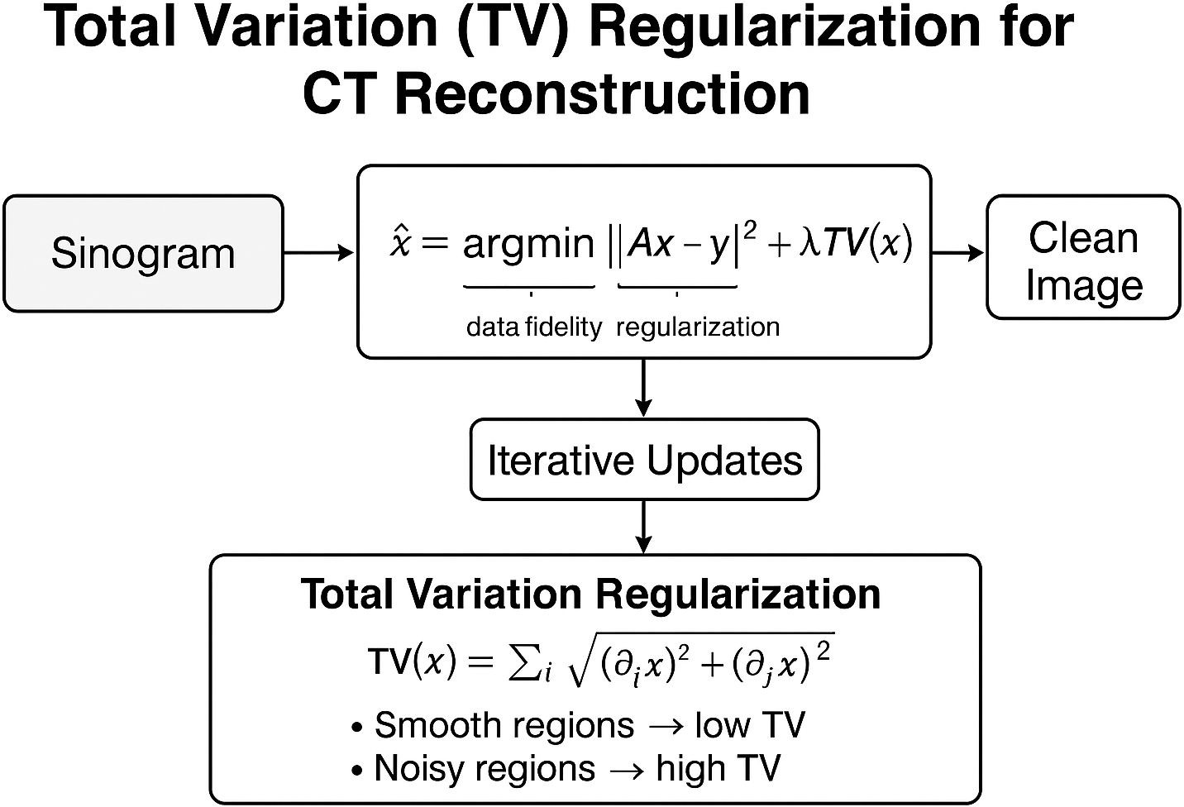


Total Variation (TV) Regularization
Core Idea
Reconstruct the CT image by minimizing a balance between data-fidelity and total variation (gradient sparsity) to promote piecewise-smooth images.
Algorithm Flow
Initialize image x0 = FBP(y)
Iterate:
Forward projection: Ax_k
Compute loss: L(x_k) Compute gradient: ∇L(x_k) =
Update x_(k+1) using Adam optimizer
Track best reconstruction
Output: x* = best reconstruction
+
Loss Function :
10

Slide 12
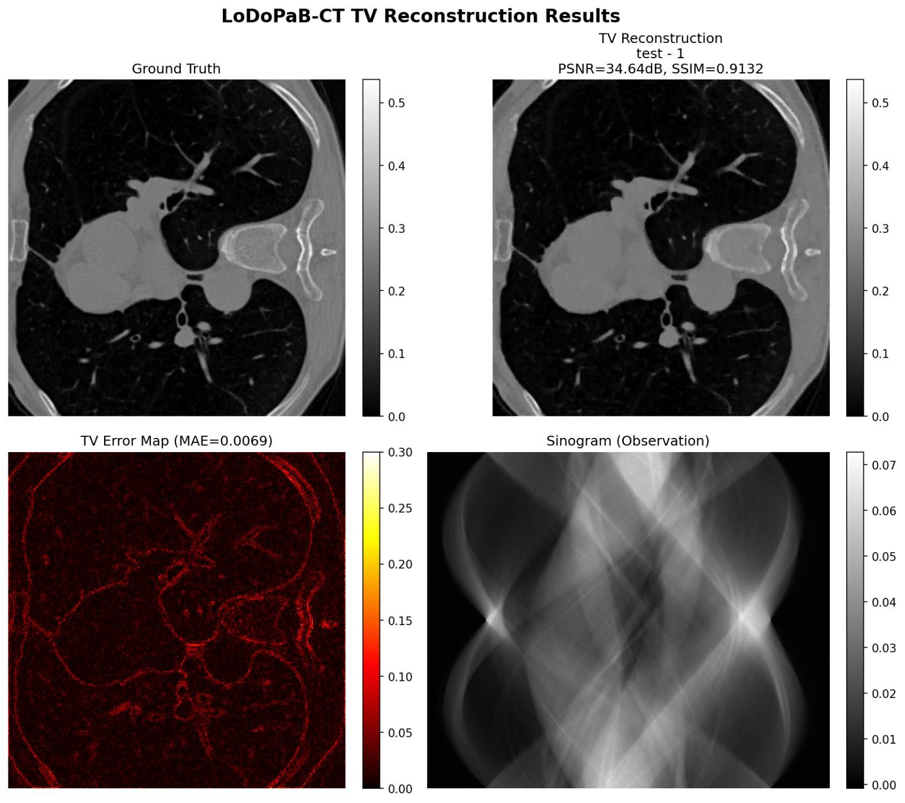
TV Reconstruction

Slide 13
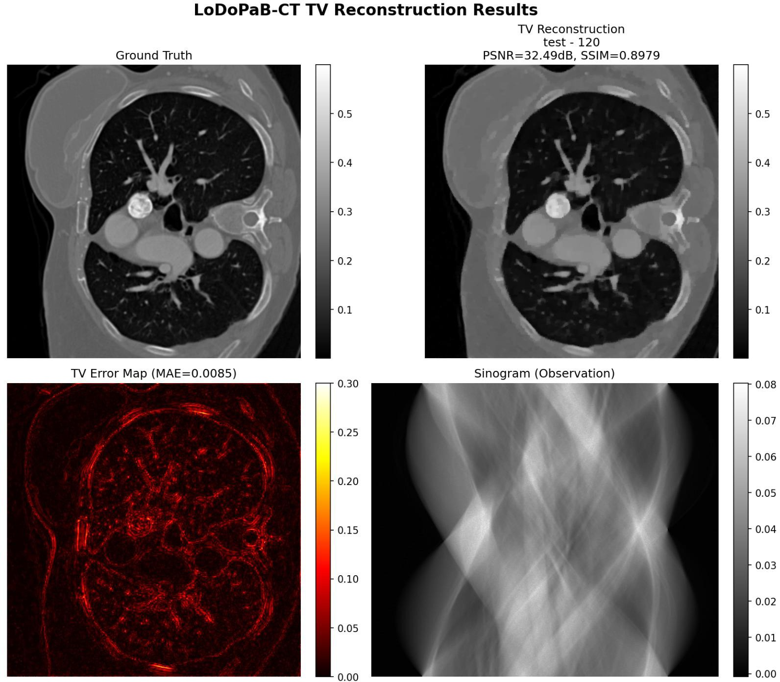
TV Reconstruction

Slide 14
500 Iterations
1000 Iterations

Slide 15
Mean Metrics for TV Reconstruction
For 1000 iterations | PSNR (db) | SSIM | MSE | MAE
Validation | 32.24 | 0.824 | 0.0002 | 0.0089
Test | 31.42 | 0.781 | 0.0003 | 0.0107
14

Slide 16


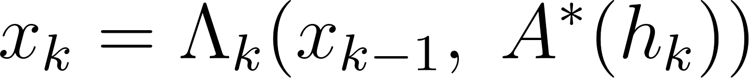

Learned Primal - Dual Reconstruction
Core idea:
Learn an iterative algorithm that alternates primal (image) and dual (data) updates.
Each update step is replaced by a learned CNN block, while still using the CT forward model and its adjoint.
Algorithm
Initialize primal image and dual .
For each iteration k = 1,…,K :
Dual Update:
Primal Update:
Output final reconstructed image .

Slide 17
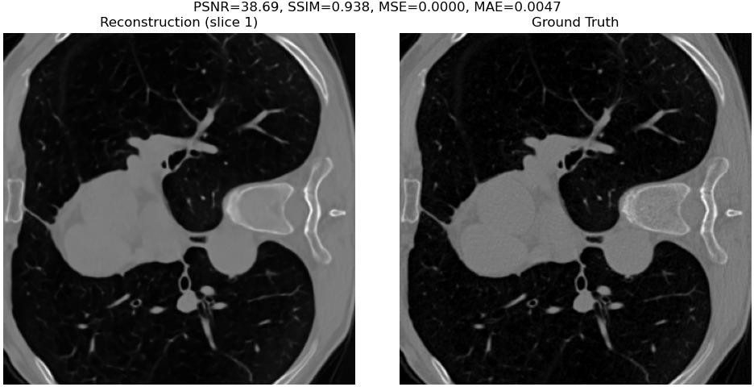
Learned Primal - Dual Reconstruction

Slide 18
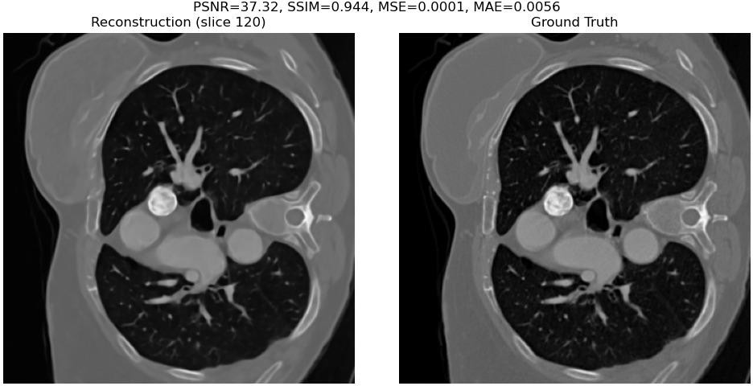
Learned Primal - Dual Reconstruction

Slide 19
Mean Metrics for Learned Primal Dual Reconstruction
 | PSNR | SSIM | MSE | MAE
Validation | 36.9281 | 0.8844 | 0.0001 | 0.0069
Test | 36.0520 | 0.85 | 0.0002 | 0.0086
18

Slide 20
Analysis - Test Set Results
Method | PSNR | SSIM | PSNR | SSIM
FBP | 30.516 | 0.7372 | 30.45 | 0.7415
TV | 31.42 | 0.781 | 33.36 | 0.830
Learned PD | 36.052 | 0.85 | 36.25 | 0.866
Challenge Set
https://ieeexplore.ieee.org/stamp/stamp.jsp?arnumber=10979336
Proposed FAST-DDPM diffusion model reconstructs full-dose CT from 10% low-dose input, achieving
37.5 dB PSNR and 0.92 SSIM on the evaluation set (38 train + 10 test patients).
https://www.nature.com/articles/s41597-021-00893-z https://www.mdpi.com/2313-433X/7/3/44

Slide 21
Progress
Completed :
Applied FBP on LoDoPaB-CT dataset.
Explored multiple filters: Hann, Hamming, Cosine, RamLak, Shepp Logan.
Preprocessing and Post Processing: Bilateral, Gaussian, Wavelet, Median, TV denoising, Non Local Means, Anscombe transform
Deep Learning Enhancement - Trained U-Net on enhanced images obtained from FBP.
Applied TV Regularization on LoDoPaB-CT dataset.
Applied Learned PD on LoDoPaB-CT dataset.
Future Work :
Extend experiments to other CT datasets: SynthRAD, AAPM Low-Dose Challenge, or Mayo Clinic datasets.
Cross-scanner and cross-dose generalization.
Exploring deep learning reconstruction networks.
Assess impact on downstream tasks such as segmentation or lesion detection.
20

Slide 22




Timeline
Literature Review (Research papers)
Exploring Total Variation Regularization and Learned Primal Dual methods.
Extensive and rigorous testing on multi-site, multi-acquisition datasets to quantify the generalizability
Phase 1
Phase 3
Phase 5
Phase 2
P
Phase 4
Phase 6
Exploring FBP + Mathematical filters + Pre and Post processing methods
Combining classical methods with deep learning for enhancement
Assessing downstream task performance to quantify clinical relevance of the enhancement
21

Slide 23
THANK YOU
22

