Slide 1
A2: Physiological ground truth
TASK 1 · PART A
Is lateralised mu/beta ERD actually in the signal, subject by subject?
C3
C4
40 subjects (S070–S109) · imagined left vs right fist · runs 4, 8, 12
Imagine the left fist: power drops at C4
Notes:
A2 asks whether the brain signal we expect from motor imagery is really there, per subject. Left-fist imagery should lower 8-30 Hz power over the right motor cortex (C4); right-fist imagery over the left (C3).

Slide 2
What A2 asks
Imagining a fist should quiet the opposite motor cortex
1
Power at C3, C4 and neighbours
around the cue, against a baseline we justify
Expected pattern
2
Reference
explain the unknown reference, then choose a filter
LEFT fist
C4 drops
RIGHT fist
C3 drops
3
Lateralisation index
mu and beta, each with a single-subject test
Each hand is driven by the opposite hemisphere. The drop is ERD, measured in dB against rest.
4
Label and show
present or absent for all 40, show 3 of each
Notes:
The four deliverables of A2 on the left; the physiology we are testing for on the right. ERD = event-related desynchronisation.

Slide 3
How it was computed
The same pipeline for all 40 subjects
1 Epoch
2 Re-reference
3 Wavelet power
4 Test and label
1–40 Hz filter, −1.5 to 4.0 s around each cue
Laplacian: C3, C4 minus mean of 4 nearest electrodes
Morlet 6–30 Hz, f/2 cycles; ERD in dB per trial
Permutation test on C3−C4, LI, present or absent
Time around the cue
cue
baseline
skip
active window, 0.5–4.0 s
−1.5 s
Baseline is pooled over trials per subject and band, blind to class label
4.0 s
Notes:
Decisions D5 (baseline and window), D4 (reference). The first 0.5 s after the cue is skipped to avoid the cue-evoked visual response and the ERD onset lag. About 45 trials per subject.

Slide 4
Choosing a reference
The recording reference is undocumented, so we filter its influence out
Every channel contains the reference signal. It is shared by C3 and C4, but its own activity and its distance to each site differ, and a lateral reference such as a mastoid would bias one hemisphere.
Raw
Reference leakage stays in the signal.
12
present
CAR
Cancels shared terms, but smears artefacts over all channels.
16
present
Chosen on principle: Laplacian. Mean μ LI (.26 vs .19 CAR, .15 raw) was only a check.
Laplacian
Weights sum to zero, so shared terms cancel; stays local.
14
present
Notes:
Decision D4. Raw C3-C4 would keep reference leakage. CAR also cancels common terms but spreads frontal and ocular artefact everywhere. The Laplacian is local and its weights sum to zero. Present counts: raw 12, Laplacian 14, CAR 16.

Slide 5
Index and test
One number per band, one p-value, one label
ERD PER TRIAL
Label rule
ERD = 10 · log10( P_active / P_baseline ) dB
Negative means power fell relative to rest
present if both hold:
min(μ p, β p) < 0.025
contralateral ERD < 0 dB
Otherwise absent.
LATERALISATION INDEX
LI = (ipsi − contra) / (|ipsi| + |contra|)
Above 0: the contralateral side desynchronises more
One-sided label permutation, 10,000 shuffles, seed = subject ID. 0.05 is split across the 2 bands.
TEST STATISTIC
T = mean(C3−C4 | left) − mean(C3−C4 | right)
Large positive T: contralateral ERD, as predicted
Notes:
Decision D6. One-sided because physiology predicts the direction; a two-sided test would also count wrong-direction asymmetries. The contralateral-desynchronisation condition blocks a 'present' label from a synchronisation-only effect.

Slide 6
14 of 40 subjects
Lateralised ERD is present in 14 subjects; the reference shifts that by ±2
14
present (Laplacian)
26
absent
Notes:
With the Laplacian: 10 subjects pass the mu test and 13 pass beta individually (p < 0.025); 14 are labelled present once the contralateral-drop condition is applied to either band. Counts by reference: raw 12, CAR 16, Laplacian 14. Source: outputs/a2_all_references.csv.

Slide 7
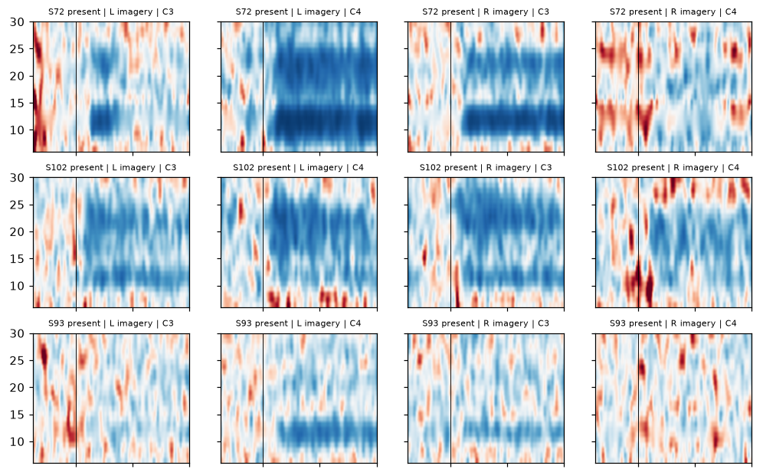
Present: three examples
Power falls over the opposite hemisphere (blue), as predicted
Blue = power drop, red = rise, black line = cue. Left imagery should be blue at C4, right imagery at C3.
S72: μ −8.6 dB contra vs −2.7 ipsi, p < 0.001
S93: μ −2.8 vs −0.8 dB, p < 0.001
S102: drops on both sides; passes on β (p < 0.001), μ LI only 0.06
Picked by rule: most negative contralateral ERD among significant bands.
Notes:
Rows: S72, S102, S93. Columns: left imagery C3, left imagery C4, right imagery C3, right imagery C4. Time axis is -1.5 to 4.0 s, 6-30 Hz. Full-size figure: outputs/a2_examples_3present_3absent.png.

Slide 8
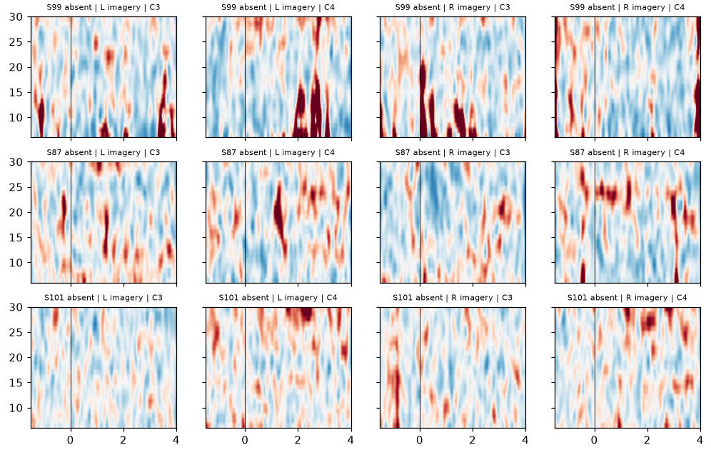
Absent: three examples
No band-limited drop after the cue; absent means not detected
S99: μ p 0.84, β p 0.66. Dark red bursts are artefacts that nothing rejected
S87: μ p 0.63, β p 0.63
S101: μ p 0.76, β p 0.59
With about 45 trials per subject only a clear effect is detectable. Absent is not proof of no ERD.
Picked by rule: the three absent subjects with the highest p.
Notes:
Rows: S99, S87, S101, selected as the absent subjects with the highest minimum p across the two bands. Artefact rejection is not applied (decision D7).

Slide 9
Where the label is weak
Four things to keep in mind when reading the per-subject table
1
LI = 1 can mean synchronisation
2
One band can carry the label
S85, S92 and S95 reach LI = 1 in both bands, S108 in β: their ipsilateral power rose above 0 dB.
S89 has μ LI −0.01 and passes on β alone. S102 desynchronises on both sides yet passes on β.
3
The reference changes the count
4
No artefact rejection yet
12 present with raw, 14 with Laplacian, 16 with CAR. Borderline subjects flip with the filter.
Heavy trials can dominate the means (S99, S95 at C3). Decision D7; revisit if A3 or Part B needs it.
Notes:
LI = (ipsi - contra) / (|ipsi| + |contra|). When ipsi is positive and contra negative the ratio equals exactly 1, so LI = 1 is not a perfect effect: it flags ipsilateral synchronisation. The label itself is driven by the permutation test, not by LI.

Slide 10
Hand-off to A3 and Part B
What A2 produced, and what is blocked
Outputs
Next
a2_lateralisation.csv
LI, p-value and label per subject
Part B
Each test subject's accuracy is correlated with their LI.
erd/S070 … S109.png
one ERD map per subject
A3 is blocked on one thing
The prediction must be Keyen’s own words, committed before any confound decoder runs. The current PREDICTIONS.md entry is a Claude draft.
a2_examples_3present_3absent.png
the six example subjects
Notes:
The brief says to predict which non-motor route is decodable before running A3, and the project rules say predictions are Keyen's own words. No A3 test has been run.

