Slide 1
Health Care System
Team :
1- S. Varshith reddy : 2018B3A70022H
2- Manideep : 2019A7PS0016H
3- Aryan Surana : 2018B4A70937H

Slide 2
About the Problem
Conventional database systems are managed by powerful stakeholders and institutions, having power and reason to force their hand.
Databases support data manipulation operations like create, read, update, and delete, which compromises privacy and security.
With conventional health databases there always exists the risk of single point of failure

Slide 3
Why Blockchain is used ?
Decentralized management: Blockchain is a peer-to-peer, decentralized database management system.
Immutable: Blockchain only supports create and read functions i.e, it is very difficult to meddle with the data or records.
Secure: Blockchain improves security and privacy using asymmetric cryptography.
Code is implemented using blockchain which would prove to be an innovative answer to the demand for decentralized and secure storage of the health history with simultaneous personal access control.

Slide 4
About the Project
User can access the following functions using the code:
Create a block
View personal details
Edit personal details
View other user’s detail

Slide 5
Encryption
We use Asymmetric Key encryption for Users to secure the
Data and the Access.
Users are provided with two keys:
Private key: A nonce value is generated in the form of a number. This number is used to view or update one’s medical records.
Public Key: This key can be used to access other users data. This is encrypted name of the user.

Slide 6
Implementation:
Till now we started learning about blockchain technology and how it secure
the data and stores the transactions and implemented the first method,
createBlock():
Takes input from user. Then encrypts the user’s name into a hash to create
the public key. Then data string is mined and the block is added to the
chain.

Slide 7
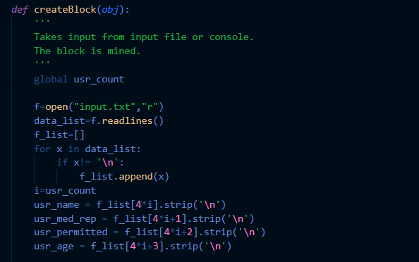

Slide 8
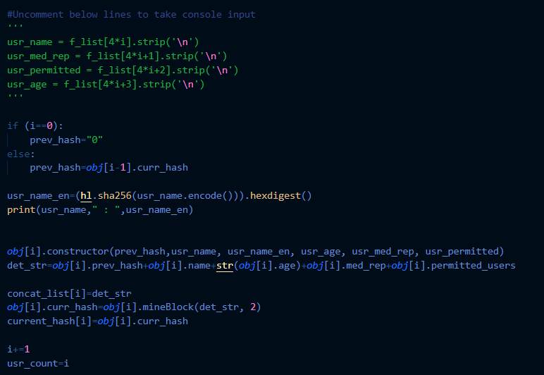

Slide 9
Resources:
What is blockchain technology
All about Blockchain | Simply Explained
Ethereum - Tutorial 5 - Blockchain, Blocks, and Mining
Creating Your First Blockchain with Java. Part 1.
Blockchain Hash Function
Blockchain Proof of work

Slide 10
Group Members:
S. Varshith Reddy :2018B3A70022H
Manideep : 2019A7PS0016H
Aryan Surana : 2018B4A70937H

Slide 11
Thank you !!

